Slide 1
Exploring Functions

Slide 2
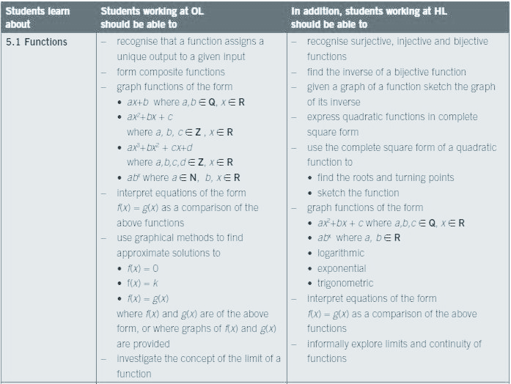
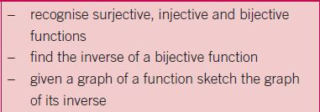
Link to the Syllabus

Slide 3

Activity
Match the algebra with the graph
Decide whether it is a function and if so, classify it as injective, surjective or bijective

Slide 4








Solutions

Slide 5
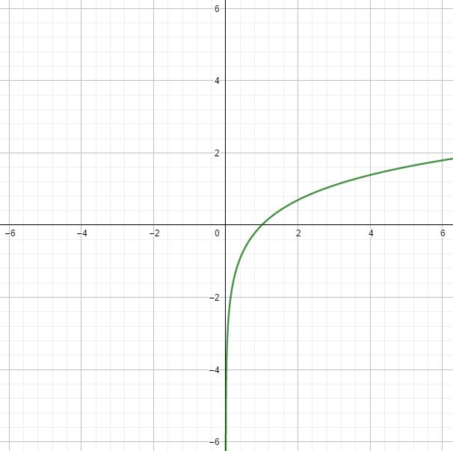
Bijective Function

Slide 6
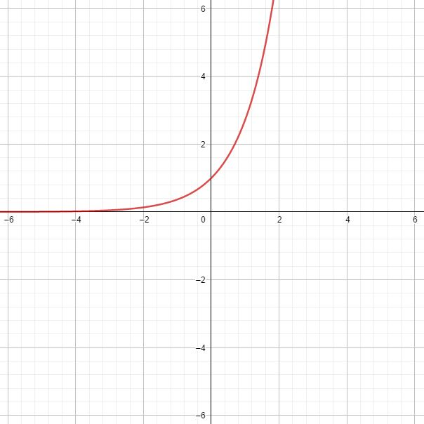
Injective Function

Slide 7
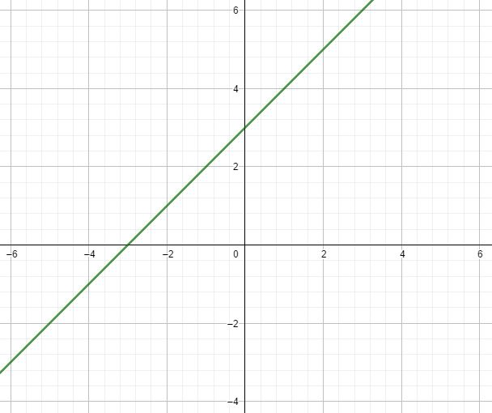
Bijective Function

Slide 8
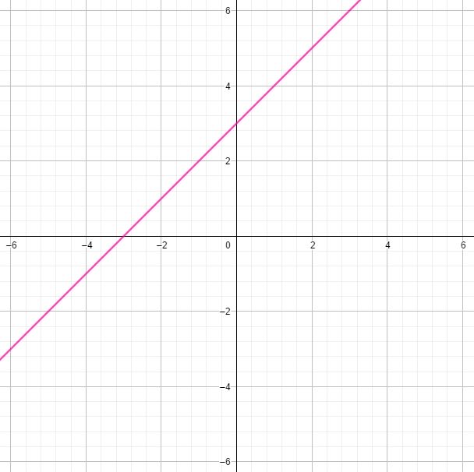
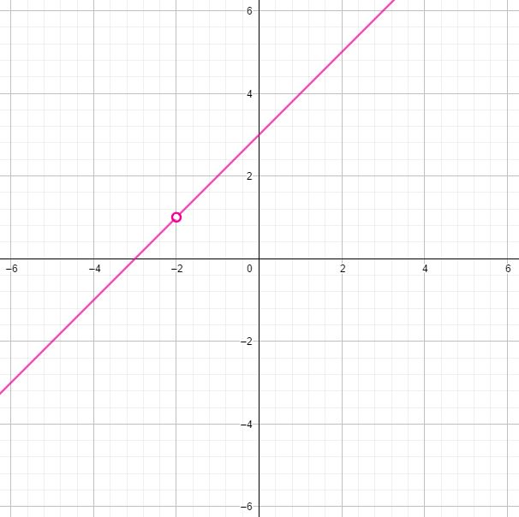
Not a Function

Slide 9
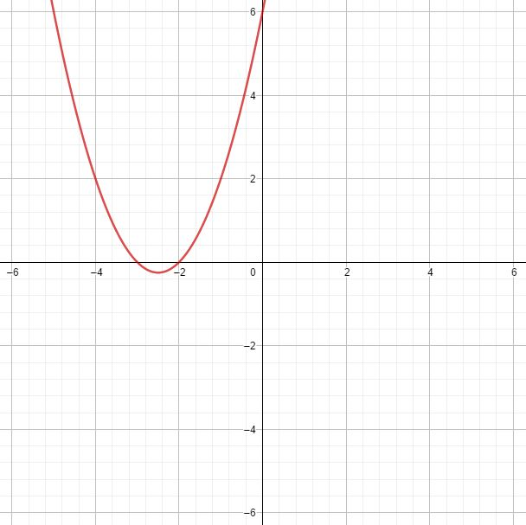
Function - neither injective nor surjective

Slide 10
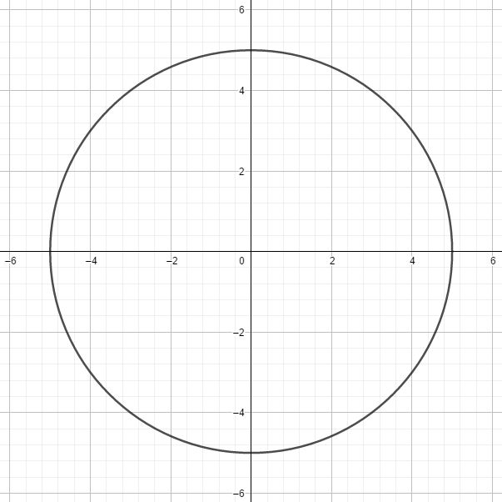
Not a Function

Slide 11
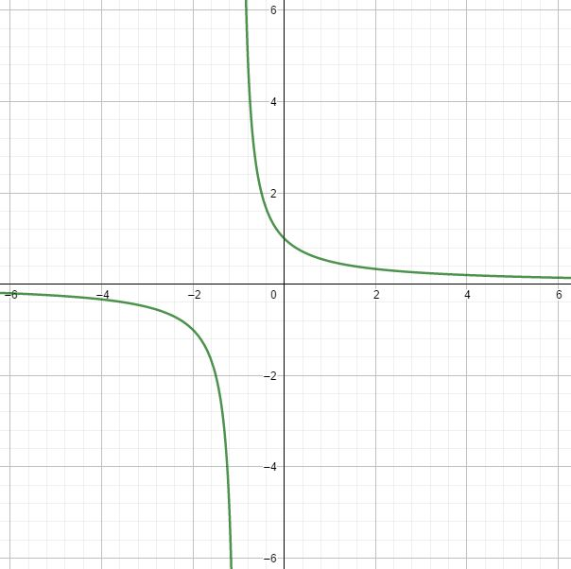
Not a Function

Slide 12
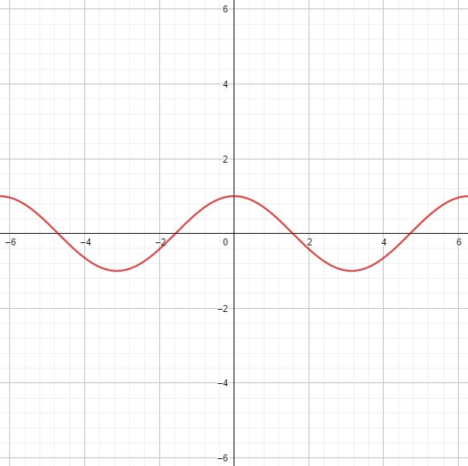
Surjective Function

