Slide 1
Nature is getting cheeky!
April 2020

Slide 2
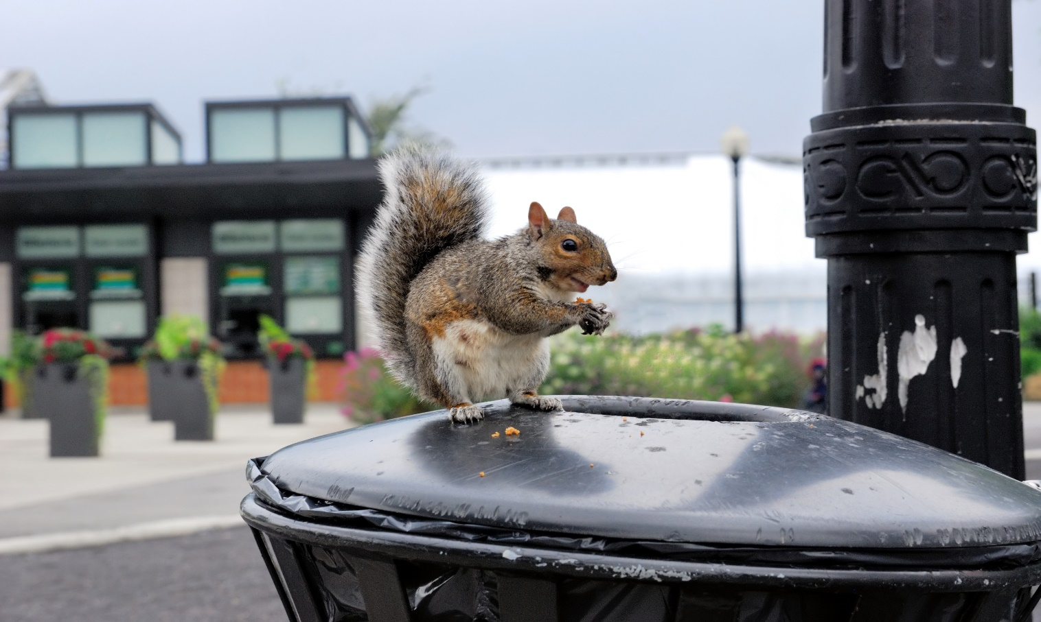
Nature is getting cheeky,
It’s coming out to play,
It wonders where the humans are,
Why they’ve gone away!

Slide 3
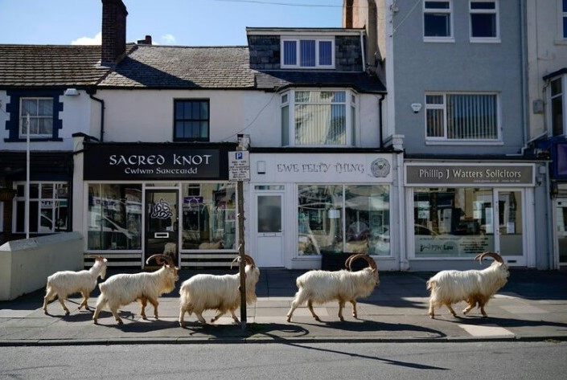
Lots of space to roam and play,
Plenty food to eat,
No crowds of noisy humans,
Clogging up the streets.

Slide 4
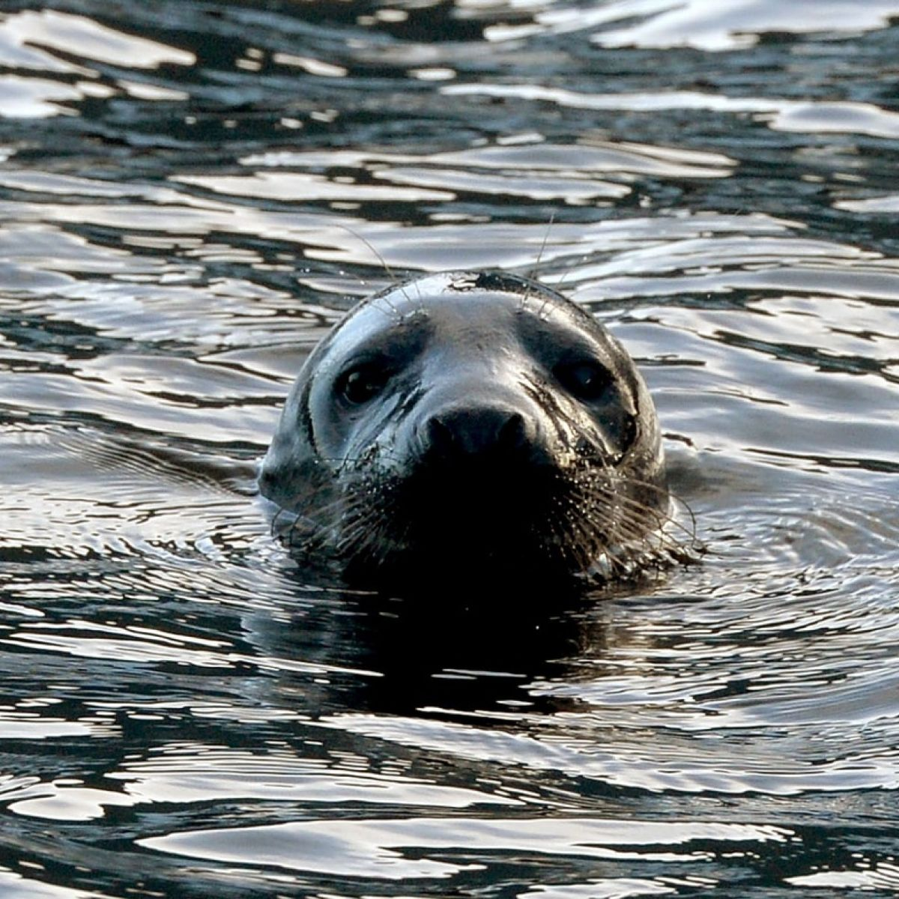
Seals swim up the Liffey,
On a shopping trip to town,
They poke their smooth heads up,
And gulp the clean air down.

Slide 5
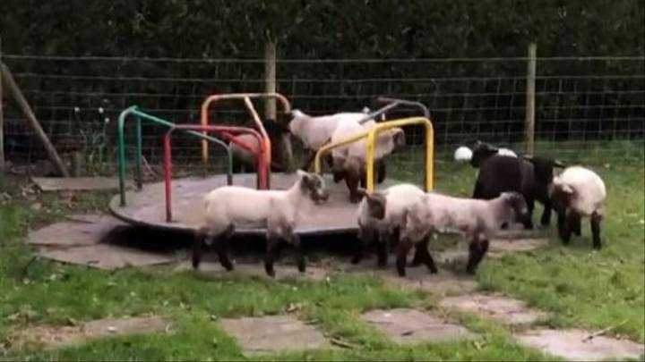
Lambs play on the roundabouts,
Like children after school,
Now’s their chance to have some fun,
To play and act the fool!

Slide 6
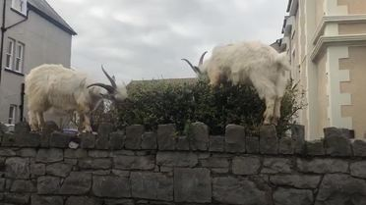
Goats jump up on garden walls,
To reach the juicy leaves,
Mrs. Squint looks out her window,
She sees but can’t believe!

Slide 7
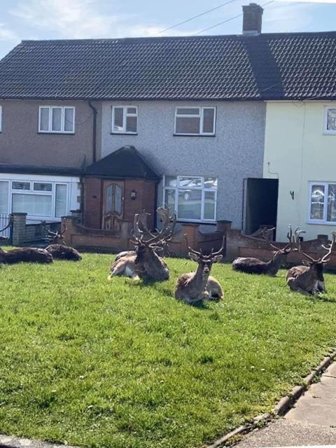
Meanwhile, right outside the house,
Deer lounge and chew the grass,
They’ve never been so at their ease,
Enjoying their free pass.

Slide 8
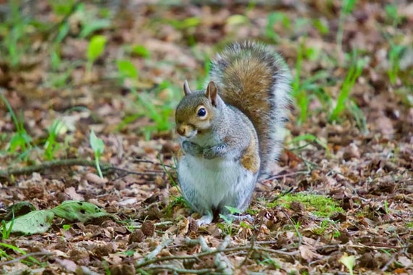
As I was running through the park,
I saw a squirrel today,
He sat and stared, I’m sure he winked,
He meant “We’re here to stay!”

Slide 9
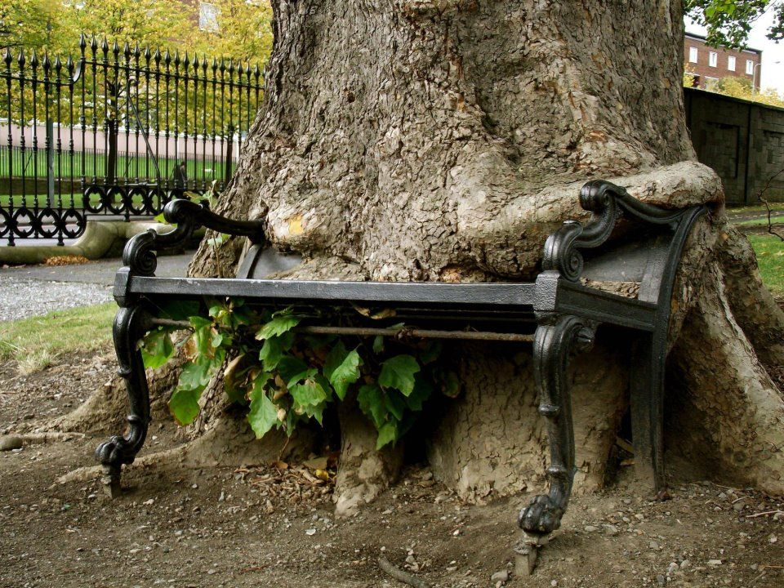
I ran on and had a think,
This cheekiness is great,
It’s nature’s way of telling us,
That it’s getting very late.

Slide 10

We need to stop and have a think,
What we’re doing to the planet,
It’s ours to cherish, not to own,
Respect, enjoy and share it!

