Slide 1
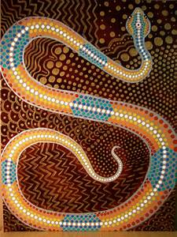
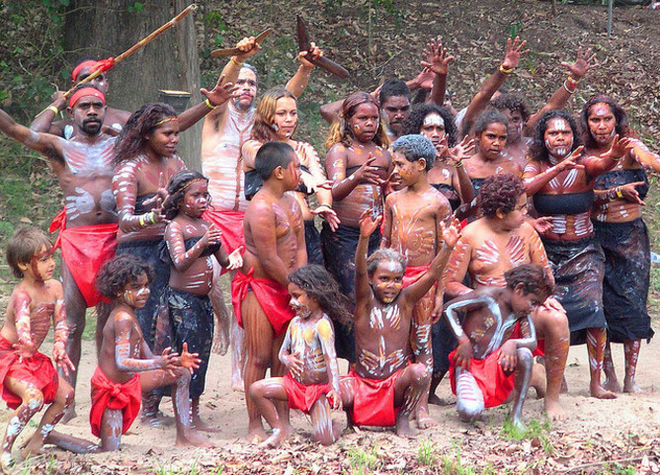
Aborigines
The first people to live in Australia ☺

Slide 2
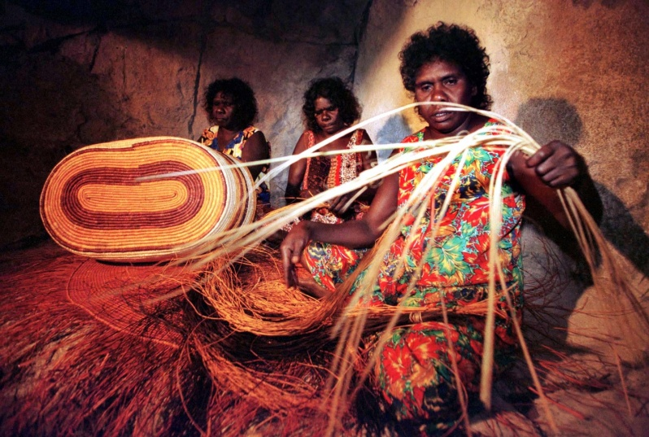
The Aborigines or Aboriginals were the first people ever to live in Australia thousands and thousands of years ago!
They lived together in small groups called Tribes.
They spoke lots of different languages.

Slide 3
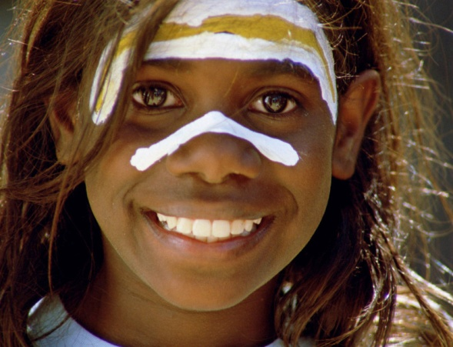
The Aborigines were nomadic people.
The word nomadic will be a new word for you.
It simply means that they moved from place to place in search of food and water. They didn’t live in the one place like me or you. They lived in places for a little while and then they moved on to a new place ☺

Slide 4
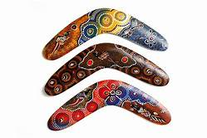
The Aborigines were Hunters and Gatherers.
This means that they hunted animals and they
gathered berries, nuts, fruit
so that they would have something to eat.
Have you ever seen a boomerang before? I’m sure you have! Aborigines used boomerangs to hunt for food. They also used spears. How do you think they made boomerangs and spears? What did they use?

Slide 5
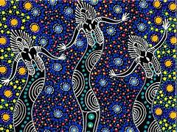
Dreamtime
As we learn in Grow in Love, we believe that God created this earth, the animals, the plants, the people and everything else in the world.
However, the Aborigines believed in something different. They believed in ‘Dreamtime’. This simply means that they believe that spirits created this world and everything in it.
Just like we have stories in the Bible about God, Aborigines have ‘Dreamtime Stories’ which explain how the Spirits created everything on this earth. You can read some of these stories on Twinkl.ie.
My favourite is ‘How the Kangaroo got their tails’. You should check them out ☺

Slide 6
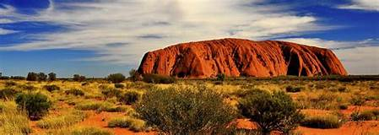
Aborigines believe that the Spirits who created this earth want them to take care of the land, so the land is so important to them. You might remember in Read At Home you read a text about Ayers Rock or the Ulru as it’s also known!
This was a sacred spot for the Aborigines as it was so beautiful.

Slide 7
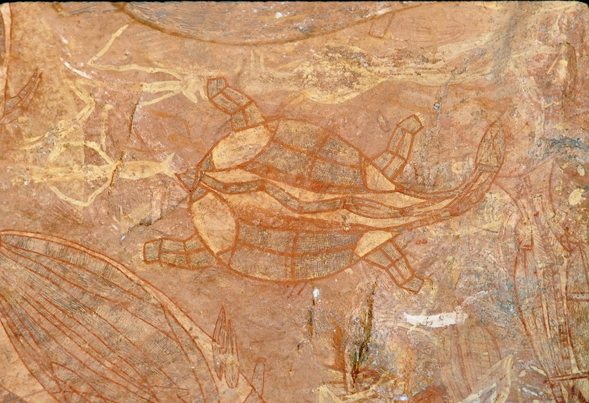
Aborigines loved to tell stories, especially the Dreamtime Stories from one generation to the next. They drew pictures on rocks to help tell and remember the stories.
Historians (people who study history) have found lots of rocks like this one in Australia with lots of pictures drawn on them. What do you think this story was about?

Slide 8
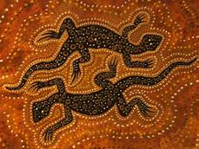
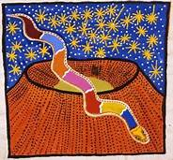
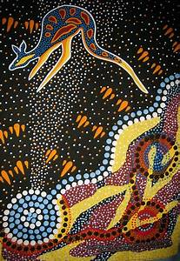
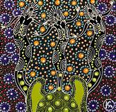
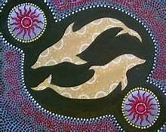
I hope you liked learning about the aboriginals! Maybe you could draw your own Dreamtime Story and send me a picture of it? Here are some ideas for you! Ms. Molloy ☺

