Slide 1
Algebra through the Lens of Functions
Quadratic Patterns

Slide 2
Introducing Quadratic Functions

Slide 3
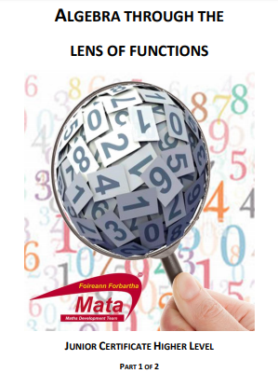
Prior Knowledge
Exploration of linear patterns
Creating and interpreting graphs of linear functions
Critical points of a linear function
Understanding of a variable and constant
Rate of change of a linear function

Slide 4
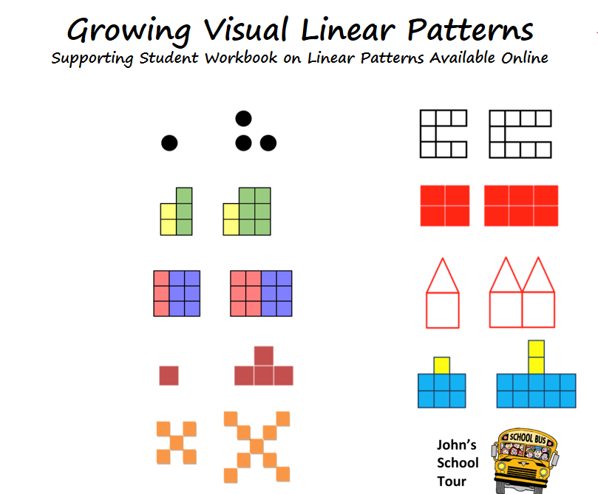
Prior Knowledge
Exploration of linear patterns:
Expressions
Equivalence
Distribution
Multiple Representations

Slide 5
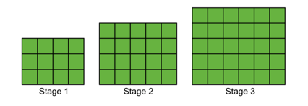
Activity
How many blocks in the 50th stage?

Slide 6
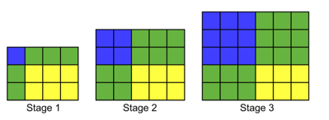
Activity
How many blocks in the 50th stage?

Slide 7
Activity - Solutions
How many blocks in the 50th stage?

Slide 8
Activity - Solutions
How many blocks in the 50th stage?
Stage 1 Stage 2 Stage 3 ….. Stage 50
3x4, 4x5, 5x6, ….. 52x53 = 2756 blocks

Slide 9
Activity - Solutions
Stage 1 Stage 2 Stage 3 Stage 50
1x1, 2x2, 3x3 …… 50x50
2x1 2x2 2x3 2x50
1x3 2x3 3x3 50x3
2x3 2x3 2x3 2x3
=2756 blocks

Slide 10
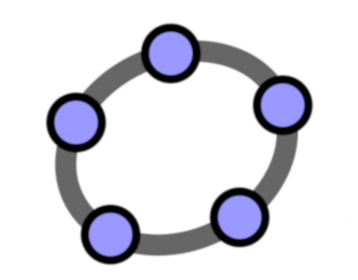
Multiple Representations
https://www.geogebra.org/classic/zfxp4kdg

Slide 11
Activity - Extensions
Which stage has 90 squares?

Slide 12
Activity - General
Which stage has n squares?
b=(s+2)(s+3)
b = s²+5s + 6

Slide 13
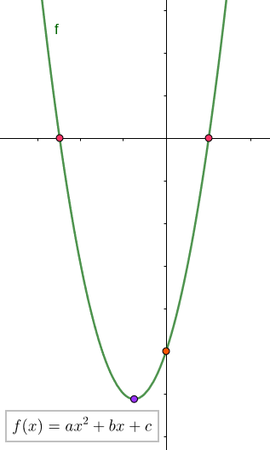
Future Learning
Solving Quadratic Equations
Key Features of Quadratic Functions
Graphical Solutions to Algebraic Inequalities
Analysing the Table of Values of Quadratic Functions in Greater Depth

Slide 14
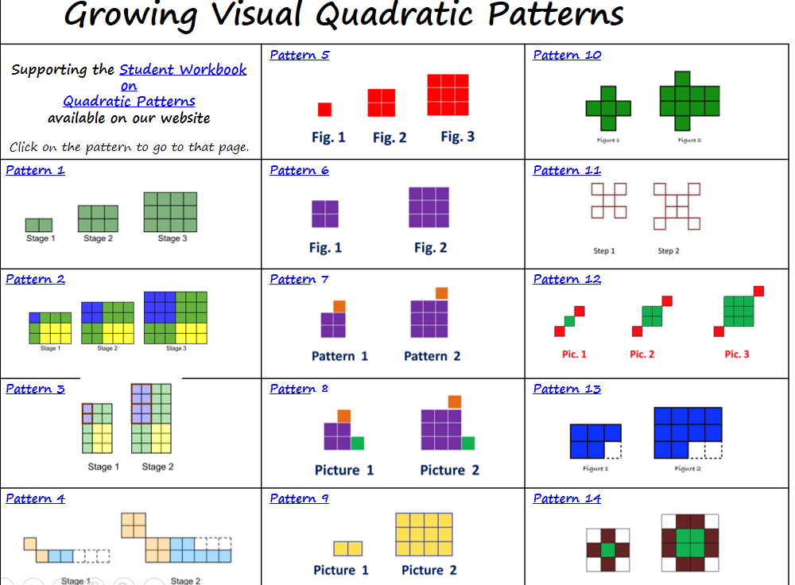
Quadratic Patterns

Slide 15
Summary
Students are introduced to new algebraic procedure through the exploration of patterns.
Students see the need for new strategies.
Students make sense of their learning.
Students maintain a positive disposition to their mathematics.

Slide 16
Transformations of Quadratic Patterns

Slide 17
Transformations
Student’s expressions:
b = s²+5s + 6
b=(s+2)(s+3)
What would happen if we:
add 2 blocks to each stage?
double the amount of blocks in the pattern?
add 2 to our stage number?

Slide 18
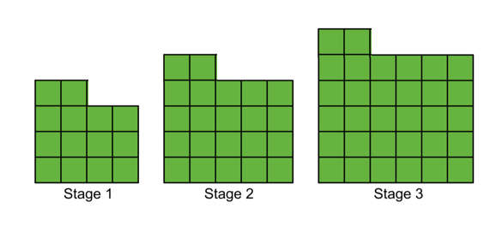
Changing the output
Adding a constant
Student original expressions:
b = s²+5s + 6
b=(s+2)(s+3)
What would happen if we added 2 blocks to each stage?
https://www.geogebra.org/classic/nbnhsqcp

Slide 19
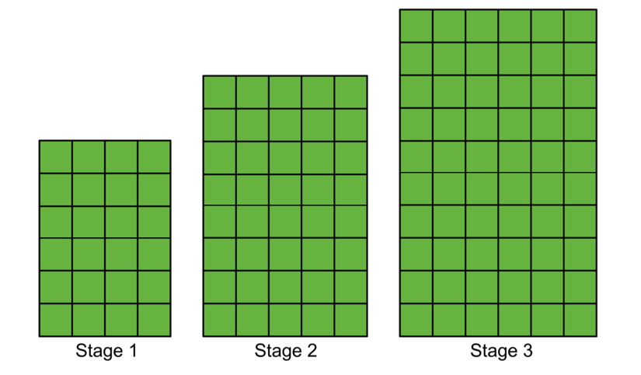
Changing the output
Multiplying by a constant
Student original expressions:
b = s²+5s + 6
b=(s+2)(s+3)
b=2(s+2)(s+3)
b=2(s²+5s+6)
What would happen if we doubled the amount of blocks in the pattern?

Slide 20
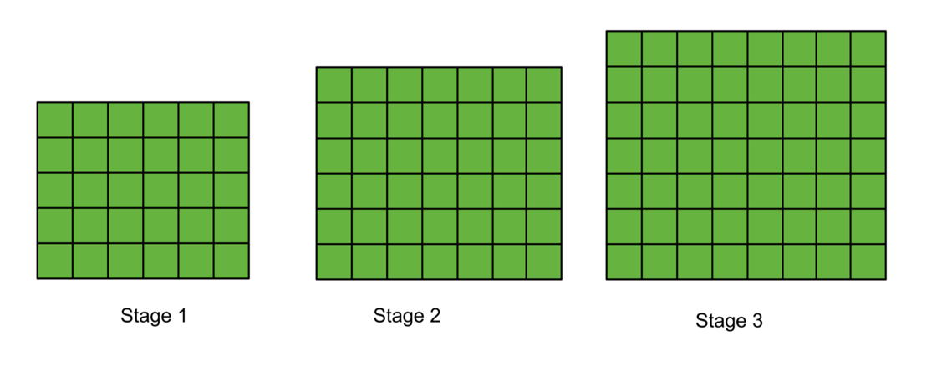
Changing the input (stage number)
Student original expressions:
b = s²+5s + 6
b=(s+2)(s+3)
What would happen if we add 2 to our stage number?
b=(s+4)(s+5)
b=(s+2)²+5(s+2)+6

Slide 21

Transformation of continuous functions
https://www.geogebra.org/m/zj5ryyUp
https://www.geogebra.org/classic/a6cddta6

