Slide 1

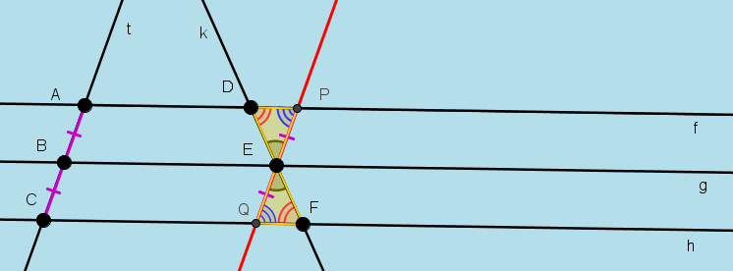
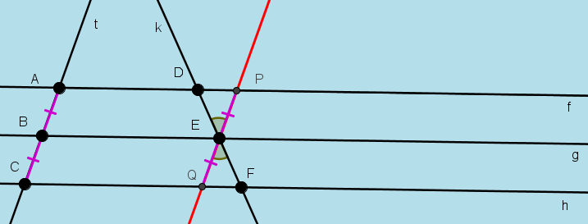
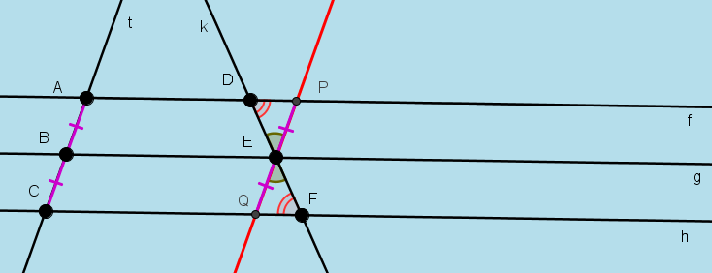
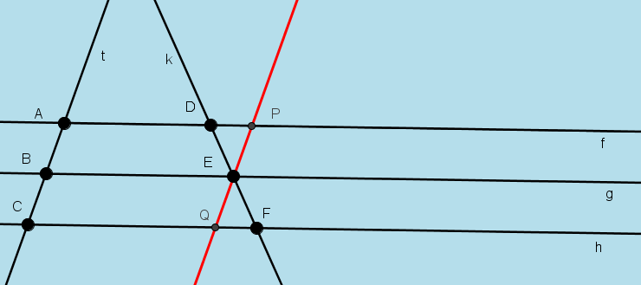
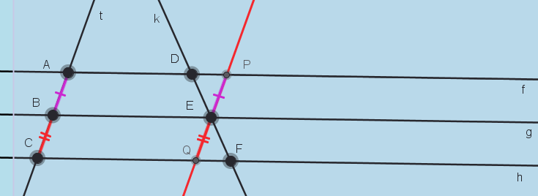
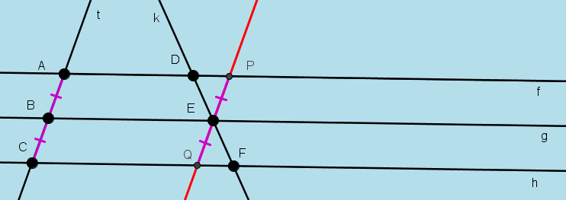
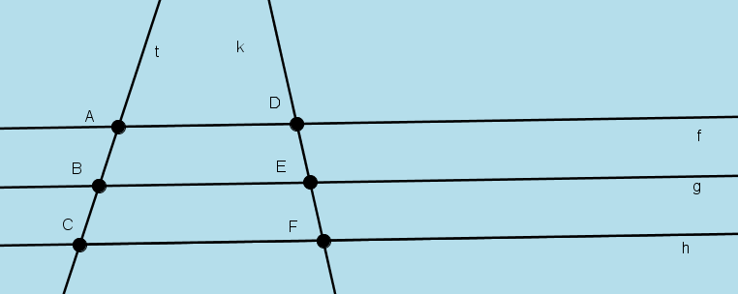
Theorem 11. If 3 parallel lines cut off equal segments on some transversal
line, then they cut off equal segments on any other transversal.
USE THE FORWARD AND THE BACK ARROWS ON THE KEYBOARD TO VIEW AND REWIND PROOF.
Given: 3 parallel lines f, g and h intersecting a transversal line t at points A, B and C such that |AB|= |BC|. Another transversal line k intersects
the parallel lines at D, E and F.
To Prove: |DE|= |EF |
Construction: Through E draw a line parallel to AB, intersecting f at P and h at Q
Proof: APEB and BEQC are parallelograms
Therefore |AB| =|PE| and |BC| =|EQ| Opposite sides of parallelograms
But |AB| =|BC| Given
Therefore |PE| =|EQ|
|∠DEP| = |∠QEF| Vertically Opposite Angles
|∠EDP| = |∠EFQ| Alternate Angles
Therefore |∠DPE| = |∠EQF|
Therefore triangles DPE and QEF are congruent (ASA)
Therefore |DE|= |EF | Q.E.D.

