Slide 1

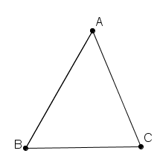
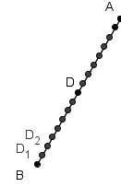
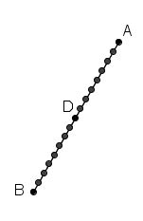
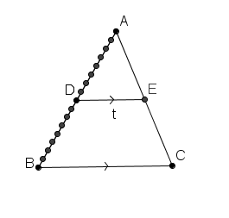
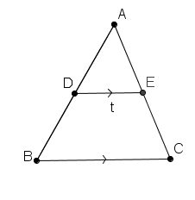
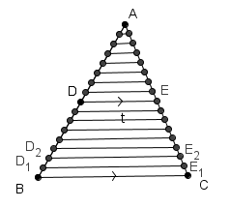
Theorem 12 Let ABC be a triangle . If the line t is parallel to BC and
cuts [AB] in the ratio m:n, then it also cuts [AC] in the same ratio.
USE THE FORWARD AND THE BACK ARROWS ON THE KEYBOARD TO VIEW AND REWIND PROOF.
Given: Triangle ABC
Line t is parallel to BC
Line t cuts AB in the ratio m:n at D
To Prove: Line t also cuts AC in the ratio m:n.
Construction: Divide AB into m+n equal segments.
(The number of divisions depends on the value of m and n.)
Proof: Line t cuts AB in the ratio m:n at D. (Where m and n are natural numbers.)
Thus there are equally spaced points D₀=B, D₁, D₂, D₃ , ...... D_{m-1},D _{m}= D, D_{m+1},.....D_{m+n-1}, D_{m+n}=A (The number of divisions depends on the value of m and n.)
Note the segments [B, D₁], [D₁,D₂] etc. are equal in length.
Draw lines D₁ E ₁, D₂ E ₂ ,,..... parallel to BC with E ₁, E ₂ etc on AC.
Then [CE₁ ], [E₁E ₂ ], [E ₂ E₃ ],........ [E_{m+n-1} A ] have the same length. Theorem 11
Hence E divides AC in the ratio m:n and line t cuts AC in the ratio m:n.
Q.E.D.

