Slide 1

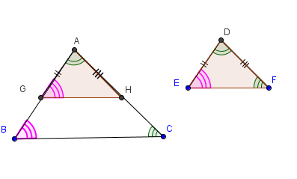
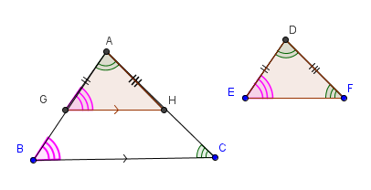
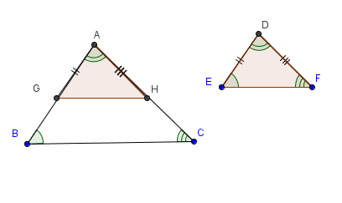
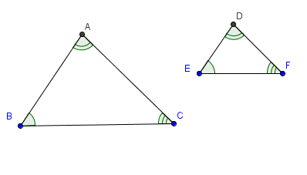
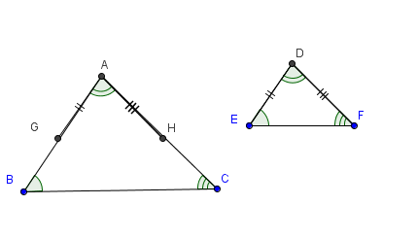
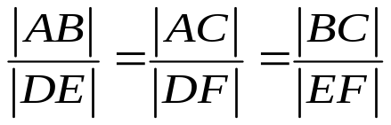
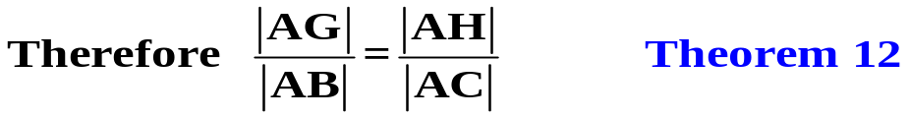
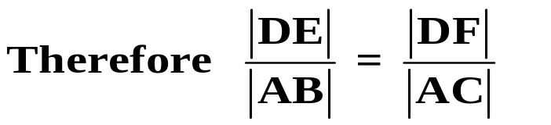
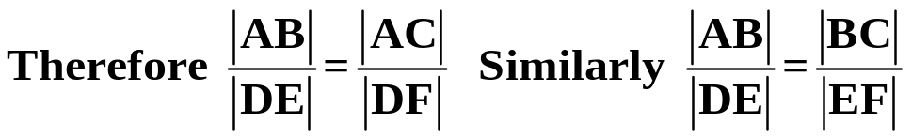
Theorem 13. If 2 triangles ABC and DEF are similar then their sides
are proportional in order .
USE THE FORWARD AND THE BACK ARROWS ON THE KEYBOARD TO VIEW AND REWIND PROOF.
Given: 2 Similar Triangles ABC and DEF
To Prove:
Construction: Pick a point G on the line segment AB so that |AG|= |DE|
and a point H on the line segment AC so that |AH| =|DF|
Proof: Triangle AGH is congruent to the triangle DEF (SAS)
|∠AGH| = |∠ABC|
Therefore GH is parallel to BC
Since |AG| = |DE| and |AH| = |DF|
Q.E.D.

