Slide 1
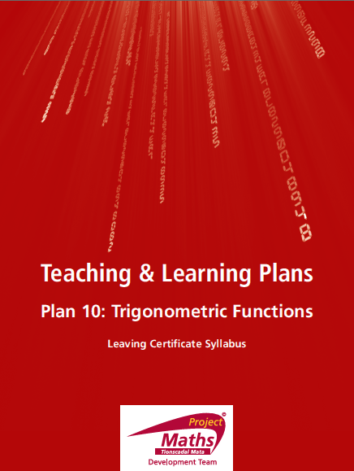

Slide 2
INDEX
Student Activity 1: | Introduction
Student Activity 2: | Angles in the first quadrant 0° < θ < 90°
Student Activity 3: | Angles in the second quadrant 90° < θ < 180°
Student Activity 4: | Angles in the third quadrant 180° < θ < 270°
Student Activity 5: | Angles in the fourth quadrant 270° < θ < 360°
Student Activity 6: | Summary on finding trig functions of all angles
Student Activity 7: | Solving trig equations
Reflection & Appendix

Slide 3
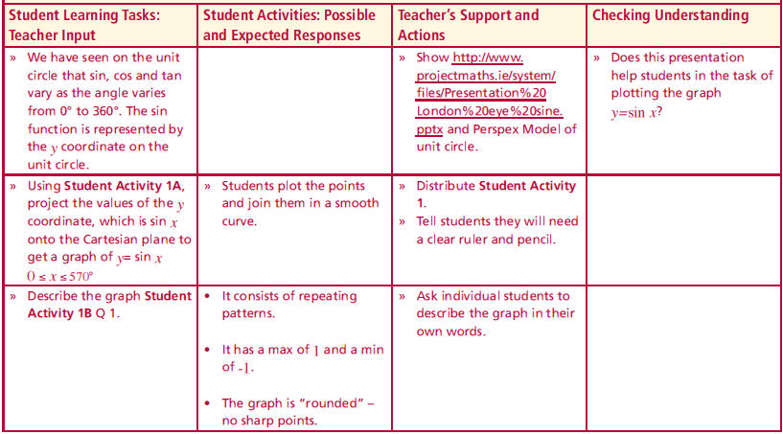
Student Activity 1: Introduction
We have seen on the unit circle that sin, cos and tan vary as the angle varies from 0° to 360°. The sin function is represented by the y coordinate on the unit circle.
Lesson interaction

Slide 4
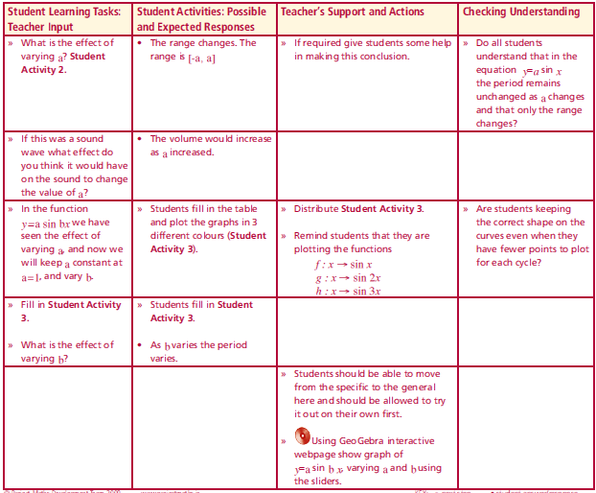
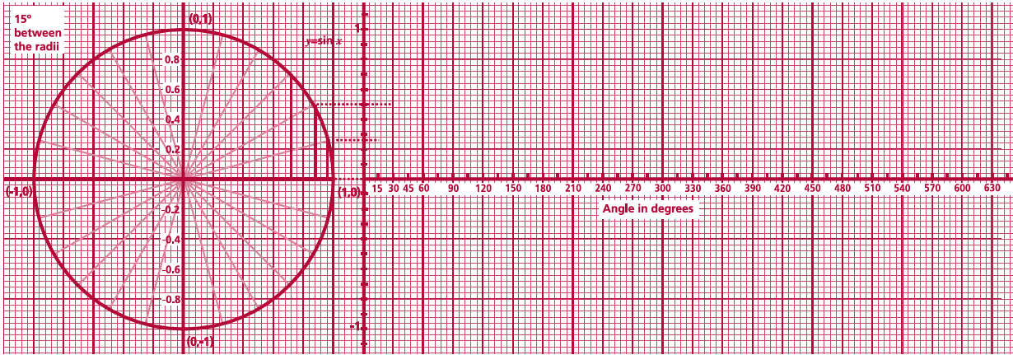
Student Activity 1: Introduction
Graph of y= sin x
Complete the projection of sin values from the unit circle onto the Cartesian plane on the right and then join the points with a smooth curve.
Lesson interaction

Slide 5
Student Activity 1: Introduction
Graph of y= sin x
Complete the projection of sin values from the unit circle onto the Cartesian plane on the right and then join the points with a smooth curve.
Lesson interaction

Slide 6
Student Activity 1: Introduction
Graph of y= sin x
Complete the projection of sin values from the unit circle onto the Cartesian plane on the right and then join the points with a smooth curve.
Lesson interaction

Slide 7
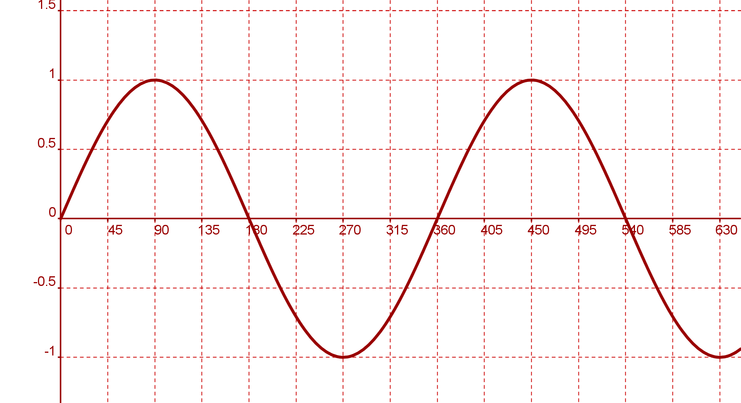
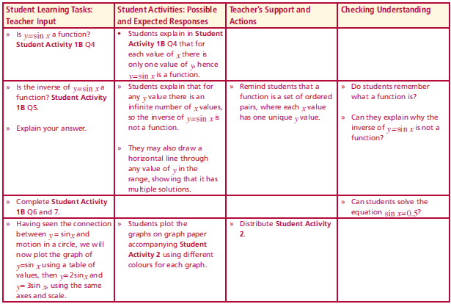
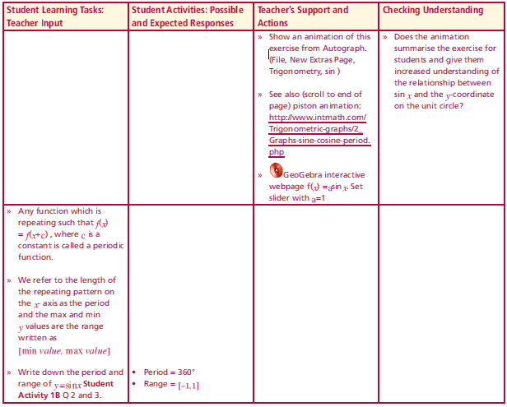
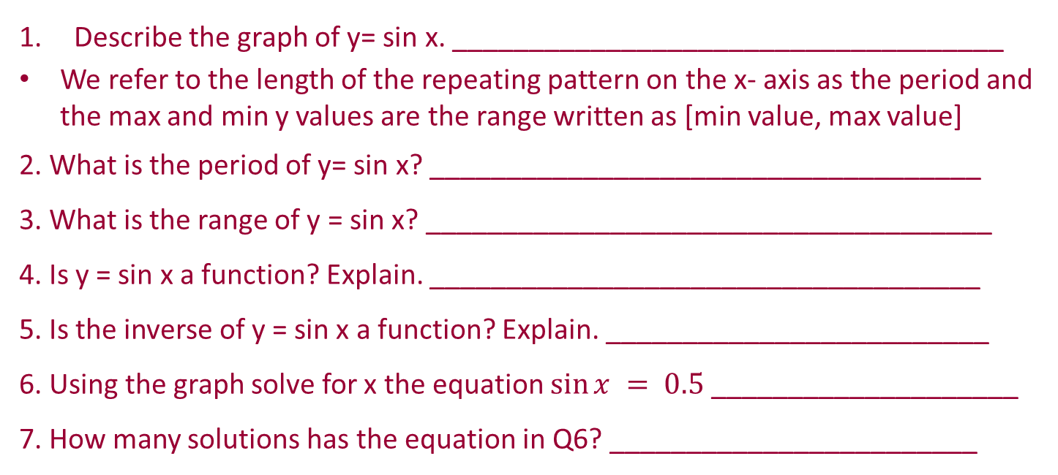
Student Activity 1: Introduction
Lesson interaction
Lesson interaction

Slide 8
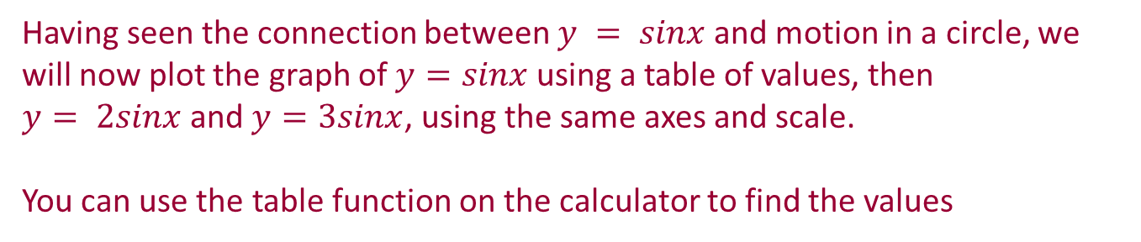
Student Activity 2

Slide 9
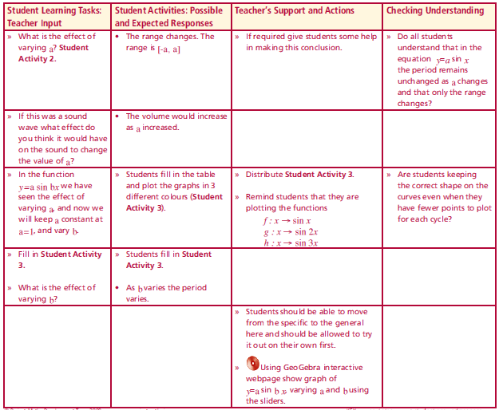
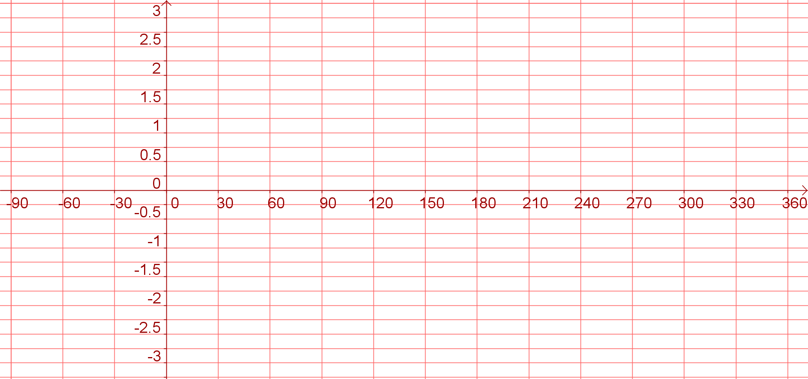
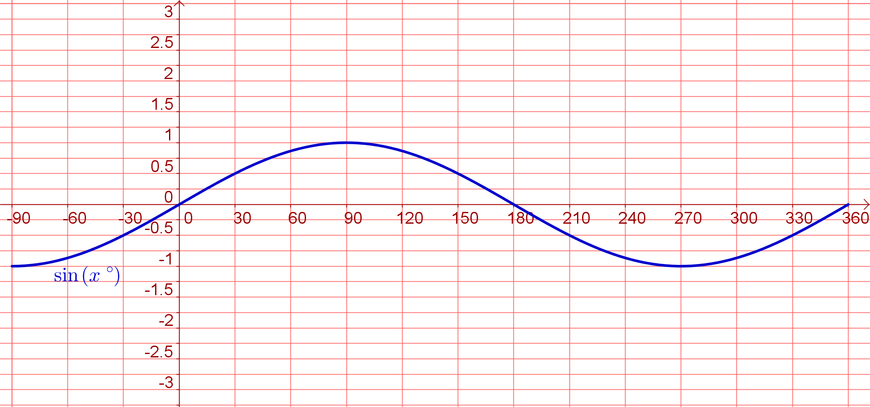
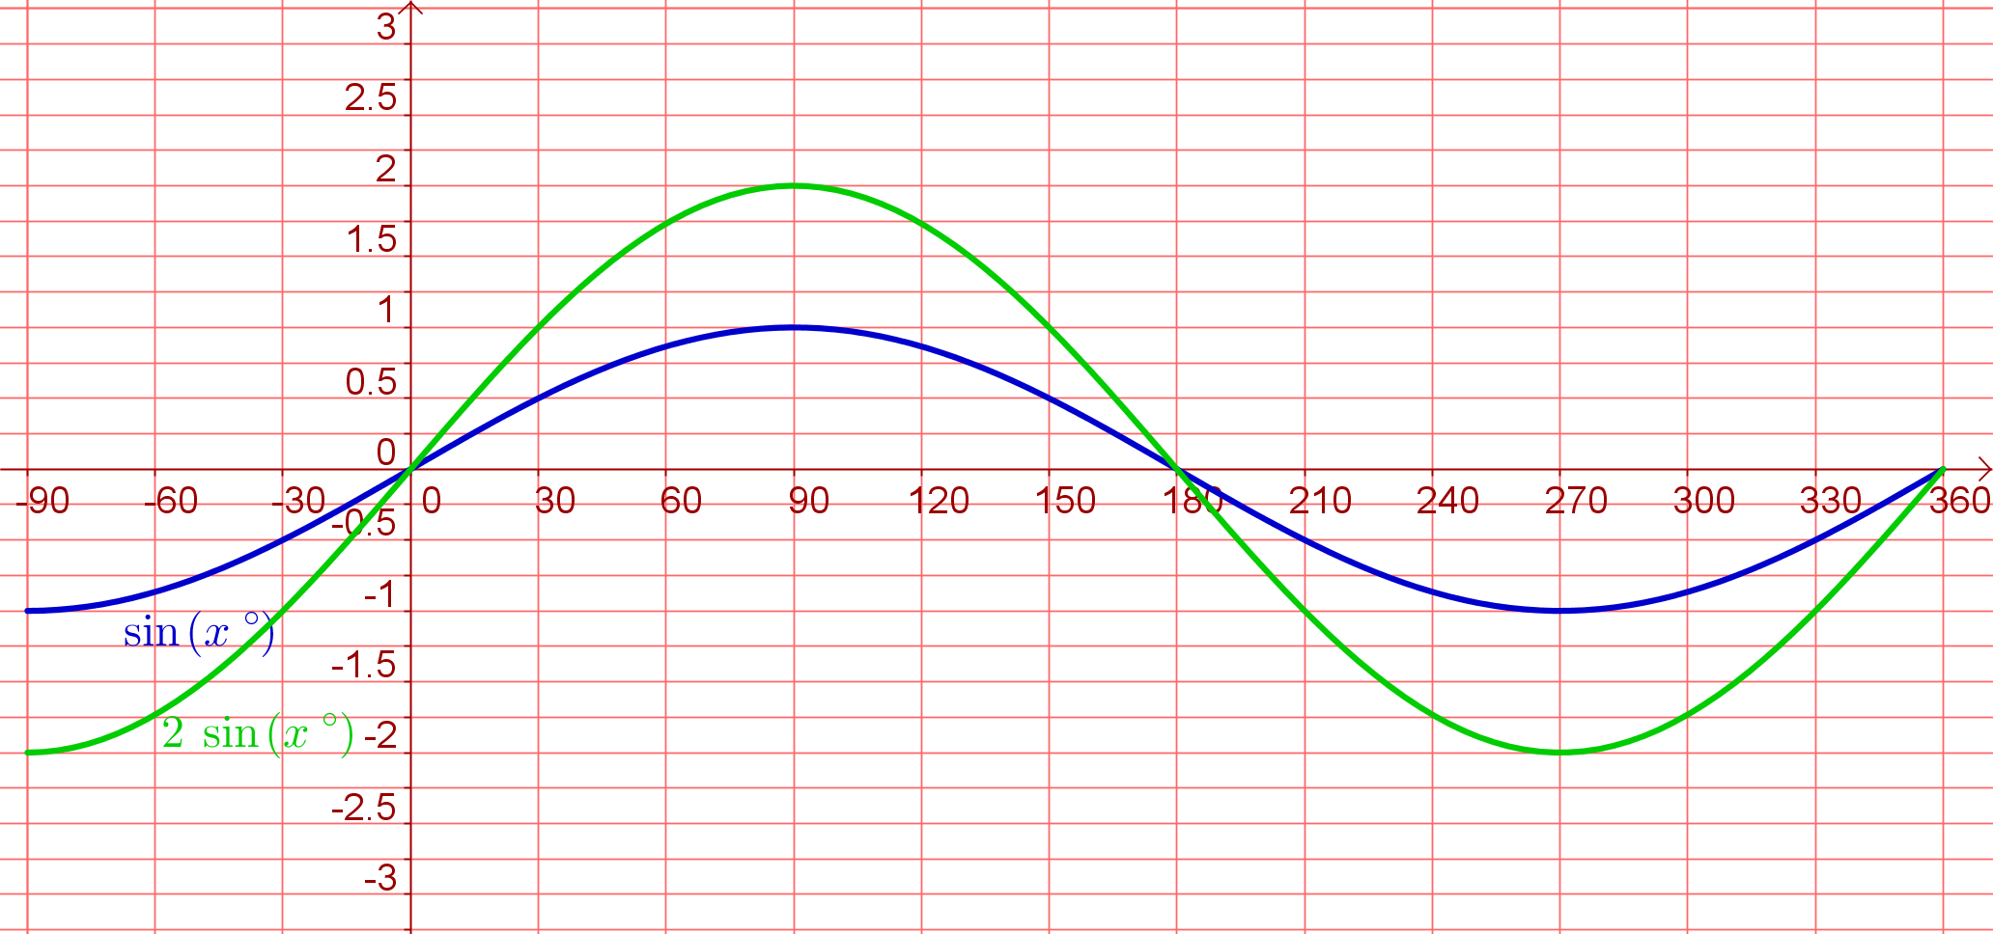
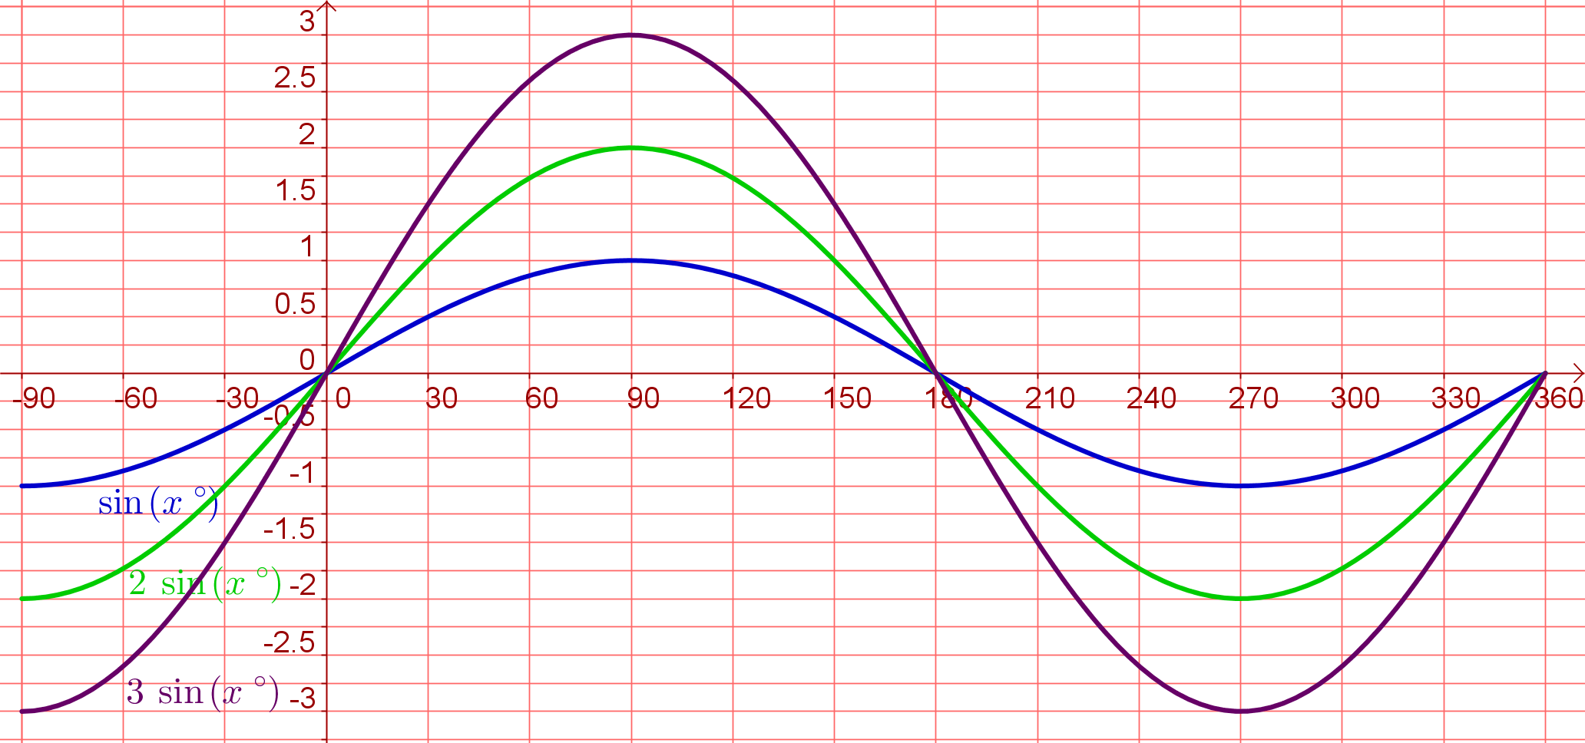
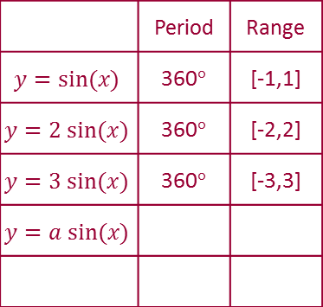
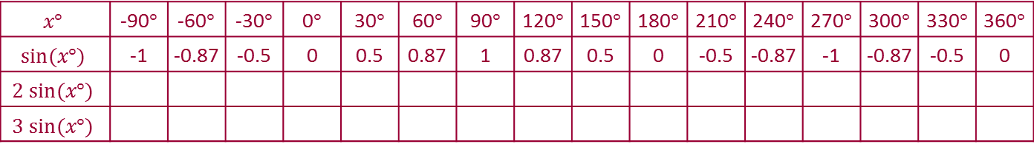
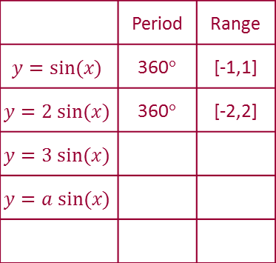
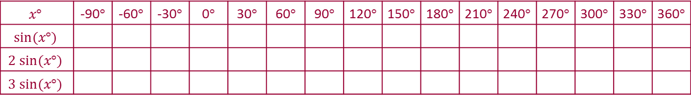
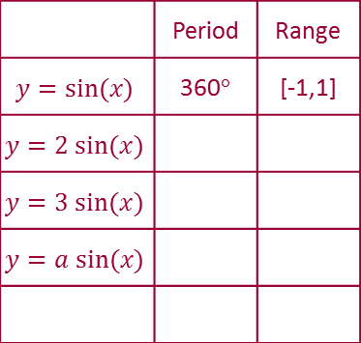
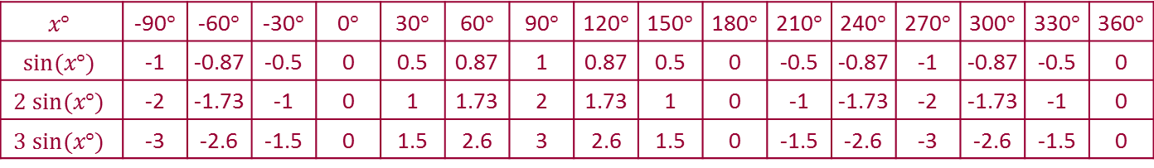
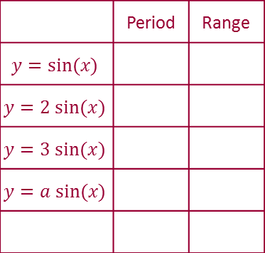
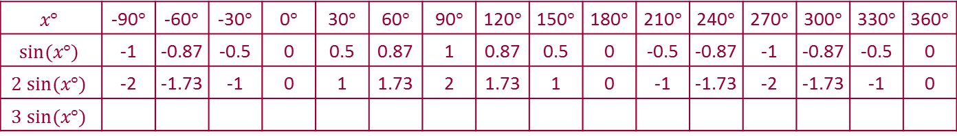
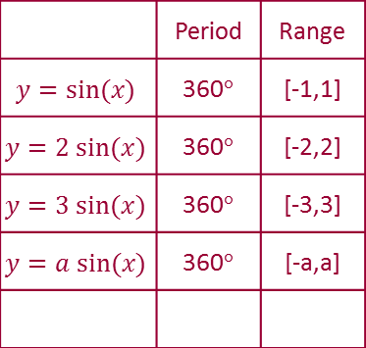
Student Activity 2
Using a calculator, or the unit circle, fill in the table for the following graphs and plot all of them using the same axes.
y = sin x, y = 2sin x, y = 3sin x
Use different colours for each graph.
Lesson interaction
 | -1 | -0.87 | -0.5 | 0 | 0.5 | 0.87 | 1 | 0.87 | 0.5 | 0 | -0.5 | -0.87 | -1 | -0.87 | -0.5 | 0
 | -1 | -0.87 | -0.5 | 0 | 0.5 | 0.87 | 1 | 0.87 | 0.5 | 0 | -0.5 | -0.87 | -1 | -0.87 | -0.5 | 0
 | -2 | -1.73 | -1 | 0 | 1 | 1.73 | 2 | 1.73 | 1 | 0 | -1 | -1.73 | -2 | -1.73 | -1 | 0
 | -1 | -0.87 | -0.5 | 0 | 0.5 | 0.87 | 1 | 0.87 | 0.5 | 0 | -0.5 | -0.87 | -1 | -0.87 | -0.5 | 0
 | -2 | -1.73 | -1 | 0 | 1 | 1.73 | 2 | 1.73 | 1 | 0 | -1 | -1.73 | -2 | -1.73 | -1 | 0
 | -3 | -2.6 | -1.5 | 0 | 1.5 | 2.6 | 3 | 2.6 | 1.5 | 0 | -1.5 | -2.6 | -3 | -2.6 | -1.5 | 0
 | Period | Range
 | Period | Range
 |  | [-1,1]
 | Period | Range
 |  | [-1,1]
 |  | [-2,2]
 | Period | Range
 |  | [-1,1]
 |  | [-2,2]
 |  | [-3,3]
 | Period | Range
 |  | [-1,1]
 |  | [-2,2]
 |  | [-3,3]
 |  | [-a,a]

Slide 10

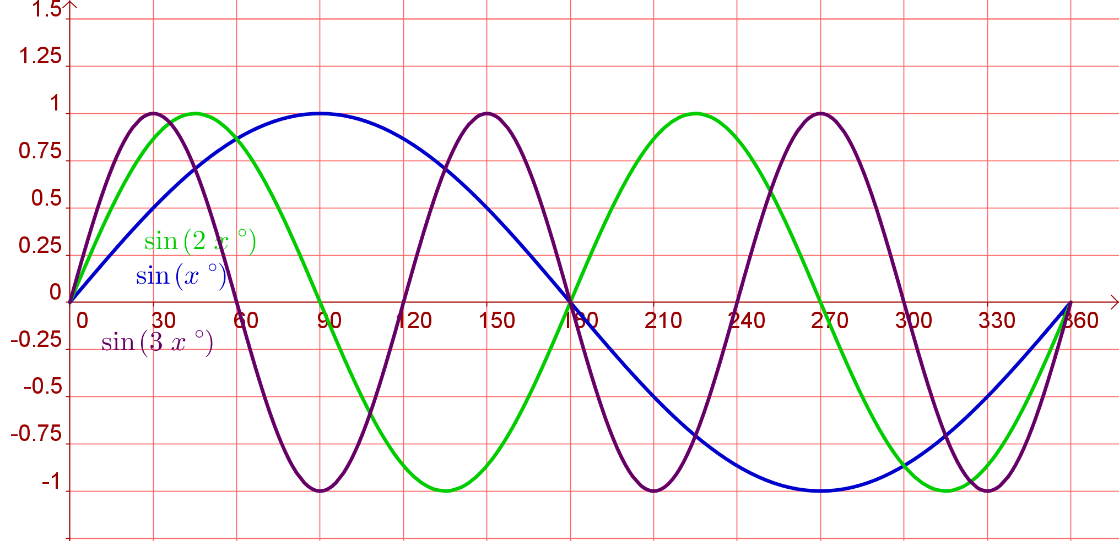
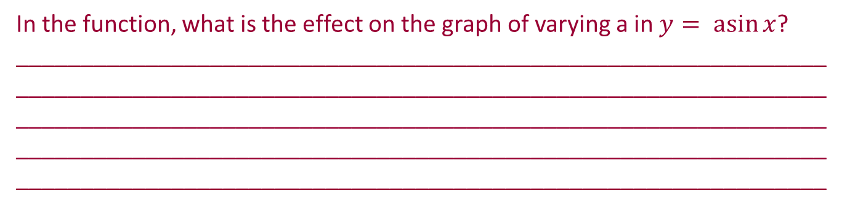
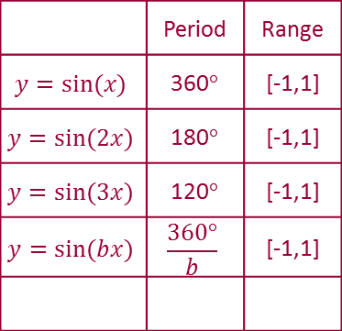
 | Period | Range
 |  | [-1,1]
 |  | [-1,1]
 |  | [-1,1]
 |  | [-1,1]
Lesson interaction

Slide 11

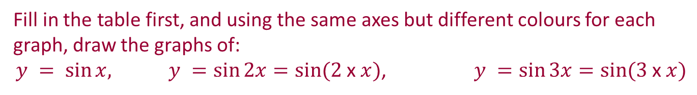
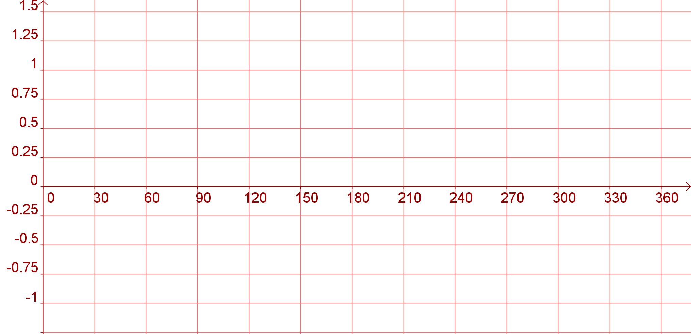
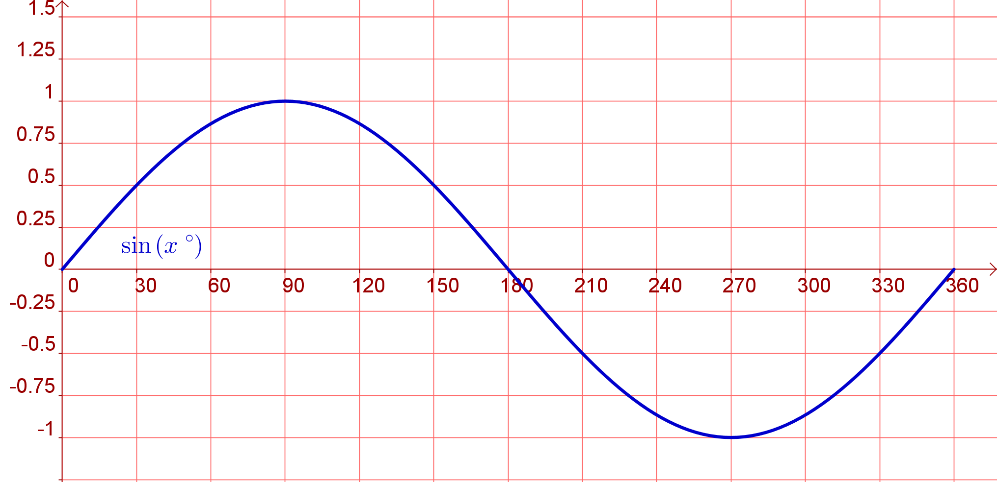
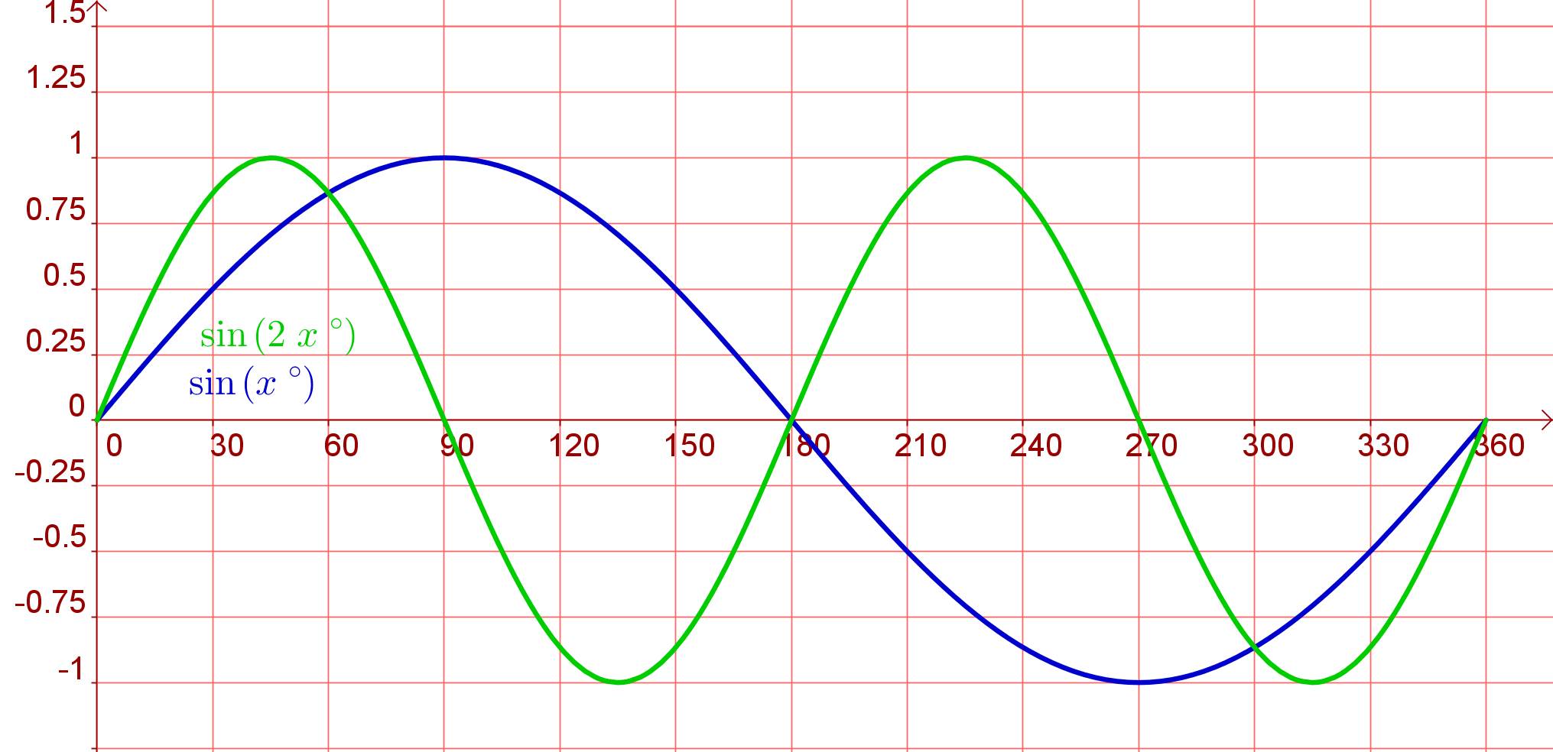
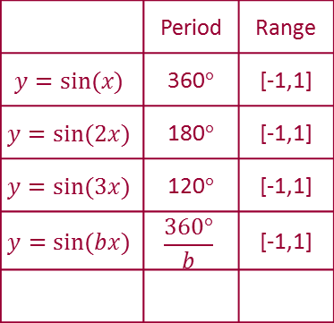
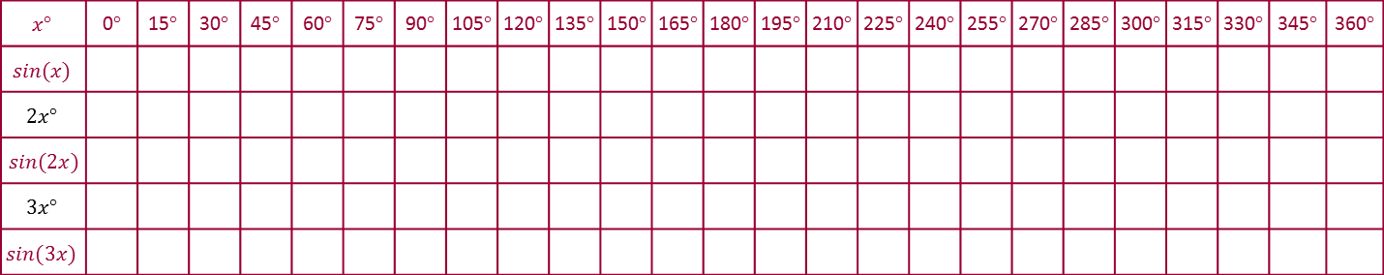
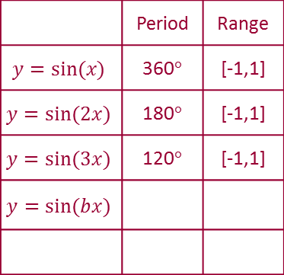
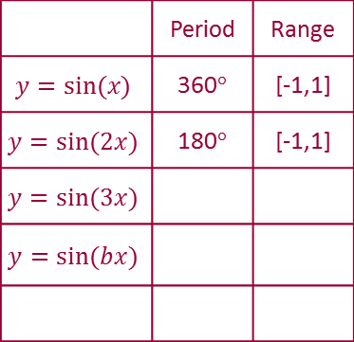
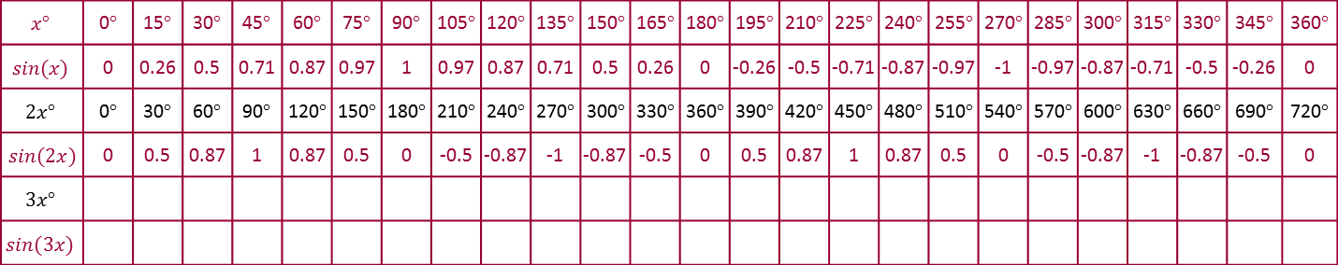
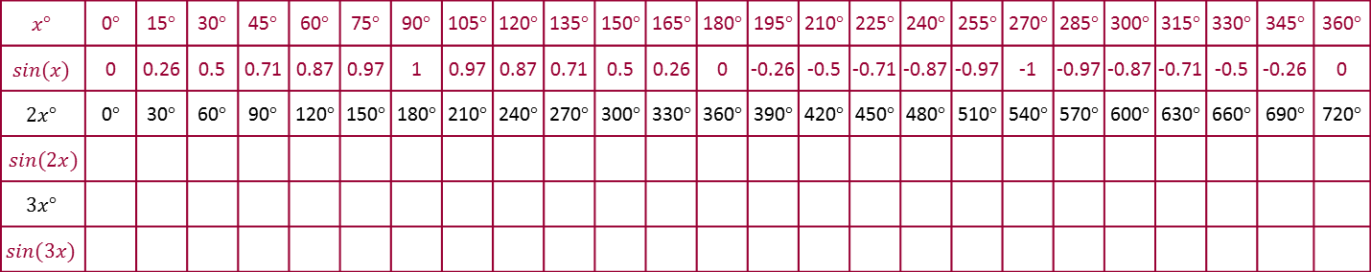
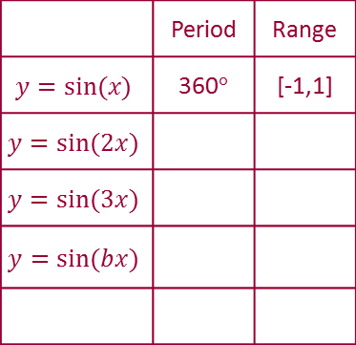
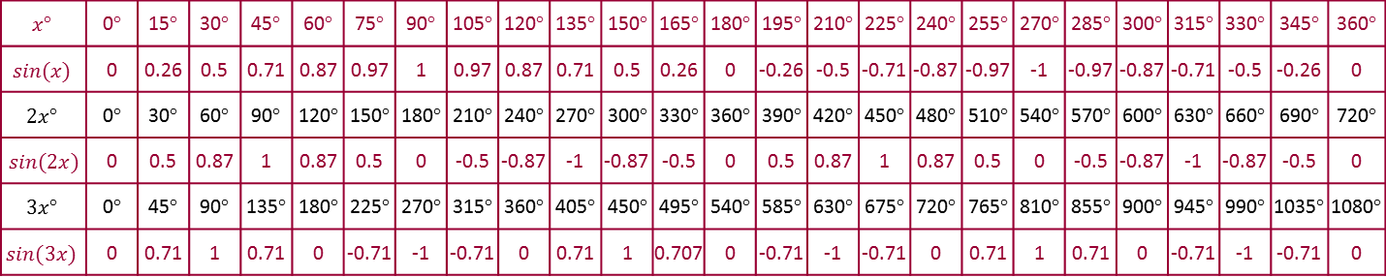
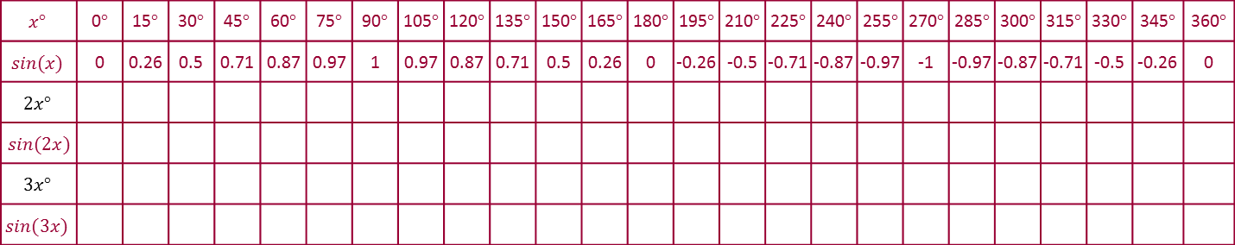
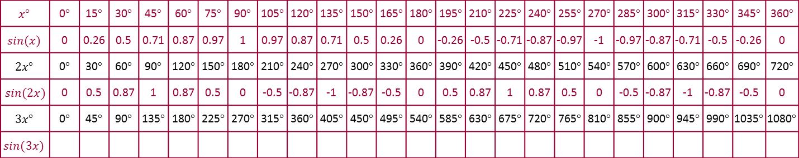
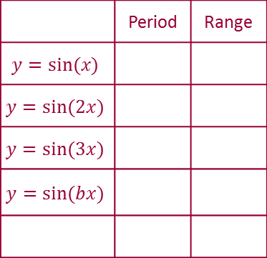
 | 0 | 0.26 | 0.5 | 0.71 | 0.87 | 0.97 | 1 | 0.97 | 0.87 | 0.71 | 0.5 | 0.26 | 0 | -0.26 | -0.5 | -0.71 | -0.87 | -0.97 | -1 | -0.97 | -0.87 | -0.71 | -0.5 | -0.26 | 0
 | 0 | 0.26 | 0.5 | 0.71 | 0.87 | 0.97 | 1 | 0.97 | 0.87 | 0.71 | 0.5 | 0.26 | 0 | -0.26 | -0.5 | -0.71 | -0.87 | -0.97 | -1 | -0.97 | -0.87 | -0.71 | -0.5 | -0.26 | 0
 | 0 | 0.26 | 0.5 | 0.71 | 0.87 | 0.97 | 1 | 0.97 | 0.87 | 0.71 | 0.5 | 0.26 | 0 | -0.26 | -0.5 | -0.71 | -0.87 | -0.97 | -1 | -0.97 | -0.87 | -0.71 | -0.5 | -0.26 | 0
 | 0 | 0.5 | 0.87 | 1 | 0.87 | 0.5 | 0 | -0.5 | -0.87 | -1 | -0.87 | -0.5 | 0 | 0.5 | 0.87 | 1 | 0.87 | 0.5 | 0 | -0.5 | -0.87 | -1 | -0.87 | -0.5 | 0
 | 0 | 0.26 | 0.5 | 0.71 | 0.87 | 0.97 | 1 | 0.97 | 0.87 | 0.71 | 0.5 | 0.26 | 0 | -0.26 | -0.5 | -0.71 | -0.87 | -0.97 | -1 | -0.97 | -0.87 | -0.71 | -0.5 | -0.26 | 0
 | 0 | 0.5 | 0.87 | 1 | 0.87 | 0.5 | 0 | -0.5 | -0.87 | -1 | -0.87 | -0.5 | 0 | 0.5 | 0.87 | 1 | 0.87 | 0.5 | 0 | -0.5 | -0.87 | -1 | -0.87 | -0.5 | 0
 | 0 | 0.26 | 0.5 | 0.71 | 0.87 | 0.97 | 1 | 0.97 | 0.87 | 0.71 | 0.5 | 0.26 | 0 | -0.26 | -0.5 | -0.71 | -0.87 | -0.97 | -1 | -0.97 | -0.87 | -0.71 | -0.5 | -0.26 | 0
 | 0 | 0.5 | 0.87 | 1 | 0.87 | 0.5 | 0 | -0.5 | -0.87 | -1 | -0.87 | -0.5 | 0 | 0.5 | 0.87 | 1 | 0.87 | 0.5 | 0 | -0.5 | -0.87 | -1 | -0.87 | -0.5 | 0
 | 0 | 0.71 | 1 | 0.71 | 0 | -0.71 | -1 | -0.71 | 0 | 0.71 | 1 | 0.707 | 0 | -0.71 | -1 | -0.71 | 0 | 0.71 | 1 | 0.71 | 0 | -0.71 | -1 | -0.71 | 0
 | Period | Range
 | Period | Range
 |  | [-1,1]
 | Period | Range
 |  | [-1,1]
 |  | [-1,1]
 | Period | Range
 |  | [-1,1]
 |  | [-1,1]
 |  | [-1,1]
 | Period | Range
 |  | [-1,1]
 |  | [-1,1]
 |  | [-1,1]
 |  | [-1,1]

Slide 12

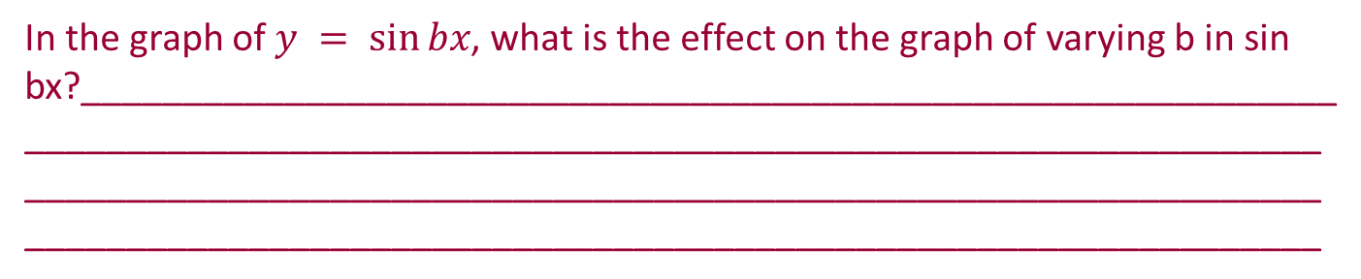

 | Period | Range
 |  | [-1,1]
 |  | [-1,1]
 |  | [-1,1]
 |  | [-1,1]

Slide 13
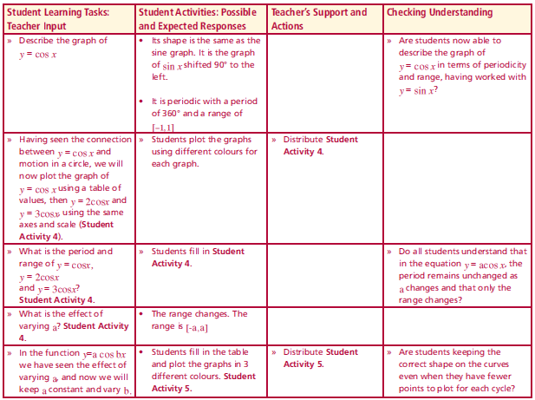

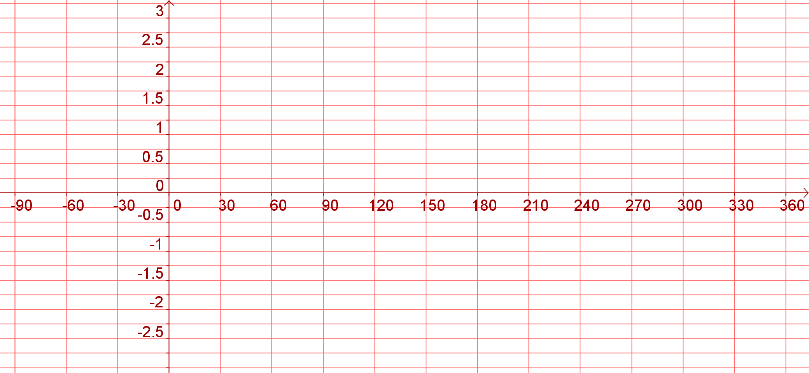
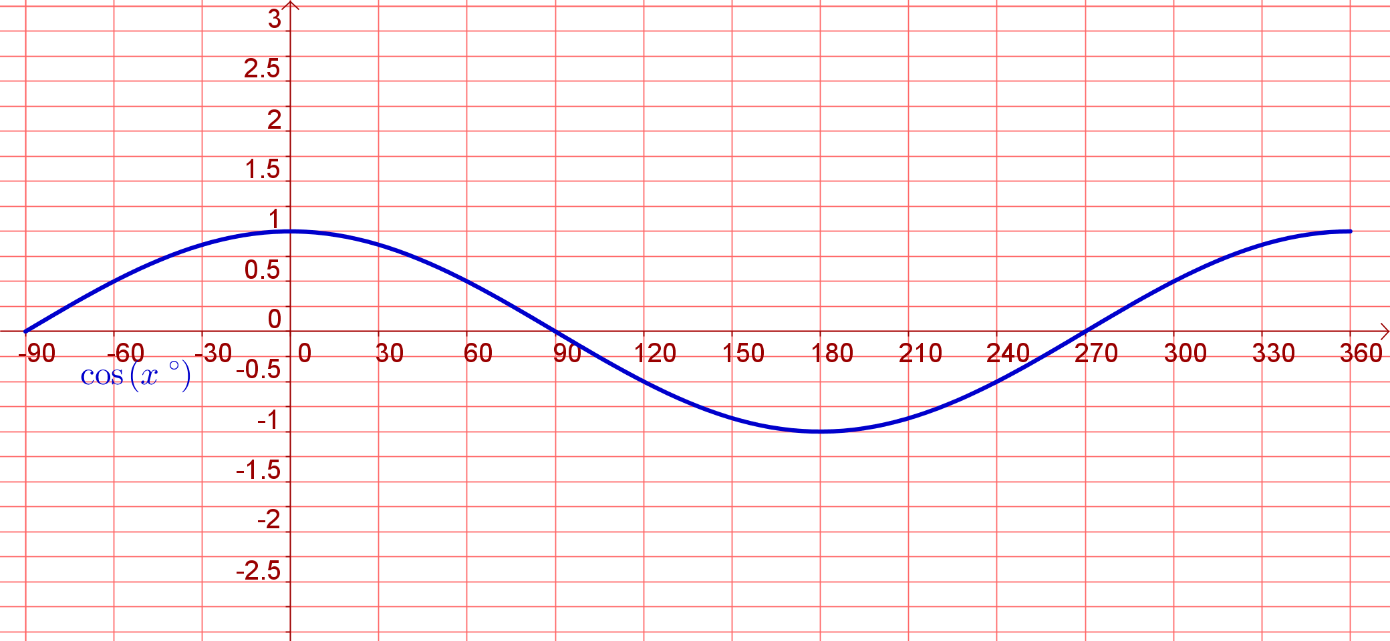
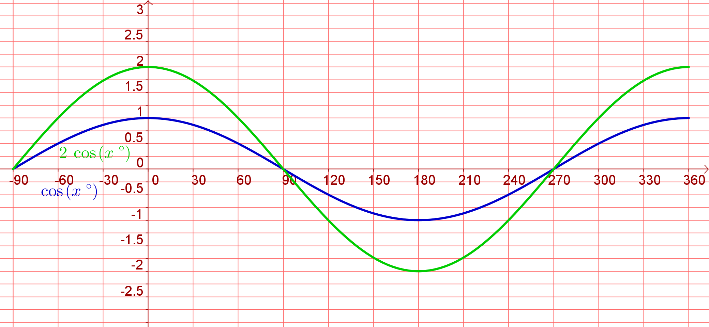
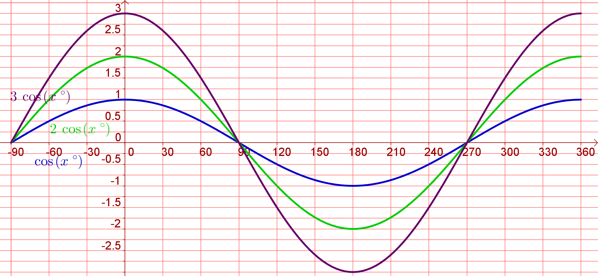
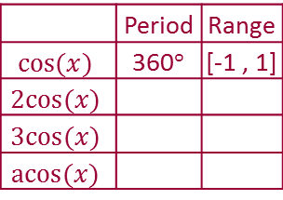

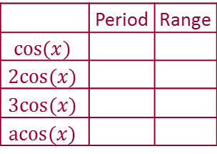
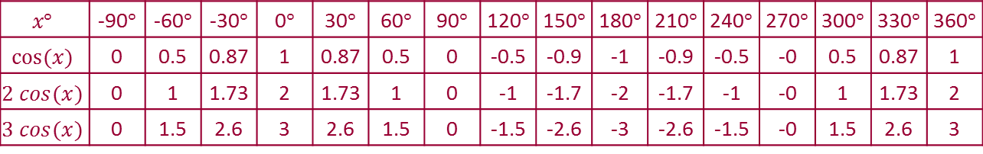





Student Activity 4
Lesson interaction
 | 0 | 0.5 | 0.87 | 1 | 0.87 | 0.5 | 0 | -0.5 | -0.9 | -1 | -0.9 | -0.5 | -0 | 0.5 | 0.87 | 1
 | 0 | 0.5 | 0.87 | 1 | 0.87 | 0.5 | 0 | -0.5 | -0.9 | -1 | -0.9 | -0.5 | -0 | 0.5 | 0.87 | 1
 | 0 | 1 | 1.73 | 2 | 1.73 | 1 | 0 | -1 | -1.7 | -2 | -1.7 | -1 | -0 | 1 | 1.73 | 2
 | 0 | 0.5 | 0.87 | 1 | 0.87 | 0.5 | 0 | -0.5 | -0.9 | -1 | -0.9 | -0.5 | -0 | 0.5 | 0.87 | 1
 | 0 | 1 | 1.73 | 2 | 1.73 | 1 | 0 | -1 | -1.7 | -2 | -1.7 | -1 | -0 | 1 | 1.73 | 2
 | 0 | 1.5 | 2.6 | 3 | 2.6 | 1.5 | 0 | -1.5 | -2.6 | -3 | -2.6 | -1.5 | -0 | 1.5 | 2.6 | 3
 | Period | Range
 | Period | Range
 |  | [-1 , 1]
 | Period | Range
 |  | [-1 , 1]
 |  | [-2 , 2]
 | Period | Range
 |  | [-1 , 1]
 |  | [-2 , 2]
 |  | [-3 , 3]
 | Period | Range
 |  | [-1 , 1]
 |  | [-2 , 2]
 |  | [-3 , 3]
 |  | [-a , a]

Slide 14



 | Period | Range
 |  | [-1 , 1]
 |  | [-2 , 2]
 |  | [-3 , 3]
 |  | [-a , a]

Slide 15
















Student Activity 5
Lesson interaction
By filling in a table first, and using the same axes but different colours for each graph, draw the graphs of
 | 1 | 0.97 | 0.87 | 0.71 | 0.5 | 0.26 | 0 | -0.26 | -0.5 | -0.71 | -0.87 | -0.97 | -1 | -0.97 | -0.87 | -0.71 | -0.5 | -0.26 | -0 | 0.26 | 0.5 | 0.71 | 0.87 | 0.97 | 1
 | 1 | 0.97 | 0.87 | 0.71 | 0.5 | 0.26 | 0 | -0.26 | -0.5 | -0.71 | -0.87 | -0.97 | -1 | -0.97 | -0.87 | -0.71 | -0.5 | -0.26 | -0 | 0.26 | 0.5 | 0.71 | 0.87 | 0.97 | 1
 | 1 | 0.97 | 0.87 | 0.71 | 0.5 | 0.26 | 0 | -0.26 | -0.5 | -0.71 | -0.87 | -0.97 | -1 | -0.97 | -0.87 | -0.71 | -0.5 | -0.26 | -0 | 0.26 | 0.5 | 0.71 | 0.87 | 0.97 | 1
 | 1 | 0.87 | 0.5 | 0 | -0.5 | -0.87 | -1 | -0.87 | -0.5 | -0 | 0.5 | 0.87 | 1 | 0.87 | 0.5 | 0 | -0.5 | -0.87 | -1 | -0.87 | -0.5 | -0 | 0.5 | 0.87 | 1
 | 1 | 0.97 | 0.87 | 0.71 | 0.5 | 0.26 | 0 | -0.26 | -0.5 | -0.71 | -0.87 | -0.97 | -1 | -0.97 | -0.87 | -0.71 | -0.5 | -0.26 | -0 | 0.26 | 0.5 | 0.71 | 0.87 | 0.97 | 1
 | 1 | 0.87 | 0.5 | 0 | -0.5 | -0.87 | -1 | -0.87 | -0.5 | -0 | 0.5 | 0.87 | 1 | 0.87 | 0.5 | 0 | -0.5 | -0.87 | -1 | -0.87 | -0.5 | -0 | 0.5 | 0.87 | 1
 | 1 | 0.97 | 0.87 | 0.71 | 0.5 | 0.26 | 0 | -0.26 | -0.5 | -0.71 | -0.87 | -0.97 | -1 | -0.97 | -0.87 | -0.71 | -0.5 | -0.26 | -0 | 0.26 | 0.5 | 0.71 | 0.87 | 0.97 | 1
 | 1 | 0.87 | 0.5 | 0 | -0.5 | -0.87 | -1 | -0.87 | -0.5 | -0 | 0.5 | 0.87 | 1 | 0.87 | 0.5 | 0 | -0.5 | -0.87 | -1 | -0.87 | -0.5 | -0 | 0.5 | 0.87 | 1
 | 1 | 0.71 | 0 | -0.71 | -1 | -0.71 | -0 | 0.71 | 1 | 0.71 | 0 | -0.71 | -1 | -0.71 | -0 | 0.71 | 1 | 0.71 | 0 | -0.71 | -1 | -0.71 | 0 | 0.71 | 1
 | Period | Range
 | Period | Range
 |  | [-1,1]
 | Period | Range
 |  | [-1,1]
 |  | [-1,1]
 | Period | Range
 |  | [-1,1]
 |  | [-1,1]
 |  | [-1,1]
 | Period | Range
 |  | [-1,1]
 |  | [-1,1]
 |  | [-1,1]
 |  | [-1,1]

Slide 16



 | Period | Range
 |  | [-1,1]
 |  | [-1,1]
 |  | [-1,1]
 |  | [-1,1]

Slide 17



Student Activity 6

Slide 18



Student Activity 6

Slide 19


Student Activity 6

Slide 20






Student Activity 7
Lesson interaction
 |  | 30° | 60° | 75° | 80° | 85°
Lesson interaction

Slide 21






Student Activity 7B
By filling in a table first, and using the same axes but different colours for each graph, draw the graphs of
 | - | -3.73 | -1.73 | -1.00 | -0.58 | -0.27 | 0.00 | 0.27 | 0.58 | 1.00 | 1.73 | 3.73 | - | -3.73 | -1.73 | -1.00 | -0.58 | -0.27 | 0.00 | 0.27 | 0.58 | 1.00 | 1.73 | 3.73 | - | -3.73 | -1.73 | -1.00 | -0.58 | -0.27 | 0.00
Student Activity 7C
 | Period | Range
 | Period | Range

Slide 22


Using TABLE MODE to find the coordinates of a function

Slide 23




Ensure that the calculator is SETUP to do calculations using degrees
A small D appears on the top line

Slide 24




Change the mode of the calculator
Choose Table
Change the mode of the calculator

Slide 25


















Slide 26









Press AC
Right arrow to arrive at the place we wish to be
Keep pressing = as nothing else has changed

Slide 27
For your information the table function can also work in radians

Slide 28




Table Mode in Radians
We can SETUP the calculator in Radians and find then coordinates of a trig function
(It does also work in
Degree Mode)

Slide 29
Change the mode of the calculator
Choose Table
Change the mode of the calculator

Slide 30












