Slide 1
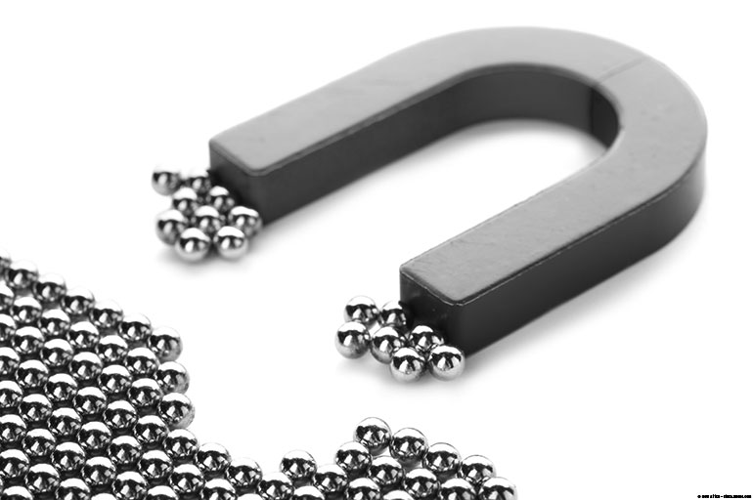
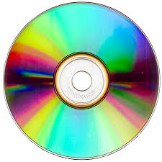
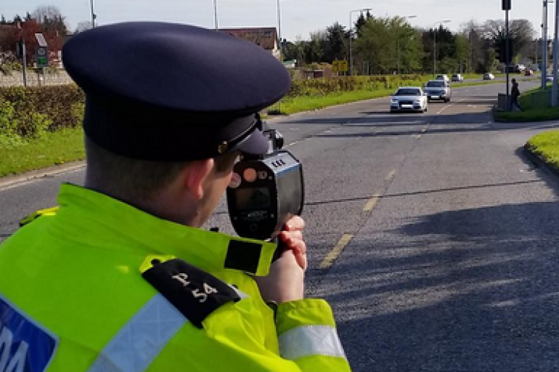
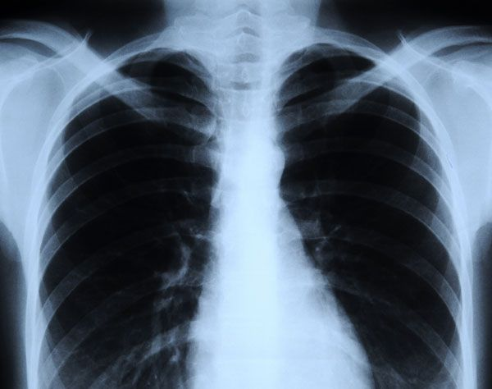
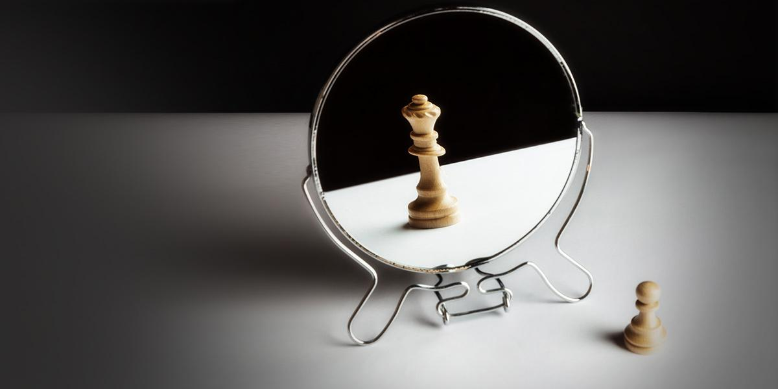
Physics: An Answer To Many Questions

Slide 2
Introduction
Physicists are very inquisitive people; they want to know how and why things happen. Have you ever wondered why when you rub a pen in your hair the pen can pick up a piece of paper?
As you proceed through the course you will use special scientific equipment and apply theories to see how things happen.
Theoretically planning the world!

Slide 3
Areas in Physics You Will Study
Mechanics and Motion
Heat
Waves and Sound
Light and Optics
Electricity and Magnetism
Atomic Physics and Electronics
Nuclear and Particle Physics

Slide 4
Course Structure
Forces
Motion
Mechanics
Energy
Heat Transfer
Heat
SHC
Refraction, diffraction, interference
Physics
Waves
Resonance
20% of GCE
Electricity
Voltage
Current
Resistance
Power
40% of AS
20% of GCE
Modern Physics
Waves
Basic and Derived Units
Electron
Radioactivity
20% of AS
10% of GCE
Practical
AND
Practical's

Slide 5
Expectations
Elite group
So few are able for the course
Completely new language compared to JC
Little Physics covered in JC
Lots of Algebra Linear and quadratics
Calculator competencies
No units = No marks!!
Organisation

Slide 6
Units in Physics
What words do you think of when you hear the term 'units' mentioned?
Mentimeter Code: 25 78 27 5

Slide 7
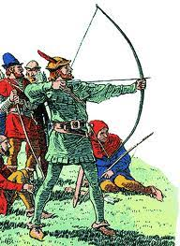
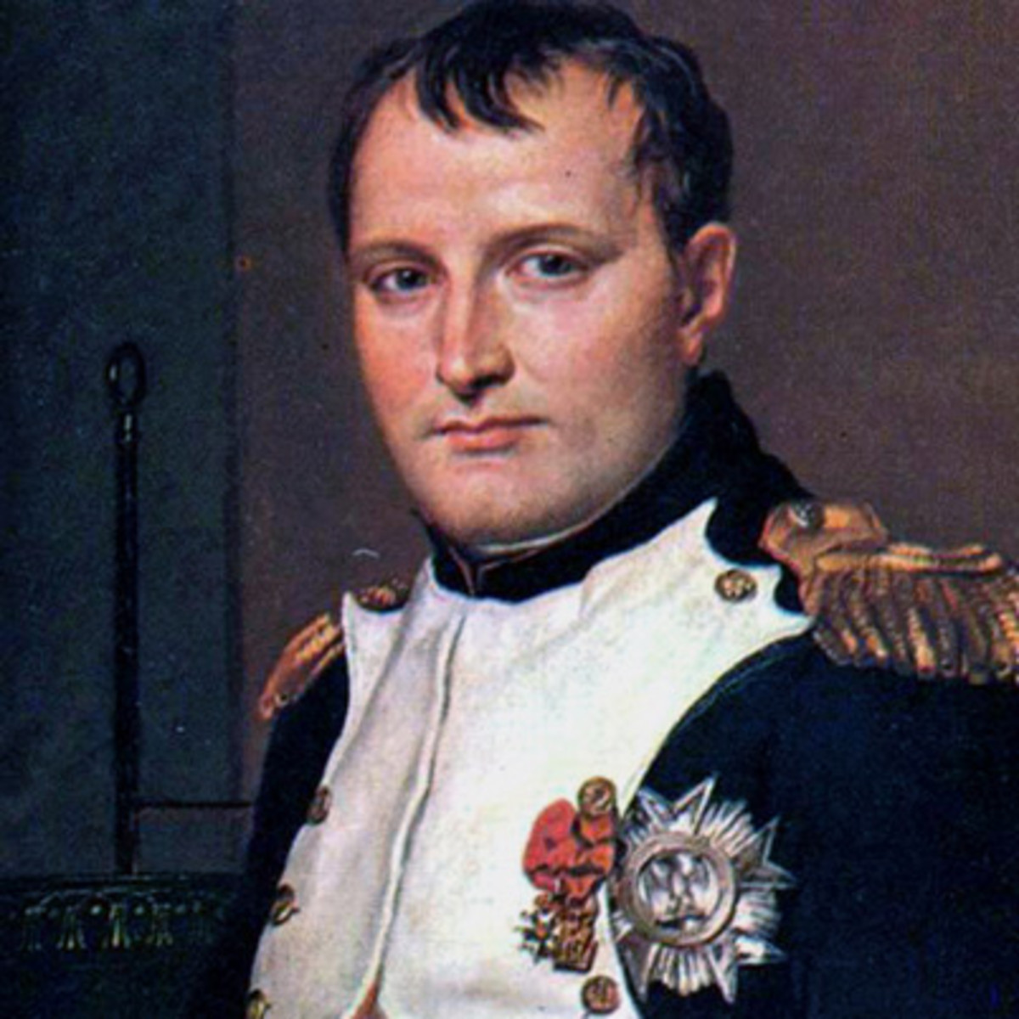
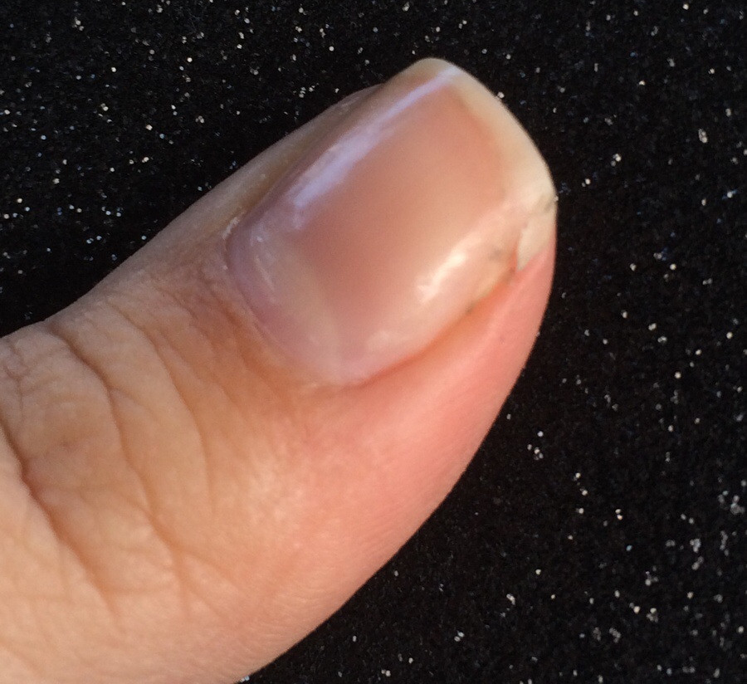
Physics Trivia
Where do units come from?
Imperial – Actual things
Metric – Napoleon Bonaparte

Slide 8
Physics Trivia
Imperial – Inch
King Charles – between the top of his thumb nail and the first joint is equivalent to an inch.
Where the term rule of thumb came from.

Slide 9

Physics Trivia
Imperial – Foot
King Charles – Between his wrist to his elbow is equivalent to a foot.
Take of your shoe it’s the same length as your wrist to your elbow.

Slide 10
Physics Trivia
Imperial – Yard
Lord of Leinster – Distance between a arrow pulled back to your nose is 1 yard.
Strongbow and archer ➔

Slide 11
What brought about change?
Not everyone's distances were the same, somebody measured a piece of land and found it to be 100 yards, another person measured it and found it was 98 yards, another may have counted 95 yards.
This caused arguments as there was a difference hence the arrival of the metric system!

Slide 12
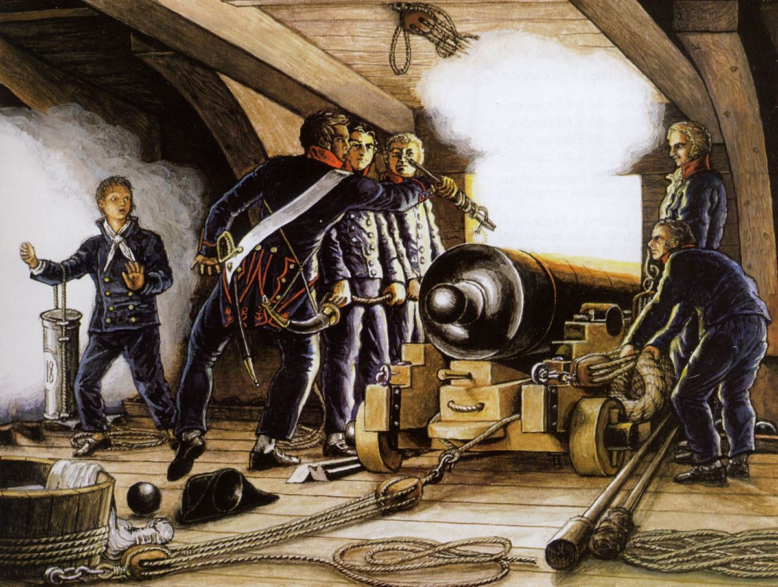
Physics Trivia
Napoleon Bonaparte – man responsible for the metric system in the 18th Century
If you study the city map of Paris, around the area of the Arch de Triomphe you’ll notice the streets are curved, this was to protect the streets when cannon balls were fired during the French revolution.

