Slide 1
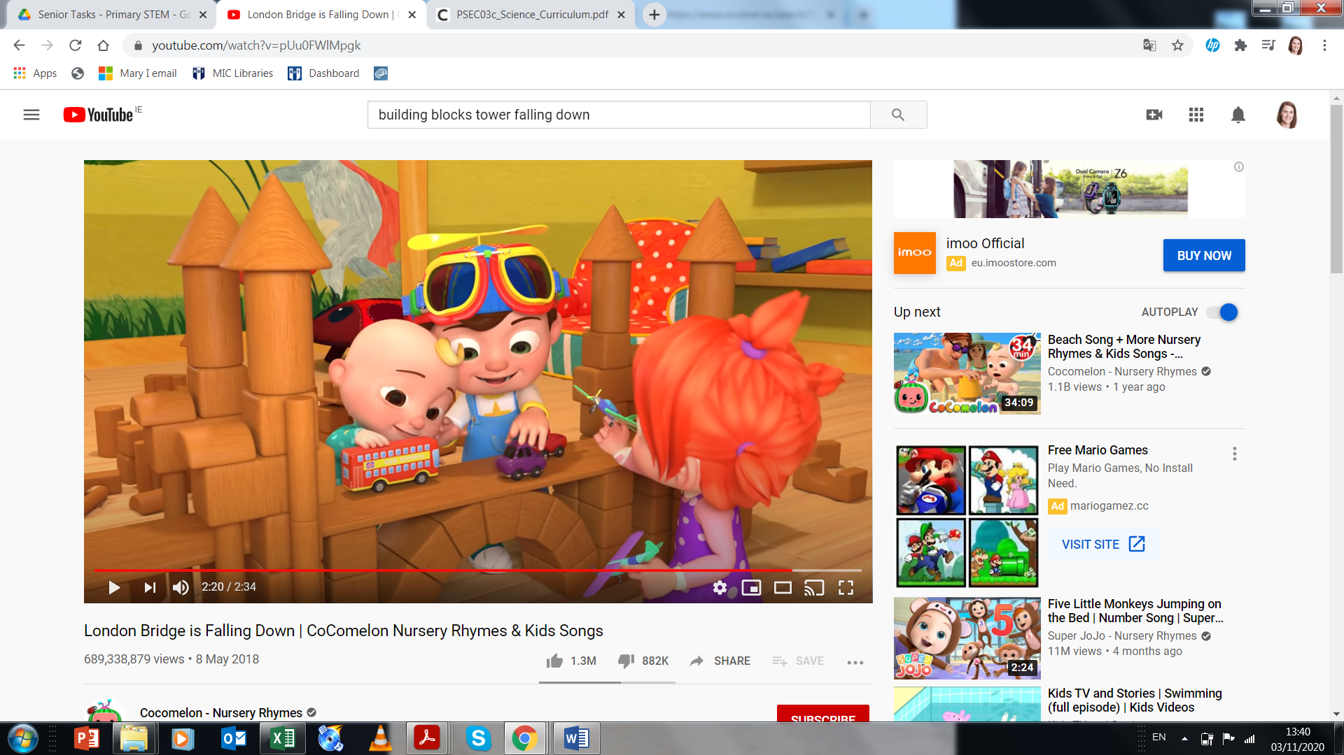
What’s Going On? – London Bridge
What do you notice happening in this video? Why did that happen?
What do you think makes a good bridge?
I wonder could we help JJ and his friends make any other type of bridge?
Why do we need bridges? Does anyone know where there are other bridges?
https://www.youtube.com/watch?v=pUu0FWlMpgk

Slide 2
Céard atá ag tarlú? – Droichead Londan
Cad atá ag tarlú san fhísean seo, dár leat?
Cén fáth ar tharla sé sin?
I do thuairim, céard a theastaíonn chun droichead maith a dhéanamh?
Cén fáth go dteastaíonn droichid uainn? An bhfuil a fhios ag aon duine cá bhfuil droichid eile?
An mbeadh muid in ann cabhrú le JJ agus a chairde chun saghas eile droichead a thógáil?
https://www.youtube.com/watch?v=pUu0FWlMpgk

