Slide 1
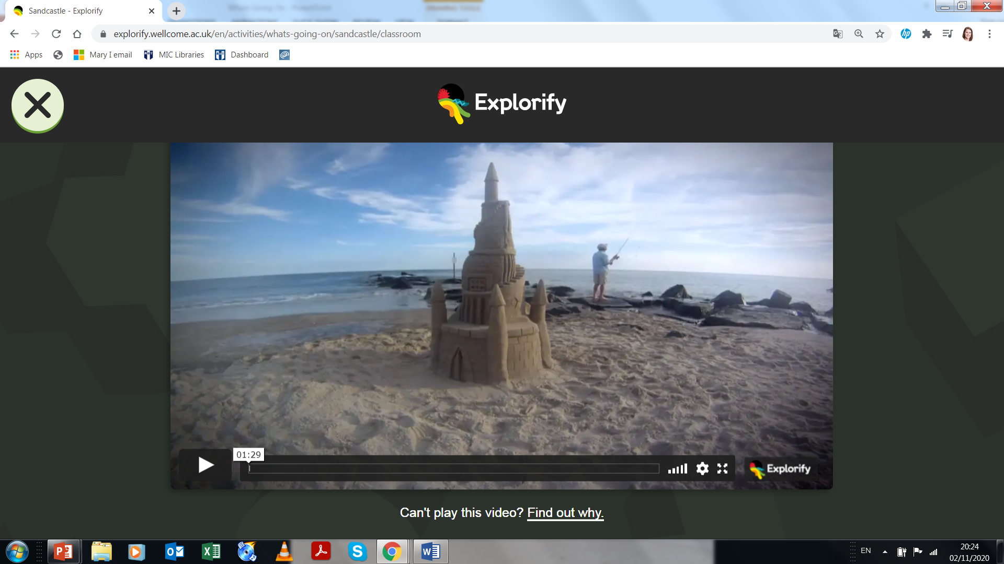
What’s Going On? – Sandcastles
What do you think is happening?
What is changing around the sandcastle?
What caused the sandcastle to fall? How could you test your idea?
Describe what you see using one word.
https://explorify.wellcome.ac.uk/en/activities/whats-going-on/sandcastle/classroom

Slide 2
Céard atá ag tarlú? – Caisleán Gainimh
Céard atá ag tarlú, dar leat?
Ceard atá ag athrú timpeall an chaisleáin?
Cén fáth gur thit an caisleán? An mbeadh tú in ann do smaoineamh a thástáil? Cén bealach?
Ag úsáid focal amháin, déan cuir síos ar an méid atá ag tarlú.
https://explorify.wellcome.ac.uk/en/activities/whats-going-on/sandcastle/classroom

