Slide 1
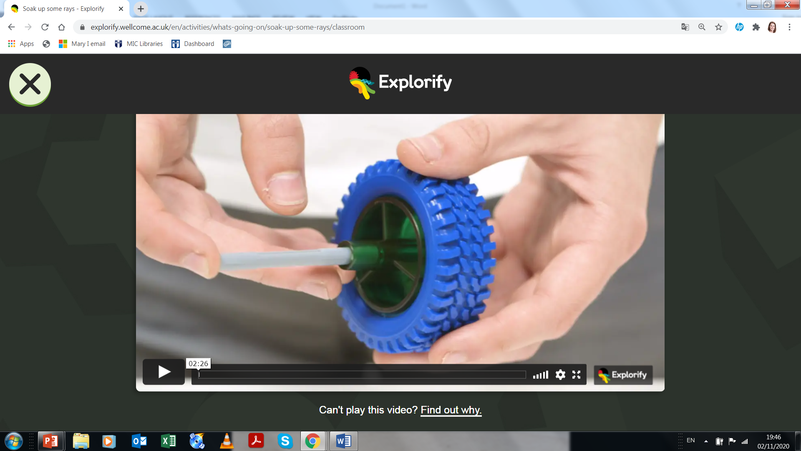
What’s Going On? – Electric Car
What are the pros and cons of using the sun as an energy source?
What are the different parts of the car? What do they do?
What else uses the sun as a source of energy?
Are there any other ways to make a toy car move?
https://explorify.wellcome.ac.uk/en/activities/whats-going-on/soak-up-some-rays

Slide 2
Céard atá ag tarlú? – Carr Leictreach
Céard iad na buntáistí agus na míbhuntáistí a bhaineann leis an ngrian mar fhoinse fuinnimh?
Céard iad na páirteanna difrúla den charr? Céard a dhéanann siad?
Cén rudaí eile a úsáideann an ghrian mar fhoinse fuinnimh?
An bhfuil bealaí eile chun carr bréige a bhogadh?
https://explorify.wellcome.ac.uk/en/activities/whats-going-on/soak-up-some-rays

