Slide 1
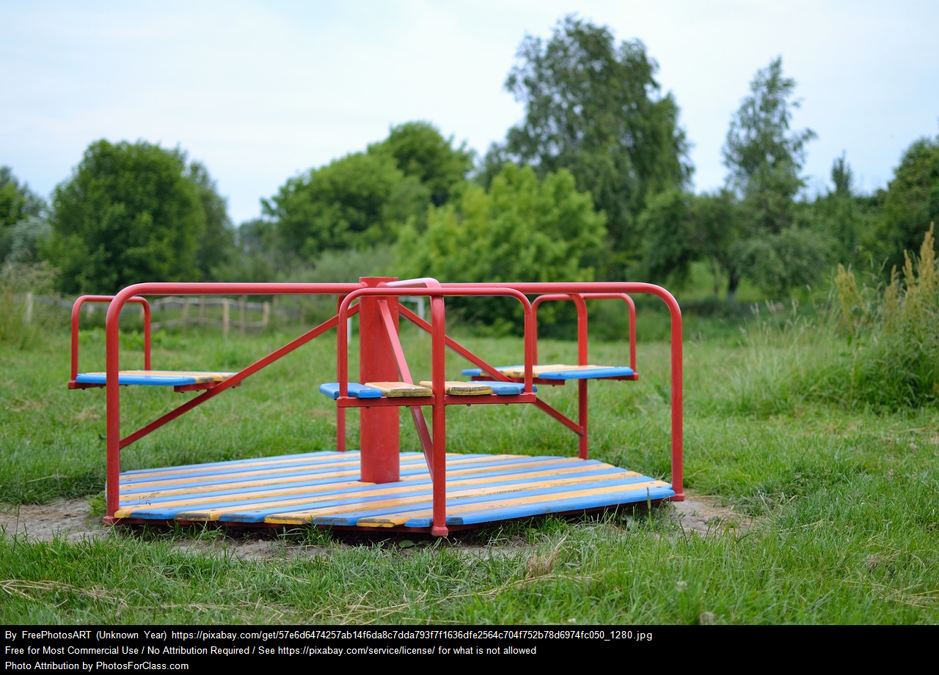
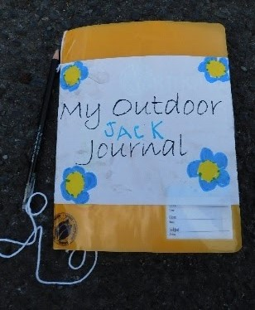
Sit Spot – Senior Classes
Use your senses to create a record of your local environment.
What do you notice?
What do you wonder?
What observations can you collect at different height levels?

Slide 2
Áit Suí – Na Ranganna Sinsearacha
Úsáid do cheadfaí chun chuntas a thabhairt ar do thimpeallacht áitiúil
Céard a thugann tú faoi deara?
Céard a chuireann ionadh ort?
Ag airdí difrúla, céard iad na breathnuithe is féidir a bhailiú?

