Slide 1

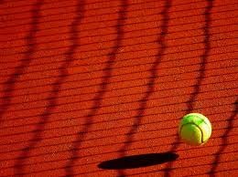

Odd One Out Junior 2
How are they similar/ different?
Which one is the odd one out? Why?
Can anyone think of another reason?

Slide 2



An Ceann Corr- Sóisear 2
Cén chaoi atá siad mar an gcéanna/ difriúil?
Cén ceann atá corr, dar leat? Cén fáth?
An féidir leat smaoineamh ar aon chúis eile?

