Slide 1
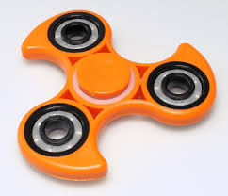
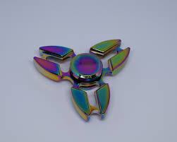
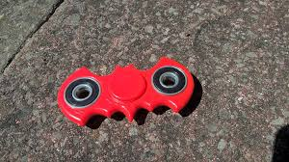
Odd One Out Senior 2
How are they similar/ different?
Which one is the odd one out? Why?
Can anyone think of a reason why each image could be the odd one out?

Slide 2


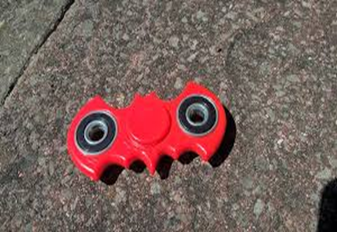
An Ceann Corr- Sinsear 2
An féidir le haon duine smaoineamh ar chúis go bhféadfadh gach íomhá a bheith mar an gceann corr?
Cén chaoi atá siad mar an gcéanna/ difriúil?
Cén ceann atá corr? Cén fáth?

