Slide 1
St. Colmcille
A saint through the artist’s eye

Slide 2
Imagining the Past
St. Colmcille lived a long time ago-nearly 1500 years!
Due to this fact, very little is know about how he looked. Artists have used their imaginations to fill in these gaps, and as a result, there are a wide variety of images of St. Colmcille in the world.

Slide 3
One saint… or three?
St. Colmcille goes by a variety of names. He is sometimes referred to as St. Colmcille and sometimes as St. Columba or St. Columb.
St. Colmcille has been depicted in:
-painting
-stained glass and
-sculpture.

Slide 4
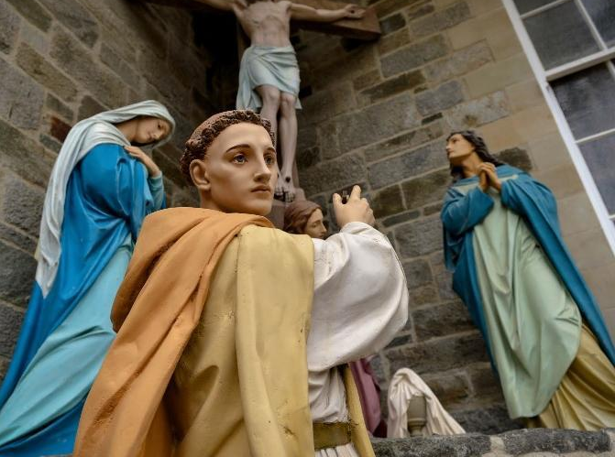
Statue of St. Columba-St. Columba’s Church, Longtower, Derry

Slide 5
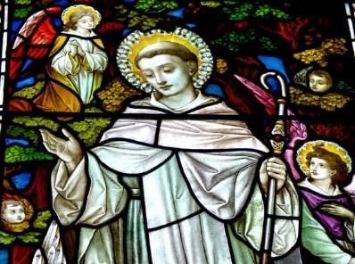
Stained glass window-St. Columba’s Church, Longtower, Derry

Slide 6
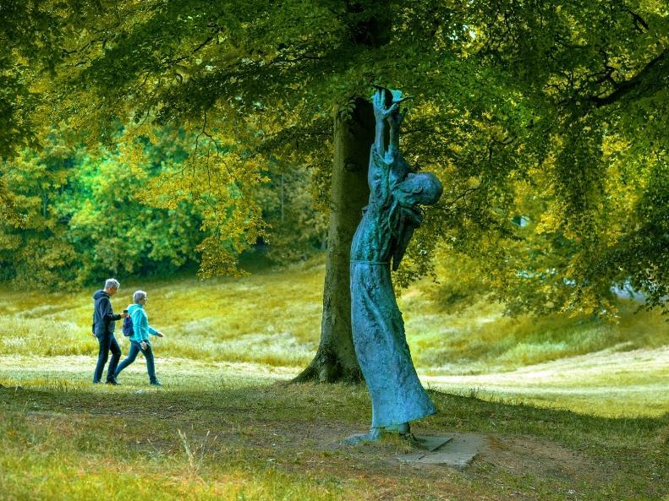
Sculpture of St. Columba-St. Columb’s Park, Derry

Slide 7
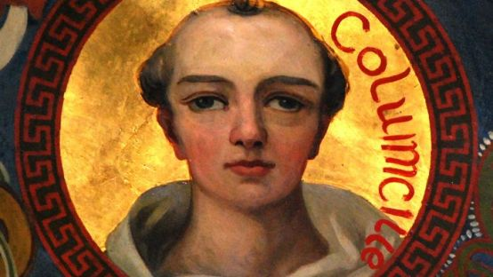
Painting of St. Colmcille-St. Eunan’s Cathedral, Letterkenny

Slide 8
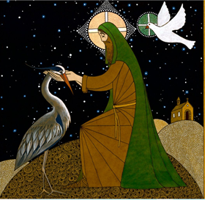
St. Colmcille-painting by Seamus McArdle

Slide 9
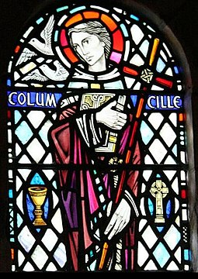
Stained glass window of St. Colmcille-Iona Abbey

Slide 10
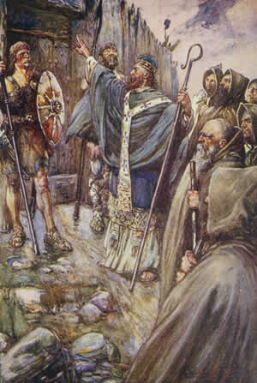
St. Colmcille-painting by J.R.Skelton

Slide 11
Over to you!
Based on your reading and using your imagination, draw/paint St. Colmcille as you see him in your mind’s eye.

