Slide 1
Forms of Precipitation
How rain/hail/sleet/snow form

Slide 2
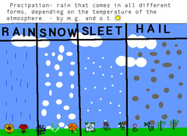
What is "Precipitation"?
-Precipitation is any form of water that falls to earth.

Slide 3
How does precipitation occur?
-Precipitation occurs when water evaporates up into the atmosphere
-It then stays in the atmosphere until the atmosphere is saturated.
-When this happens it has no choice but to condense back into water and drop down to the earth.
(evaporation is the change of water from a liquid to a gas)
(saturation point is when an object cannot hold any more of something)
(condensation is the change of water from a gas to a liquid)

Slide 4
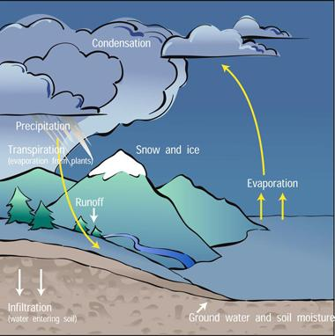

Slide 5
There are five types of precipitation that we will be examining today:
-rain
-sleet
-hail
-snow
-freezing rain

Slide 6
Rain
-clouds are made up of dust and water droplets that condense around them.
-these droplets then collide into other droplets, swallowing them and becoming bigger.
-Eventually these droplets are so big that the cloud cannot keep them afloat in the atmosphere, and they fall.

Slide 7
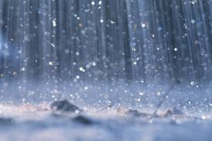

Slide 8
Snow
-Snow occurs when the atmosphere is so cold that instead of the water gas condensing to form water, it goes straight to ice, forming ice crystals.
These ice crystals then attract the water droplets that have not yet frozen.
-Eventually they become so heavy they must fall.
-Snow can be in snow pellet or snowflake form.

Slide 9
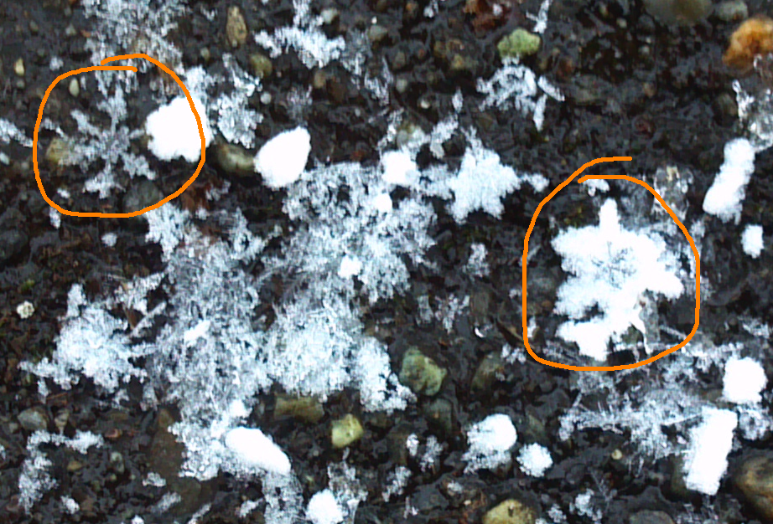

Slide 10
Sleet
-Sleet is really a mixture of snow and rain.
-Unlike normal snow, the snow in sleet goes through the liquid stage before becoming ice.
-This is why it is "sludgy" and not light and fluffy.

Slide 11
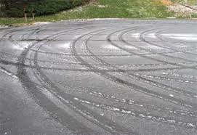

Slide 12
Hailstones
-Hailstones happen when ice crystals form and try to fall.
-If it is windy they get caught by gusts of wind and pushed back up into their cloud, gathering more water and becoming bigger.
-This can happen two or three times before they fall. This is why they are so hard and dense.

Slide 13
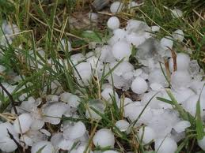

Slide 14
Freezing Rain
-Freezing rain happens when the water droplets become super-chilled.
-They do not freeze in the air and become ice crystals, instead they freeze on impact with something on earth.
-This can also be called "glaze".

