Slide 1
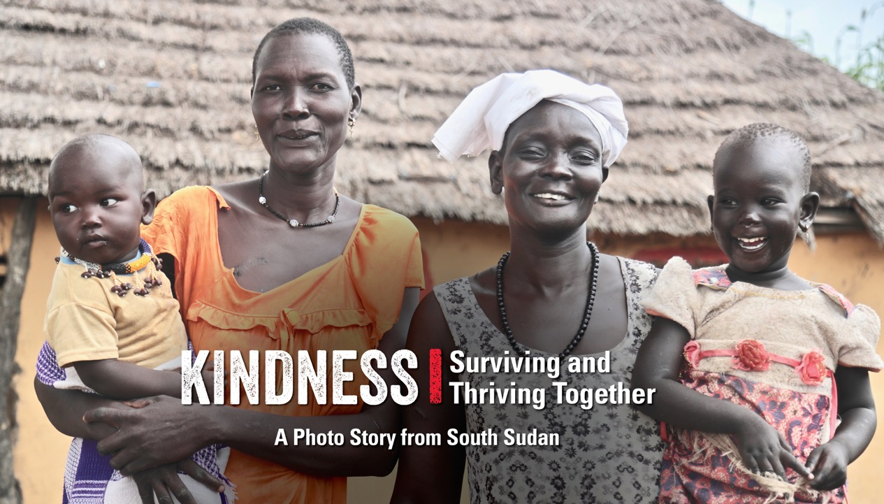
Notes:
Kindness: Surviving and Thriving Together – A Photo Story from South Sudan
This is a story about two mothers who are good neighbours. Their names are Awut and Ajak and they live in a village called Malek in South Sudan. Before starting to learn about them, let’s learn about South Sudan!

Slide 2
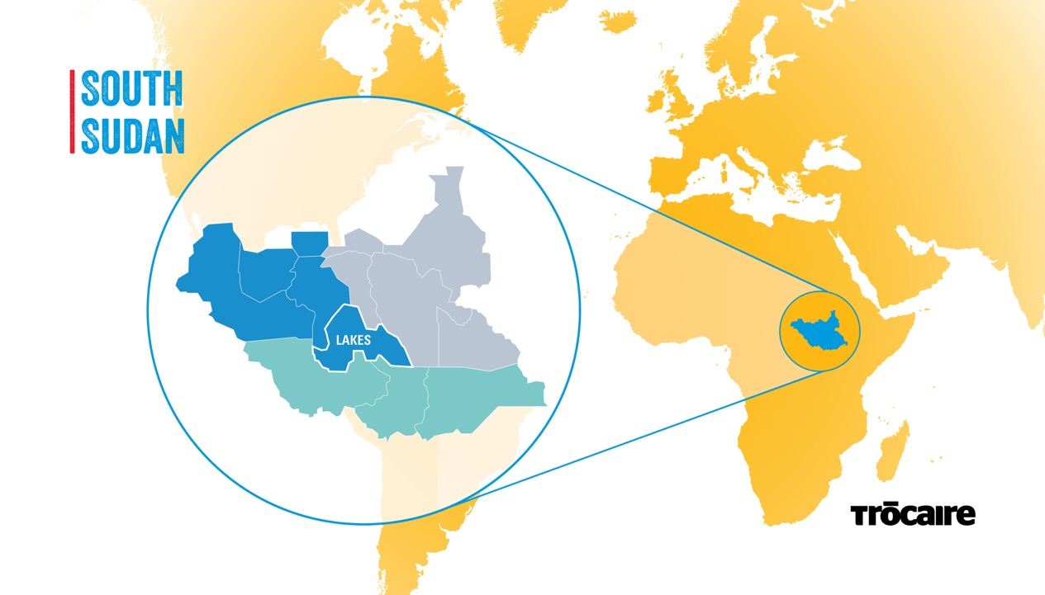
Notes:
This is South Sudan.
South Sudan is a country located in Africa. It is the newest country in the world. It became independent in 2011. Can you research five facts about South Sudan?

Slide 3


Slide 4
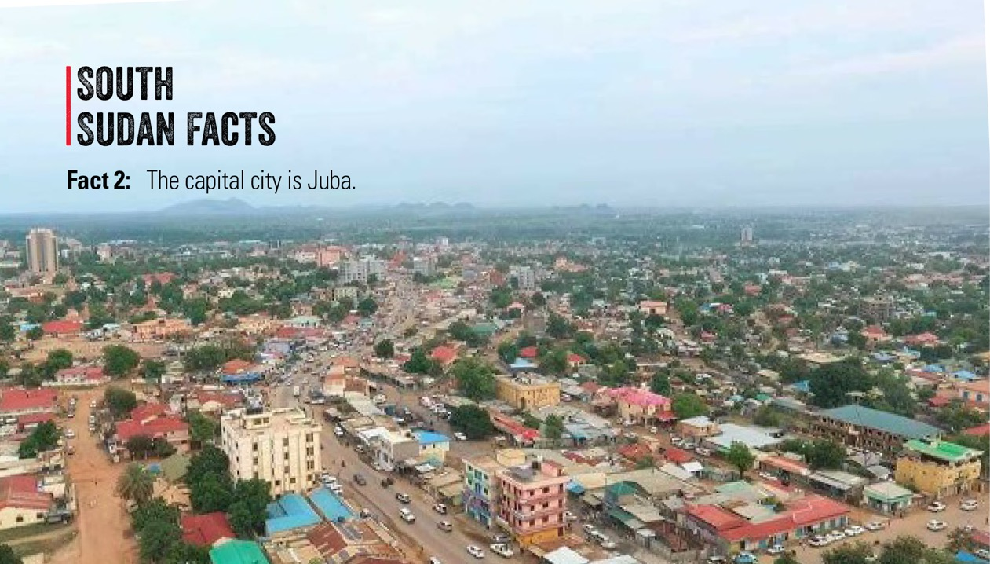

Slide 5


Slide 6
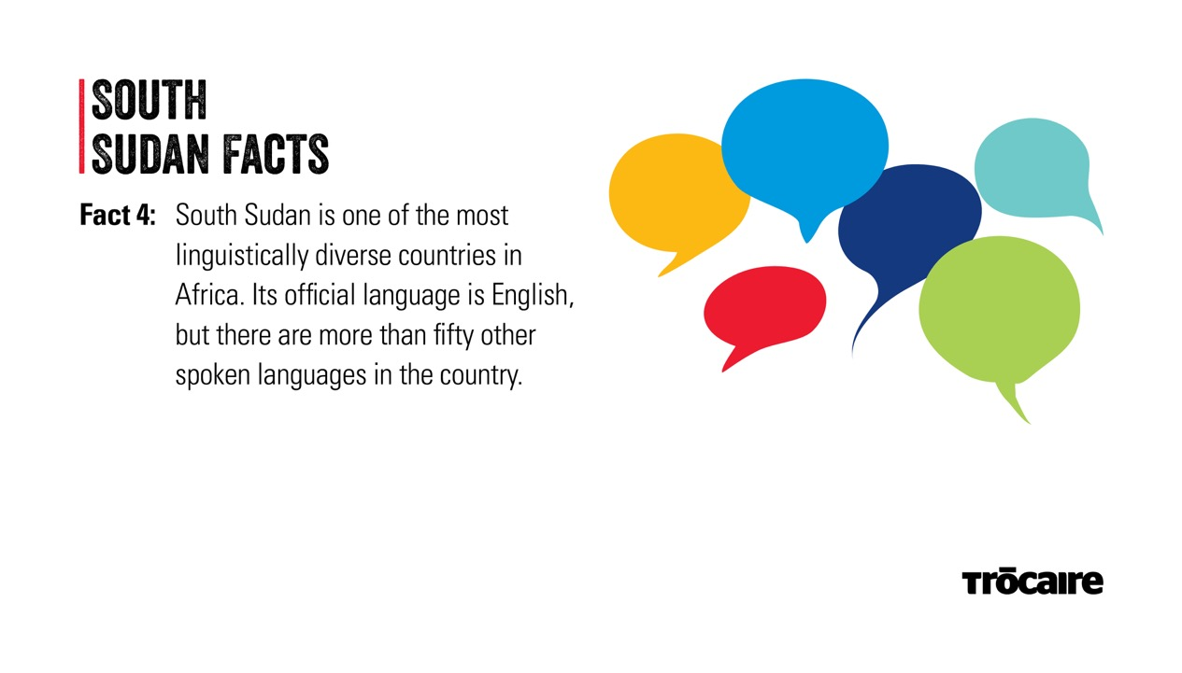

Slide 7
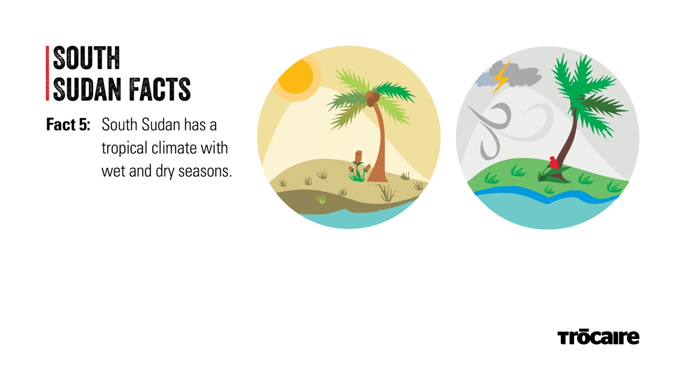

Slide 8
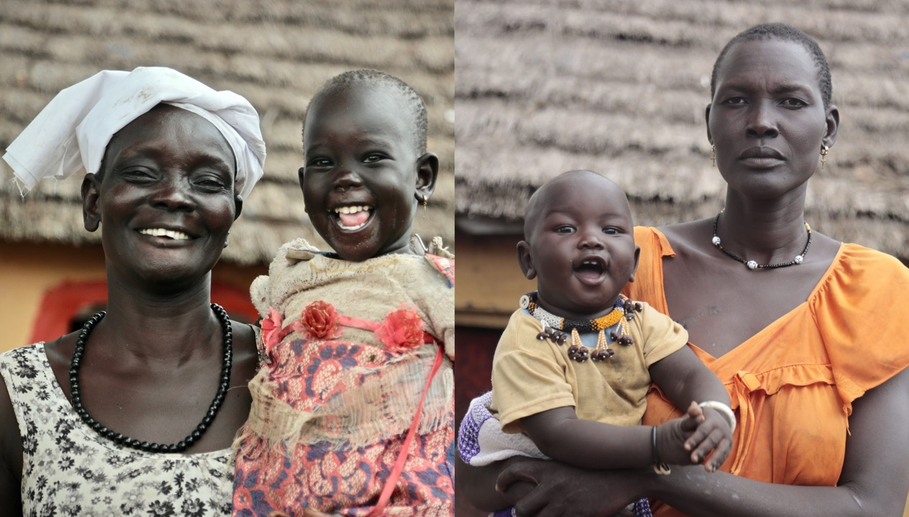
Notes:
Now I am going to introduce you to Awut and Ajak. Let’s learn about them! The picture on the left is Awut with her granddaughter, Nyajima, who is two years old. The picture on the right is Ajak, who is carrying her youngest child, a boy named Ngor. He is eight months old.
Note: It is important to note that this is only one perspective from South Sudan. Avoid reinforcing negative stereotypes as you teach this lesson. Conflict and poverty are a reality for the families featured, but not everyone in, or from, South Sudan has had this experience.

Slide 9
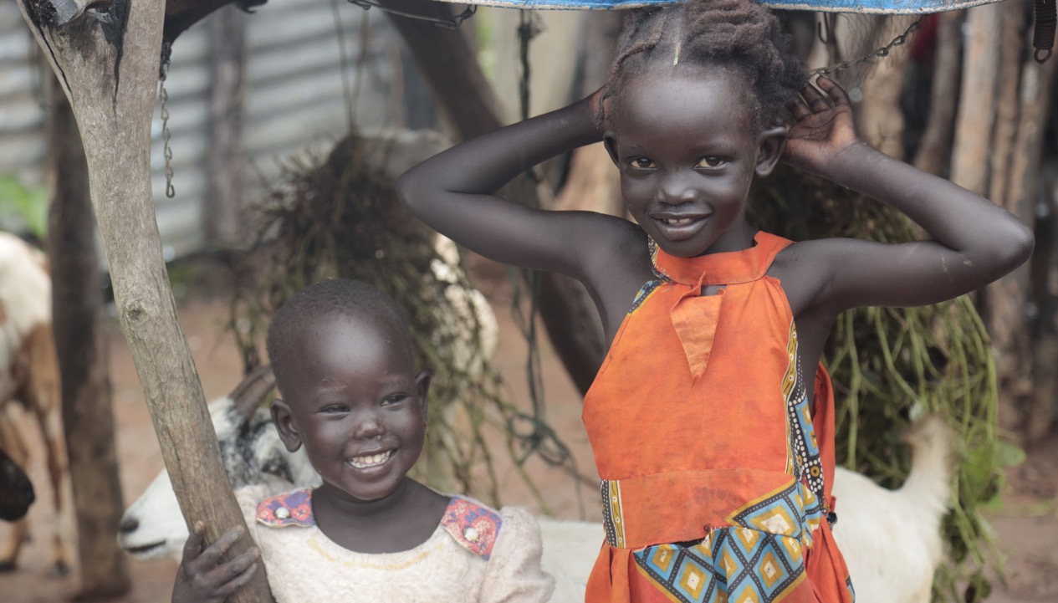
Notes:
Nyibak and Nyajima are Awut’s grandchildren. Nyibak is five years old. She likes to care for her younger cousin Nyajima, who is two. Look carefully at this photo of Nyajima and Nyibak. Do you see any animals? Do you have animals at home?

Slide 10
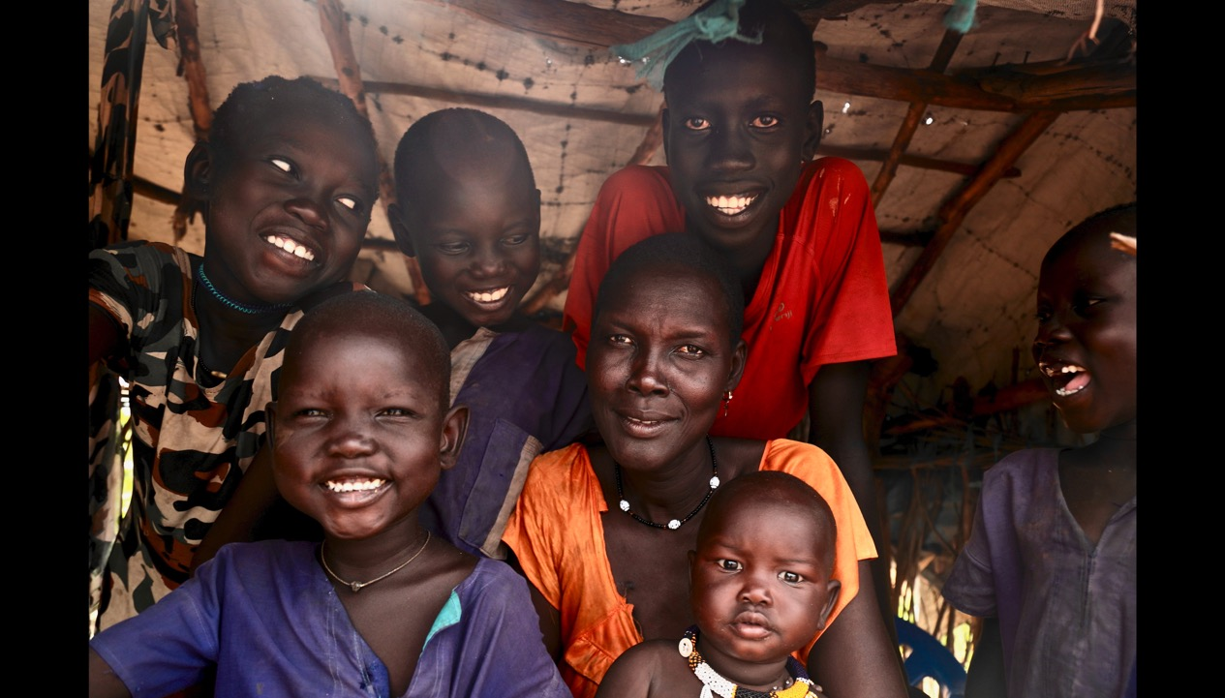
Notes:
Here you can see Ajak (34) with her children, Baby Ngor (8 months) on her lap, then clockwise from Ngor’s right, Majak (4), Yonjima (11), Pawany (7), Malong (14) and Chiech (6).
Ajak is originally from the Lakes State, but she moved around South Sudan with her husband because of his work. Like Awut, her village became unsafe and she and her family had to leave. Ajak arrived in Malek with her eight children and husband who was very ill. She had no place to live and was worried about how she could take care of her family. When Awut met Ajak she knew that this was her opportunity to help her.
Ajak said, ‘Awut welcomed and settled us next to her. She gave me food to start up and settle in. I had nothing. So she tried to help me and my family. I am thankful to her.’
Now Ajak and her children have their own house, next door to Awut’s house.
Awut believes that education is very important and she would like to send her children to school but unfortunately she can’t. ‘I don’t have the power to do that,’ she explains. The little that she has is used for food, medicine and clothing. It is not enough to pay for school fees, shoes, uniforms and other school requirements. Do you think this is fair? How did you feel when school closed in March for lockdown?

Slide 11
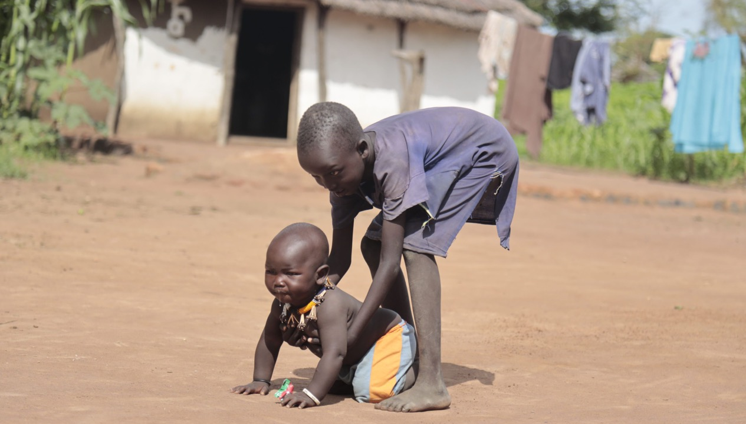
Notes:
Ajak is proud of her children because they listen to others and help when they can. In this photo, you can see Chiech (6) helping his baby brother Ngor (8 months), who has been trying to walk.

Slide 12
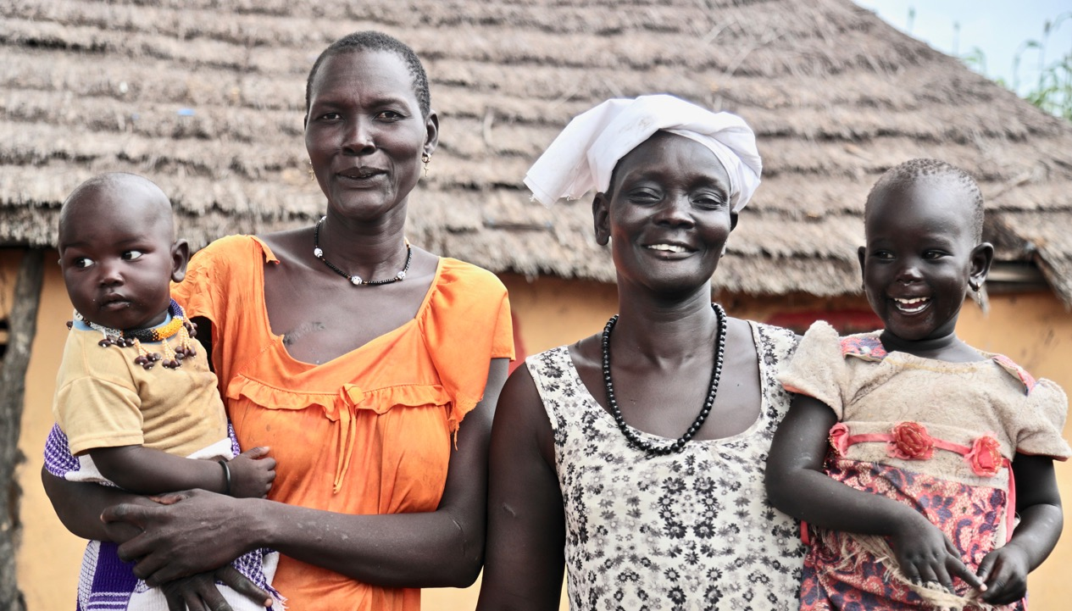
Notes:
Ajak and Awut and their families are very good friends now. When Awut cooks a meal, she invites Ajak and her children to join them. She looks after Ajak’s children while Ajak goes to catch fish for the families to share.
Ajak said, ‘We sit together and discuss ways of life. We share a lot. When she is down, I lift her up and vice versa. She is a very dear friend. We help each other in times of need.’

Slide 13
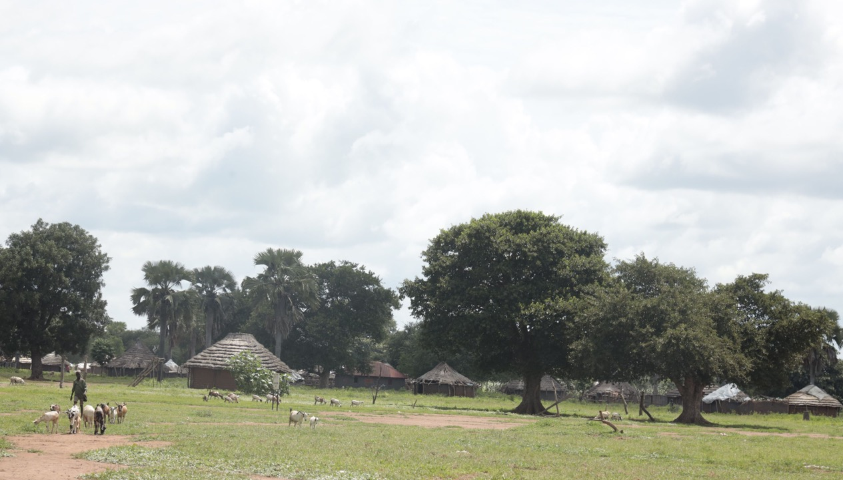
Notes:
This is Malek, the community where Awut and Ajak live. What do you see? In what ways is Malek the same as or different from where you live?

Slide 14
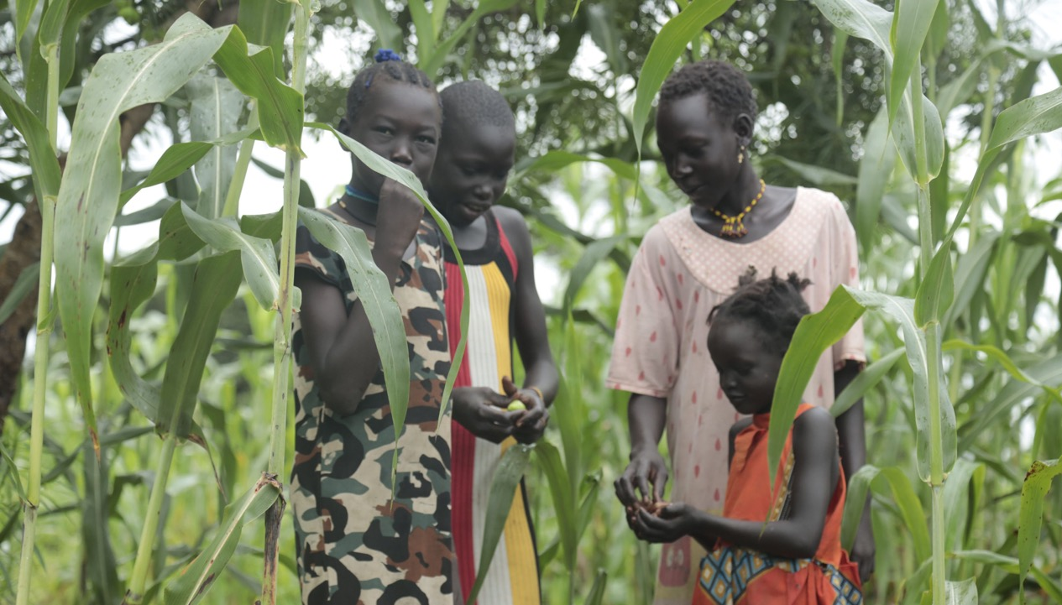
Notes:
Here some of the girls from both families have gone out to the fields where Awut and Ajak are growing sorghum. The girls are looking for some small fruits that have dropped from the trees hanging over the crop. The bigger girls, including Ajak’s daughter Yomjima, are sharing with Nyibak, who is Awut’s granddaughter. Have you picked fruit, nuts or berries? Who did you share them with?

Slide 15
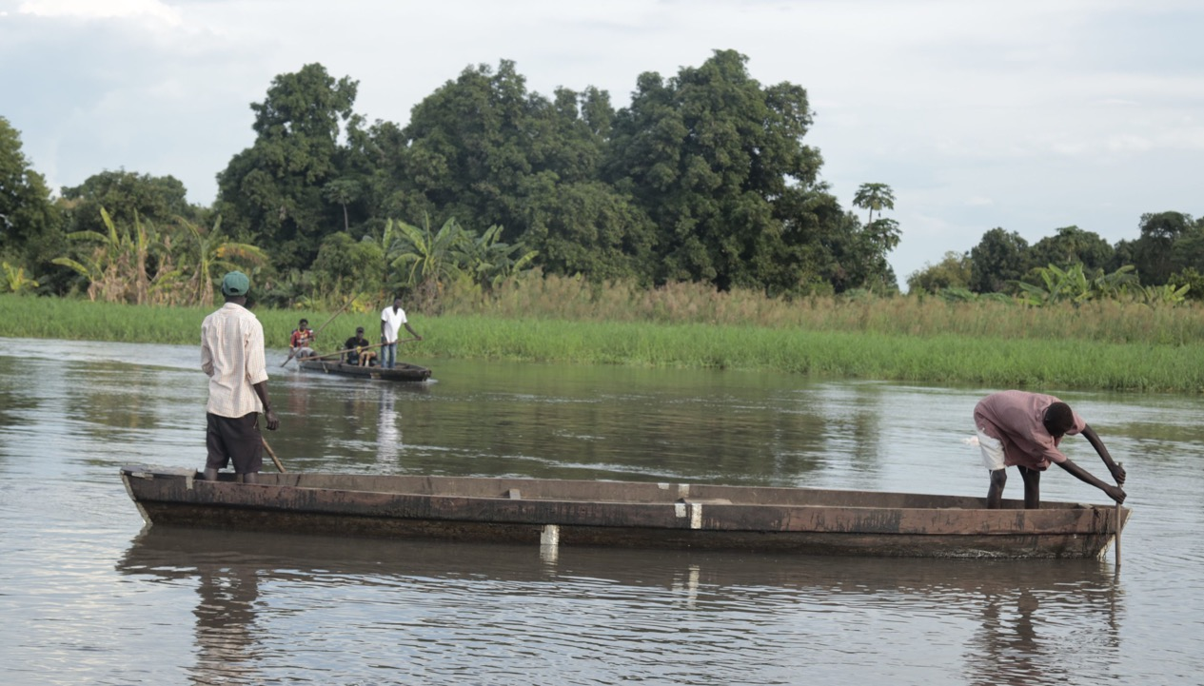
Notes:
Here are some people from Malek going out fishing. When someone from Awut or Ajak’s family catches a lot of fish, they share with their neighbours.
Read the quote: ‘Give a man a fish and you feed him for a day; teach a man to fish and you feed him for a lifetime.’ What does it mean?
Trócaire has provided seeds and tools to help the people of Malek. Discuss: In your opinion what it’s more important, to provide food for people or to provide seeds and tools so they can grow their own food?

Slide 16
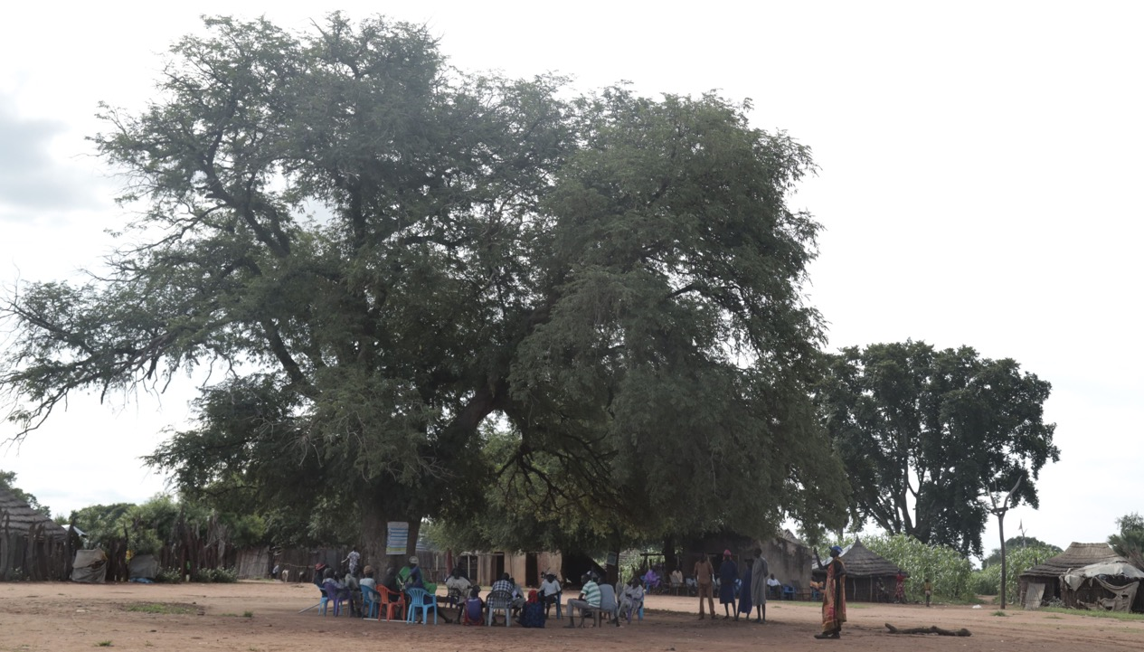
Notes:
This big tree is an important part of Awut and Ajak’s community. When the community wants to get together to talk and make decisions, they gather underneath the tree. Everyone comes so that the decisions are made together.
Do you think Covid-19 has impacted these gatherings? If so, how?
What are some important places in your community? Who are the people that work there?

Slide 17
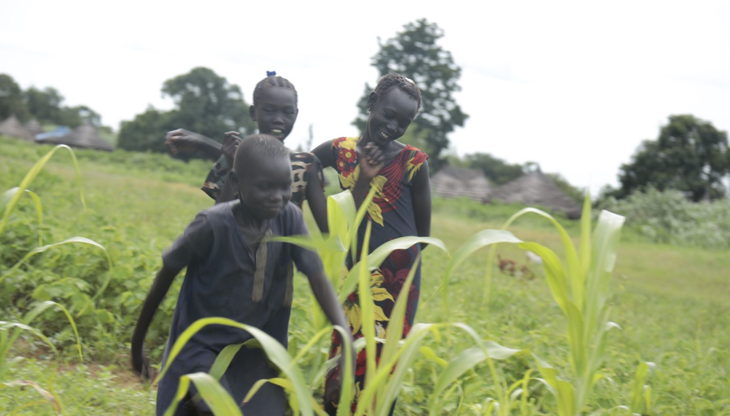
Notes:
Here Pawany, his older sister Yomjima and a neighbour have been out working in the field. Now they are walking home and enjoying a chat.

