Slide 1
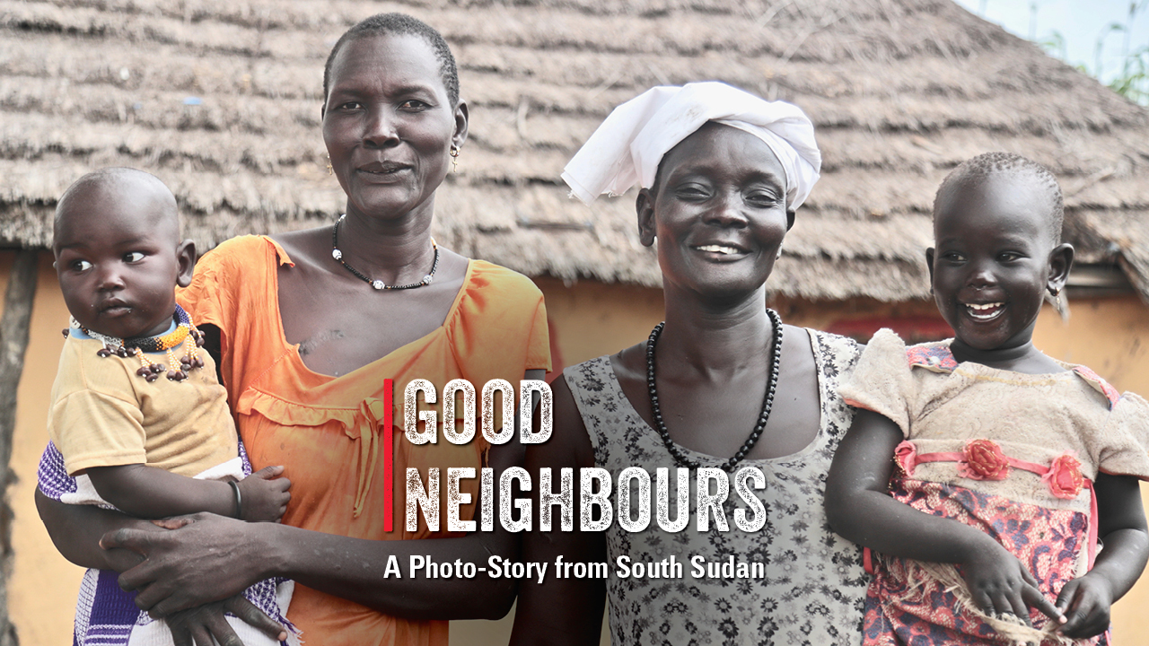
Notes:
Ajak (34) with her son Ngor (8 months); Awut (48) and her granddaughter Nyajima (2), Malek, Lakes State, South Sudan.
Photo credit: Achuoth Deng, CAFOD/Trócaire

Slide 2


Slide 3
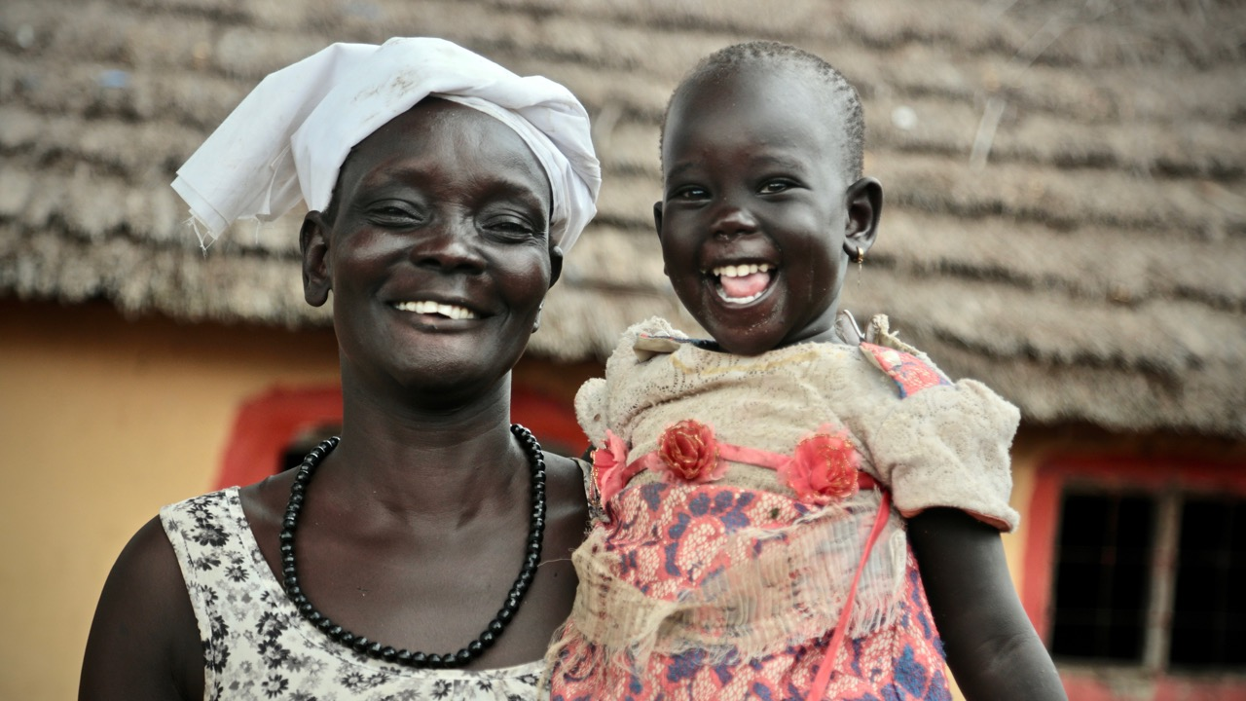
Notes:
Awut (48) and her granddaughter Nyajima (2), Malek, Lakes State, South Sudan.
Photo credit: Achuoth Deng, CAFOD/Trócaire

Slide 4
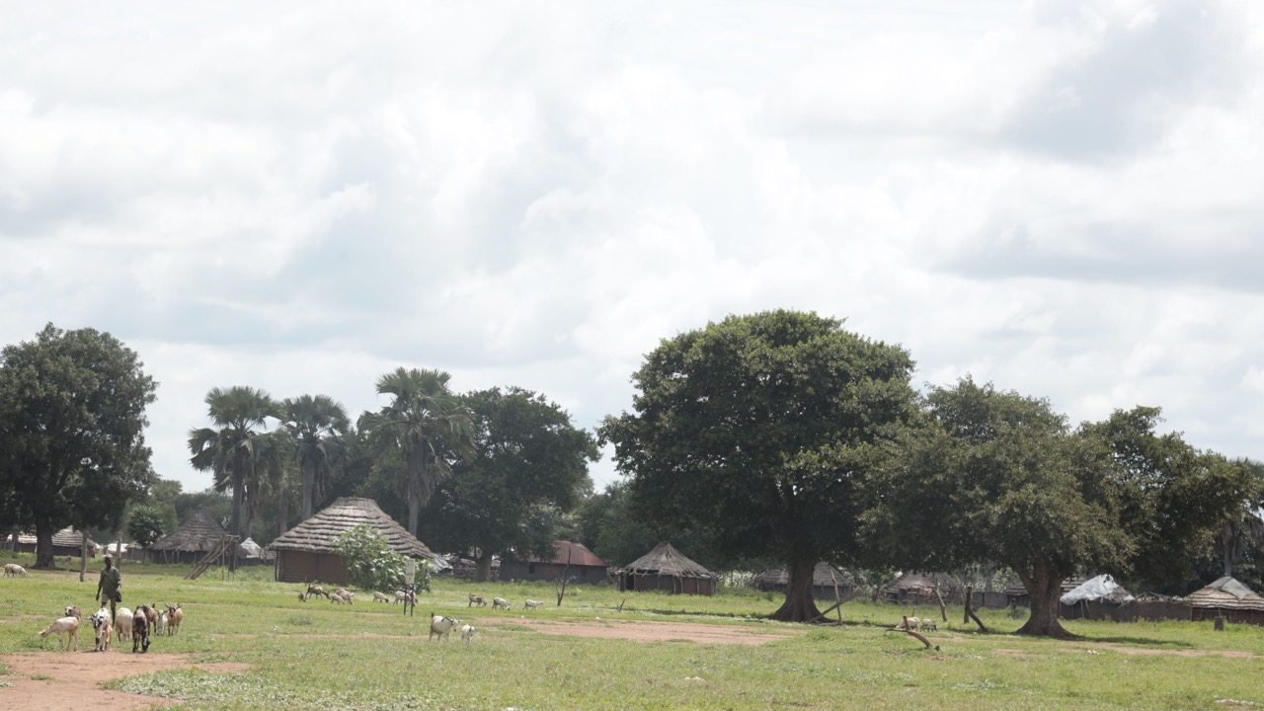
Notes:
Village Scene, Malek, Lakes State, South Sudan.
Photo credit: Achuoth Deng, CAFOD/Trócaire

Slide 5
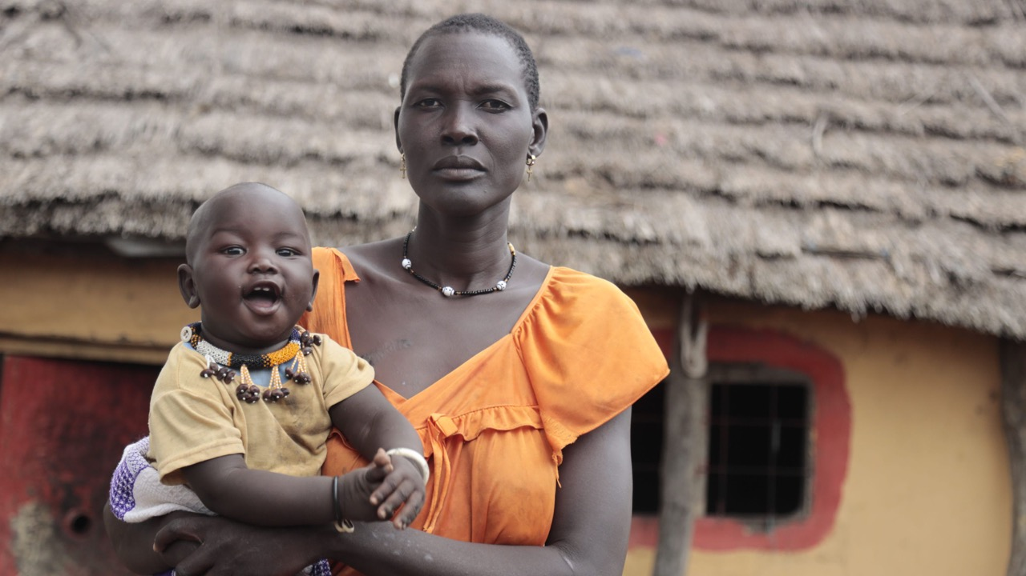
Notes:
Ajak (34) with her son Ngor (8 months), Malek, Lakes State, South Sudan.
Photo credit: Achuoth Deng, CAFOD/Trócaire

Slide 6
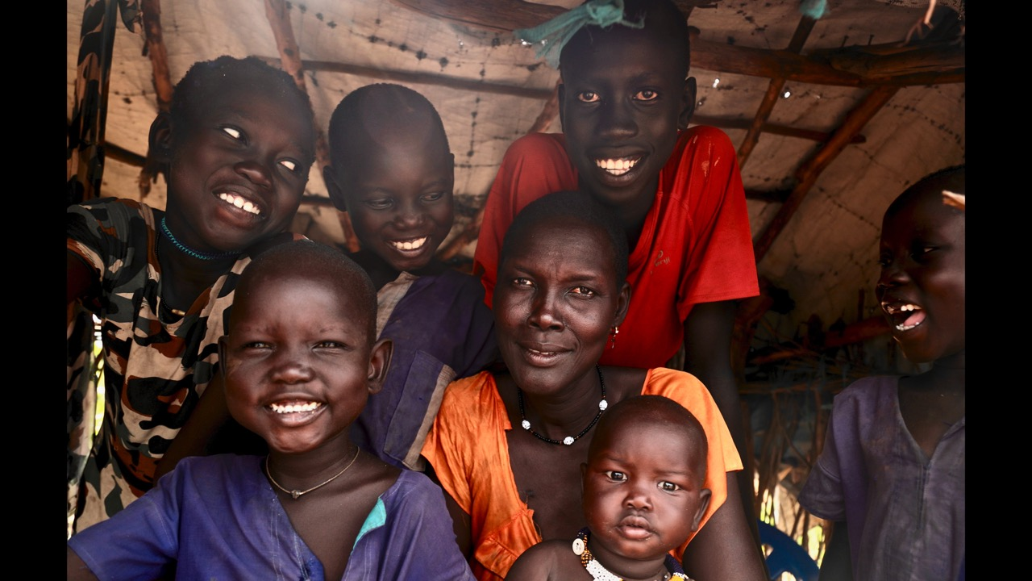
Notes:
Ajak (34) with her children, Baby Ngor (8 months) on her lap, then clockwise from Ngor's right, Majak (4), Yonjima (11), Pawany (7), Malong (14) and Chiech (6), Malek, Lakes State, South Sudan.
Photo credit: Achuoth Deng, CAFOD/Trócaire

Slide 7
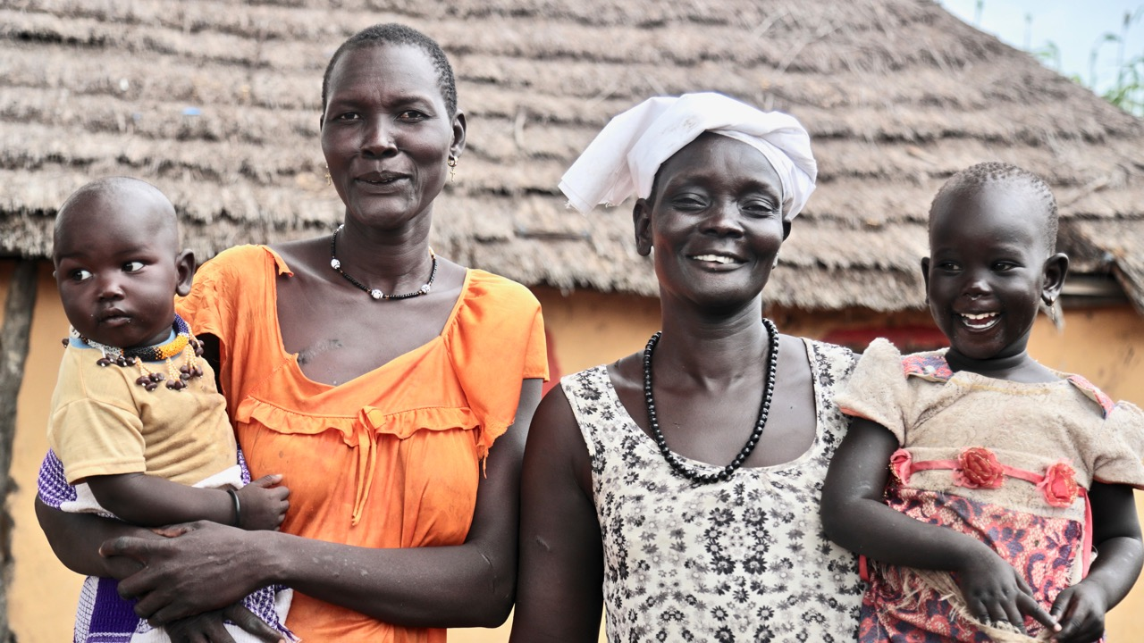
Notes:
Ajak (34) with her son Ngor (8 months), neighbour Awut (48) and her granddaughter Nyajima (2), Malek, Lakes State, South Sudan.
Photo credit: Achuoth Deng, CAFOD/Trócaire

Slide 8
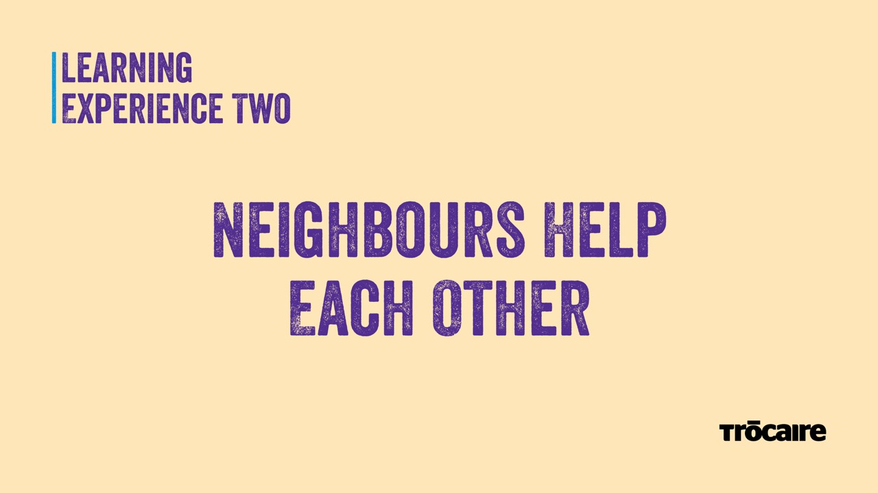

Slide 9
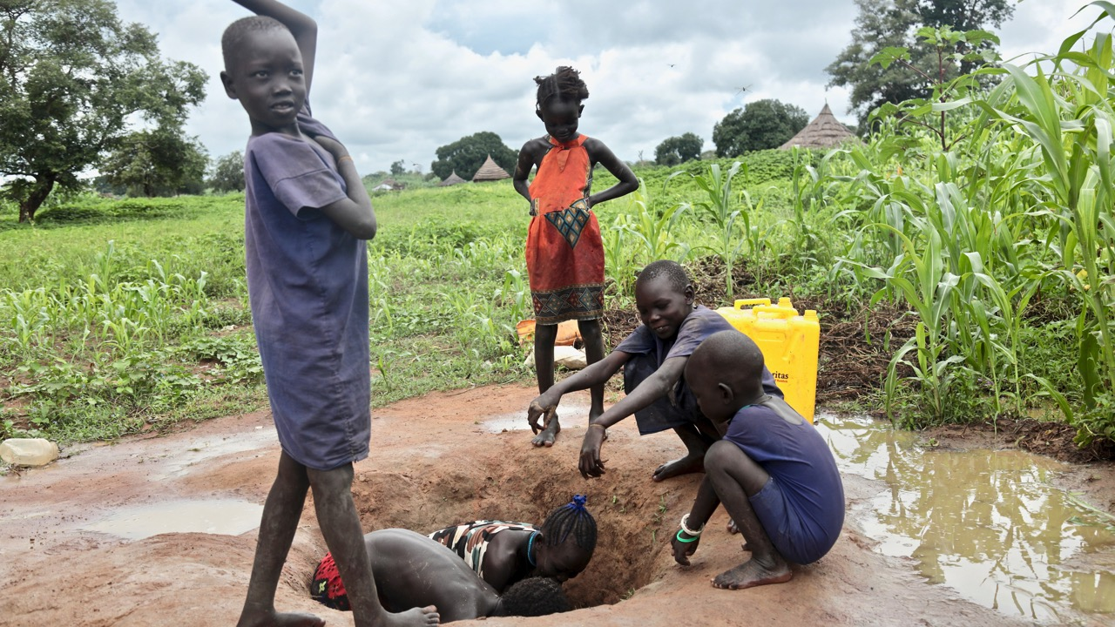
Notes:
Brothers Chiech (6), Pawany (7) and Majak (4), with their sister Yomjima (11), and neighbour Nyibak (5) collecting water, Malek, Lakes State, South Sudan.
Photo credit: Achuoth Deng, CAFOD/Trócaire

Slide 10
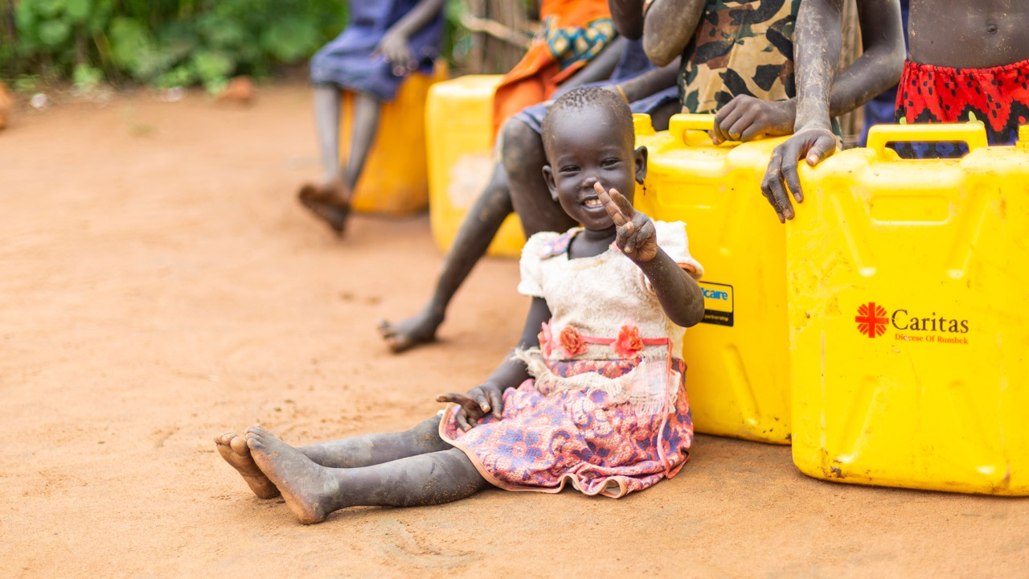
Notes:
Nyajima (2) and neighbours with water containers, Malek, Lakes State, South Sudan.
Photo credit: Achuoth Deng, CAFOD/Trócaire

Slide 11
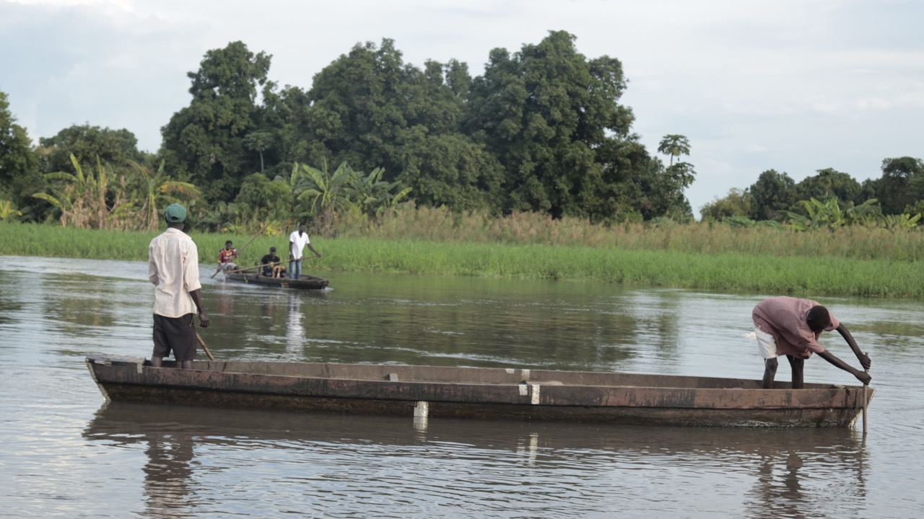
Notes:
On the River, Malek, Lakes State, South Sudan.
Photo credit: Achuoth Deng, CAFOD/Trócaire

Slide 12
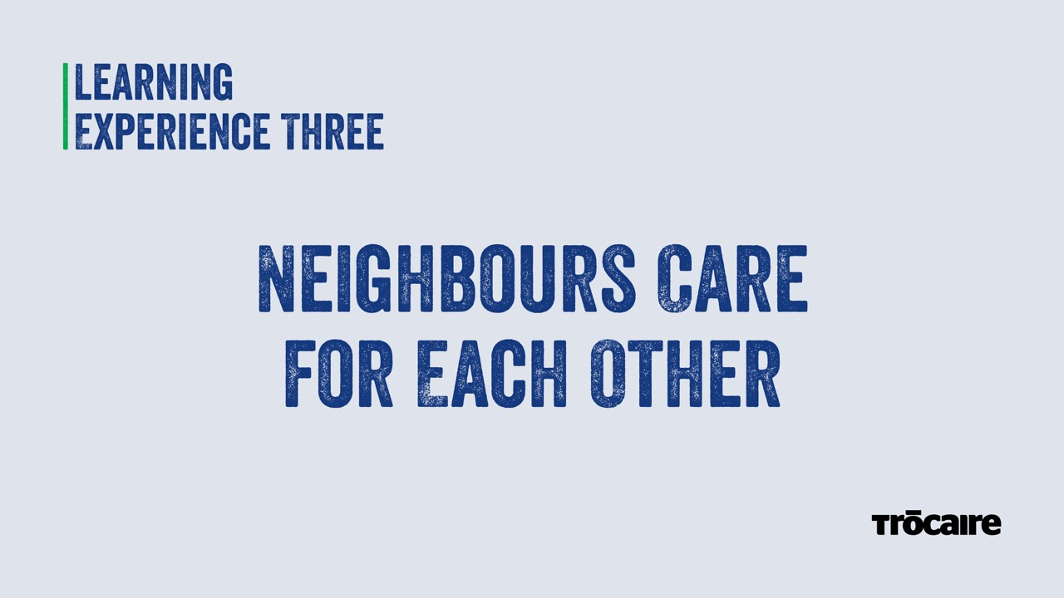

Slide 13
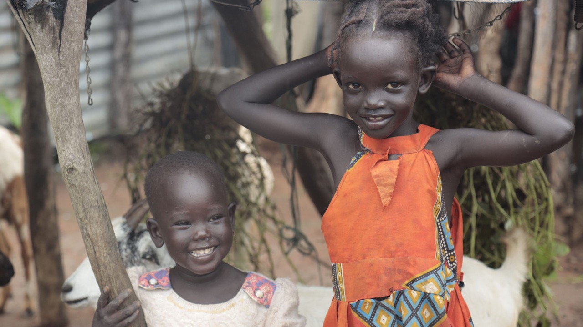
Notes:
Nyajima (2) and her cousin Nyibak (5), Malek, Lakes State, South Sudan.
Photo credit: Achuoth Deng, CAFOD/Trócaire

Slide 14
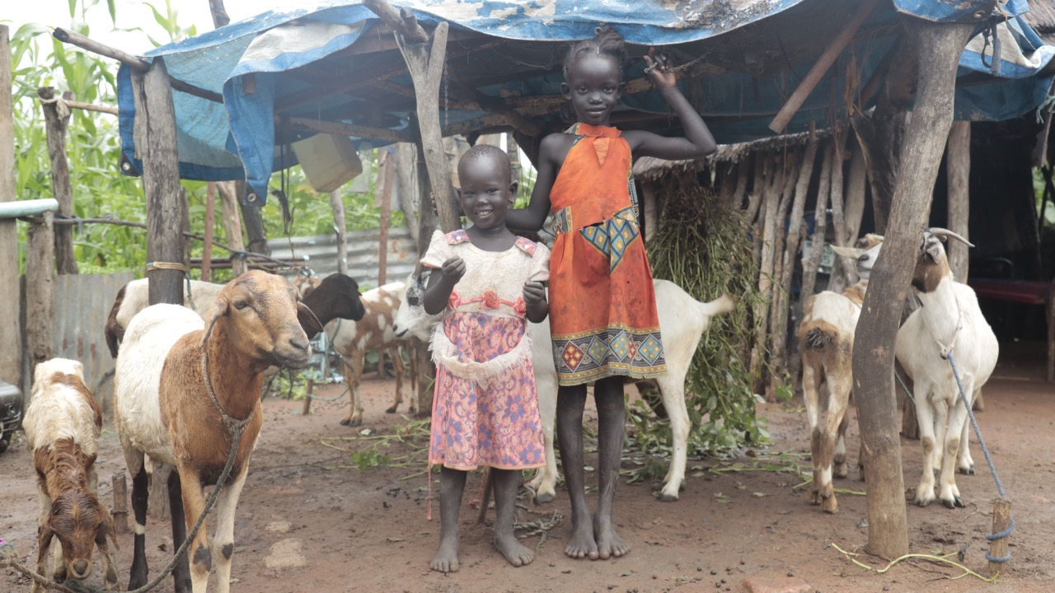
Notes:
Nyajima (2) and her cousin Nyibak (5) with goats, Malek, Lakes State, South Sudan.
Photo credit: Achuoth Deng, CAFOD/Trócaire

Slide 15


Slide 16
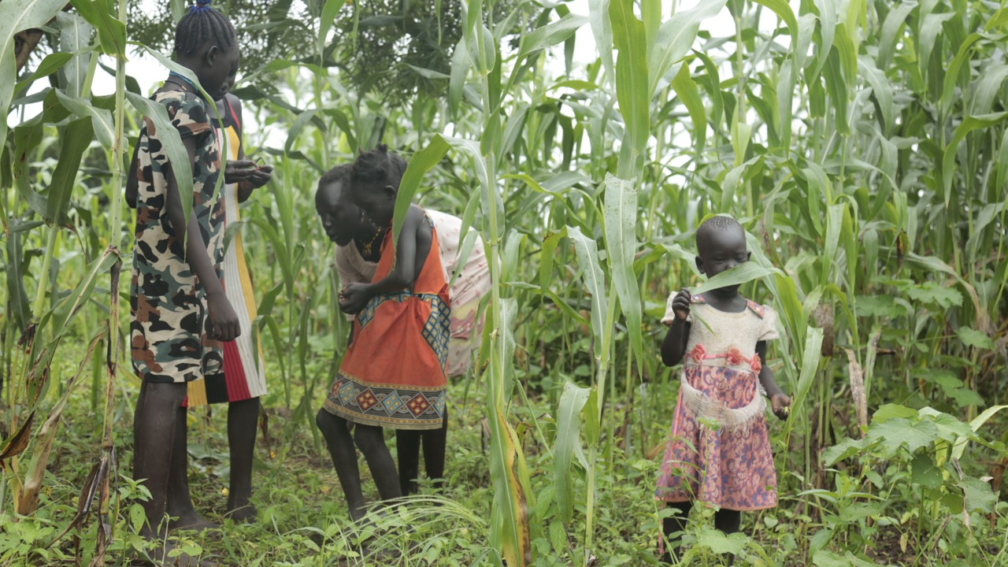
Notes:
Yomjima (11), Nyibak (5) and Nyajima (2) with neighbours in sorghum field, Malek, Lakes State, South Sudan.
Photo credit: Achuoth Deng, CAFOD/Trócaire

Slide 17
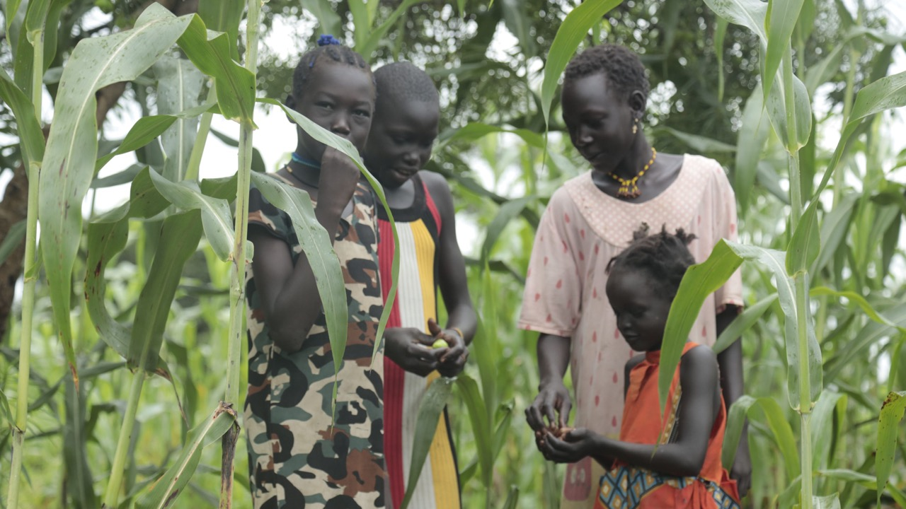
Notes:
Yomjima (11) and Nyibak (5) with neighbours in sorghum field, Malek, Lakes State, South Sudan.
Photo credit: Achuoth Deng, CAFOD/Trócaire

Slide 18


Slide 19
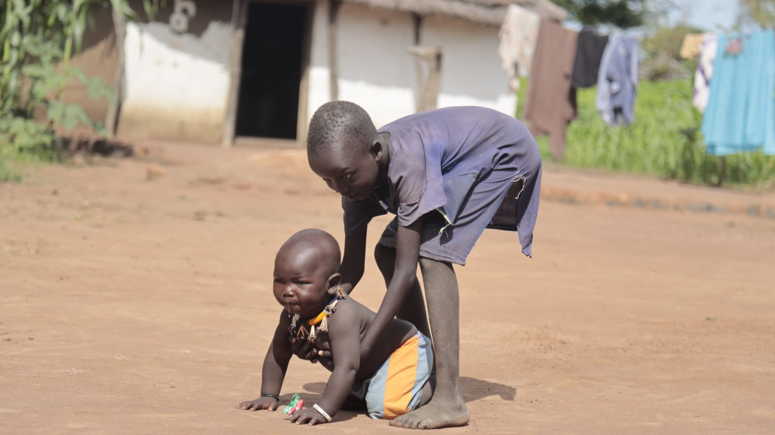
Notes:
Chiech (6) helping his brother Ngor (8 months), Malek, Lakes State, South Sudan.
Photo credit: Achuoth Deng, CAFOD/Trócaire

Slide 20
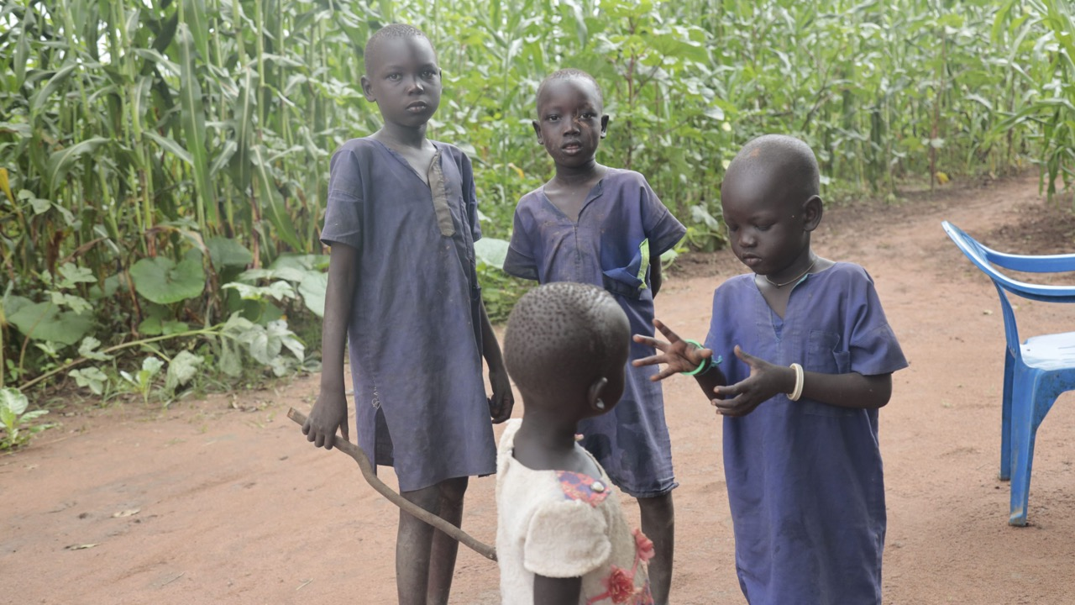
Notes:
Brothers Pawany (7), Chiech (6) and Majak (4), talking to their neighbour Nyajima (2), sorghum field, Malek, Lakes State, South Sudan.
Photo credit: Achuoth Deng, CAFOD/Trócaire

Slide 21
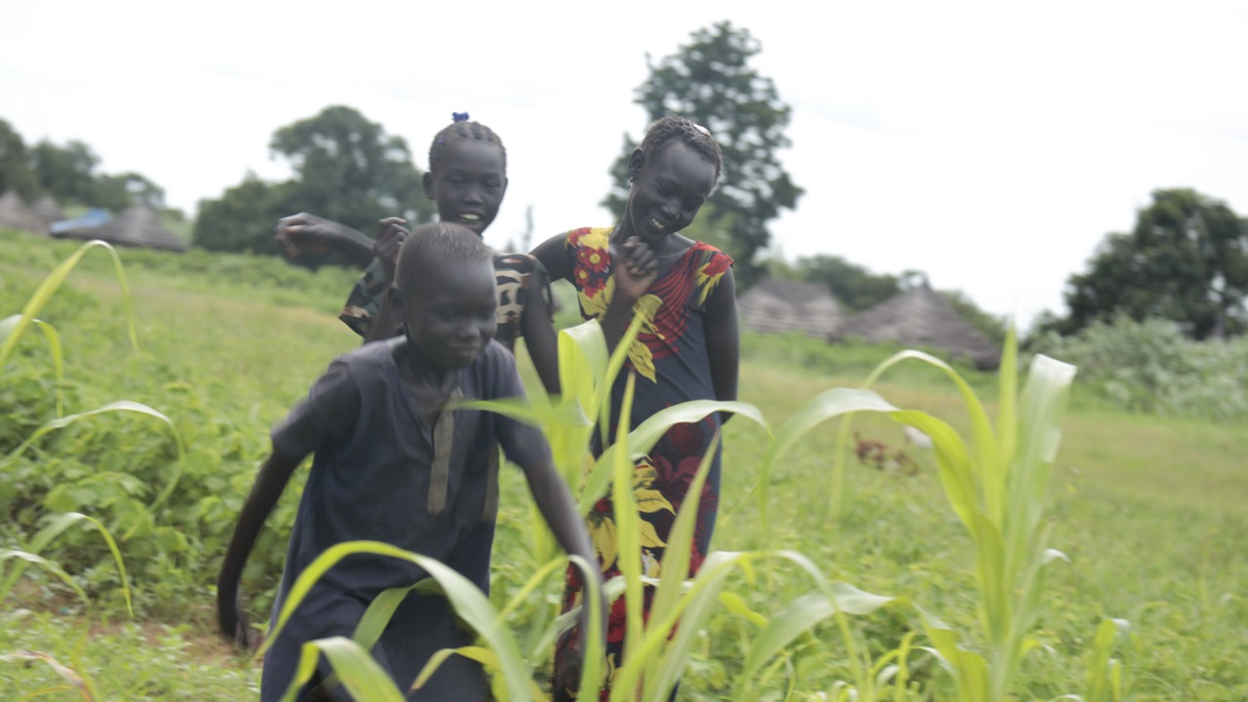
Notes:
Pawany (7), his sister Yomjima (11) and a neighbour, Malek, Lakes State, South Sudan.
Photo credit: Achuoth Deng, CAFOD/Trócaire

Slide 22
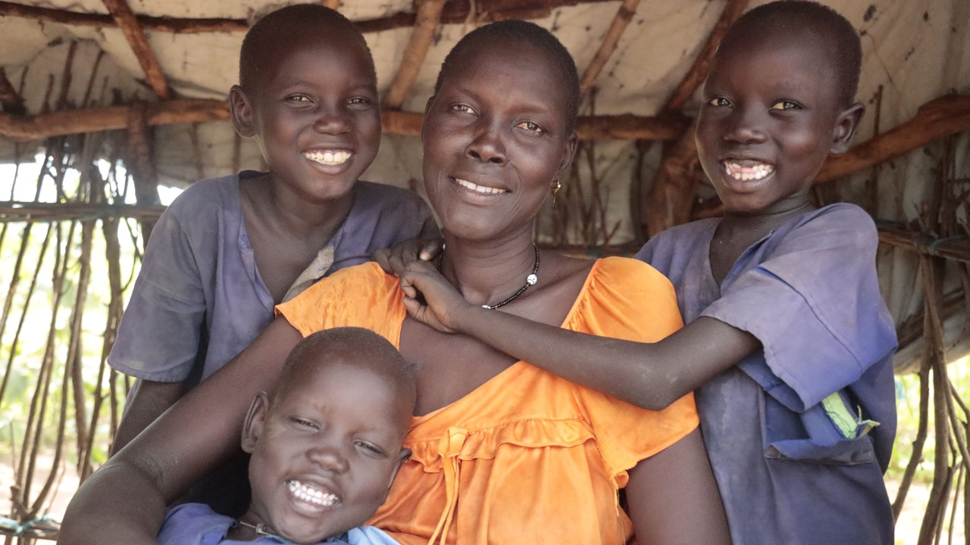
Notes:
Ajak (34) with her sons Majak (4), Chiech (6) and Pawany (7), Malek, Lakes State, South Sudan.
Photo credit: Achuoth Deng, CAFOD/Trócaire

Slide 23



Slide 24


Slide 25
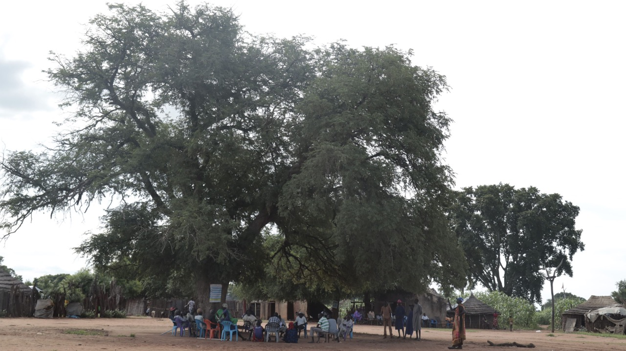
Notes:
Village meeting, Malek, Lakes State, South Sudan.
Photo credit: Achuoth Deng, CAFOD/Trócaire

Slide 26
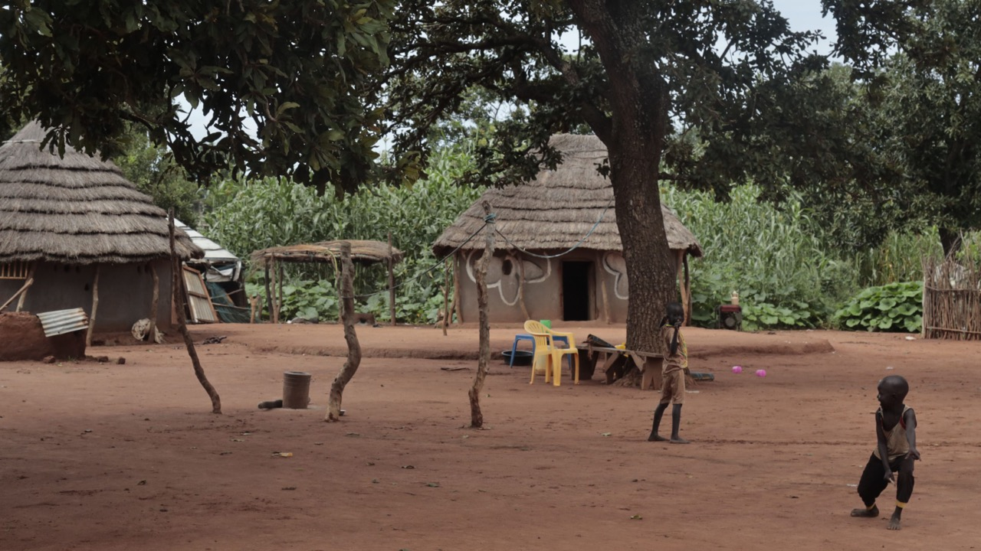
Notes:
Village scene, Malek, Lakes State, South Sudan.
Photo credit: Achuoth Deng, CAFOD/Trócaire

Slide 27
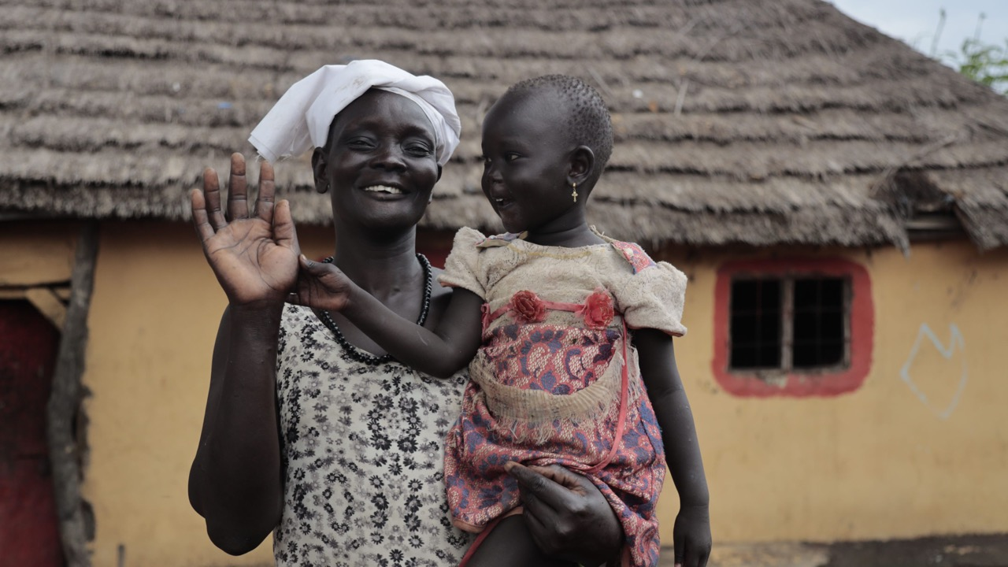
Notes:
Awut (48) with her granddaughter Nyajima (2), Malek, Lakes State, South Sudan.
Photo credit: Achuoth Deng, CAFOD/Trócaire

