Slide 1
Procedural Writing: Chocolate Easter Nests

Slide 2
Procedural Writing
Procedural writing provides the reader with instructions or directions for doing something.
Examples of procedural writing include:
recipes
experiments
directions to locations
how to (how to build a snowman)
give rules for board games, sports, home, school etc.

Slide 3
Procedural Writing should...
Clearly state a goal or objective.
Provide an overview or a list of materials or resources needed.
Address safety procedures that need to be followed.
Include all the steps for the procedure.
State instructions in a step by step pattern leaving nothing out. Use words like, first, next, then, finally…

Slide 4
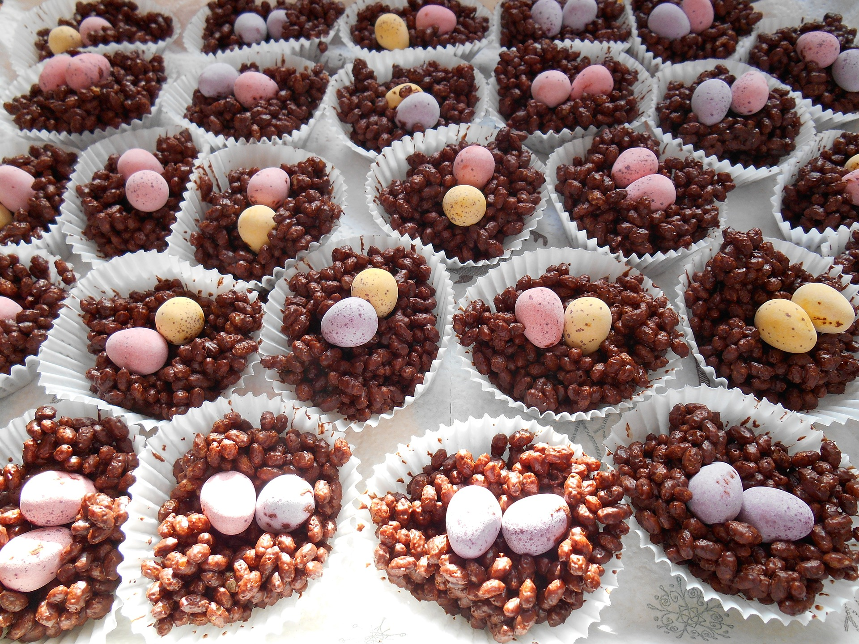
Chocolate Easter Nests Recipe

Slide 5
1
2
Ingredients
1
Utensils
Cooking chocolate
Cereal
Chocolate Eggs
Spoon
Bowl
Bun Cases

Slide 6
Method
Break the chocolate into pieces and put it in the bowl.
Melt the chocolate in the microwave.
Pour the cereal into the chocolate.
Mix until the cereal is totally covered.
Spoon the mixture into bun cases and put chocolate eggs on top.
Chill in the fridge for an hour.
Eat and enjoy!

Slide 7
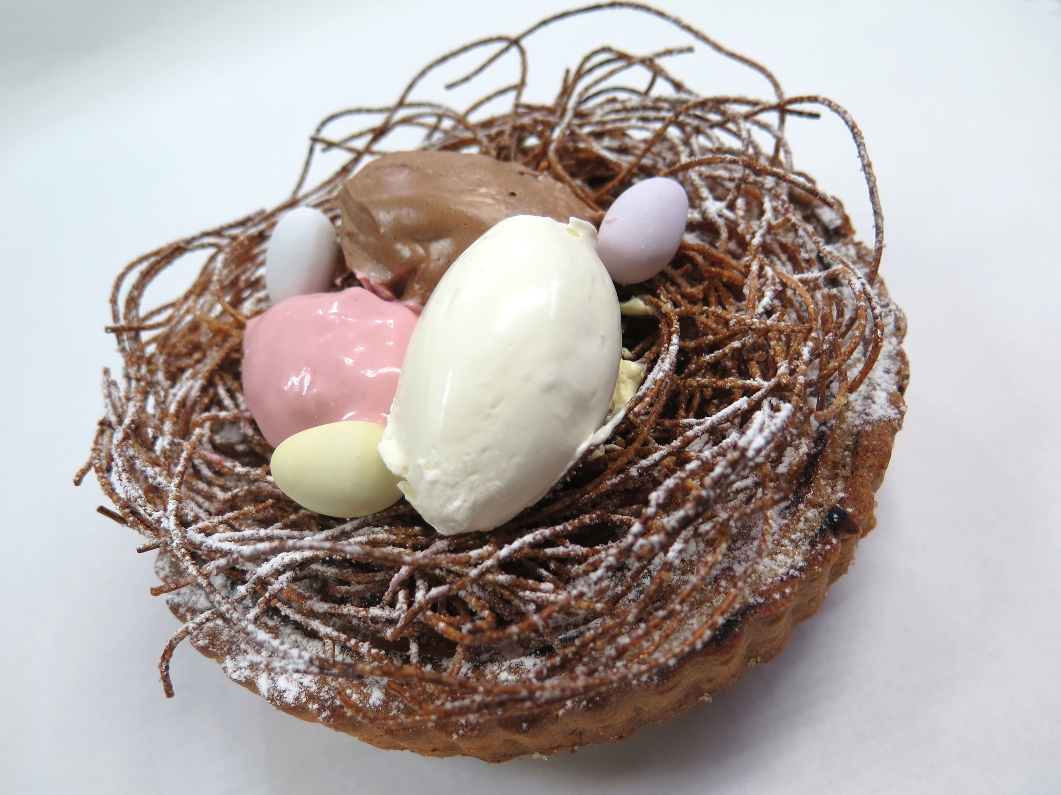
What else could you add to your recipe to make it even better?
Smarties?
Fluffy toy chicks?
Make your own!

