Slide 1
The Anglo-Irish Treaty
Lesson 1
What I need to know and understand:
The course and outcome of the negotiations that led to the Treaty.
Controversies arising from the negotiations and outcome.
Skills I will develop:
1. Analysing and extracting information from primary and secondary sources.
2. Constructing historical paragraphs.
Key Concepts I must learn and understand:
External Association
Envoy Plenipotentiaries
The Government of Ireland Act; 1920
Articles of Agreement
Ms. Brady

Slide 2
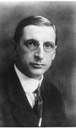
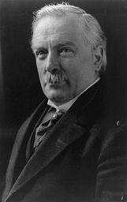
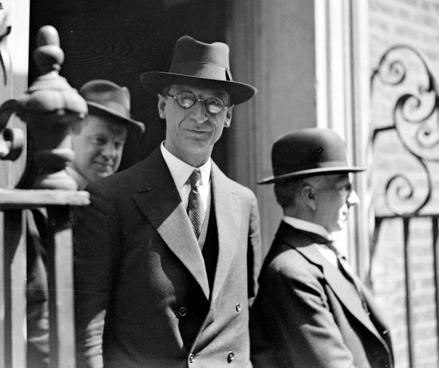
Background
Between July & October 1921, DeValera & Lloyd George met in London and corresponded with each other in an attempt to resolve key issues between British Government & Sinn Féin.
These talks produced no agreement.

Slide 3
Negotiations, London (October – December 1921)
The Irish Delegation – those that went to negotiate.
Arthur Griffith, Michael Collins, Robert Barton, George Gavin Duffy, Eamon Duggan , Erskine Childers.
Controversy 1:
Controversary 2:
Confusion over position of Plenipotentiaries
De Valera remains in Dublin.
‘Envoys‘ are people who represent their government on diplomatic missions abroad.
‘Plenipotentiary‘ means having full power‘ i.e. plenipotentiaries have full power to negotiate settlements without referring back to their superiors. (PDST, 2012)
WHY?
De Valera claimed he must remain at home to diffuse any ongoing hostilities
&
by having the Irish delegation revert back to him would create a time-lapse which would help control direction of negotiations.
However, De Valera qualified the delegation as envoy plenipotentiaries BUT instructed them to refer back to Dublin regarding ‘a main question’ or ‘complete text of the draft treaty about to be signed’
This caused confusion and controversary during the negotiations as it disempowered the Irish delegation and became unacceptable to the British delegation.
Other reasons and considerations:
Q. 1 - Worksheet
Critical Thinking: Can you think of any other disadvantages of the Irish Delegation – discuss with a classmate and make a list.
Notes:
Passionate but inexperienced
Removed from support of Dáil Éireann & Dáil Cabinet (London)
Made up of moderates & extremists
Confusion over power of plenipotentiaries
3

Slide 4

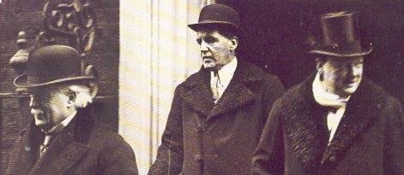
Negotiations, London (October – December 1921)
Lesson 2
Controversary 3
Dominion status: The term is used to describe the degree of self-government given to former colonies of the British Empire beginning with Canada in 1867. (PDST 2012)
‘External Association’
De Valera’s key concept -an independent, united Ireland, ‘externally associated’ to the Britain Empire.
British Delegation
Lloyd George, Winston Churchill, Lord Birkenhead , Austen Chamberlain
This external association was conceived as an attempt to pacify Unionists’ fears of an Catholic-dominated, independent Ireland and in some way, to pacify British ‘imperialists’ who feared of a ‘domino effect’ on their other colonies within the Empire.
De Valera instructed that the Irish Delegation propose this concept as ‘Draft Treaty A’
Highly experienced (Involved in Paris Peace Settlement, 1919)
Diplomatic craft of P.M. Lloyd George – The ‘Welsh Wizard’
Situated in London, psychological advantage
Government of Ireland Act (1920) already in place with Northern Ireland state already founded
Griffith & Collins struggled with promoting ‘External Association’ concept. It was an unacceptable proposal for the British Delegation who was insisting on ‘Dominion Status’.
Worksheet
Q. 2

Slide 5
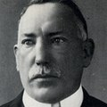
Negotiations, London (October – December 1921)
The Government of Ireland Act, 1920
Controversary 4:
Partition and the Boundary Commission
The Government of Ireland Act decided between the British Gov. and Unionists came into force on May 3rd, 1921, as the Anglo-Irish War continued. It partitioned Ireland and created a 6 county Northern Irish state.
How would the Sinn Féin delegation overcome the already-established Northern Ireland State?
When partition was discussed during the negotiations; it was proposed by the British that a ‘Boundary Commission’ would be set up at a later date to look at the border between a future Irish State (26 counties) & Northern Ireland (established by Govt. of Ireland Act 1920) in return for Sinn Féin’s acceptance of a partitioned Ireland.
To pacify Unionists the British included the clause – Northern Ireland could ‘opt out’ of the Irish Free State – they did so 2 days after the treaty was signed.
The Boundary Commission was accepted by Dail Eireann.
James Craig – Unionist Representative
Controversary 5:
The Oath of Allegiance (Most Contentious issue for hardline republicans during the subsequent Dail Debates on the Treaty.

Slide 6
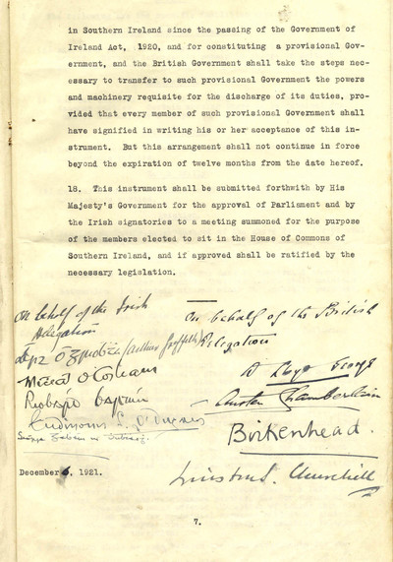
Articles of Agreement
Lesson 3
5th December - Lloyd George threatened war if he did not get a definitive acceptance to the Draft Treaty, the Irish delegation reluctantly signed the treaty at 2:10 am 6th Dec. 1921
Articles 1 & 2: Irish Free State recognised as a dominion of the British Commonwealth.
Articles 3 & 4: The King of England would be represented in Ireland by a Governor-General and that all TDs in Dáil Eireann would have to swear an oath of allegiance to the King.
Article 5: The Irish Free State would pay a share of the UK war debt.
Articles 6 – 9: The ‘Treaty Ports’: British Navy would have access to Cobh, Berehaven & Lough Swilly.
Articles 11 – 15: Northern Ireland & its right to ‘opt out’ of Irish Free State
Article 12: The Boundary Commission to be set up to determine the border between North & South, if the Northern Parliament (Stormont) opted out of the Irish Free State.
“Think what have I got for Ireland … Something which she has wanted these past 700 years, will anyone be satisfied with this bargain, will anyone? I tell you this, early this morning I have signed my death warrant.”
Michael Collins -After signing the treaty.
Q. 3 Worksheet.

Slide 7
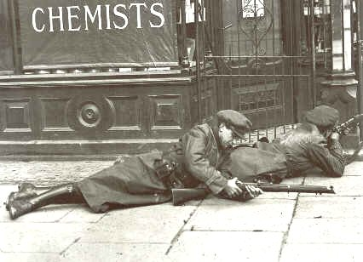
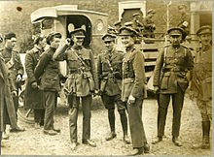
The Dail Debates – Controversial Outcomes
Controversary 7:
Outbreak of the Irish Civil War
Controversary 6:
Sinn Fein split
Pro-Treaty
Freedom to achieve freedom
Control of Internal Affairs
Removal of British forces from Ireland
Avoidance of ‘total war’
Collins, Griffith, MacNeill, Cosgrave
Anti-Treaty
Michael Collins film clip: https://www.youtube.com/watch?v=oFetFqrVBNc
Oath of Allegiance
Partition
Dominion Status not External Association
De Valera, Brugha, Markievicz
Recap clip: https://www.youtube.com/watch?v=xOanL6Ui0q8

