Slide 1
Remixing
In
Soundtrap
Remixing in the classroom as a flexible framework for broader learning outcomes

Slide 2
Key Messages
We are more important than the software!
What we do with an app is what gives it meaning or significance
Remixing: “A flexible framework”
A working sample: Take On Me Project
Leaning into our individual strengths as musicians/educators
Intentions and follow up
Remixing: ”A flexible framework”
The intention of tonight’s workshop is not entirely altruistic!
In the Spring series: We will actually make music together
3
Notes:
Facilitator Notes
What are the Key Messages we want you to take home today? These are overarching messages that span the 3 years of support, new messages may be added. It is important to note that the learner is at the heart(the focus) of these messages.
central to this last key message.
Background Information
These Key messages have been taken from the Design Framework and we will revisit them during each national seminar day. It is important not to go off script whilst reading these out to the group.
The Specification provides an understanding of the Classical world and intends to provide a prism for which the students the students can look at their own world.

Slide 3
Sample Unit Of Learning
Week | Learning Activities | Resources
Week 1/2 | Listening task: Compare 2 performances of “Take On Me” Features of 80’s music production | Intro/Verse 1/Chorus 1 of Original track. Intro/Verse 1/Chorus 1 of MTV Unplugged version
Week 2/3 | Performing the chorus of ‘Take On Me’ on ukulele Exploring I V vi IV chord progression Listening to other songs that use the same progression. Adele “Someone Like You”, U2 “With or Without You”, Ed Sheeran “Photograph” etc. Chord banks/Diatonic chords | Ukulele TABS of songs Chord Diagrams of C Major keys Recordings of other songs with I V vi IV
Week 3/4 | Comparing the harmony used in Take On Me chorus on original track with that used in MTV unplugged. Adding a back beat to the isolated vocal track Experimenting with other chords | SoundTrap project with the two harmonisations loaded in. The isolated vocal of Take On Me
Week 4/5 | Research Remixing Listen critically to a few remixes Listening Task: Compare a remix with it's original track | Mark Ronson Ted Talk – CLICK to watch Recordings of songs that use samples Listening worksheet
Week 5/6/7 | Make a Re-mix of Take On Me in your preferred style/genre of music Make detailed notes about the process/decision making Write a programme note based on your composition Complete a self evaluation on the project | Soundtrap Audio file of isolated vocal MIDI file of chords Evaluation Sheet Programme Note Layout
What we are
Teachers and school
Leaders
Teacher Educators
Facilitators/Enablers
Purveyors of lifelong
learning
Notes:
Facilitator Notes:
What is the PDST and what support can we provide for teachers and schools?
We are teachers and school Leaders, we are Teacher Educators, Facilitators/Enablers and Purveyors of lifelong learning.
It is very important to remember that the PDST are not Evaluators, Policy Makers, Curriculum developers or Providers of solutions.
Background Information/ advisor notes.
Evaluators= SEC State Examination Commission
Policy Makers = NCCA National Council Curriculum Assessment. The Inspectorate

Slide 4
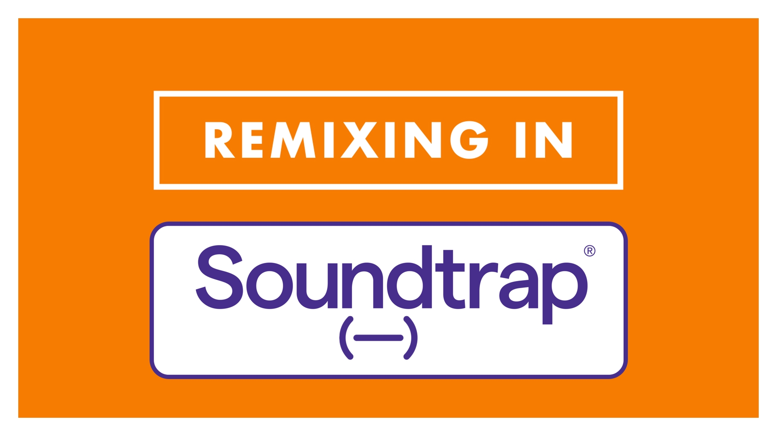
How to Remix in SoundTrap
Click the image to
watch the how-to
video

Slide 5

Isolating Vocals/Parts:
A few tips (click the underlined links)
Tik Tok
AI
Internet
“Voceux”
“Vocalslice”
“Just Vocalss”
Moises.ai
Lalal.ai
Google
YouTube

Slide 6
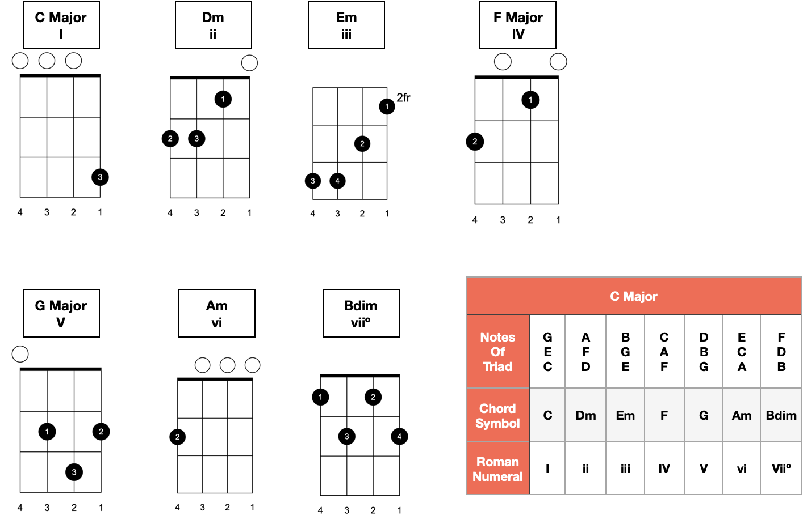
Chords in C Major on Ukulele

Slide 7
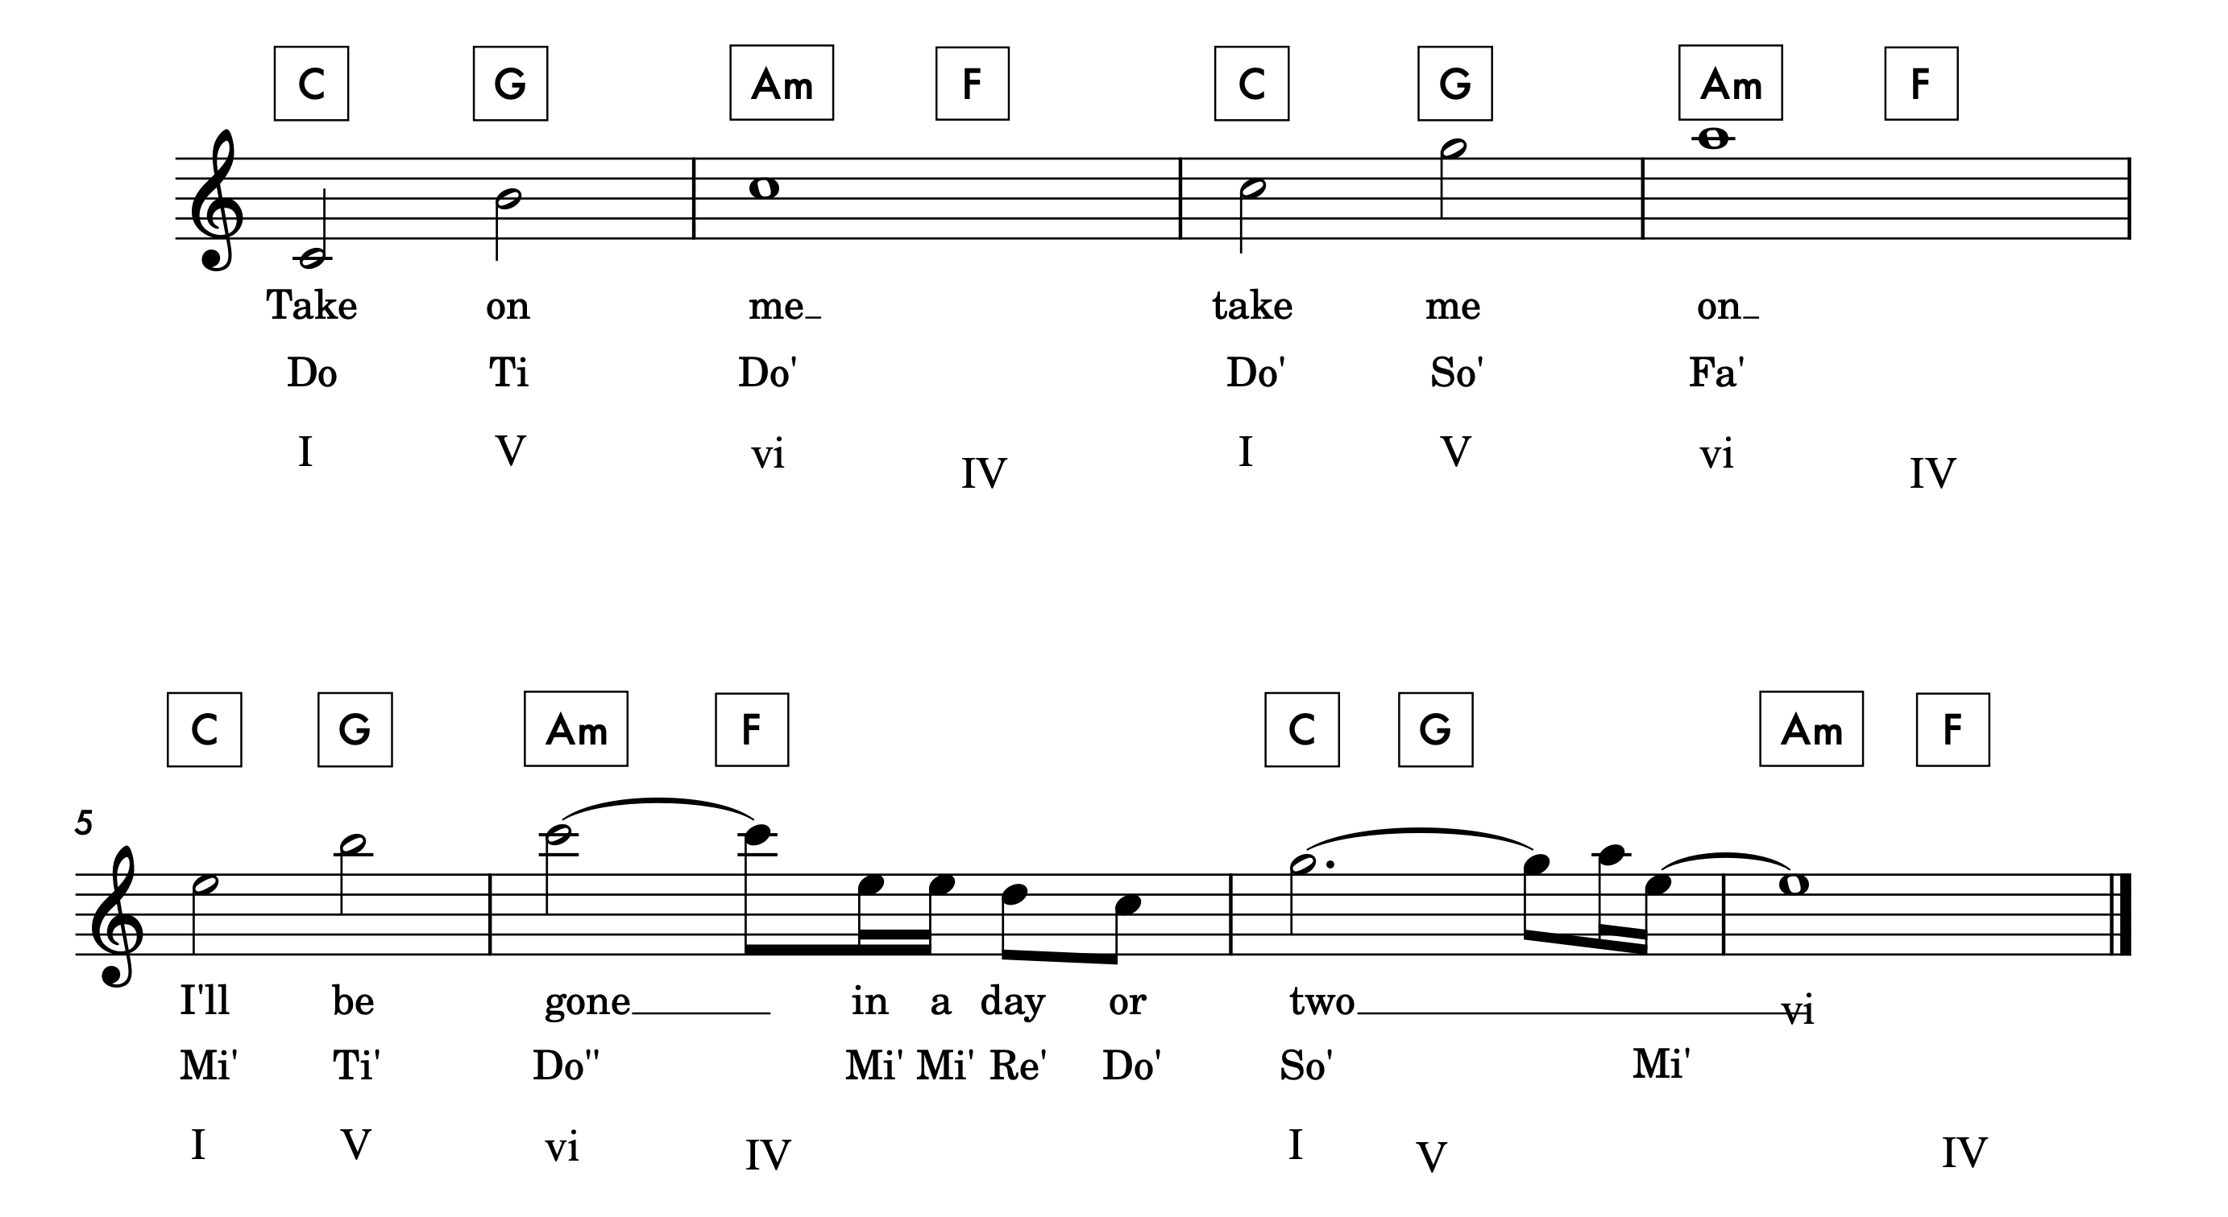
Take On Me
(Chorus in C Major)

