Slide 1


Using Soundtrap to Support Singing
Some Ideas
November 2021

Slide 2
Warm Ups !!!!
Lipthrills !!!!! (pretend horse sounds or the classic motor bike sound)
Let’s count and Sing!
1, 121, 12321, 1234321, 123454321
8, 878, 87678, 8765678, 876545678

Slide 3
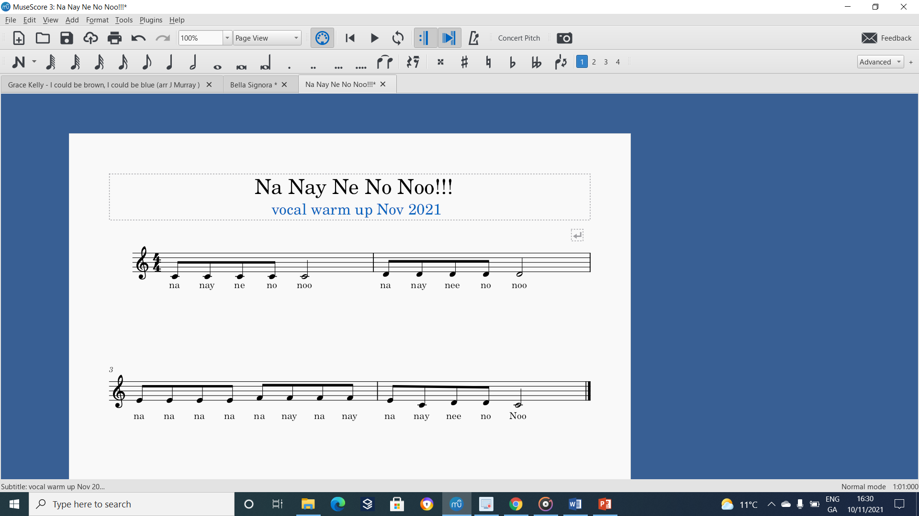
Warm up No 2! (up in semitones!)

Slide 4
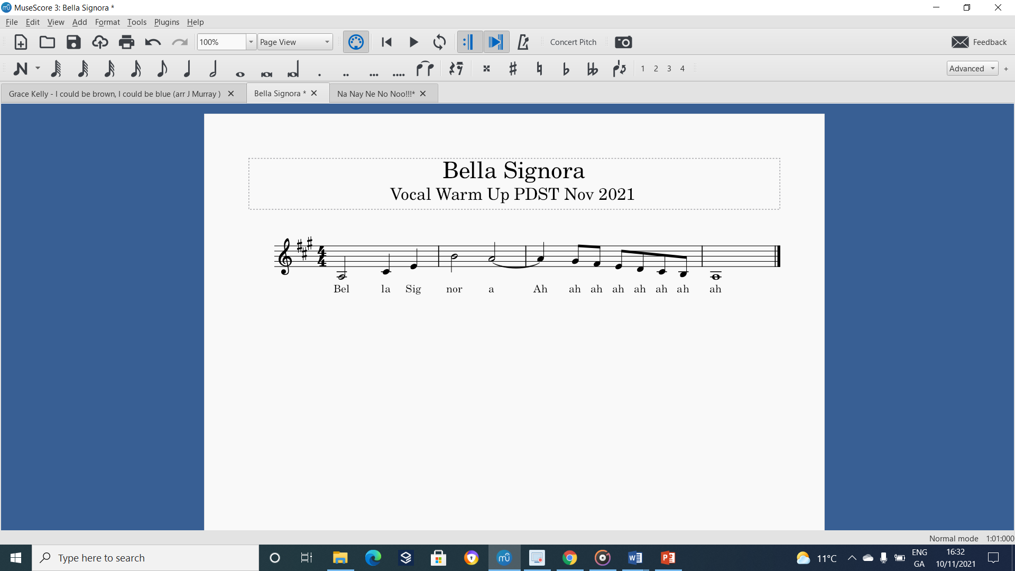
Warm up No 3 – (up in semitones !)

Slide 5
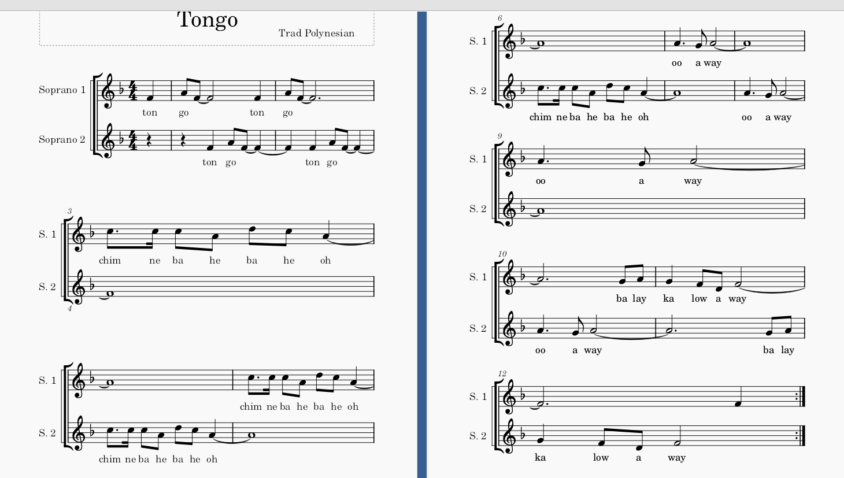
Let’s Sing !!!!! ( -Thanks Helen!!)

Slide 6
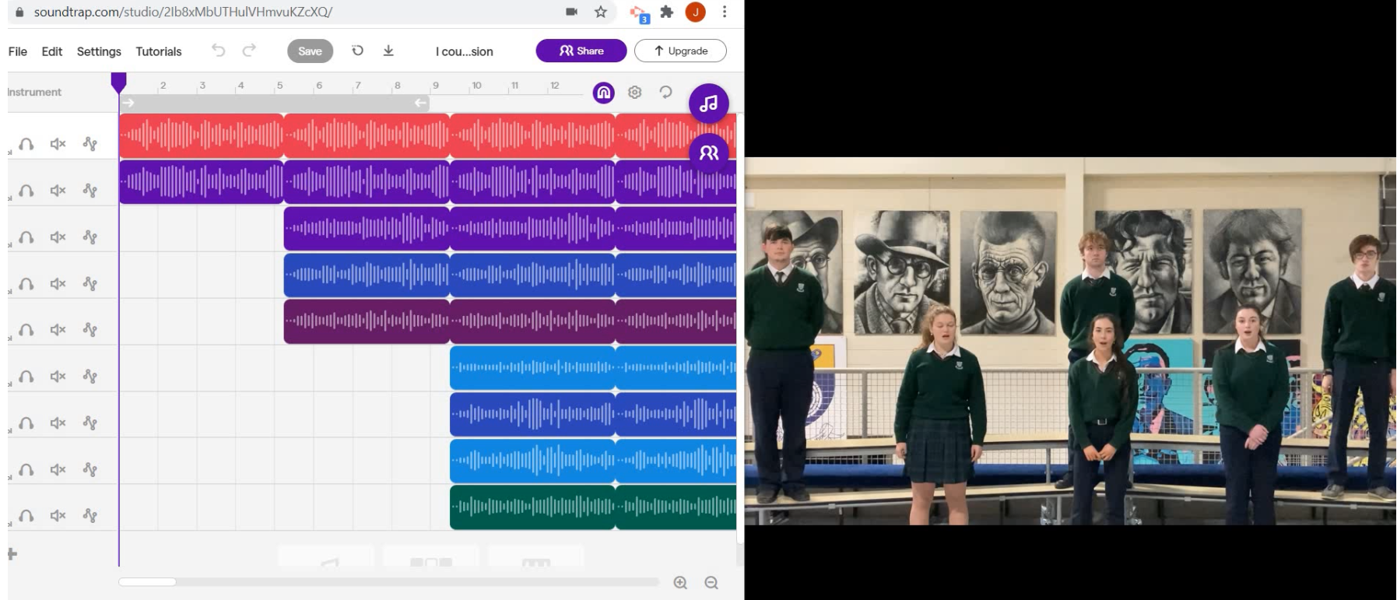
Soundtrap Tutorial – my experience!!!!
https://youtu.be/Z2zWlvoERZU

Slide 7
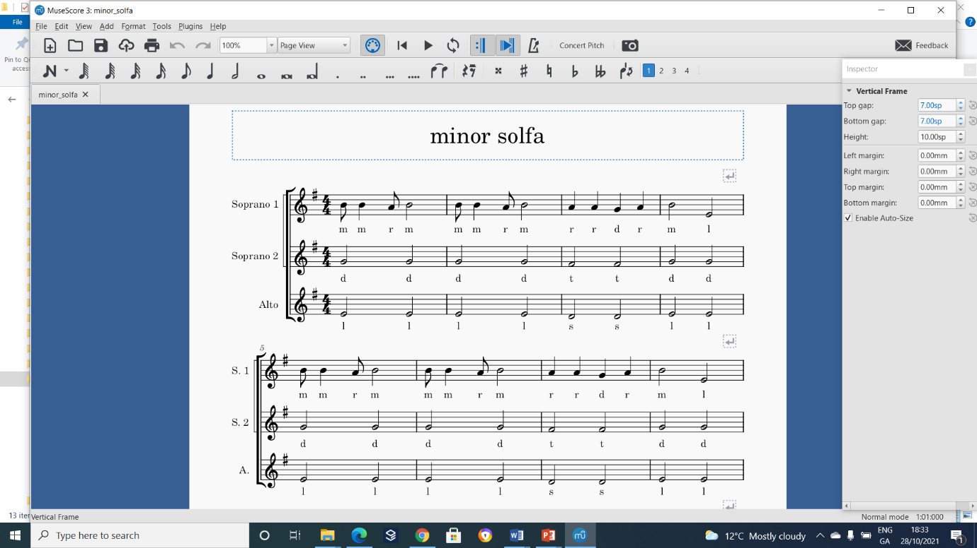
Let’s Sing!!!!!

Slide 8
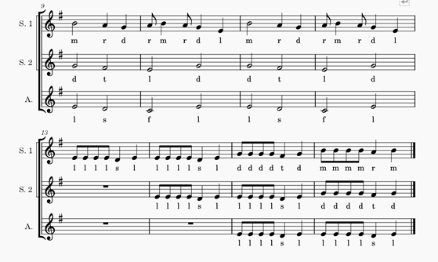
Keep singing!!!!

Slide 9

Some examples ……..Christmas is coming …….
Christmas Tik Tok (3rd Year Style)
(Angels we have heard on high)
Descant recorders – 3 part – students! Recorded individually then layered
Treble Recorder ( myself)
Guitar player – student
Piano player – bass only
https://youtu.be/TO5dxK_Au0Y

Slide 10
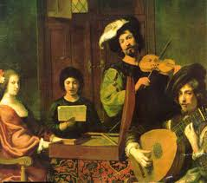
Here's another !!!!! The Madrigal Tik Tok!!!
Soundtrap – The English Madrigal
(My take on the English Madrigal using Soundtrap)
Fair well dear love – it’s me singing all parts – literally
Now is The Month Of Maying – it’s myself, Rose and Helen – a family trio
Video Editor to compile all the visuals
The visuals are Google images !!!!!
https://youtu.be/fWb-RpwI8go

Slide 11
Soundtrap - let’s be creative
Sing together – but not necessarily at the same time!
Play together – but not necessarily at the same time!
Backing tracks – I see huge potential here
Recording studio – this software is a good as what the Beatles used when they were recording
Cross-curricular – well I connected with history and art
Found sounds – well it’s only a small step to this – Anna will take us on this journey

Slide 12
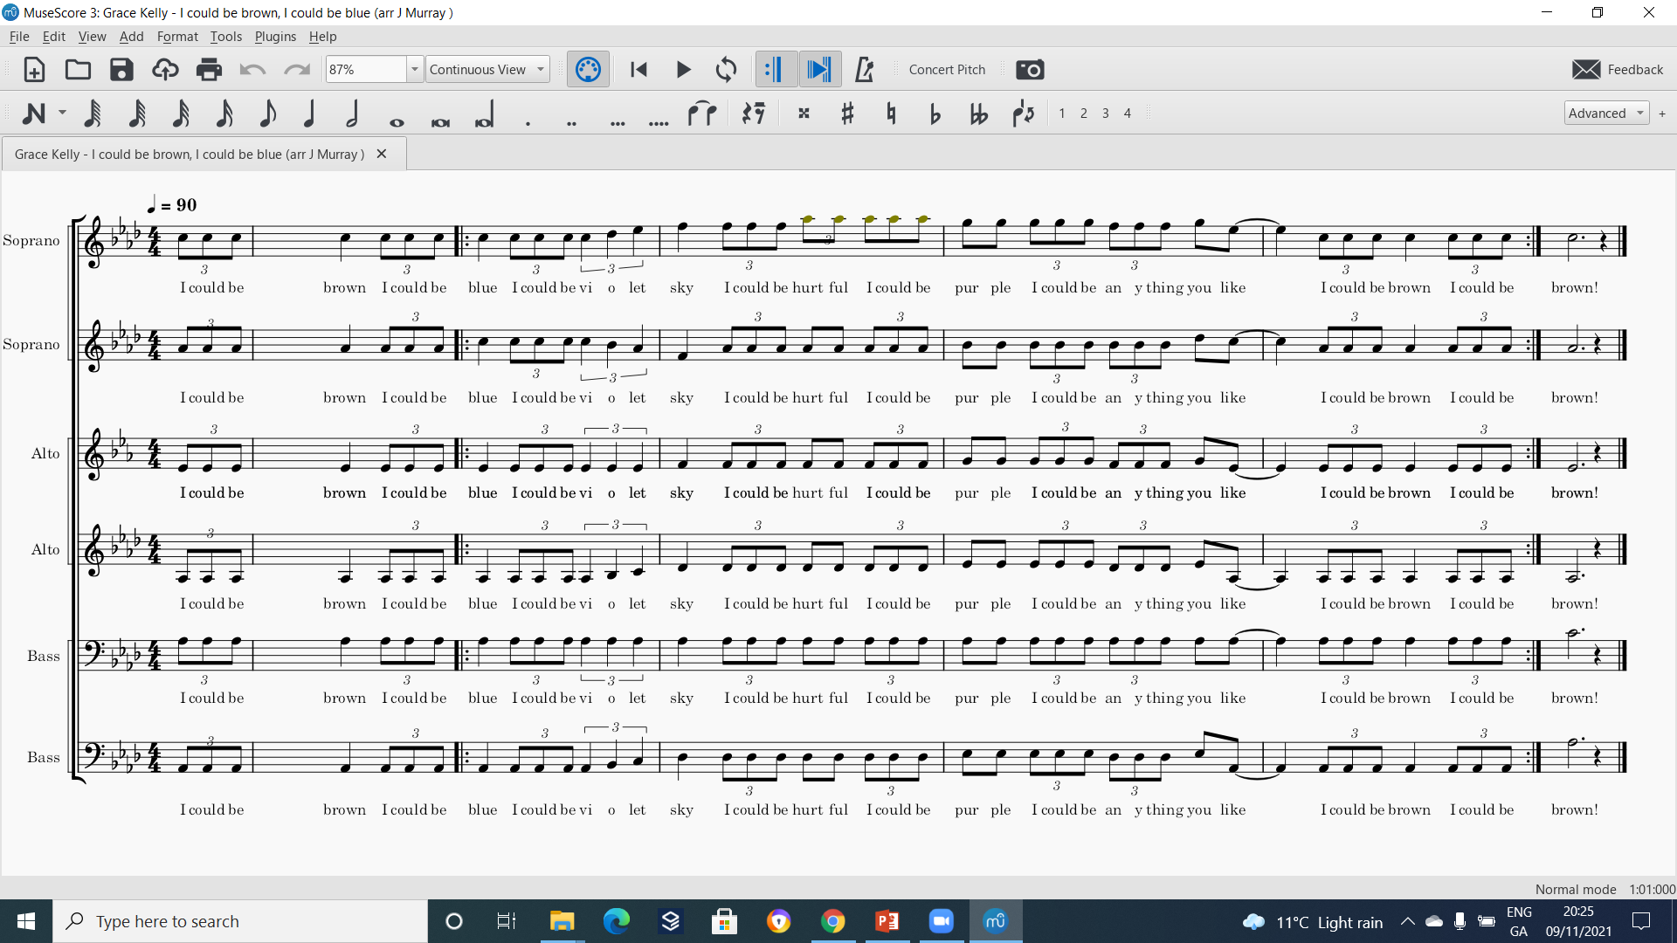
Tik Tok – I could be brown………..

Slide 13
I hope this was helpful

