Slide 1
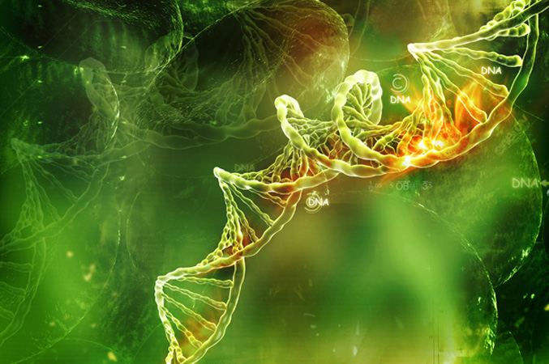
Immune System

Slide 2
The Immune System - Leaving Cert Biology syllabus reference.
General defence system to include the skin and mucous membrane lining of the breathing, reproductive and digestive tracts. Phagocytic white blood cells.
Specific defence system (immune system): antigen antibody response. Definition of “induced immunity”.
Vaccination and immunisation.
Role of lymphocytes: B and T cell types. Role of B cells in antibody production. Role of T cells as helpers, killers, suppressors, and memory T cells.

Slide 3
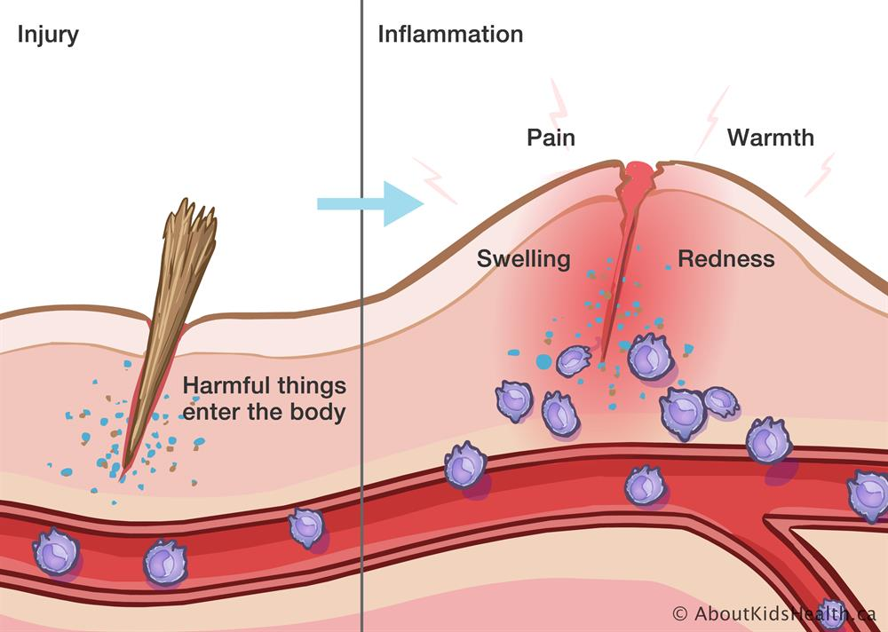
General defence system to include the skin and mucous membrane lining of the breathing, reproductive and digestive tracts. Phagocytic white blood cells.
Immunity is the body’s defence against disease. Pathogens are disease causing microorganisms such as bacteria.
The skin acts as a barrier to keep out harmful bacteria, If the skin is damaged platelets clot the blood forming scabs which seal the wound and keep out infections.
Sebaceous glands in the skin produce an oil called sebum which prevents the skin from cracking.
Mucus made by tiny cells in the breathing system trap duster and bacteria.
The mucous membrane that lines the digestive tract and and reproductive systems acts as a barrier against pathogens.
The mucous membrane of the stomach is adapted to produce acid which kills bacteria.
Inflammation is the normal response of your body’s immune system to injuries or infection. Increased blood flow causes swelling and redness. White blood cells quickly react

Slide 4
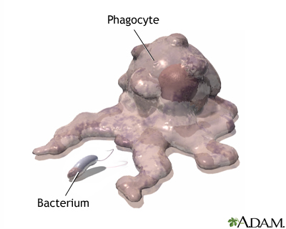
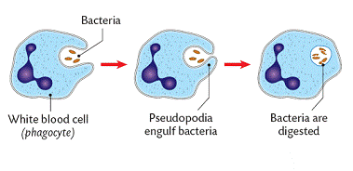
General defence system to include the skin and mucous membrane lining of the breathing, reproductive and digestive tracts. Phagocytic white blood cells.
All white blood cells are made in the bone marrow.
There are 2 main types of white blood cells Monocytes and Lymphocytes.
Monocytes leave the bone marrow when mature. They can engulf or eat pathogens in a process called phagocytosis.
White blood cells that engulf pathogens are known as phagocytic white blood cells.
A macrophage is an example of a large phagocyte found in all tissues of the body that will engulf and digest foreign cells in the body

Slide 5
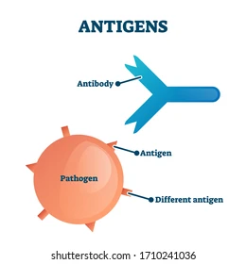
Specific defence system (immune system): antigen antibody response. Definition of “induced immunity”.
Lymphocytes leave bone marrow early and mature in the lymph system. Lymphocytes can be classified as B cells or T Cells.
The B cells that make antibodies are called plasma B Cells. Antibodies are proteins produced by the body in response to an invading pathogen with foreign antigens on its surface. Antibodies are specific as each type will only bind with a particular antigen. The measles antibody will bind to the measles virus but not to any other pathogen.
Antibodies attach to antigens on the surface of invading cells causing them to clump together. Pathogens that are clumped together cannot infect cells and are easily destroyed by macrophages.
Some B cells become memory cells which can quickly turn into plasma B cells if an infection returns.

Slide 6
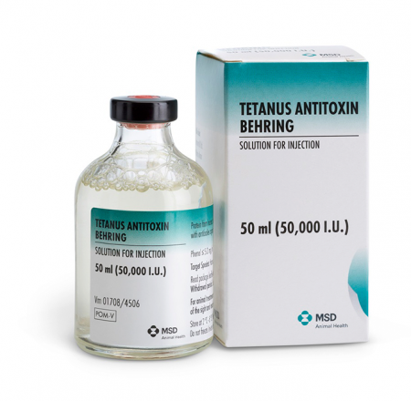
Specific defence system (immune system): antigen antibody response. Definition of “induced immunity”.
Induced immunity occurs when a person is protected against a pathogen due to specific antibodies in the blood.
In active immunity the person with the infection makes their own antibodies to give long lasting protection.
In passive immunity antibodies are transferred from another organism into the infected person – short lived effect. Breast milk provides antibodies from the mother to the baby so is a form of natural passive immunity.
An injection of antibodies as in the case of a Tetanus injection is a form of artificial passive immunity. This type of injection is given when the patient is unable to make antibodies or there is not enough time to do so. It provides short term protection.
Tetanus antitoxin, is a medication made up of antibodies against the tetanus toxin.^{[1]} It is used to prevent tetanus in those who have a wound that is at high risk

Slide 7
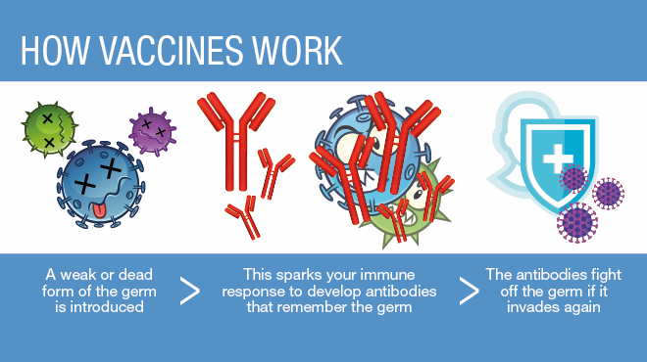
Vaccination and immunisation.
A vaccination is a non disease causing dose of a pathogen causing antibody production to protect against infection.
mRNA vaccines used to protect against Covi-19 contain instructions for white blood cells to make antibodies to bind to the Covid 19 virus.
Vaccinations lead to active immunity as the person makes their own antibodies.
Older people have a greater amount of antibodies in their blood than younger people as they have been exposed to many different antigens in their lifetime.
This means older people are often immune to infections that recur in the community.

Slide 8
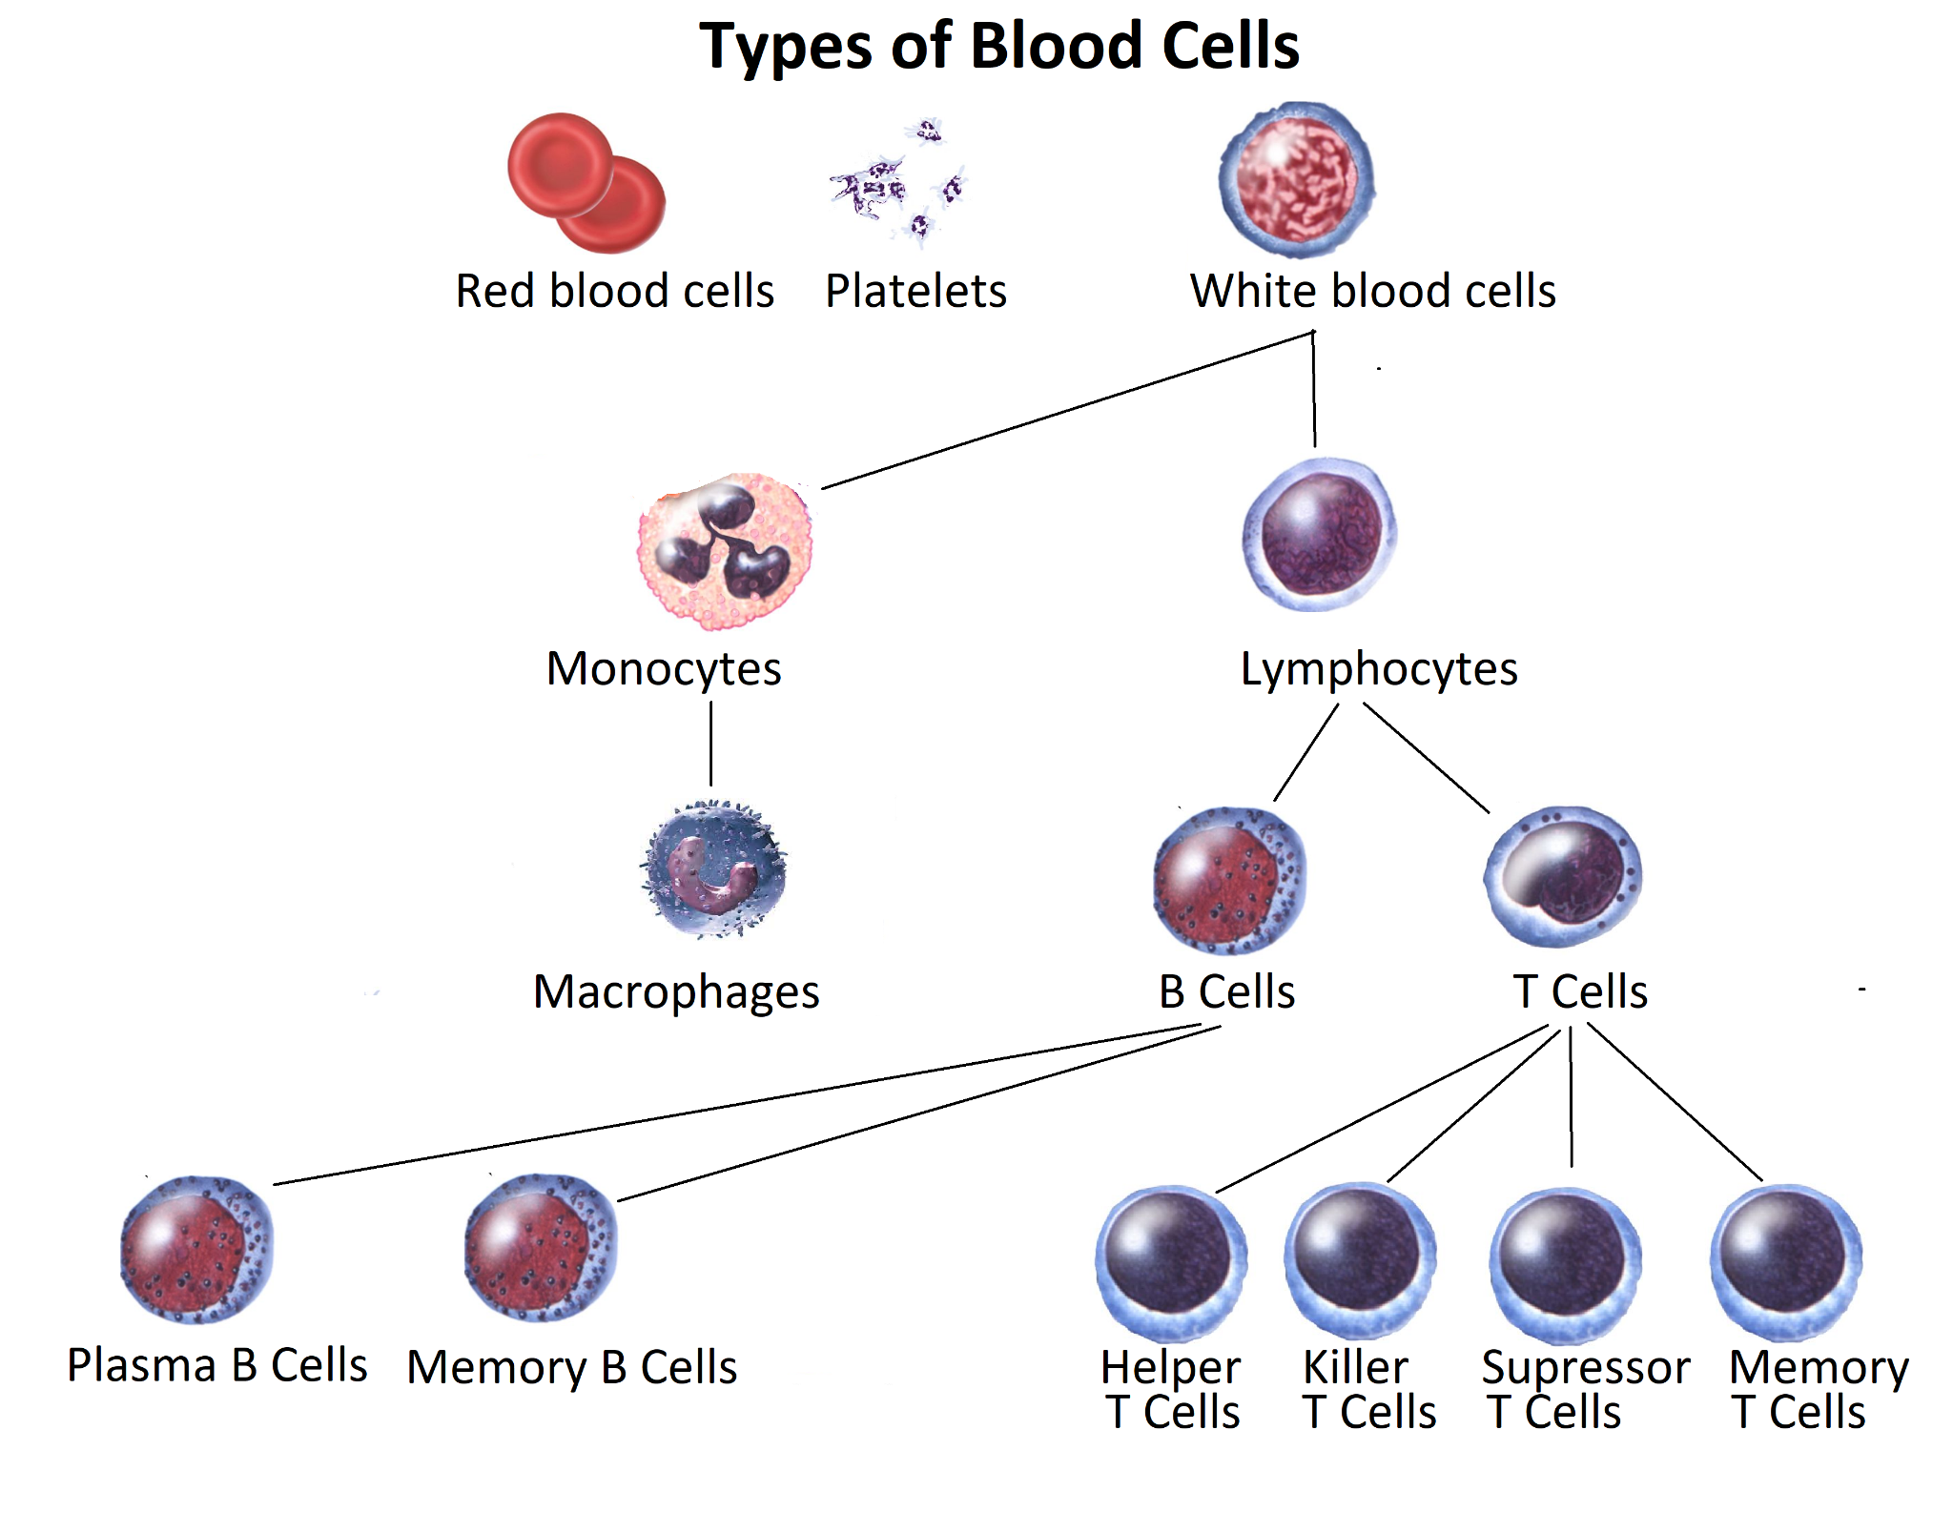
Role of lymphocytes: B and T cell types. Role of B cells in antibody production. Role of T cells as helpers, killers, suppressors, and memory T cells.
One group of lymphocytes are known as T Cells.
There are 4 types of T cells.
Killer T cells which destroy infected or abnormal cells such as cancer cells.
Helper T cells which recognise antigens as foreign and activate killer T cells and stimulate B cells to produce matching antibodies.
Suppressor T cells which turn off the immune response when the infection is defeated preventing autoimmune disorders.
Memory T cells remain in the body and can remember antigens and react quickly if the pathogen returns.

