Slide 1
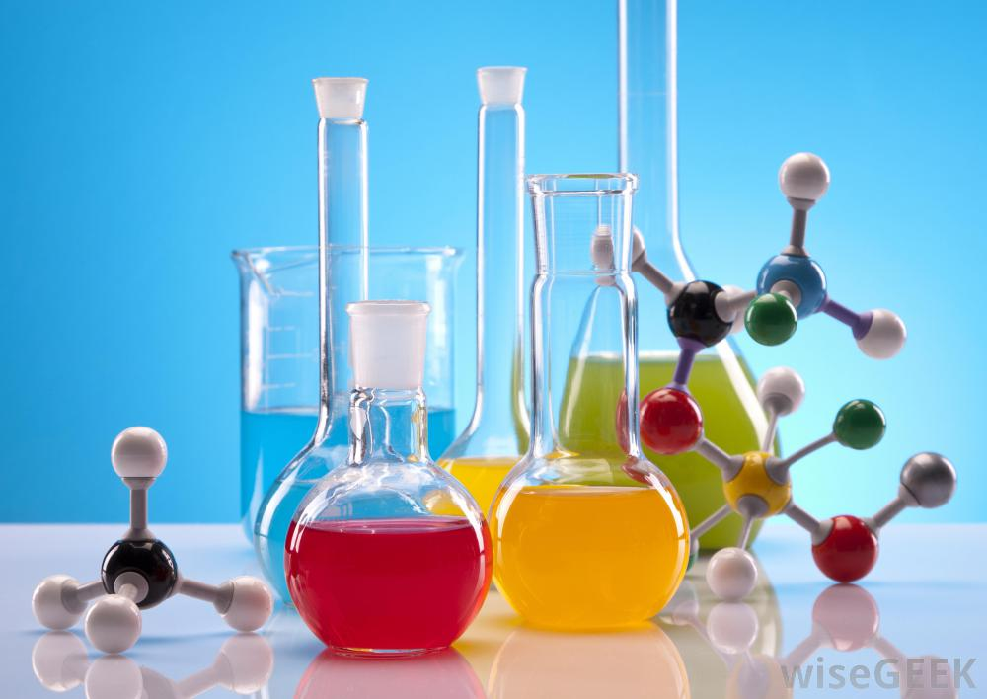
Human Health
BW6

Slide 2
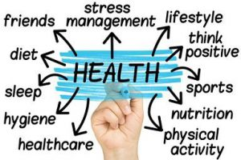
Learning Intentions
Inherited factors that affect health
Cystic Fibrosis
Down Syndrome
Genetic screening for heart disease and breast cancer genes.
Gene Therapy.
Carbohydrates: function, sources
Proteins: function, sources
Fats: function, sources
Vitamins : function, sources
Minerals: function, sources
Balanced diet
Practical activities - Food tests
Smoking,
Exercise
Pollutants
Radiation
Microorganisms.
Pathogens and the bodies defence system

Slide 3
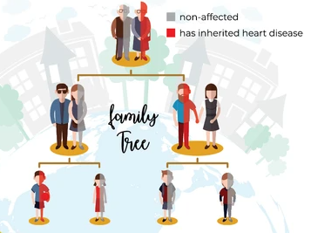
Inherited factors that affect health
Genes are passed on from parents to their children through sexual reproduction. Mistakes or mutations that build up in chromosomes or DNA can lead to genetic diseases or disorders.
Mistakes in single sections of DNA can lead to single-gene disorders such as cystic fibrosis, sickle cell anemia and Huntington's disease.
Many disorders such as heart disease, high blood pressure, alzheimer's disease, diabetes and cancer can be caused by a combination of environmental factors and mutations in multiple genes
Chromosomal disorders such as down syndrome, and turner syndrome are caused by errors in chromosome numbers in cells.
If your parents or grandparents suffered from heart disease it is possible that you may also carry a gene that puts you at increased risk. You can inherit a predisposition to heart disease and something in your environment such as poor diet triggers it.

Slide 4
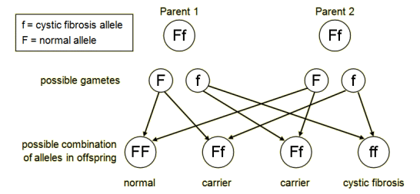
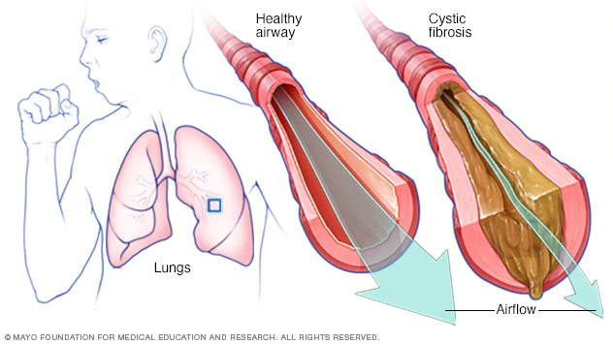
Cystic Fibrosis CF
Cystic fibrosis is a hereditary disease that causes the body to produce a thick, sticky mucus that can clog the lungs. Cystic fibrosis (CF) can be life-threatening, and people with the condition tend to have a shorter-than-normal life span. Ireland has the highest proportion of CF people in the world.
Mutations in the CFTR gene on chromosome 7 can lead to cystic fibrosis. A person normally has 2 CFTR genes. If only 1 gene is mutated the person is a carrier but does not have CF. CF is caused by the inheritance of a faulty gene from both parents.
There is no cure for CF, but a number of treatments are available to help control the symptoms,
Medicines to widen the airways and make the mucus in the lungs thinner and easier to cough up
A lung transplant may eventually be needed if the lungs become greatly damaged.

Slide 5
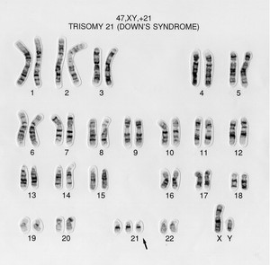
Down Syndrome
Down syndrome is a genetic disorder caused by the presence of all or part of a third copy of chromosome 21. This occurs due to an error in cell division during egg of sperm formation resulting in one of the gametes having two copies chromosome 21 instead of one..
It is associated with physical growth delays, mild to moderate intellectual disability, and characteristic facial features such as eyes that slant upwards, small ears
small mouth, protruding tongue and short fingers.
People with Down syndrome may have memory problems, concentration problems, difficulty problem solving and difficulty understanding the consequences of their actions.
Early intervention programmes provide healthcare, education and treatments, such as speech therapy and physiotherapy.
A karyotype or chromosome photo of a person with Down Syndrome showing 3 copies of chromosome 21 instead of 2.

Slide 6

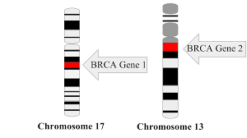
Genetic screening for heart disease and breast cancer genes.
Medical conditions that run in a family are caused by changes in genes that are passed from generation to generation.
A mutation is a change in DNA that may be caused by radiation or chemical factors. Some mutations increase with age or can spontaneously occur.
Many different types of heart disease run in families. A mutation in a gene on chromosome 12, that regulates cholesterol levels, may raise the risk of heart disease in carriers up to 49 %.
Genetic testing is the process of taking a sample of a person's DNA to look for changes that could cause inherited heart disease. The results of the test can be used to inform a person about lifestyle and dietary changes that may be necessary to reduce the risk of heart disease.
A mutation in the BRCA genes on chromosomes 13 and 17 raises a person’s risk for breast, ovarian and other cancers. The BRCA gene test is a blood test to find out if if a person has a DNA mutation that increases the risk of breast cancer.

Slide 7
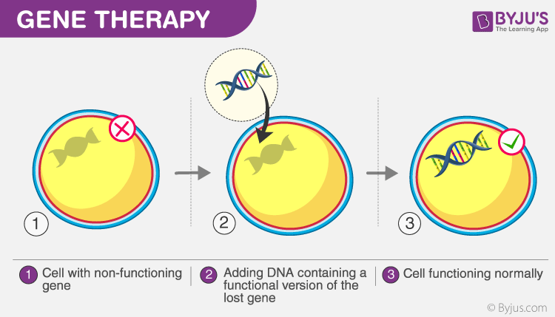
Gene Therapy.
Gene therapy is an experimental technique that uses genes to treat inherited diseases by replacing a mutated gene that causes disease with a healthy copy of the gene.
A new gene is inserted directly into a cell. A carrier such as a virus could be genetically engineered to deliver the replacement gene into the nucleus of the target cells causing healthy functioning proteins to be made by the cell preventing the inherited disorder.
Experiments, performed in cells in a laboratory setting
have restored normal protein production in lung cells with mutated genes that cause cystic fibrosis
Potential Gene Therapy for CF Restores Protein Levels in Early Studies
Gene therapy is risky and is still under study to make sure that it will be safe and effective.

Slide 8
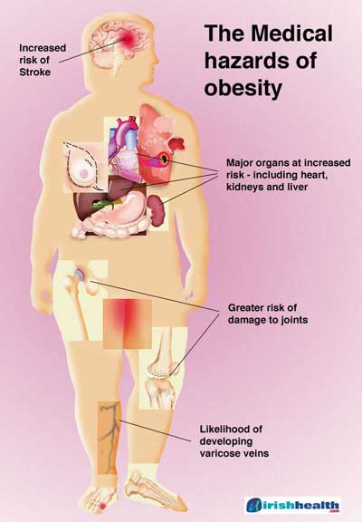
Obesity
Obesity is a medical condition in which excess body fat has built up to the extent that it may have a harmful effect on health. This can be caused by eating unhealthy foods high in calories and lack of exercise.
It is defined by body mass index (BMI) and further evaluated in terms of fat distribution via the waist–hip ratio and total cardiovascular risk factors.
The most widely used way to measure your weight is to calculate your body mass index (BMI). This is your weight in kilograms divided by your height in metres squared. A person is considered obese if they have a body mass index (BMI) of 30 or greater.
Obesity can cause a number of health problems, such as type 2 diabetes (a condition caused by too much glucose in the blood), and heart disease (when the heart's blood supply is blocked).

Slide 9
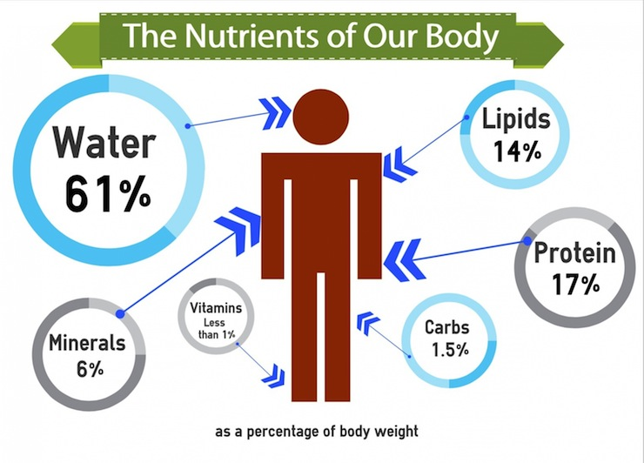
Food
We need food to provide energy, to provide material for growth and to provide the elements needed for chemical reactions in the body.
3 types of food are required in large amounts in the daily diet:
Carbohydrates
Proteins
Fats
2 other food types are required in smaller amounts:
Vitamins
Minerals
While water is not a type of food, it is an essential requirement in the diet

Slide 10
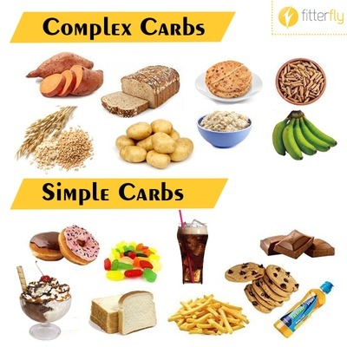
Carbohydrates: function and sources
Carbohydrates provide the body with energy.
Sugars are small carbohydrate molecules found in fruits, honey and processed foods that provide a quick supply of energy to the body.
Starch molecules are larger carbohydrate molecules found potatoes, rice, pasta and bread. These molecules take time to be digested or broken down in the body so release energy slowly throughout the day.
Fibre is a large carbohydrate found in vegetables and whole grain foods. Fibre encourages peristalsis in the digestive system and prevents constipation. Long term constipation can lead to colon cancer.
Diabetics lack a naturally occurring hormone called insulin which is needed to absorb glucose sugar from the blood into body cells. Insulin injections help to control the level of glucose in the blood.
Complex carbohydrates are made up of sugar molecules that are strung together in long, complex chains.

Slide 11
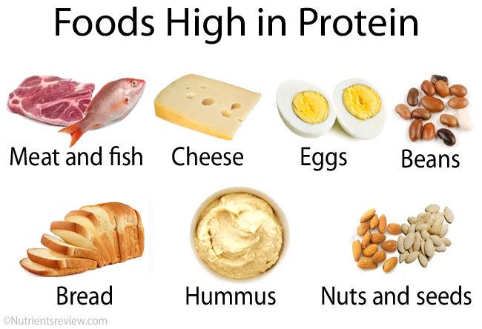
Proteins: function and sources
Proteins are needed for the growth and repair of body tissues.
Muscle is made from protein
Bone contains a large amount of protein
Protein molecules are long chains of smaller molecules called amino acids.
Fish, milk, nuts, beans are all good sources of protein.
Enzymes are special proteins produced by the body to control the rate of chemical reactions inside the body.
Lack of protein results in poor growth and malnourishment.

Slide 12
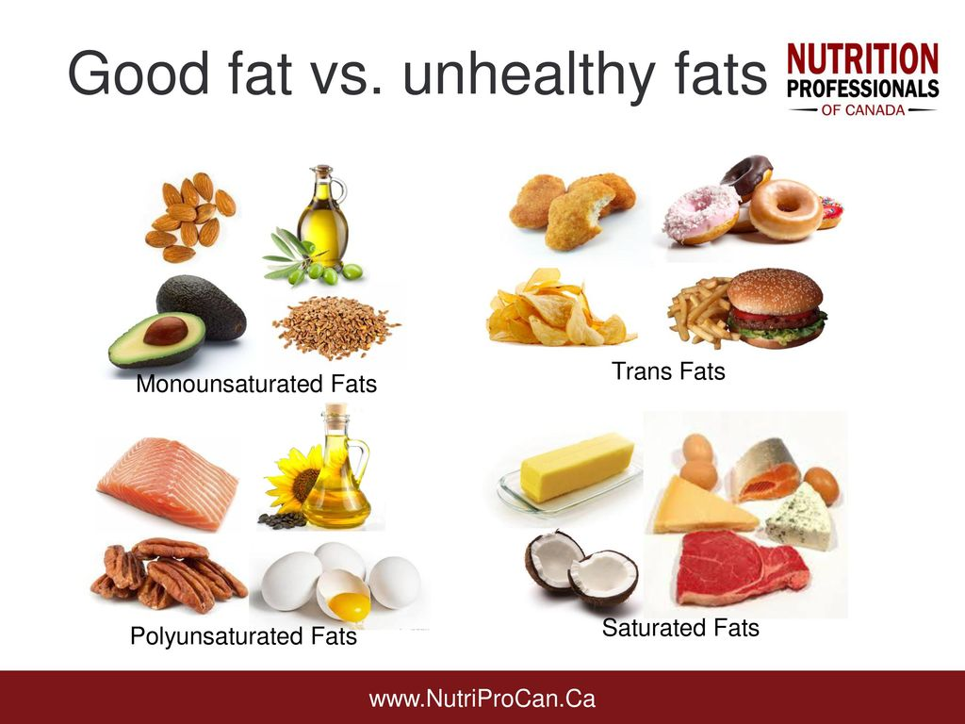
Fats: function and sources
Fats act as energy sources for the body but are stored under the skin in special cells if the energy is not needed.
Some fat storing cells are required in the body to insulate against heat loss and to maintain the body at a constant temperature. Butter, oils, fatty meats and processed foods are all sources of fat.
Types of Fats
Most unsaturated fats lower disease risk. Foods high in these good fats include vegetable oils nuts, seeds, and fish.
Trans Fats are a type of unsaturated fat found in processed foods which can increase heart disease risk.
Saturated fats, found in red meat, butter, cheese, and ice cream can lead to illness such as heart disease. Eating foods that contain saturated fats raises the level of cholesterol in your blood. High levels of LDL(bad) cholesterol in your blood increase the risk of heart disease.

Slide 13
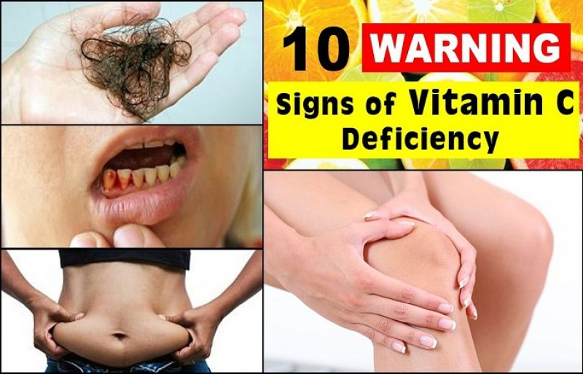
Vitamins : function, sources and deficiencies
Vitamins are organic molecules - produced by living things that are needed in small amounts in the diet.
Vitamin C is a water soluble vitamin found in oranges that is needed by the body to form connective tissue in the gums and skin. A deficiency in Vitamin C can lead to bleeding gums or scurvy.
Vitamin D is a fat soluble vitamin found in milk and dairy products. It is needed to absorb calcium from foods in bone formation. A deficiency in vitamin D can lead to rickets or poor bone formation in children.
Vitamin B occurs in many different forms and is needed for help convert food into energy in respiration.
Folic acid is an example of a Vitamin B. It is needed for healthy embryo growth in pregnancy. Folic acid is found in many green vegetables or can be taken as a supplement by a women prior to becoming pregnant. Deficiency in folic acid can lead to spinal disorders such as spina bifida in the developing embryo.

Slide 14
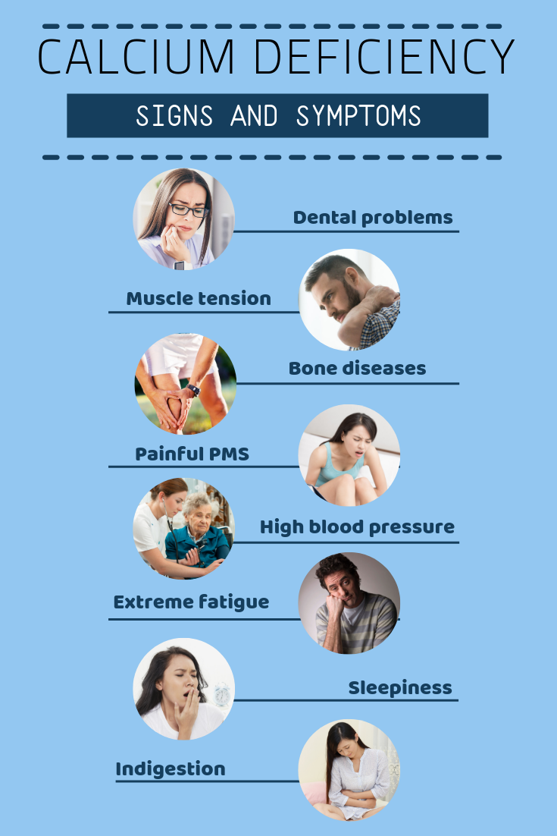
Minerals: function, sources and deficiencies
Minerals are elements in foods that our bodies need to develop and function normally.
Iron is required as a part of haemoglobin in the blood. Liver and dark green vegetables are good sources of iron in the diet.
Calcium is needed for healthy teeth and bones. Good sources of calcium are milk cheese and yoghurt.
Osteoporosis is a disorder that leads to weak and brittle bones. that are more likely to fracture. A lack of calcium in the diet and a lack of exercise can increase the risk of osteoporosis.
Astronauts who spend months in low gravity lose bone density because they don't exercise muscles that would otherwise build skeletal strength through motion. These leads to a form of osteoporosis. Astronauts must exercise for up to 3 hours a day to stimulate bone formation.

Slide 15
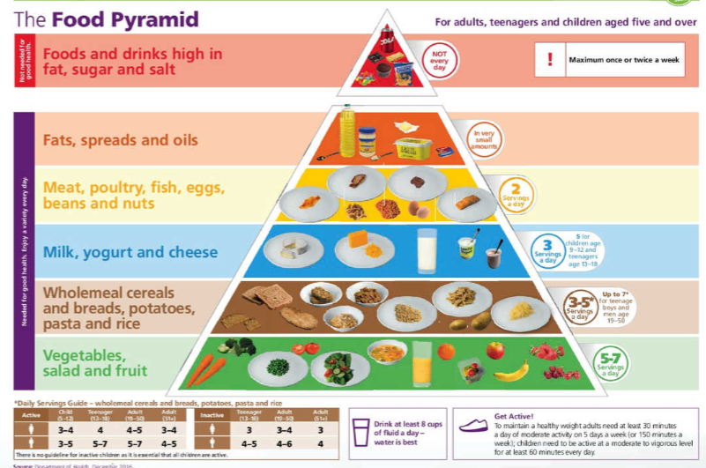
Balanced diet
Foods are made up of nutrients. Protein, fat and vitamins are types of nutrients. Your body needs the right mix of nutrients to be healthy and well.
Different foods contain different nutrients. Choosing a mixture of foods every day will help you get to get all the nutrients you need to grow and be healthy. This is what it means to eat a balanced diet.
Foods that contain the same types of nutrients are grouped together as:
vegetables, salads and fruit
wholemeal cereals and bread, potatoes, pasta and rice
reduced-fat or low-fat milk, yoghurt and cheese
lean meat, poultry, fish, eggs, beans and nuts
fats, spreads and oils
Food also gives you the fuel (calories) you need for your body to work. If you take in more calories than you use, you’ll put on weight and become overweight. If you don’t take in enough calories, you’ll be underweight. Either is bad for your health.
https://www.safefood.eu/Healthy-Eating/The-Food-Pyramid-and-The-Eatwell-Guide/The-Food-Pyramid.aspx

Slide 16
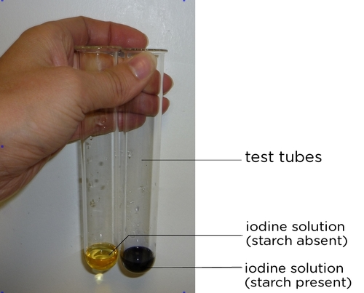
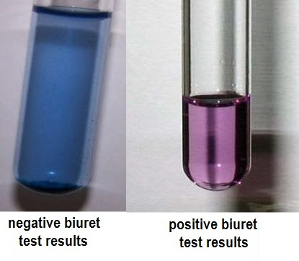
Food tests
Qualitative food tests identify the presence of a nutrient in food and not how much is present. Food samples are often crushed with a mortar and pestle with water before being tested.
Test for Starch
Add iodine solution to a food sample using a dropper. No heat is needed. A change from yellow to blue black colour shows starch is present. As a control add iodine to water and observe that it stays yellow.
Test for Protein
To test a food for protein add biuret solution or sodium hydroxide + copper sulphate to a sample of food. No heat is needed. A change from blue to violet colour shows protein is present. As a control add biuret solution to a food sample and observe that the biuret solution stays blue.

Slide 17
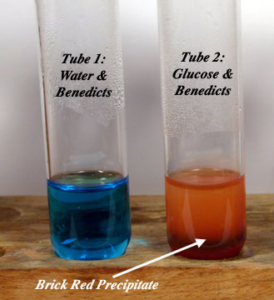
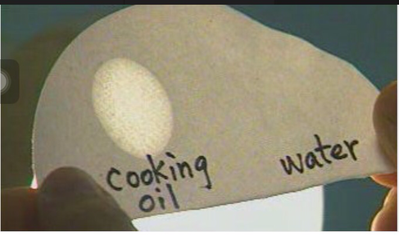
Food tests
Test for Reducing Sugars
Glucose and maltose are both reducing sugars as they form a red colour when heated with benedict's solution.
Add benedict's solution to a sample of food in a test tube and heat in hot water. A change from blue to brick red shows reducing sugar is in the food. As a control add benedict's solution to water, place in hot water and observe that the benedicts stays blue.
Test for Fat
To test a food for fat rub a sample of food in brown paper. A permanent translucent stain shows the presence of fat. As a control rub water on the brown paper and observe that the water dries leaving no stain..
Benedict's test after heating

Slide 18
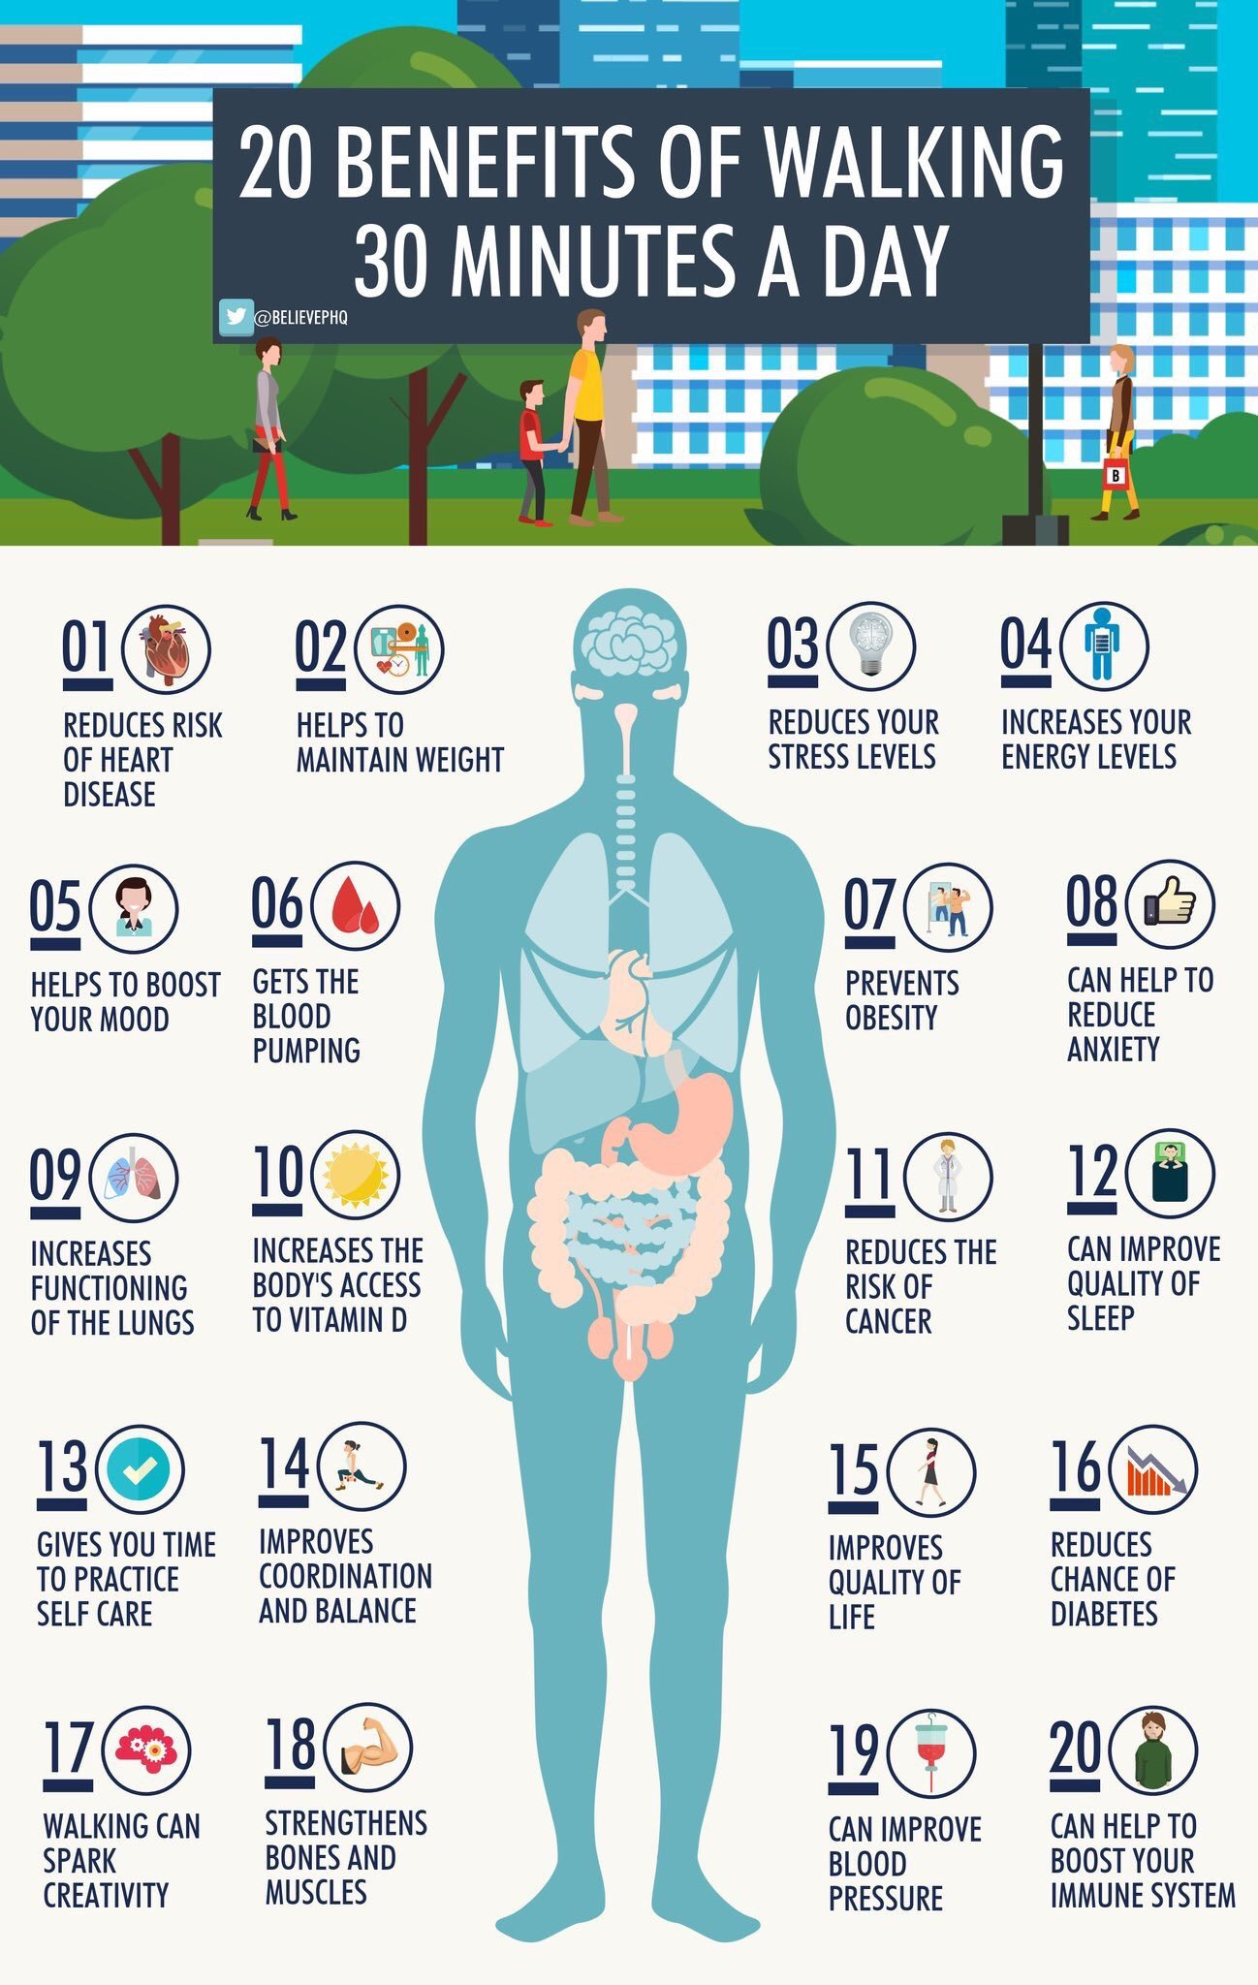
Exercise
International studies have shown that regular physical activity reduces the risk of chronic diseases, such as coronary heart disease (CHD), type 2 diabetes, stroke, cancer, osteoporosis and depression.
Moderate to vigorous activity includes sport, physical education (PE), exercise and physically demanding activities such as dancing or swimming. It also includes everyday activities such as walking and cycling.
Moderate activity causes increased breathing and heart rate, but till able to carry on a conversation. Warm or sweating slightly, comfortable pace.
Vigorous activity results in breathing heavily, cannot keep a conversation going, faster heart rate and sweating,
concentrating hard.
Adults should aim for at least 30 minutes a day of moderate activity (or 15 minutes of vigorous activity) on 5 days a week
The National Guidelines on Physical Activity for Ireland

Slide 19
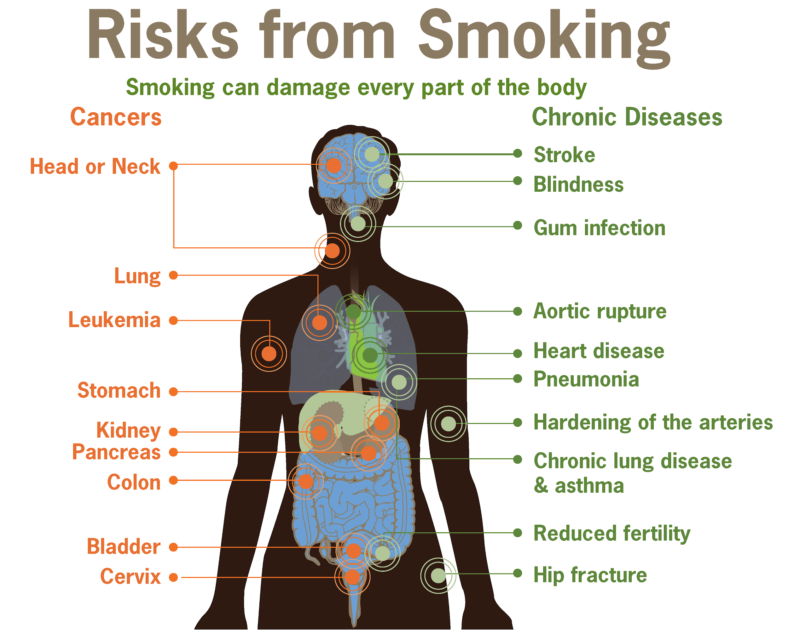
Smoking,
Cigarette smoke contains chemicals that make the blood thicker, and increase chances of clot formation, increases blood pressure and heart rate, making the heart work harder than normal. Smoking narrows arteries, reducing the amount of oxygen rich blood circulating to organs.
Smoking can cause fatal diseases such as pneumonia and lung cancer. Smoking causes the majority of deaths from chronic obstructive pulmonary disease (COPD) a collection of lung diseases including chronic bronchitis and emphysema. People with COPD have difficulties breathing, primarily due to the narrowing of their airways and destruction of lung tissue.
For women, smoking can reduce fertility and increases the risk of cervical cancer.
Effects of smoking on the body | Smokefree

Slide 20
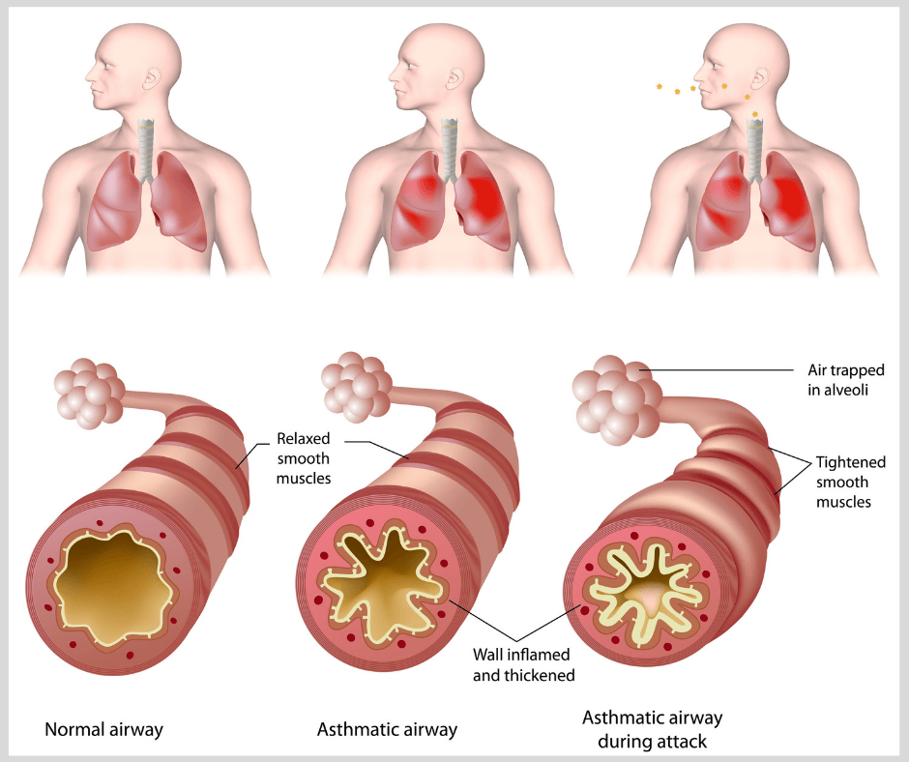
Pollutants (Asthma)
Pollution is any harmful addition to the environment.
Outdoor air pollution is a major cause illness mainly from heart disease, stroke, chronic obstructive pulmonary disease, lung cancer, and respiratory infections in children.
Most pollutants are products of burning fuels. Pollutants include particulate matter - small dust particles (PM) capable of getting deep into lung passageways causing respiratory infections and asthma.
WHO | Ambient air pollution: Health impacts
Asthma is a inflammatory disease of the airways of the lungs. Symptoms are wheezing, coughing, chest tightness, and shortness of breath. Asthma can be caused by allergens, such as pollen, dust mites, pet dander or air pollutants.

Slide 21
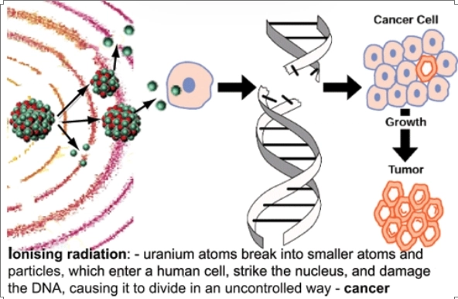
Radiation
Radiation is a type of energy released by atoms when they break down. Natural radiation comes from many sources including soil, water and air. Radon is a naturally-occurring gas seeping from from rock and soil that is the main source of natural radiation. People are also exposed to natural radiation from cosmic rays, particularly at high altitude.
Human exposure to radiation also comes from human-made sources ranging from nuclear power generation to medical uses such as X-ray machines.
Beyond certain thresholds, radiation can damage tissues and/or organs and can cause skin redness, hair loss and radiation burns,
Exposure to radiation can lead to a risk of long-term effects such as cancer, however, that may appear years or even decades later.
Damage to reproductive organs can lead to birth defects as mutated DNA is passed to offspring.
Ionizing radiation, health effects and protective measures

Slide 22
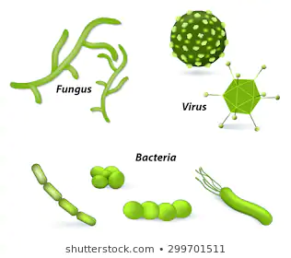
Microorganisms.
Bacteria cells are different from all other cells as they don’t have a nucleus. Tetanus, TB, Cholera, pneumonia are all bacterial diseases. Cholera is a bacterial disease often found in emergency camps with poor hygiene and crowded conditions.
Fungi can be single celled or can grow as threads or filaments. Yeast, mould and mushrooms are examples of fungi. Athlete’s foot, yeast and ringworm are examples of fungal diseases. Many fungi are useful such as edible fungi and fungi that produce antibiotics for medicine
A virus is not considered a living organism because it is not composed of cells. A virus must replicate inside a host cell it cannot reproduce itself. Measles, chicken pox, colds and the flu are all virus diseases. A virus cannot be destroyed with antibiotics. Viral infections such as colds are passed from person to person often by sneezing tiny droplets into the air that contain cells with viruses inside.

Slide 23
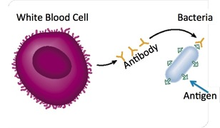
Pathogens and the bodies defence system
Microorganisms that cause disease are known as pathogens. The immune system defends the body against pathogens.
The general defence system has a number of ways to prevent the entry of all pathogens into the body. The skin acts as a barrier to pathogens, stomach acid kills many bacteria that may be in food, mucus and cilia in the breathing system trap bacteria.
White blood cells in the specific defence system produces antibodies to destroy particular pathogens when they are detected in the body. These antibodies can remain in the blood to provide long term protection against each pathogen.
Vaccines contain weakened version of a pathogen that stimulate the body to produce antibodies against a particular disease. The weakened pathogen will not cause a disease but will cause antibodies to be made.
Antigens are foreign proteins on the bacteria that the body fails to recognise as self proteins. Antigens stimulate antibodies

Slide 24
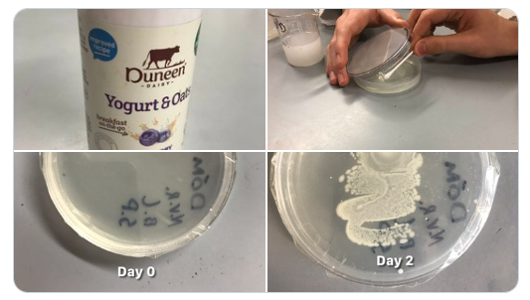
Growing bacteria
Microorganisms such as bacteria can be grown in suitable containers such as petri dishes that can easily be sealed with parafilm tape. Nutrient agar in the petri dish provides food for the bacteria to grow.
Aseptic techniques such as disinfecting bench, sterilising equipment and only slightly opening petri dish lids help prevent unwanted microorganisms contaminating the nutrient agar.
Procedure
Yoghurt drinks contain lactobacillus bacteria.
Use an inoculating loop or swab to transfer a small sample of yoghurt to agar in a dish. Seal the dish with tape. Place the dish in a warm place for 2-3 days and observe the growth of bacteria on the agar.
Inoculating agar plates with yoghurt bacteria.

Slide 25

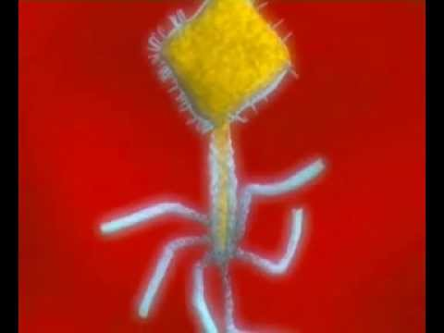
Video Links

Slide 26
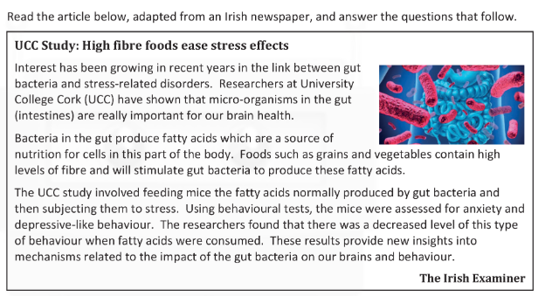
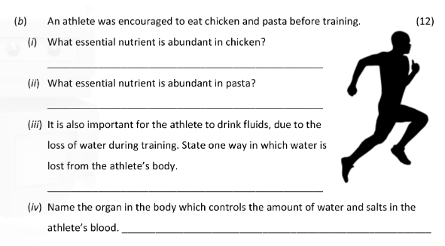
Questions
Human health is affected by environmental factors such as stress. Name another
environmental factor which has an effect on human health.
This article highlights a beneficial role of micro‐organisms in human health. State another
example of how bacteria could have an effect on human health.
Name a type of food that is high in fibre.
The study involved feeding mice fatty acids and then subjecting them to stress. Describe a
control experiment which the scientists could have used in this investigation.
What observation did the scientists note about the behaviour of the mice after they had
been fed fatty acids?

Slide 27
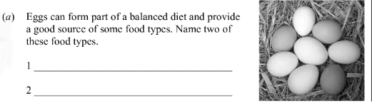
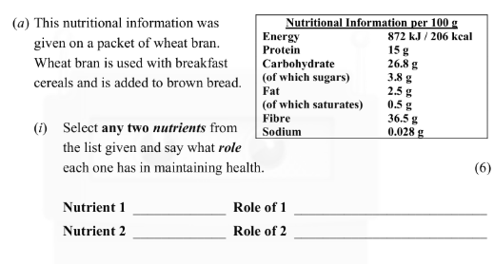
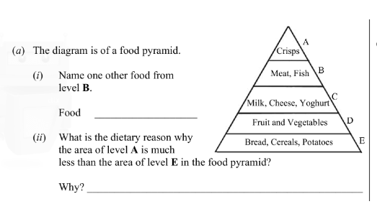
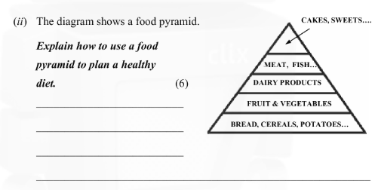
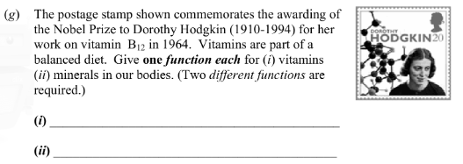

Slide 28
