Slide 1
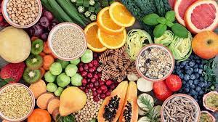
Dietary Fibre
How important and how much?

Slide 2
We will learn about :
          Composition – what is dietary fibre?
          Classification – the different types of fibre.
          Functions - what does fibre do in our bodies?
          Sources - how much we need and where we can get it.
          Deficiency – what happens if we don’t get enough fibre?

Slide 3
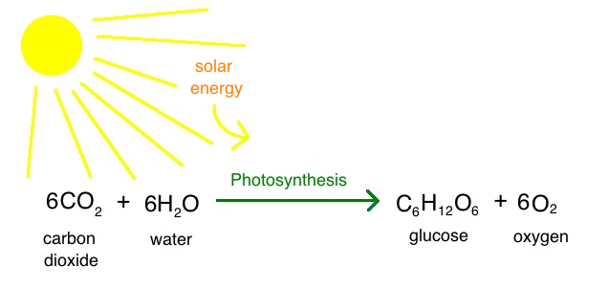
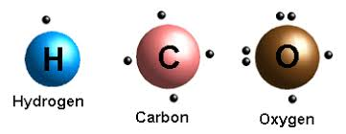
The Composition of Carbohydrates
Through the process of photosynthesis, plants can use sunlight to convert carbon dioxide from the air and water into glucose and oxygen.
All carbohydrates are made from carbon, hydrogen and oxygen, which come together in different ways to make simple sugars like glucose and fructose or more complex sugars like starch and fibre.

Slide 4
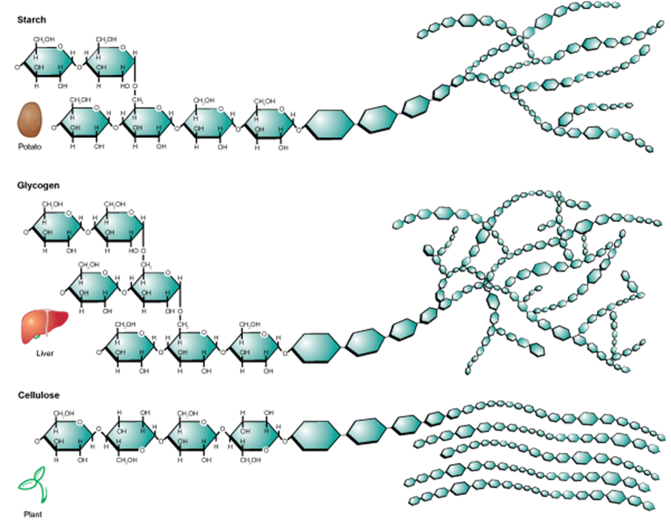
The Classification of Dietary Fibre
Along with simple sugars and starches there is a third type of carbohydrate called dietary fibre.
Unlike sugars and starches we do not have enzymes that break down the links in the long chains that make up fibre.
The fact that we cannot fully digest fibre is the main reason why it’s so important for us to eat it!

Slide 5
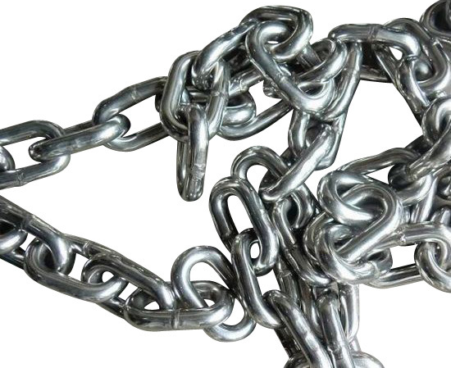
The Classification of Dietary Fibre
There are two main categories of fibre – soluble and insoluble. Most plant foods contain a mixture of both. We need both as they both have many benefits.
Both are made of long carbohydrate chains.
These cannot be broken in our stomachs or as they travel through our guts. That means that we do not digest them.

Slide 6

The Classification of Dietary Fibre
Soluble fibre can absorb water. It acts like a sponge and becomes bigger in our stomachs and guts. It fills us and slows the movement of food through our digestive tract.

Slide 7
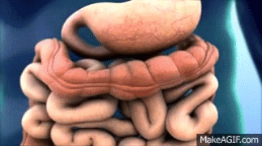
The Classification of Dietary Fibre
Insoluble fibre does not absorb water it is ‘waterproof’ and passes through our guts unchanged. It provides the bulk that pushes everything along.

Slide 8

The Classification of Dietary Fibre
So while soluble fibre slows the digestion of food down insoluble fibre keeps things moving.

Slide 9
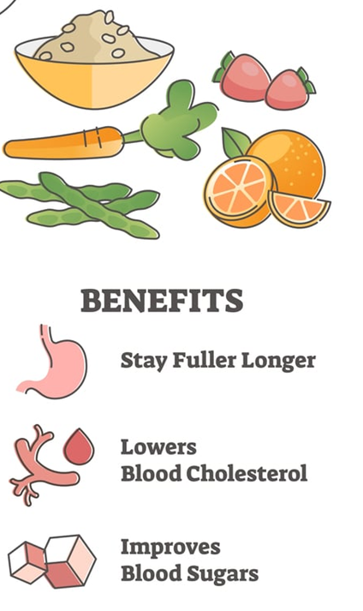
Why Do We Need Fibre? Functions
Soluble fibre absorbs water so it makes us feel full. It slows down digestion and reduces levels of cholesterol and sugar in our blood.

Slide 10
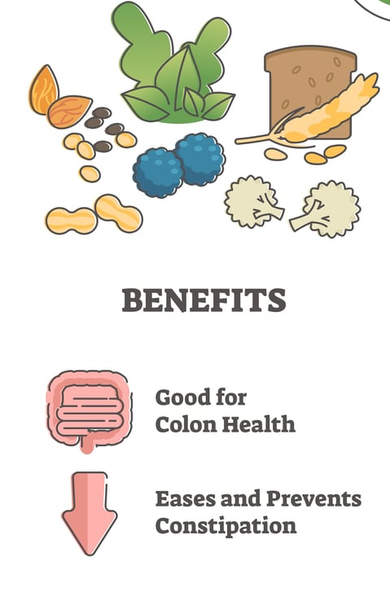
Why Do We Need Fibre? Functions
Insoluble fibre adds bulk to poo (faeces) which keeps food moving through our digestive tract.

Slide 11
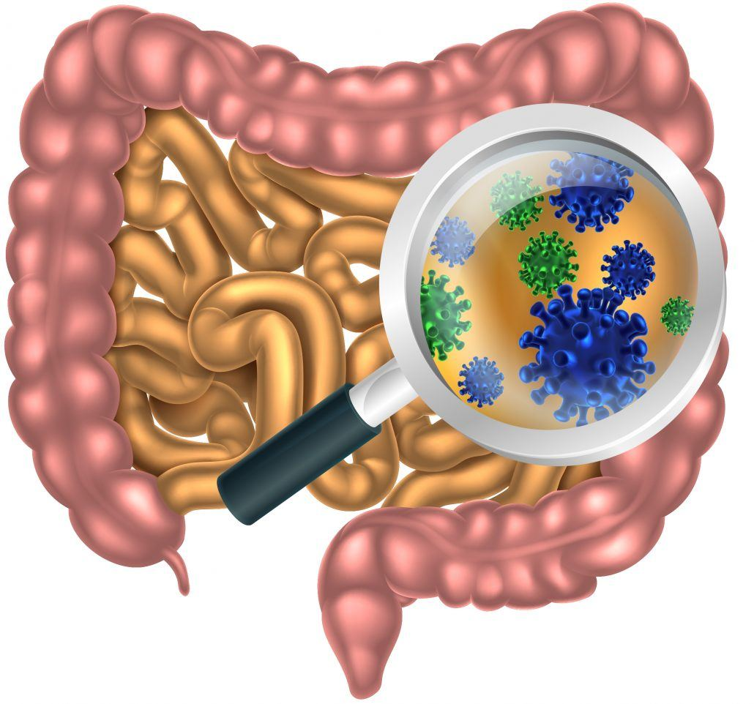
Why Do We Need Fibre? Functions
Fibre also feeds the good bacteria in our gut, helping to improve digestion and our immune systems.

Slide 12
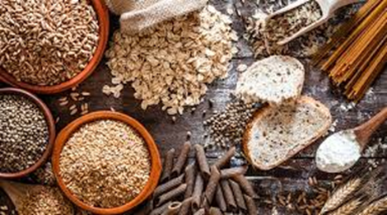
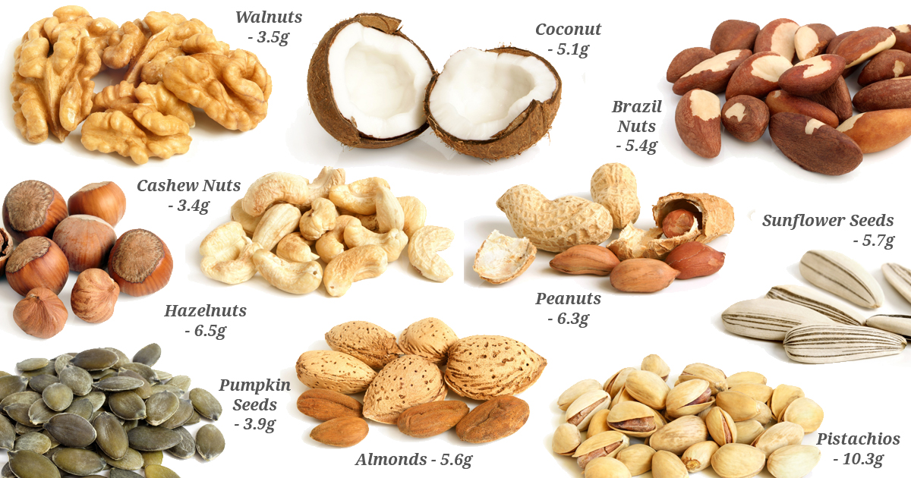
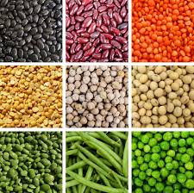
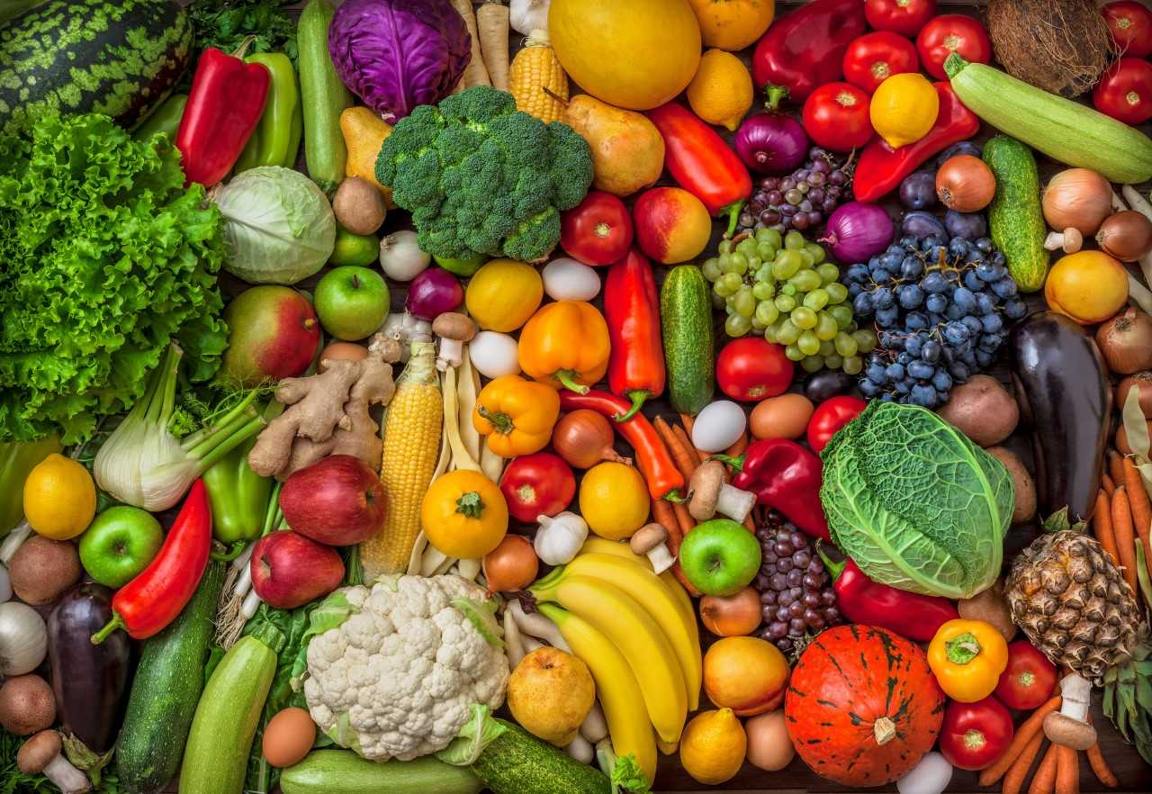
Sources of Fibre
Grains and Cereals
Nuts and Seeds
Fruit and Vegetables
Beans, Peas and Lentils

Slide 13

How Much Fibre Do We Need?
Reference Intake for Adults
Adults need between 25 and 35 grams of fibre per day.
As we have become more used to eating processed foods our fibre intake has decreased. In Ireland most of us do not eat enough fibre.
In fact, almost 80% of Irish Adults do not eat enough fibre.

Slide 14
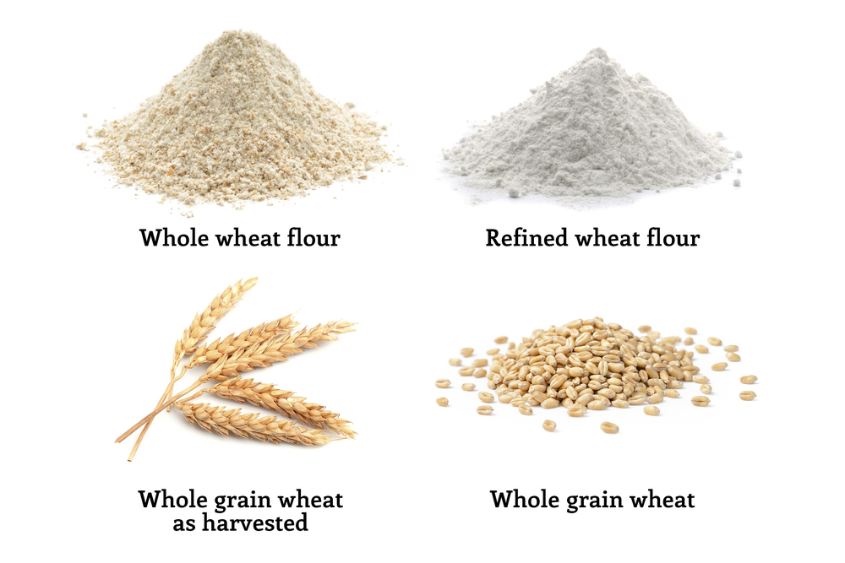
How to increase fibre intake
Fibre is the edible part of plant foods that we cannot digest.
The outer parts of fruit, vegetables, cereals and grains contain important fibre.
When food is processed or refined this is often taken away.

Slide 15

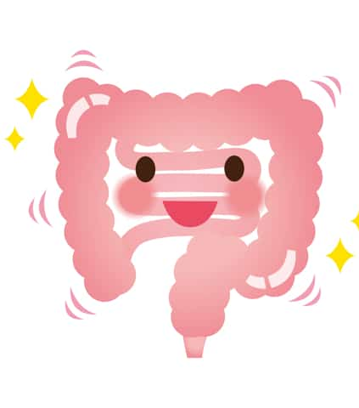
Make One Simple Switch!
Simple switches can make a big difference!
Switch from white to brown – brown bread, rice and pasta.
Switch to wholegrain breakfast cereals – porridge, oat/wheat/bran flakes or Weetabix/Shredded Wheat.
Switch sugary snacks to fruit, veg. and nuts - skin and all where possible.
Switch something on your plate to more vegetables/salads.
Remember to drink water. Fibre + water =

Slide 16
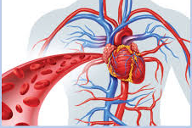
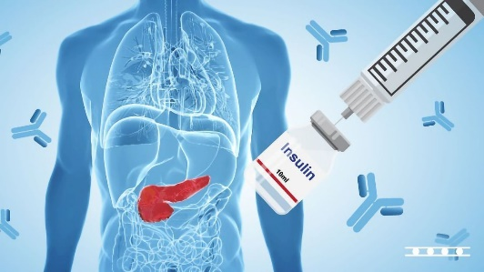

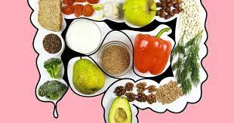
Deficiency- Why we need fibre
Increasing dietary fibre and wholegrain intake is likely to reduce the risk of
cardiovascular disease
type 2 diabetes
weight gain and obesity
some forms of cancer like bowel cancer

Slide 17
References
Slide 1 – https://everydayhealth.com
Slides 3 - ps://cdn.kastatic.org/ka-perseus-images/b5696ba86426f4fcc8be09e1a910f0033d241d24.png
https://encrypted-tbn0.gstatic.com/images?q=tbn:ANd9GcT8yfmYpV0T0tPmld5N2sT-R9C1Q-FmRtXiZg&usqp=CAU
Slide 4 = https://content.byui.edu/file/a236934c-3c60-4fe9-90aa-d343b3e3a640/1/module3/images/polysaccharides2.png
Slide 5 - https://image.made-in-china.com/202f0j00BMVaPRHGsnif/Unbreakable-Metal-Transport-Chain-General-Professional-Manufacture.jpg
Slide 6 - https://c.tenor.com/onFX1-dIQiMAAAAC/sponge-absorbs.gif
Slide 7 - https://www.peirsoncenter.com/uploads/6/0/5/5/6055321/published/3d-medical-animation-peristalsis-in-large-intestine-bowel-abp_1.gif?1556581429
Slide 8 - https://www.kelloggs.com.au/content/dam/Australia/kelloggs_au/images/articles/Kelloggs-FD-1.png
Slide 9 and 10 – https://solutionpharmacy.in/wp-content/uploads/2021/10/Dietary-Fibers.jpeg
Slide 11 – https://askthescientists.com/wp-content/uploads/2017/06/AdobeStock_95614915-1030x962.jpg
Slide 12 -https://encrypted-tbn0.gstatic.com/images?q=tbn:ANd9GcT0MIC6DD9lbqMnWmHkpsRZmOeovlObWLC_xQ&usqp=CAU
https://encrypted-tbn0.gstatic.com/images?q=tbn:ANd9GcT0MIC6DD9lbqMnWmHkpsRZmOeovlObWLC_xQ&usqp=CAU
https://encrypted-tbn0.gstatic.com/images?q=tbn:ANd9GcRdwTxWTwLHaL3mA65jIp2ILEw50KjP3tGvMA&usqp=CAUhttps://cdn1.sph.harvard.edu/wp-content/uploads/sites/21/2018/07/fruitveg.jpeg
https://www.weightlossresources.co.uk/img/h/high-fibre-nuts-seeds.jpg

Slide 18
References
Slide 14 - https://wp-public-fs.s3.ap-south-1.amazonaws.com/tasks/15ec7edeed894b90ef20bc8095398c4b429a19205bbdfb/images/wheat-flour-5ecbd80ec6cba.jpg
Slide 16 - https://encrypted-tbn0.gstatic.com/images?q=tbn:ANd9GcQ9ZnY4oW8Ow2NsHUOhak36tXoaQOEdxiE-qQ&usqp=CAU
https://assets.technologynetworks.com/production/dynamic/images/content/353685/early-detection-of-autoantibodies-in-type-1-diabetes-mellitus-and-treatment-possibilities-beyond-353685-1280x720.jpg?cb=11416947
https://cdn-dmppo.nitrocdn.com/MQtLRDiaOJqaiAMiKiWzfYWFElqSrNJq/assets/static/optimized/rev-aa2de13/wp-content/uploads/2020/12/gi-and-weight-management.jpg
https://gi.md/

