Slide 1
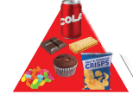
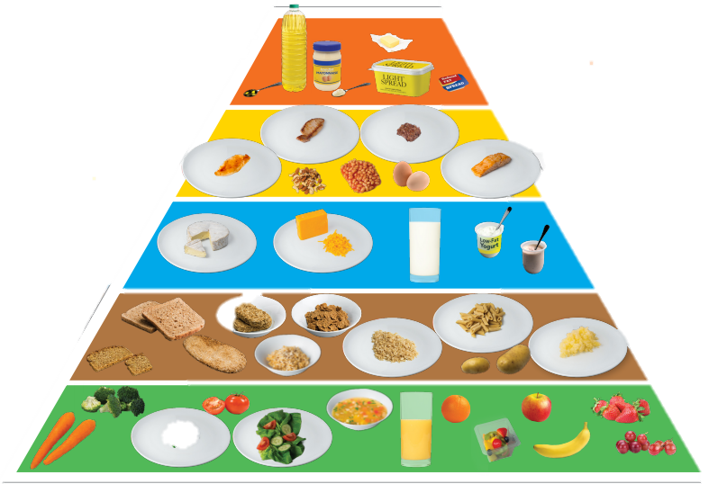
Fat –Soluble
Vitamins

Slide 2
We will learn about:
          - what fat soluble vitamins are
          - the role, sources and deficiencies of vitamins A, D, E and K

Slide 3
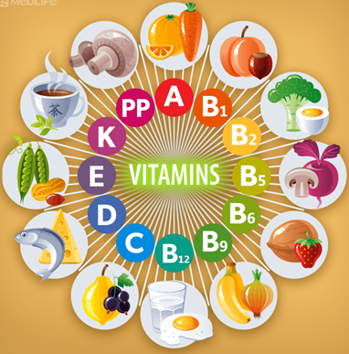
Vitamins are vital for life.
Vitamins
Vitamins are micronutrients that are necessary for our bodies to function well.

Slide 4
Vitamins – classification
B Group
and
C
Water-Soluble
Vitamins
Fat-Soluble Vitamins
AD
E
K

Slide 5
Fat-Soluble Vitamins
A
D
E
K
These vitamins can be stored in fat cells in the body

Slide 6
Water-Soluble Vitamins
B Group
and C
They cannot be stored in the body

Slide 7
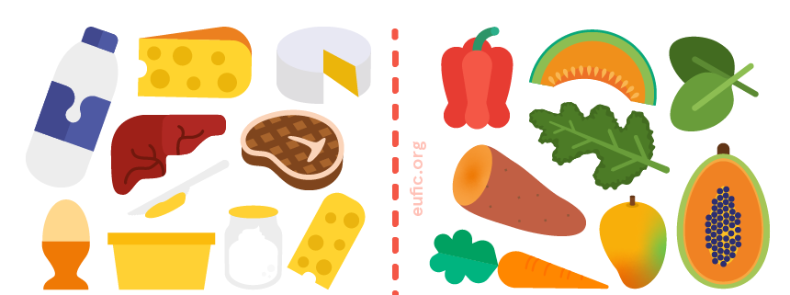
Vitamin A is found in animal products. We can make it from a provitamin (carotene), found in colourful vegetables.
A
Sources of Vitamin A- milk, meat, eggs, butter, oily fish
Sources of provitamin A/carotene

Slide 8
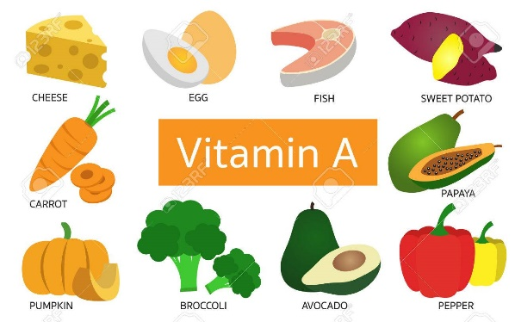

Vitamin A - Functions
Healthy hair
Healthy eyes and good eyesight
Healthy linings to nose, mouth and throat
Healthy skin
Good GROWTH

Slide 9
Vitamin A - Deficiencies
Linings of nose, mouth and throat are dry and irritated
Night Blindness
Dry skin
Delayed Growth

Slide 10
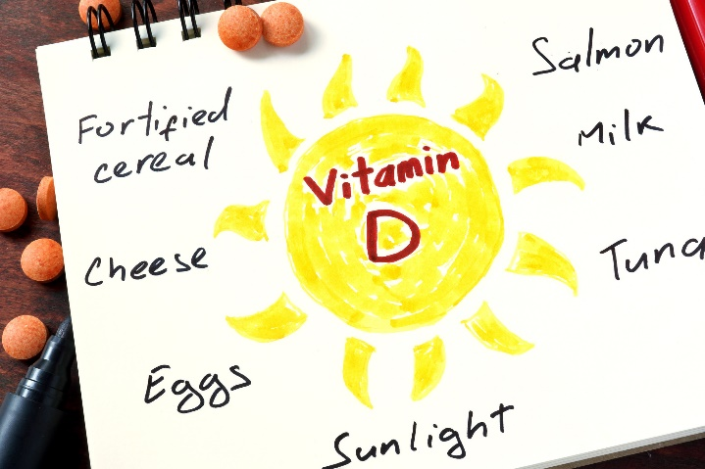
Vitamin D the Sunshine Vitamin
D
Our bodies can produce vitamin D from sunlight. Or we can get it from
oily fish – such as salmon, sardines, herring and mackerel
red meat
liver
egg yolks
fortified foods – such as some fat spreads and breakfast cereals

Slide 11
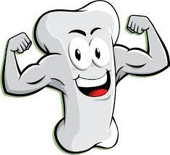
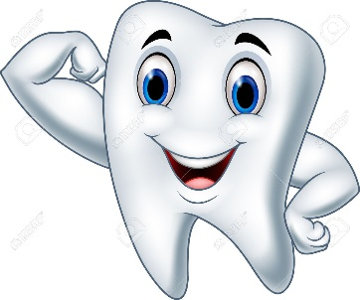

Vitamin D - Functions
Vitamin D is needed to absorb calcium for healthy bones and teeth
10-30 mins sunshine calcium healthy bones and teeth
Calcium

Slide 12
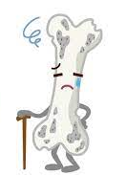
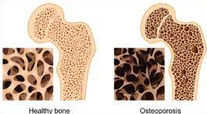
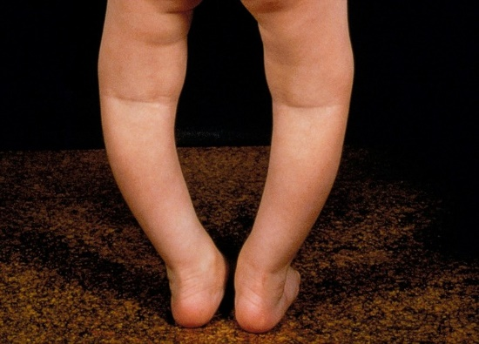
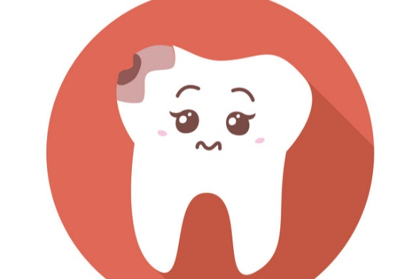
Vitamin D - Deficiencies
Rickets in children or osteomalacia in adults
Osteoporosis in adults
Tooth decay

Slide 13
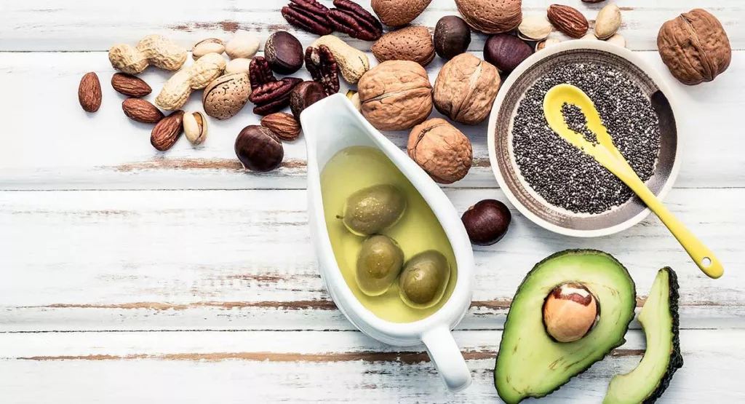
Vitamin E
E
We get vitamin E from nuts, seeds, vegetable oils and cereals

Slide 14

Vitamin E – Functions and Deficiencies
We need small amounts of vitamin E for healthy skin and eyes and for our immune systems.
We usually get enough vitamin E from our diets and deficiencies are rare.

Slide 15
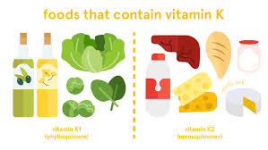
Vitamin K
K
We get vitamin K green vegetables, vegetable oils, cheese and butter. Bacteria in our guts can make it too.

Slide 16
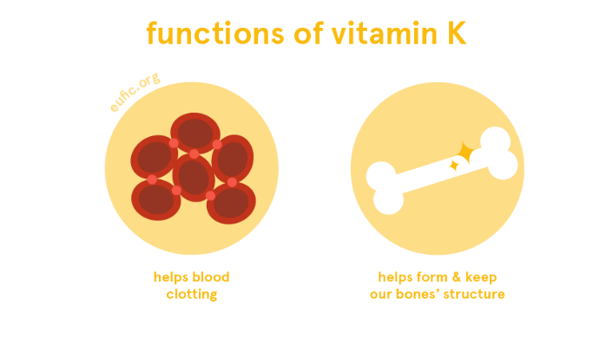
Vitamin K – Functions and Deficiencies
K
We need small amounts of vitamin K for blood clotting and bone health.
We usually get enough from our diets and deficiencies are rare.

Slide 17
Acknowledgments
Slide 1- hse.ie
Slide 3 - https://plantlet.org/wp-content/uploads/2020/11/vitamins-benefits-deficiency-test-diet.png
Slide 7 - https://www.eufic.org/en/images/uploads/images/VitaminA_Images-02.png
Slide8 - https://previews.123rf.com/images/gridsadaarm/gridsadaarm1701/gridsadaarm170100001/68663536-vitamin-a-food-sources-on-white-background-.jpg , https://illustoon.com/photo/5592.png
Slide 10 - https://domf5oio6qrcr.cloudfront.net/medialibrary/9211/iStock-491870546-Copy.jpg
Slide 11 - https://encrypted-tbn0.gstatic.com/images?q=tbn:ANd9GcTY09Rw2o_rt8B6XyWUHp-Slu-aeFcqFKYsC69OZEO-PaV5wrAsTeZTVES3k1TGDyN-Uus&usqp=CAU , https://i.pinimg.com/originals/ee/7a/7f/ee7a7f416c1e502edb3fde13a154e8ea.jpg
Slide 12 - https://406044-1278364-1-raikfcquaxqncofqfm.stackpathdns.com/wp-content/uploads/2019/10/Ricket_in_children_780x560.jpg , Theindependentbd.com , https://www.awildsmile.com/blog/wp-content/uploads/2017/12/QRfHUbz.jpg
Slide 13 - https://www.wondriumdaily.com/wp-content/uploads/2020/11/E-Feature-1024x555.jpg
Slide 14 - https://www.eufic.org/en/images/uploads/images/VitaminE_Images-01.png
Slide 15 - https://www.eufic.org/en/images/uploads/images/VitaminK_Images-02.png
Slide 16 - https://www.eufic.org/en/images/uploads/images/VitaminK_Images-01.png

