Slide 1
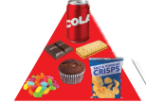
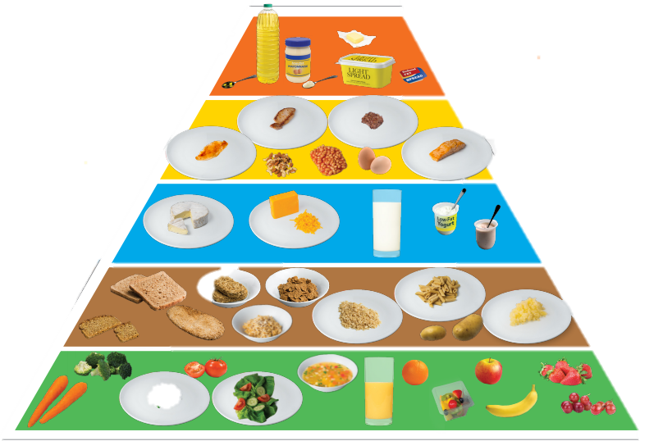
Water-Soluble Vitamins

Slide 2
We will learn about:
          - what water-soluble vitamins are
          - the role and sources of B group and C vitamins
          - what vitamin deficiencies look like

Slide 3
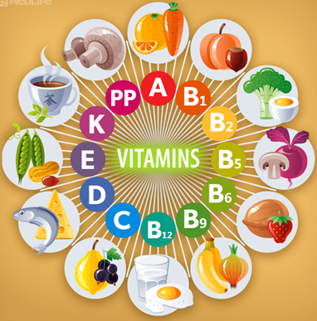
Vitamins are vital for life.
Vitamins
Vitamins are micronutrients that are necessary for our bodies to function well.

Slide 4
Vitamins – classification
B Group
and
C
Water-Soluble
Vitamins
Fat-Soluble Vitamins
AD
E
K

Slide 5
Water-Soluble Vitamins
B Group
and
C
They are not stored in our bodies.

Slide 6
B Complex Vitamins and Folic Acid
B
There are eight vitamins in this group
B12
B1
B2
B7
FOLIC
ACID
B3
B6
B5

Slide 7
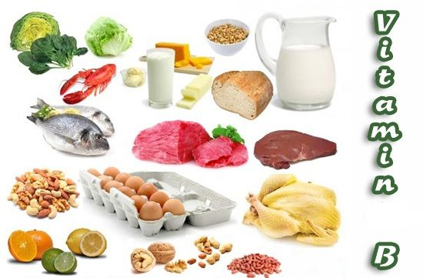

B Vitamins - Sources
B
Meat, fish, dairy, fruit, veg. eggs, mushrooms and fortified cereals
We should be able to get all of our B complex vitamins by eating a balanced and varied diet.

Slide 8
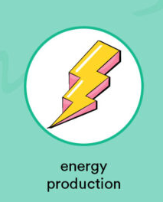

B Vitamins - Functions
B
The main functions of the B complex vitamins are controlling energy release from food that we eat and a healthy nervous system.

Slide 9
B Vitamins - Deficiencies
B
We need all of the B vitamins everyday as we don’t store them. Low levels cause tiredness, poor hair skin and nails, low mood and energy, delayed growth and very serious disease like Beriberi and Pellagra.

Slide 10
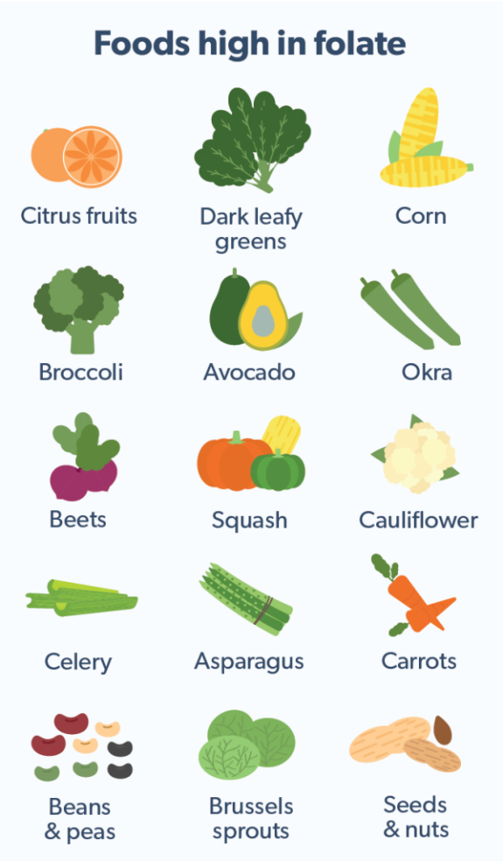
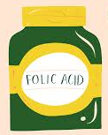
Folic Acid - Sources
B
The B Vitamin Folic Acid is very important and deserves special attention.

Slide 11
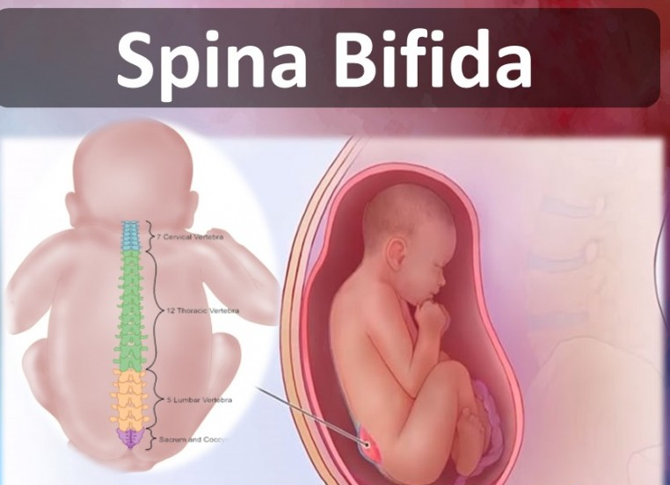
Folic Acid - Functions
B
Taking folic acid helps to prevent neural tube defects such as spina bifida.

Slide 12
Folic Acid - Deficiencies
B
If a woman could get pregnant it is very important to take folic acid supplements. If levels are low the baby is at risk of neural tube defects.

Slide 13
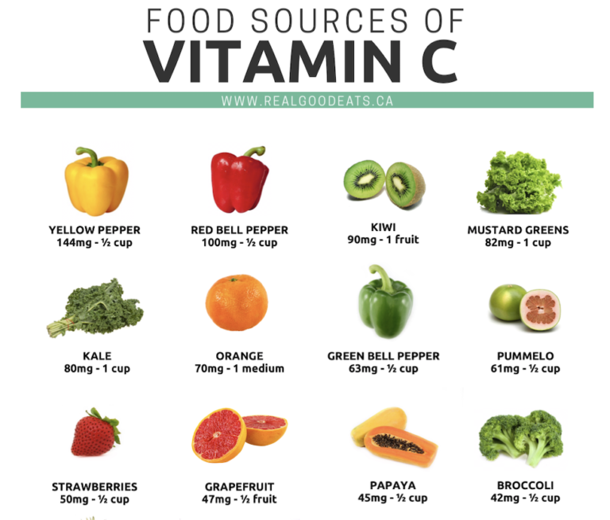
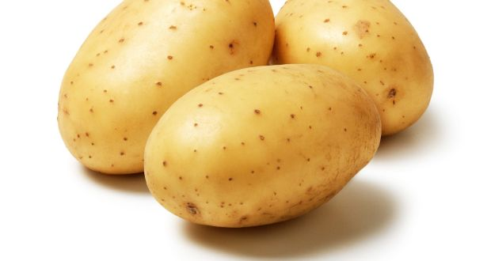
Vitamin C - Sources
C
Vitamin C Sources
Potatoes with skin

Slide 14

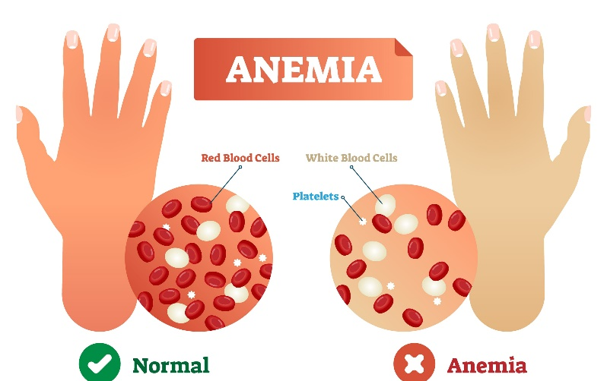
Vitamin C - Functions
C
Healing of wounds
Good immune function
Healthy skin, blood vessels, bones and cartilage
Helps in the absorption of iron

Slide 15
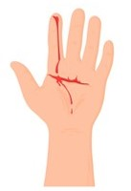

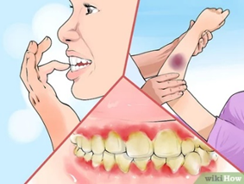
Vitamin C - Deficiencies
C
Vitamin C is needed to absorb iron so a lack if it can result in low iron or anaemia.
Delayed wound healing
Greater risk of colds
Severe deficiency leads to scurvy

Slide 16
Acknowledgments
Slide 1 – hse.ie
Slide 3 – https://plantlet.org/wp-content/uploads/2020/11/vitamins-benefits-deficiency-test-diet.png
Slide 8 - https://post.greatist.com/wp-content/uploads/sites/2/2021/12/496875-Why-Vitamin-B-Complex-Is-Basically-Bae-1296x1957-Body-858x1296.jpg
Slide 9 - https://i.pinimg.com/736x/3f/82/f0/3f82f073f8acc234b2803be58b67f5b7.jpg
Slide 10 - https://www.theguardian.com/society/2018/jan/31/folic-acid-new-research-is-a-game-changer-in-push-to-fortify-british-foods
Slide 12 - https://www.mindbodyheal.co.uk/spina-bifida-neural-tube-defect-ntd/ , https://www.verywellfamily.com/folic-acid-for-female-and-male-fertility-1959878
Slide 13 - https://ro.co/health-guide/folic-acid-for-men/ , https://www.realgoodeats.ca/food-sources-of-vitamin-c-2/
Slide 14 - https://www.eufic.org/en/images/uploads/images/VitaminE_Images-01.png
Slide 15 - https://1q41s9463ffl3qbxsn1jev2i-wpengine.netdna-ssl.com/wp-content/uploads/2013/02/iStock-1030518842.jpg , https://www.eufic.org/en/images/uploads/images/VitaminE_Images-01.png , https://www.wikihow.com/images/thumb/d/d6/Diagnose-and-Treat-Scurvy-Step-2.jpg/v4-460px-Diagnose-and-Treat-Scurvy-Step-2.jpg.webp

