Slide 1

Notes:
https://www.nationalww2museum.org/sites/default/files/styles/wide_medium/public/2021-04/league%20flag%20-%20Collin%20Makamson.png

Slide 2
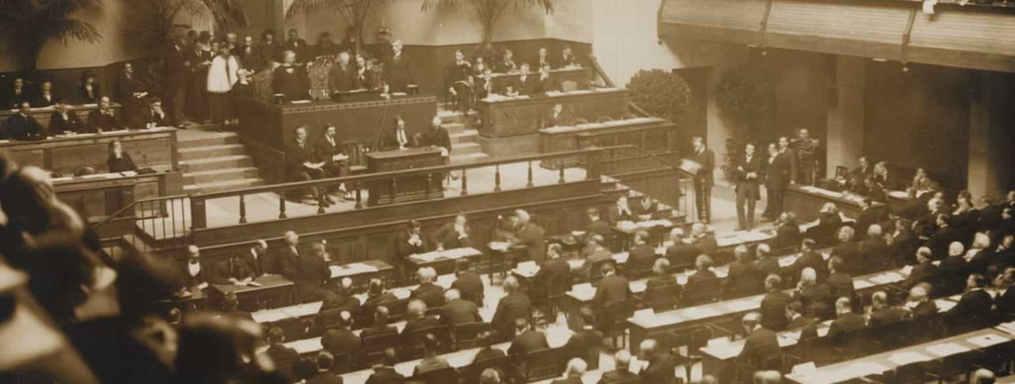
Formation of the League of Nations
Notes:
https://media.snl.no/media/60647/article_topimage_No-nb_bldsa_5c006.jpg

Slide 3
Today’s Lesson
What was the League of Nations?
Why was it founded?
Who was Woodrow Wilson?
What work did the League of Nations engage in?
How was it structured?
What is it’s legacy?
Notes:
https://upload.wikimedia.org/wikipedia/commons/2/20/Colorized_portrait_of_Thomas_Woodrow_Wilson.jpeg

Slide 4
League of Nations
The League of Nations was an international body established following the Fourteen Points plan proposed by U.S. President Woodrow Wilson.
Its creation was a consensus among the Allies with the goal of resolving international conflicts, thereby aiming to eliminate the risk of another war.
Notes:
https://upload.wikimedia.org/wikipedia/commons/2/20/Colorized_portrait_of_Thomas_Woodrow_Wilson.jpeg

Slide 5
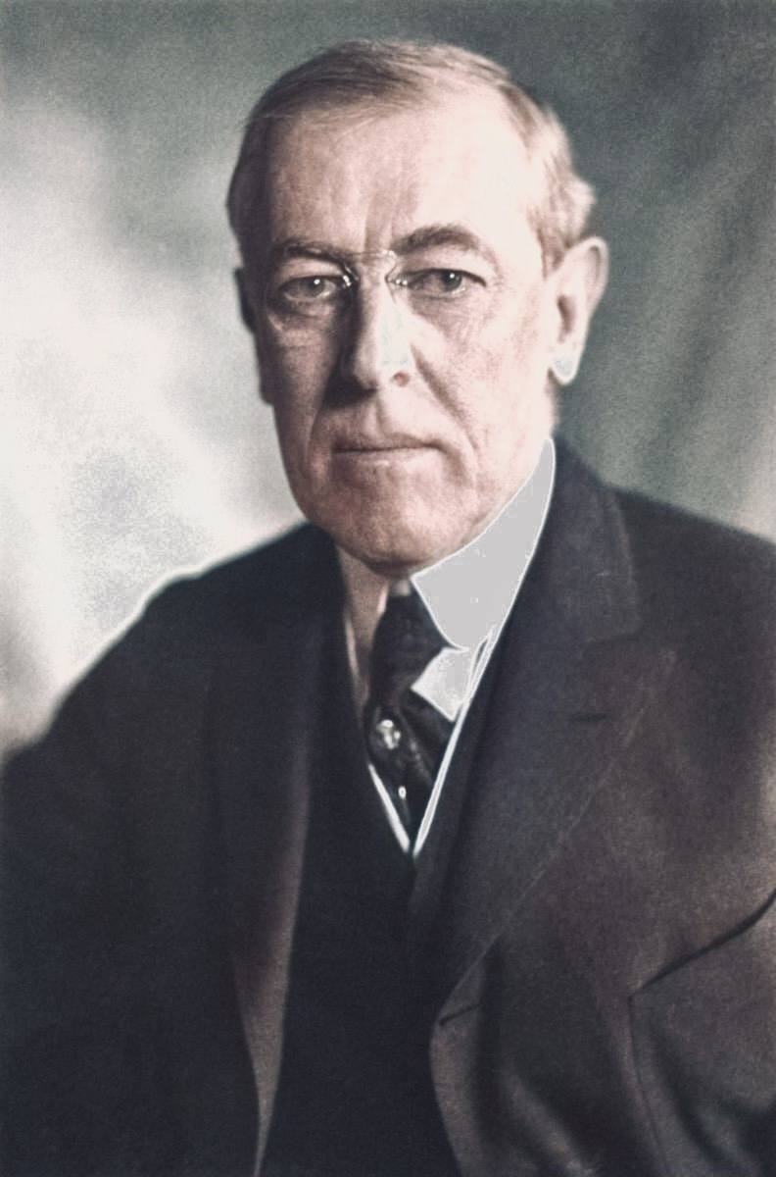
Woodrow Wilson
In January 1918, President Wilson put forth his Fourteen Points plan to the U.S. Congress, as a roadmap to restore peace in the aftermath of World War I.
A central proposal of his plan was the formation of a global institution tasked with mediating international disputes and conflicts.
By December, Wilson had presented his Fourteen Points in Paris, and this framework subsequently underpinned the Treaty of Versailles.
Notes:
https://upload.wikimedia.org/wikipedia/commons/2/20/Colorized_portrait_of_Thomas_Woodrow_Wilson.jpeg

Slide 6
Woodrow Wilson
The concept of founding the League garnered more support abroad than it did in the US.
Republican opposition arose in the US due to concerns that the treaty might infringe upon American sovereignty in global affairs and potentially embroil them in additional wars.
Many Americans, following WWI, preferred a policy of ‘isolationism’, which would continue until the Japanese attacked Pearl Harbour during WWII
Consequently, the treaty failed to gain ratification from the US Congress, leading to America's decision not to join the League of Nations.

Slide 7
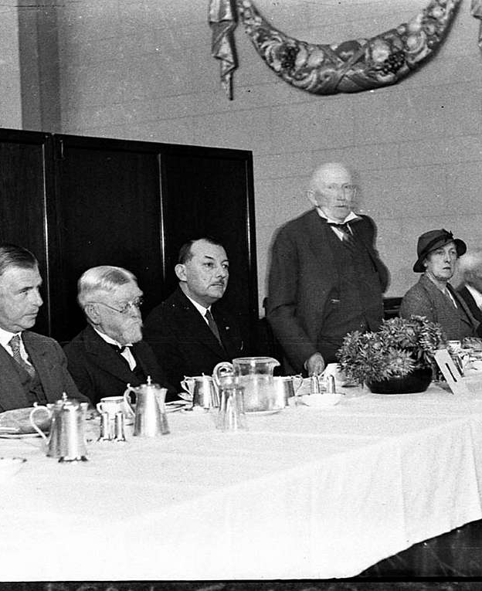
The Council
The Council of the League of Nations comprised four permanent members: Italy, France, Japan, and the UK.
Additional temporary members could be elected to join.
The Council's mandate was to handle issues related to global peace, and they convened five times annually, or during emergencies as needed.
Ireland was elected to the Council in 1930
Notes:
https://cdn2.picryl.com/photo/1935/11/05/slnsw-85638-speech-at-unidentified-dinner-league-of-nations-471f1e-1024.jpg

Slide 8
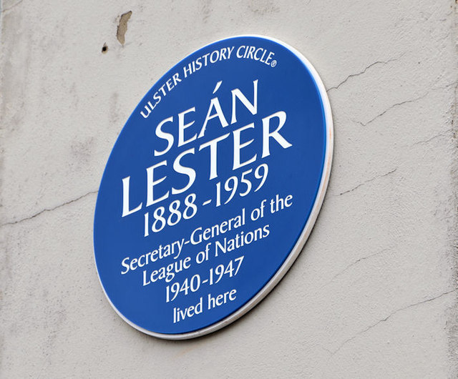
The Secretariat
The civil service section of the League, managed by a Secretary-General, was tasked with preparing meeting agendas and maintaining official records.
An Irishman, Sean Lester, became the Secretary-General in 1940 & served until the dissolution of the League of Nations in 1946
Notes:
https://upload.wikimedia.org/wikipedia/commons/e/e0/Bundesarchiv_Bild_102-02454%2C_Genf%2C_Schlusssitzung_des_V%C3%B6lkerbundrates.jpg

Slide 9
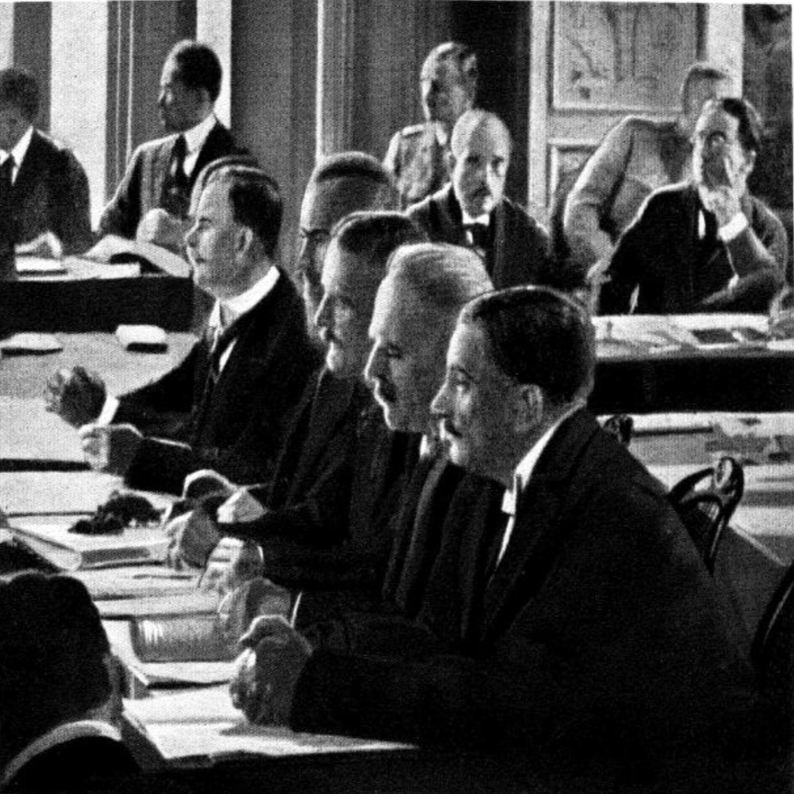
The Assembly
The Assembly of the League was made up of delegates from each member nation.
They convened for an annual session.
Each member held one vote, which they could use to suggest a course of action to the Council or to vote on the admission of a new country.
Notes:
https://upload.wikimedia.org/wikipedia/commons/4/4f/The_German_Delegates_Receiving_the_Draft_of_the_Treaty_of_Versailles%2C_May_7%2C_1919.png

Slide 10
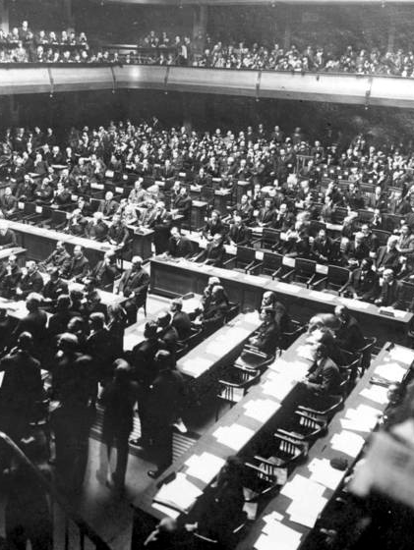
Permanent Court of International Justice
The Permanent Court of International Justice aimed to settle international disputes through legal means.
Comprising 15 judges, it addressed a wide array of global legal issues, setting precedent for international law.
However, it faced challenges, including limited enforcement capabilities and non-universal membership.
Despite its dissolution in 1946, the Court's legacy is significant, forming the basis for its successor, the United Nations' International Court of Justice, continuing to shape the landscape of international law and justice.

Slide 11
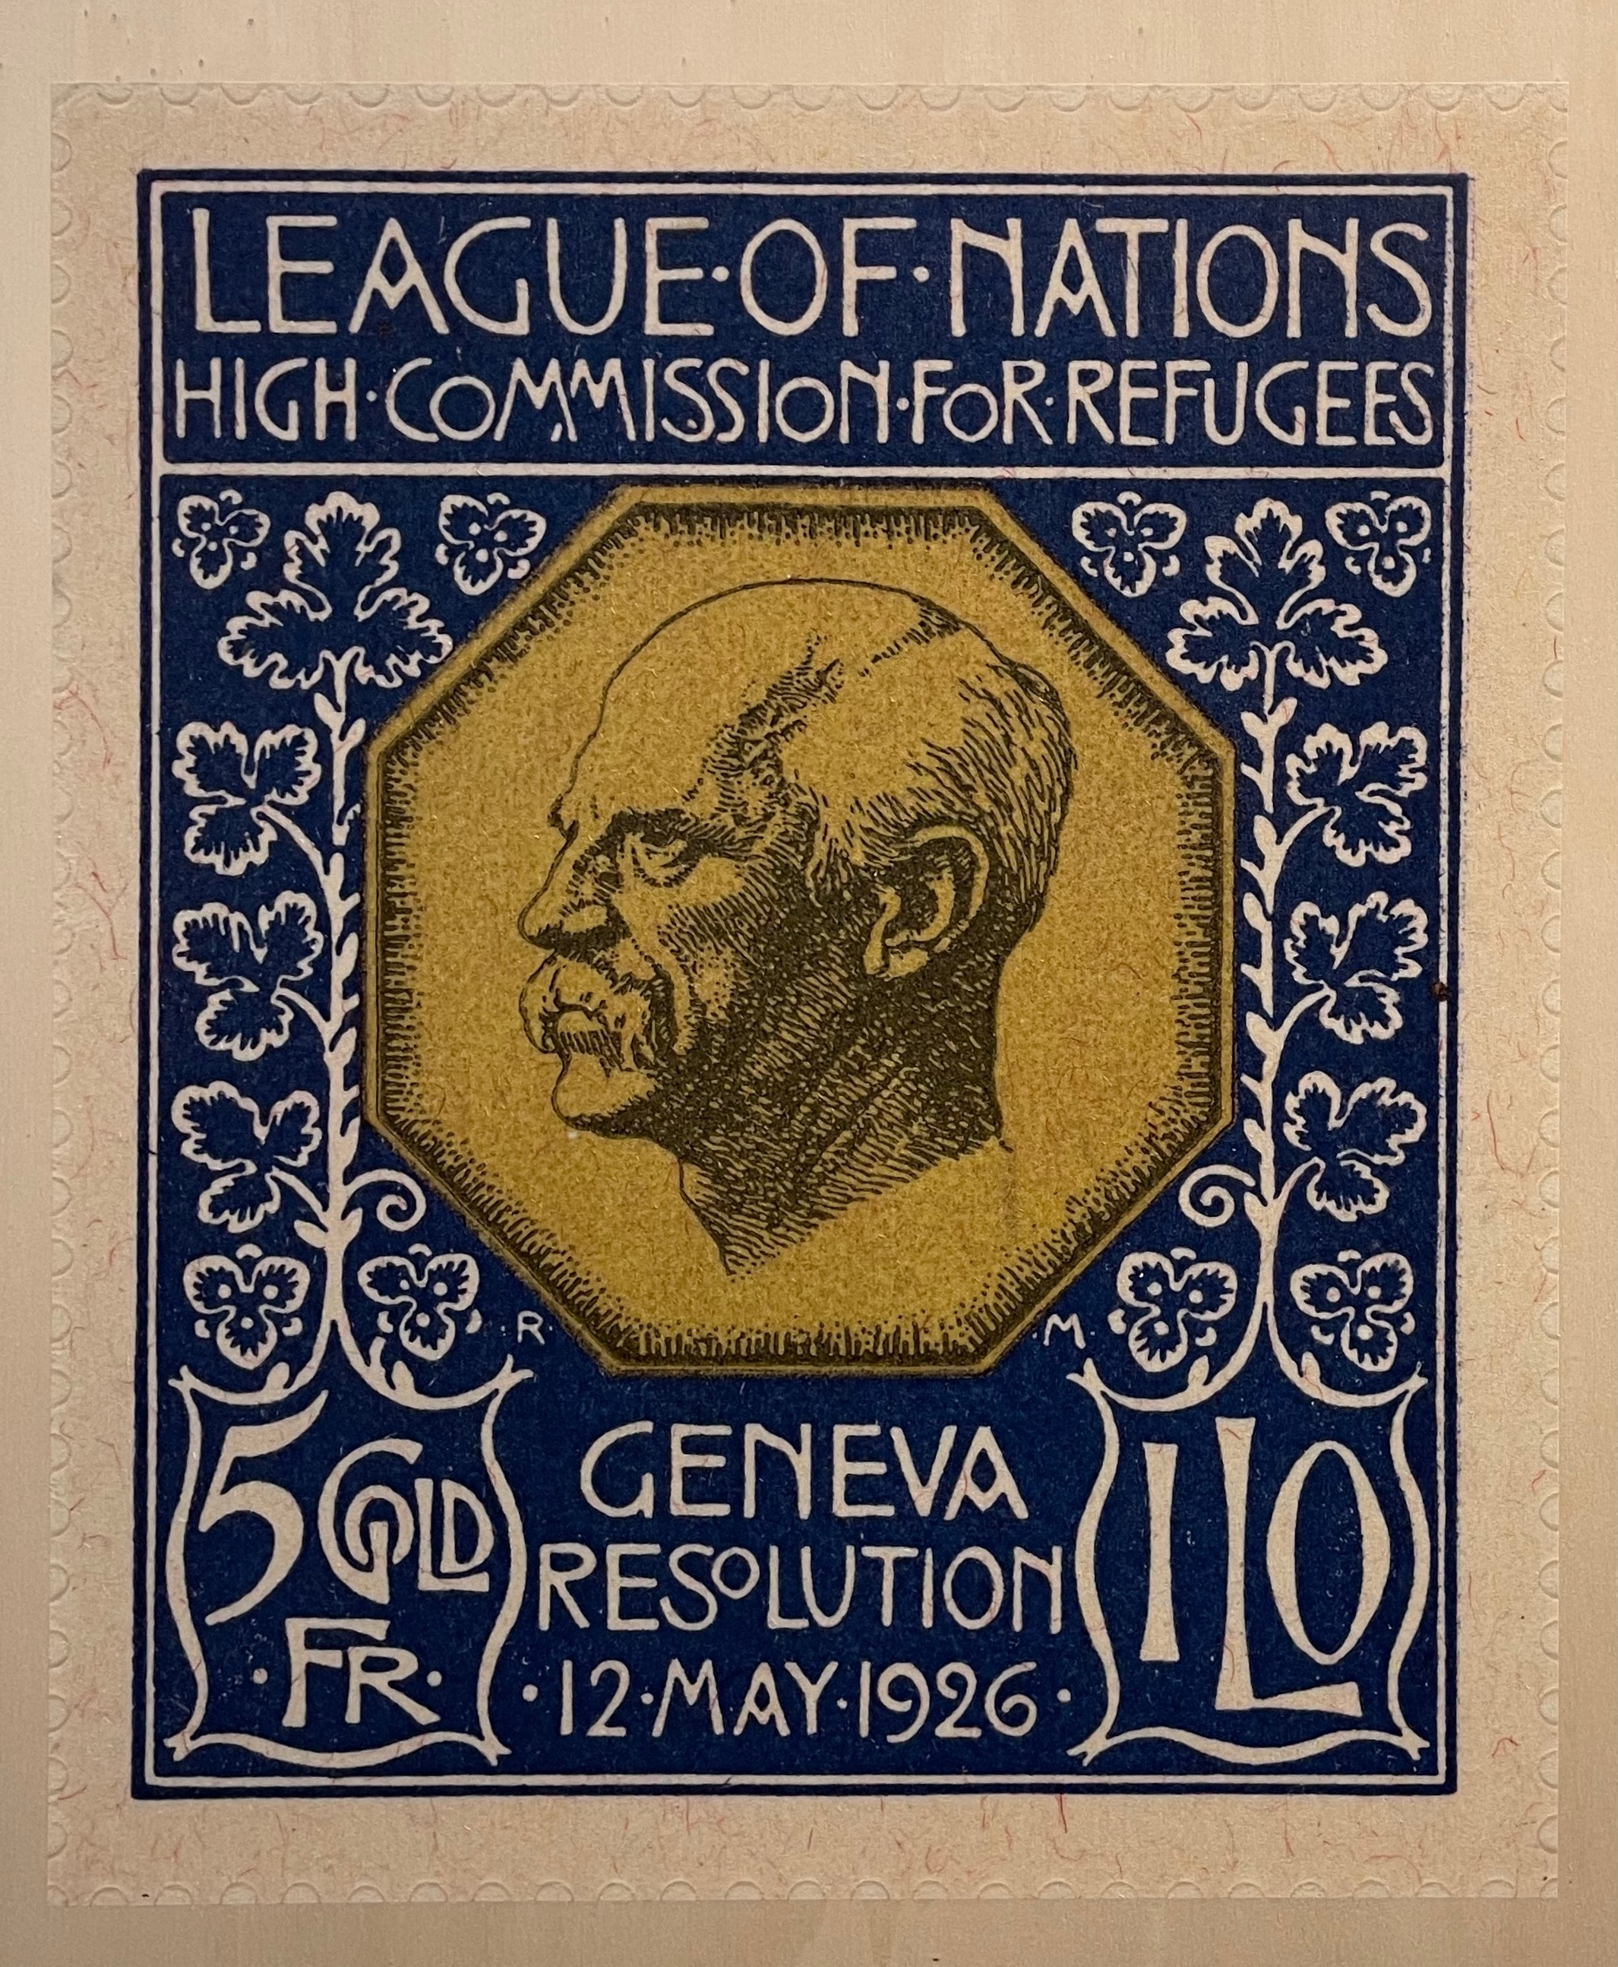
Refugee Commission
The League of Nations High Commission for Refugees, established in 1921, was instrumental in assisting displaced individuals following World War I and the Russian Revolution.
This body provided crucial humanitarian aid, facilitating resettlement, and securing legal rights for refugees.
It focused on issuing Nansen Passports, recognized by over 50 countries, offering stateless people a form of identity and the ability to cross borders legally.
The Commission's work laid the groundwork for future international refugee aid protocols and organizations, notably the United Nations High Commissioner for Refugees, fundamentally shaping global refugee policies and humanitarian responses.
Notes:
https://upload.wikimedia.org/wikipedia/commons/6/6d/Nansen_passport_stamp_%28League_of_Nations_High_Commision_for_Refugees_Geneva_Resolution_12_May_1926_5_Gold_Francs%29_Nansenpass_frimerke_oblat_Fridtjof_Nansen_%28utstilling_Nasjonalbiblioteket%29_9186.jpg

Slide 12
Slavery Commission
Established in 1924, the League of Nations' Slavery Commission marked a significant global step towards the eradication of slavery and the slave trade.
This committee aimed to gather information about the extent of slavery worldwide and worked to develop strategies to end these practices.
It produced a range of reports documenting the persistence of slavery, which helped raise global awareness about this egregious violation of human rights.
The Commission's efforts culminated in the 1926 Slavery Convention, the first international treaty to address slavery, which committed signatory nations to end the practice within their territories.
Although the League lacked enforcement mechanisms, the Commission's work signalled an international commitment to end slavery and laid the groundwork for future antislavery initiatives.

Slide 13
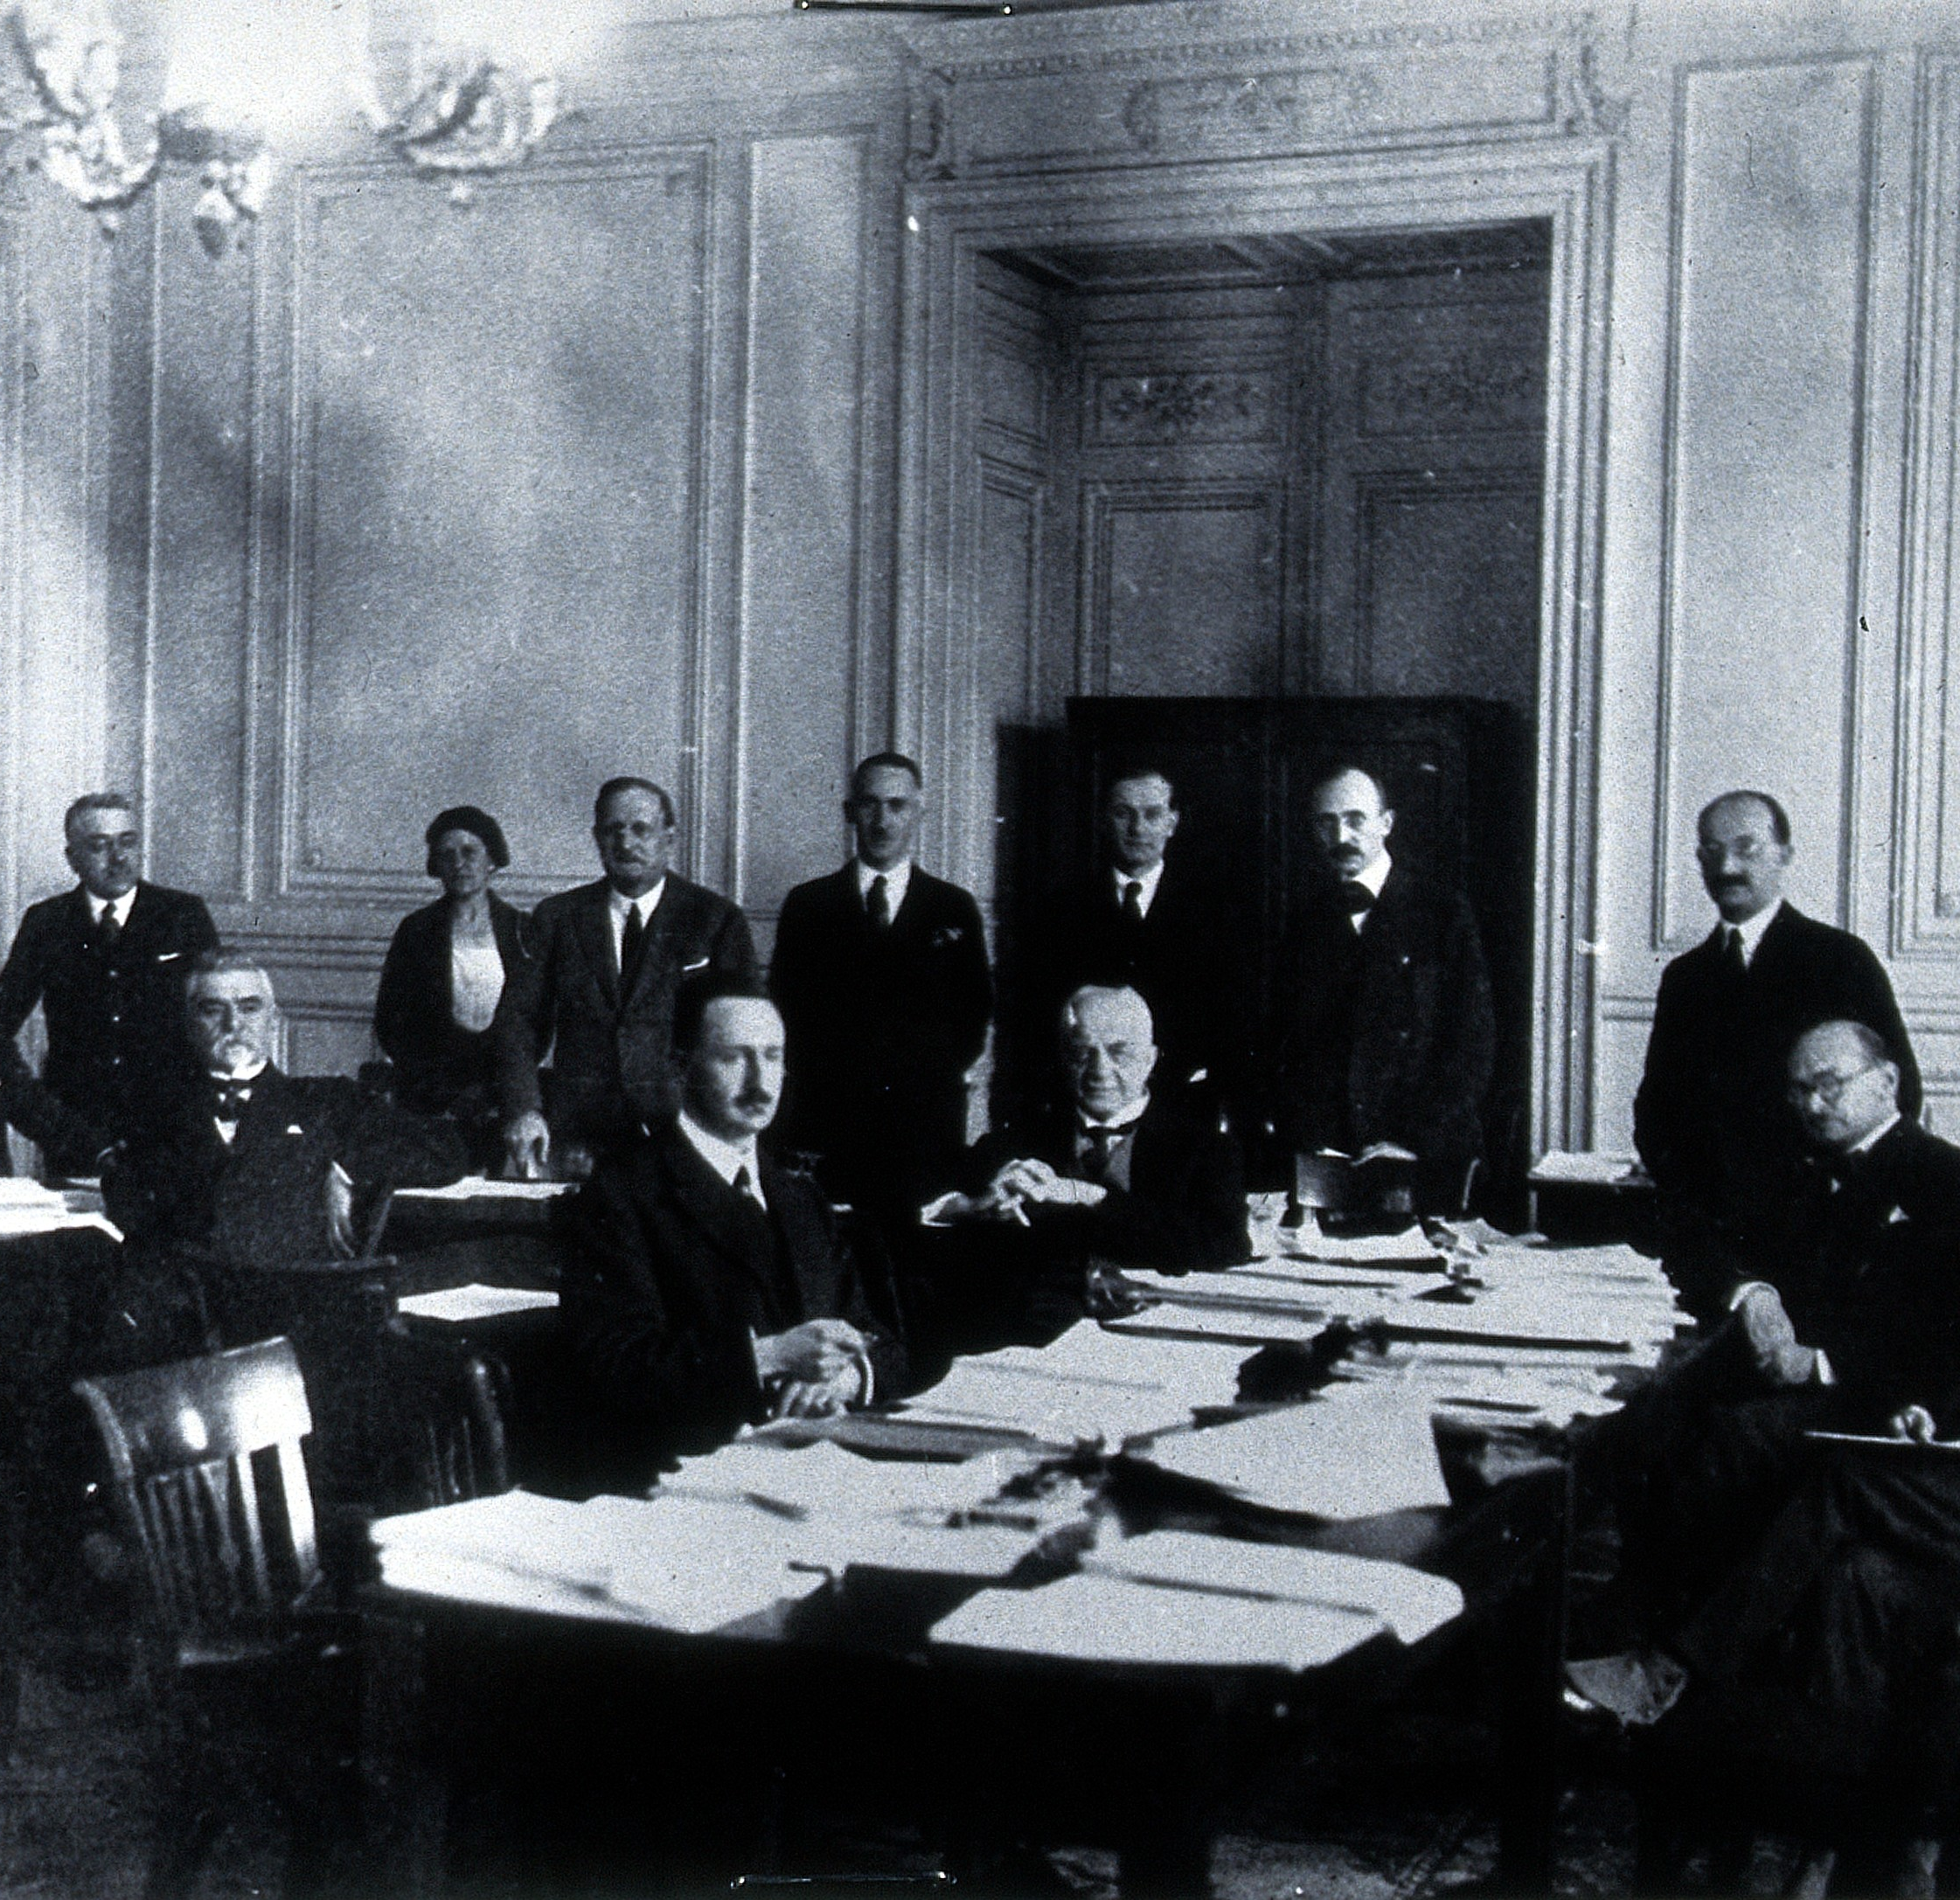
Health Committee
The Health Committee of the League of Nations, created in 1923, undertook groundbreaking efforts to combat global health issues.
The Committee coordinated international health policies, disseminated valuable health-related information, and facilitated scientific collaboration between nations.
Notable achievements included pioneering work on malaria (pictured right), leprosy, and tuberculosis, with efforts to standardize vaccines and medications.
Notes:
https://upload.wikimedia.org/wikipedia/commons/8/85/Malaria_Commission_of_the_League_of_Nations._Photograph%2C_192_Wellcome_V0028074.jpg

Slide 14
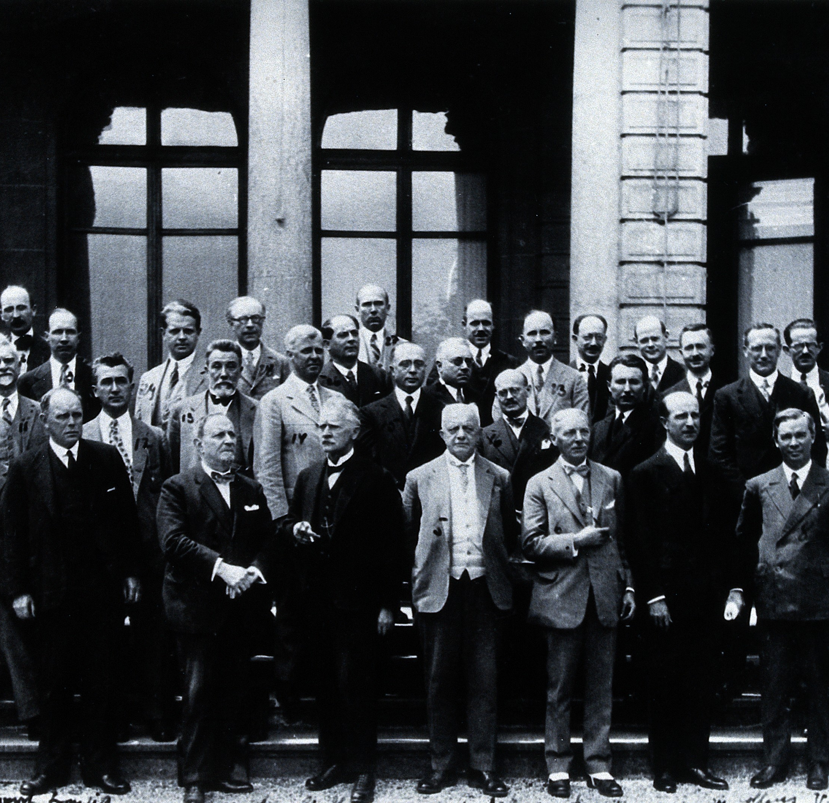
Health Committee
The committee also orchestrated the first international health campaigns, involving education, disease prevention, and control measures.
This organization was instrumental in the detection and control of disease outbreaks, contributing to public health advancements worldwide.
While the League of Nations was disbanded, its health work provided a foundation for the World Health Organization, shaping the global response to public health crises.
Notes:
https://upload.wikimedia.org/wikipedia/commons/0/08/Malaria_Commission_of_the_League_of_Nations%2C_Geneva._Photogr_Wellcome_V0028078.jpg

Slide 15
Membership
In 1920, Switzerland's neutrality led to the establishment of the League of Nations' headquarters in Geneva.
The League's Covenant came into effect on January 10, 1920, with 23 initial member states, not including the United States.
By March 10, 1920, the membership had risen to 33.
By the time of the First Assembly on November 15, 1920, the League had grown to include 42 nations, and six more joined by December.
During the Second Assembly in 1921, Estonia, Latvia, and Lithuania were admitted.
Following the addition of three more states, Egypt became the final country to join in 1937, just prior to the Fourth Assembly.

Slide 16
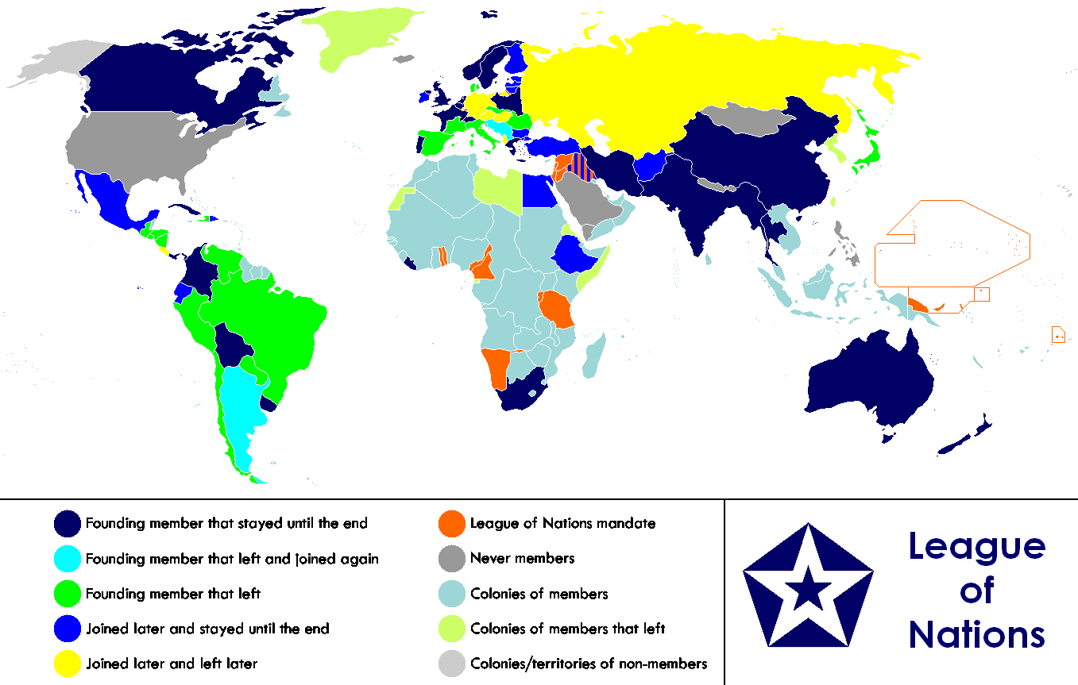

Slide 17
Today’s Lesson
What was the League of Nations?
Why was it founded?
Who was Woodrow Wilson?
What work did the League of Nations engage in?
How was it structured?
What is it’s legacy?
Notes:
https://upload.wikimedia.org/wikipedia/commons/2/20/Colorized_portrait_of_Thomas_Woodrow_Wilson.jpeg

