Slide 1

Notes:
https://www.nationalww2museum.org/sites/default/files/styles/wide_medium/public/2021-04/league%20flag%20-%20Collin%20Makamson.png

Slide 2
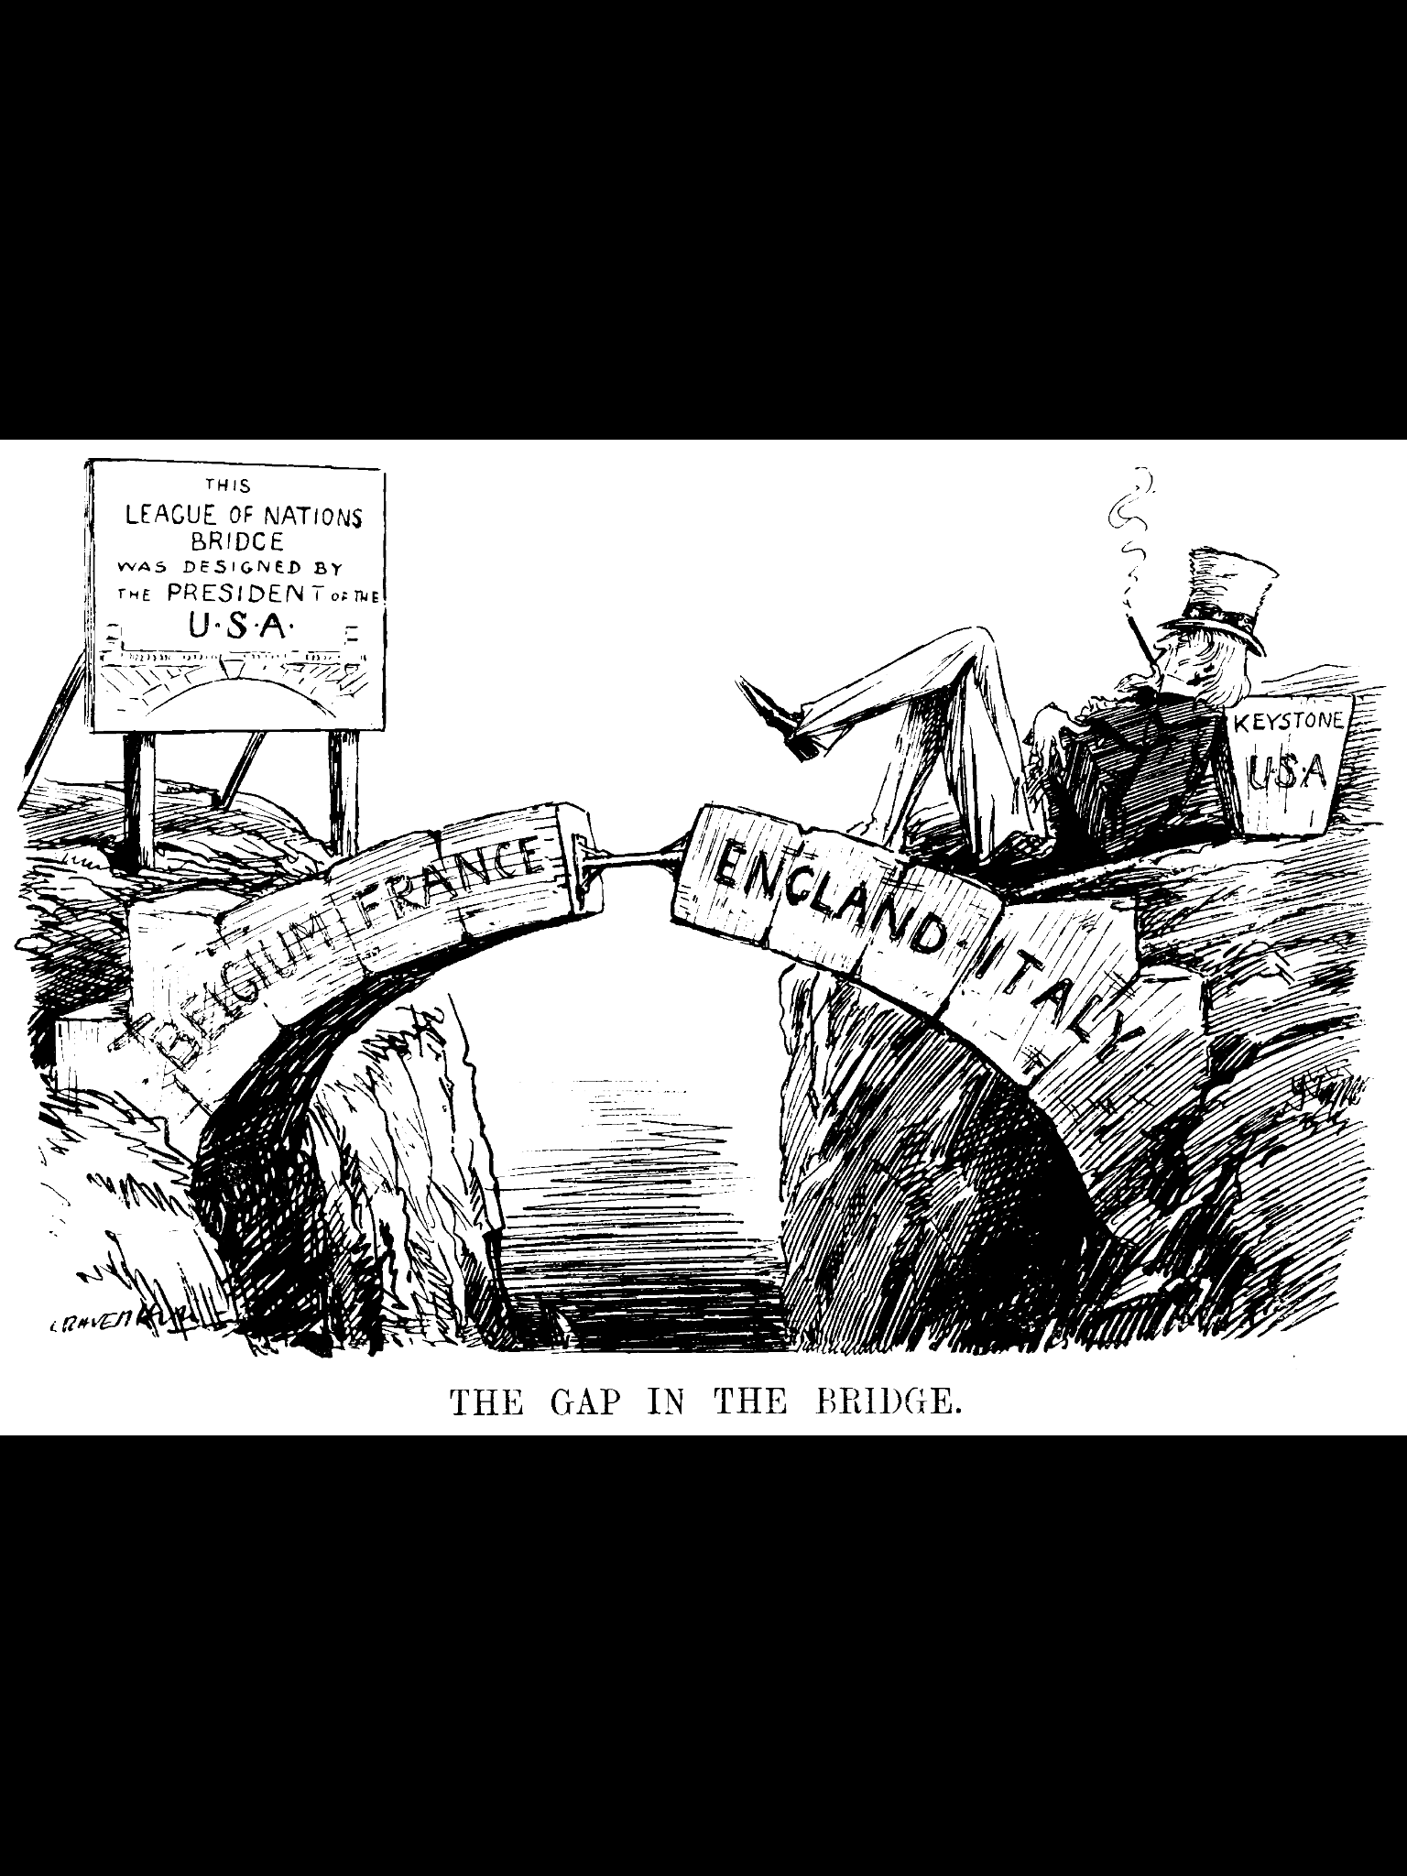
Successes & Failures of the League of Nations
Notes:
https://upload.wikimedia.org/wikipedia/commons/4/46/League_of_Nations_.png

Slide 3
League of Nations
Although the League ultimately failed in it’s goal to protect nations & stop conflicts, it did have several successes, especially in it’s early years
Notes:
https://upload.wikimedia.org/wikipedia/commons/2/20/Colorized_portrait_of_Thomas_Woodrow_Wilson.jpeg

Slide 4
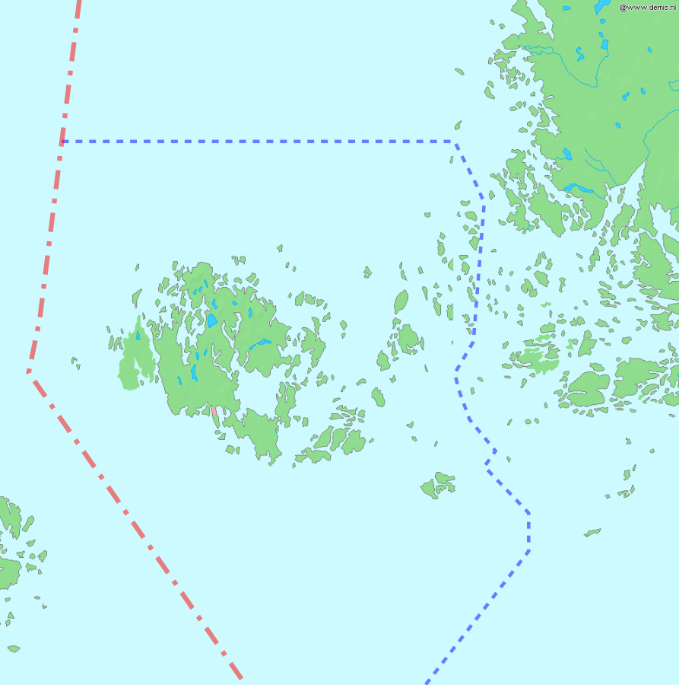
Aland Islands
In 1921, the League of Nations successfully acted as a mediator in the territorial dispute between Sweden and Finland, which centered around the Aland Islands.
These islands are geographically situated halfway between both countries.
Interestingly, despite the islands' population being predominantly Swedish-speaking, the Aland Islands have recognized Finnish sovereignty since the early 20th century.
This means that even though the residents primarily speak Swedish, the governance and territorial rights of the islands have been respected as part of Finland for several decades.
The League's intervention helped to peacefully resolve this international conflict, reaffirming the islands' status as part of Finland and fostering stability in the region.
Notes:
https://upload.wikimedia.org/wikipedia/commons/thumb/6/6c/%C3%85land_map_with_borders.svg/893px-%C3%85land_map_with_borders.svg.png?20060419162448

Slide 5
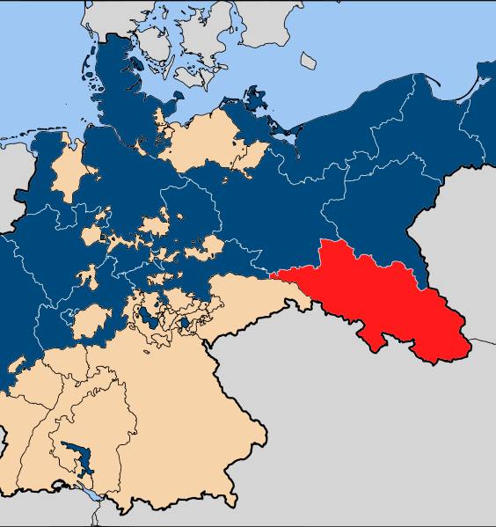
Silesia
Before the involvement of the League of Nations, the region of Upper Silesia was on the brink of a major decision.
The Treaty of Versailles stipulated that a plebiscite, or a direct vote by all members of an electorate, would be held to decide whether Upper Silesia would align with Germany or Poland.
When the votes were cast, the majority favoured Germany, sparking what came to be known as the Third Silesian Uprising.
Recognizing the escalating tensions, the League of Nations stepped in during 1922.
It undertook an investigation into the situation, after which a proposal was made for a partition of Upper Silesia.
Notes:
https://upload.wikimedia.org/wikipedia/commons/thumb/0/01/Map-Prussia-Silesia.svg/1059px-Map-Prussia-Silesia.svg.png?20070113171429

Slide 6

Silesia
The proposed solution aimed to divide the territory between Germany and Poland, thus appeasing both nations' territorial claims.
This suggestion was largely welcomed.
Both Germany and Poland agreed to the partition, recognizing it as a balanced resolution to the dispute.
Most importantly, the majority of Upper Silesians - the individuals directly affected by this decision - also concurred.
This consensus demonstrated the League's successful mediation in preventing further conflict and maintaining harmony in the region.
Notes:
https://upload.wikimedia.org/wikipedia/commons/thumb/0/01/Map-Prussia-Silesia.svg/1059px-Map-Prussia-Silesia.svg.png?20070113171429

Slide 7
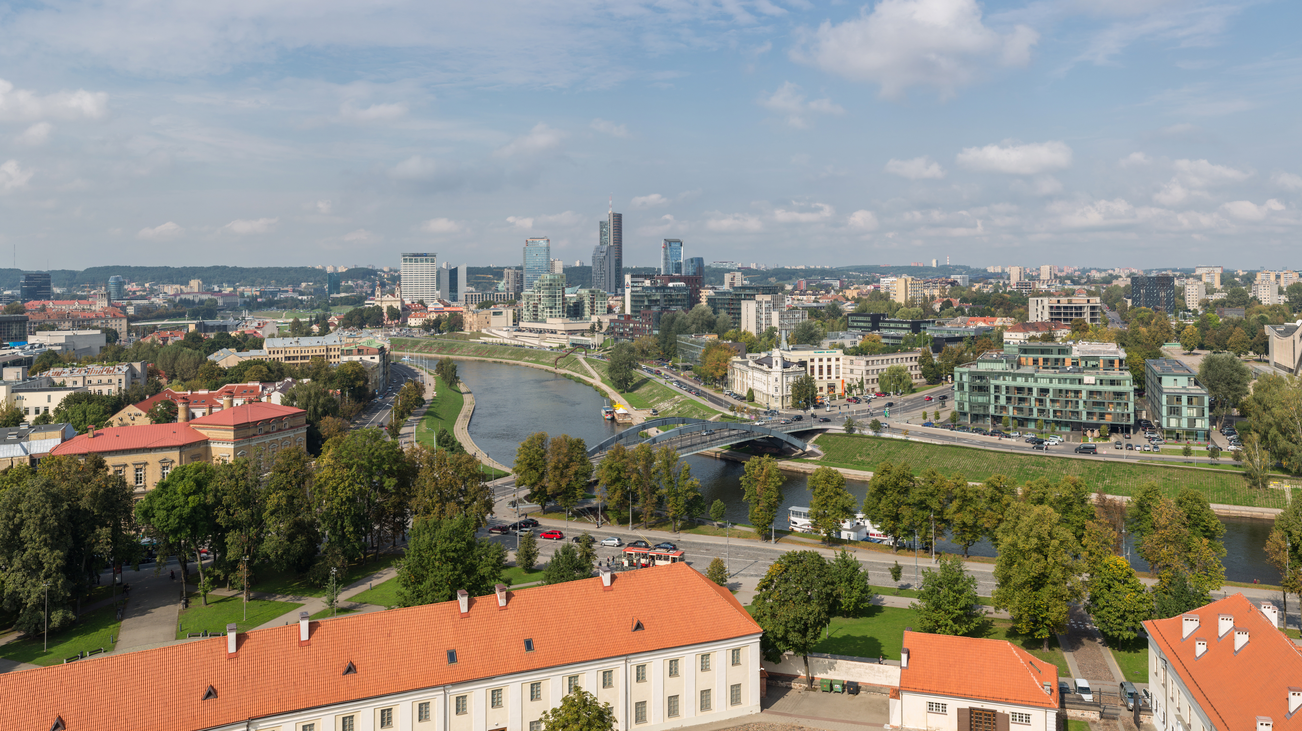
Lithuania
In the aftermath of World War I, the city of Vilna, known for its majority Polish population, was designated as the capital of Lithuania.
However, during the Polish-Soviet War in 1920, Polish military forces invaded and seized control of the city.
The League of Nations, acting as an international peacekeeping organization, denounced this action.
Yet, the Polish forces disregarded the League's condemnation and refused to vacate the city.
Notes:
https://upload.wikimedia.org/wikipedia/commons/0/05/Vilnius_Modern_Skyline%2C_Lithuania_-_Diliff.jpg

Slide 8

Lithuania
Instead of withdrawing, Poland initiated the enactment of a unification act, which formally incorporated Vilna, now renamed Wilno, into Polish territory.
Given Poland's strategic positioning as a potential buffer zone against the threat of war with Russia, Britain and France chose not to send military forces to support the League's position.
They deemed the geopolitical implications of a stable and strong Poland too significant to risk.
As a consequence of these dynamics, Wilno was recognized in 1923 as a Polish city rather than a Lithuanian one, a status which it retained until 1939.
This episode illustrates the limits of the League of Nations' influence in the face of strategic geopolitical considerations and the reluctance of its powerful member states to enforce its decisions.
Notes:
https://upload.wikimedia.org/wikipedia/commons/2/20/Colorized_portrait_of_Thomas_Woodrow_Wilson.jpeg

Slide 9
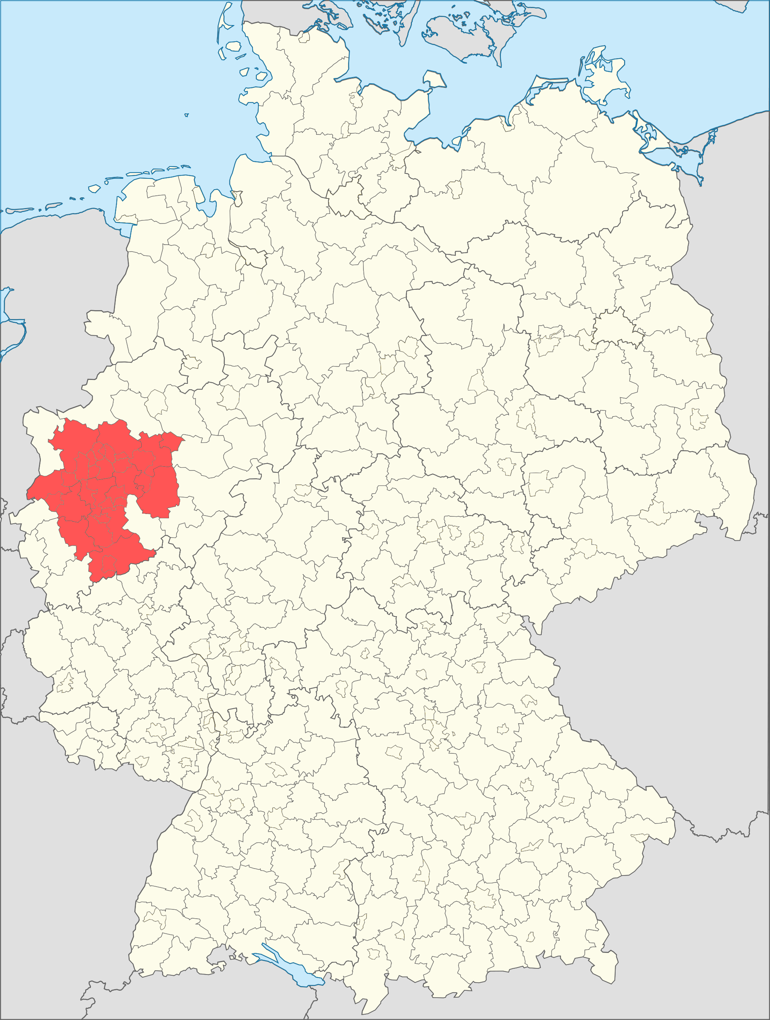
Ruhr
Under the terms of the Treaty of Versailles that concluded World War I, Germany was required to make substantial reparations payments to the Allies.
However, when Germany defaulted on these payments, France and Belgium took the drastic step of invading the Ruhr region, an industrial powerhouse of Germany, in an attempt to extract the reparations in kind.
This military action directly contradicted the League of Nations' mission to maintain international peace and prevent acts of aggression.
Notes:
https://upload.wikimedia.org/wikipedia/commons/4/4b/Metropolregion_Rhein-Ruhr.png

Slide 10
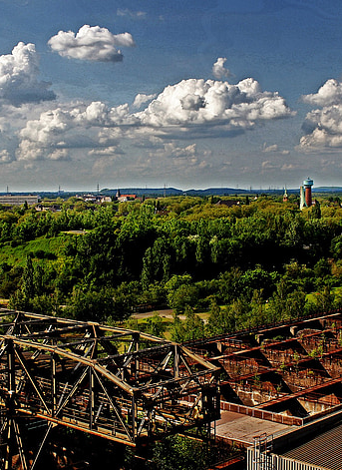
Ruhr
Despite this clear violation, the League of Nations took no corrective action.
France was a key member of the League, wielding substantial influence, and the United Kingdom, another significant member, was reluctant to take a stance that might strain its relations with France.
Consequently, the League's inaction in this instance undermined its own rules and principles.
This episode exposed the limitations of the League of Nations and its dependency on the positions and interests of its powerful member states.
It set a precedent that challenged the League's authority and effectiveness in maintaining international peace and upholding the principles it was created to protect.
Notes:
https://i0.hippopx.com/photos/414/974/522/industry-lapadu-ruhr-area-industrial-park-preview.jpg

Slide 11
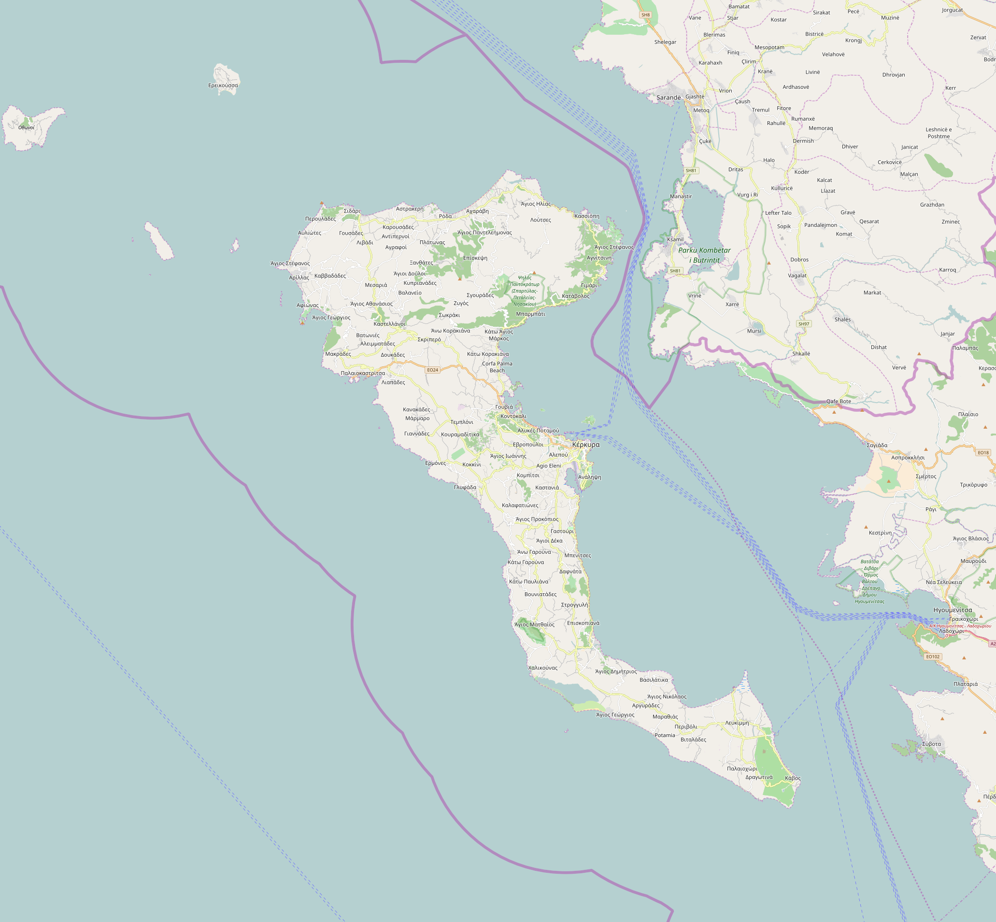
Corfu
The murder of General Enrico Tellini, an Italian officer, along with his team while they were inspecting the Greek side of the border on the island of Corfu led to a major international incident.
This event provoked an outraged response from Benito Mussolini, the Italian leader, who demanded reparations from Greece.
When Greece failed to meet his demands promptly, Mussolini launched an invasion on the Greek island of Corfu, an action that resulted in the loss of 15 lives.
Notes:
https://upload.wikimedia.org/wikipedia/commons/7/71/Map_of_island_Corfu.png

Slide 12
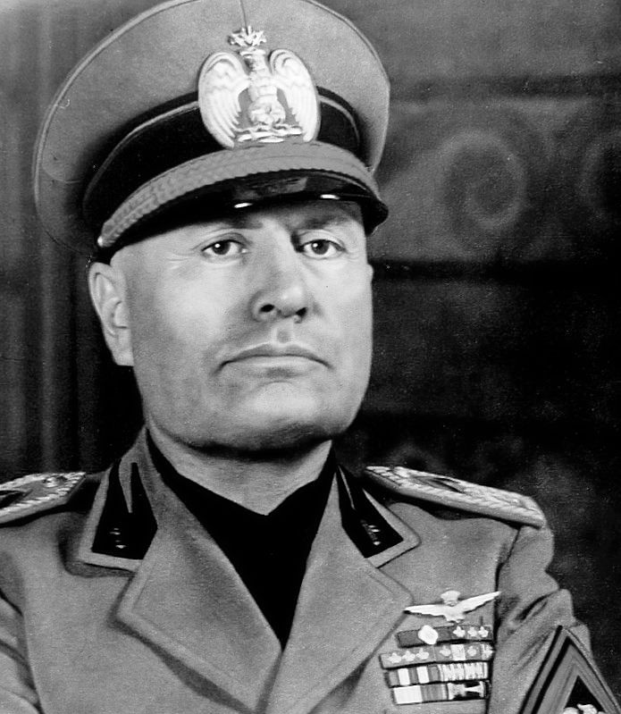
Corfu
In response to this clear act of aggression, the League of Nations condemned Italy's actions and insisted that Italy should instead pay reparations to Greece for the invasion.
However, Mussolini proved adept at manipulating the situation within the League.
After initially appearing to comply with the League's terms, he persuaded the League to reverse its decision.
The final outcome saw Greece compelled to issue an apology to Italy for the initial incident and required to make immediate payment as compensation.
This situation demonstrated the limitations of the League of Nations and highlighted the extent to which its decisions could be influenced and overridden by powerful member states.
Notes:
https://upload.wikimedia.org/wikipedia/commons/c/ce/Benito_Mussolini_uncolored.jpg

Slide 13
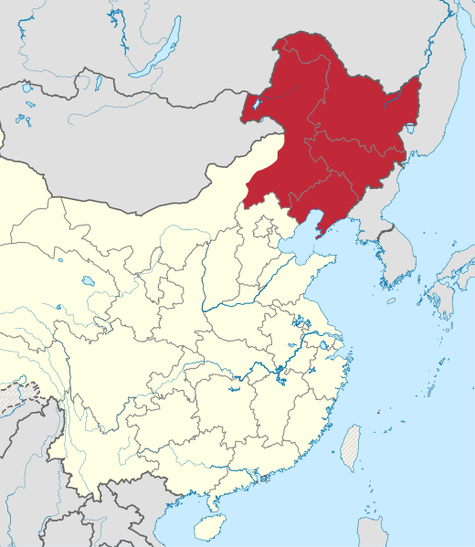
Manchuria
In 1931, Japan seized Manchuria, a region that was a part of China, and launched a military attack on the Chinese city of Shanghai.
This was a clear act of aggression and violation of China's sovereignty. In response to these hostilities, China sought assistance from the League of Nations, appealing for international support against Japan's actions.
However, the League of Nations, bound by the conflicting self-interests of its member states, failed to effectively intervene.
Rather than taking collective action to counter Japan's aggression, the member nations prioritized their individual national interests, leaving China to grapple with the situation alone.
Notes:
https://upload.wikimedia.org/wikipedia/commons/thumb/b/bd/Manchukuo_locator_map.svg/1129px-Manchukuo_locator_map.svg.png?20220521134725

Slide 14
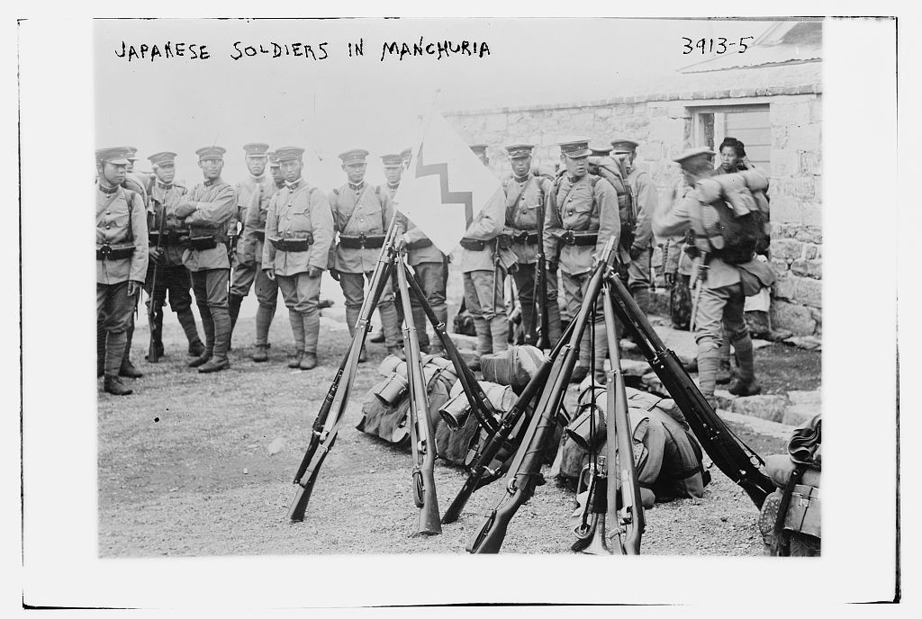
Manchuria
As a result of this inaction, Manchuria remained under Japanese control until 1945.
It was only following the Soviet invasion towards the end of World War II that the region was finally liberated from Japanese control and returned to China.
This episode marked another significant failure of the League of Nations and further highlighted its inability to enforce its principles and protect the sovereignty of nations in the face of aggressive actions by powerful states.
Notes:
https://cdn4.picryl.com/photo/1915/01/01/japanese-soldiers-in-manchuria-1024.jpg

Slide 15

Abyssinia
In October 1935, Italy, under the leadership of Benito Mussolini, invaded Abyssinia (Ethiopia) and toppled its Emperor, Haile Selassie.
In response to this unprovoked act of aggression, the League of Nations condemned Italy and imposed economic sanctions.
However, the enforcement of these sanctions was inconsistent, and crucially, oil—a critical resource for any military campaign—was excluded from the list of prohibited trade items.
Notes:
https://upload.wikimedia.org/wikipedia/commons/thumb/f/fb/Flag_of_Abyssinia_%281853-1868%29.svg/1200px-Flag_of_Abyssinia_%281853-1868%29.svg.png?20200628214250

Slide 16
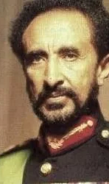
Abyssinia
Despite these attempts at resolution, in 1936, Haile Selassie personally appealed to the League of Nations for further help.
Unfortunately, the League failed to take effective action
Ultimately, the imposed economic sanctions were lifted, allowing Italy to retain its unlawfully acquired territories.
This incident dealt a severe blow to the credibility and efficacy of the League of Nations, from which it would never fully recover.
It highlighted the League's inability to enforce its decisions and protect the sovereignty of smaller nations against aggression by more powerful states.
Notes:
https://upload.wikimedia.org/wikipedia/commons/thumb/5/5d/Haile-selassie-ethiopian_king.webp/300px-Haile-selassie-ethiopian_king.webp.png?20220903051455

Slide 17
Abyssinian Crisis, 1936
“However it may be disguised, it can only be with a feeling of bitter humiliation that each successive speaker has during these days come to this Tribune.
Over fifty nations pledged themselves to one another in the most solemn manner each to respect the independence and to preserve the integrity of the territories of the others. One of these nations turned its back on its pledges freely given, and was adjudged almost unanimously by the remainder to have been an aggressor, and now, one by one, we have come here to confess that we can do nothing effective about it.
Over fifty nations we banded ourselves together for collective security. Over fifty nations we have now to confess publicly that we must abandon the victim to his fate.
It is a sad confession, as well as a bitter one. It is the fulfilment of the worst predictions of all who decried the League and said it could not succeed.
As has been said already, we are all of us in some measure responsible for this pitiable position, some much more responsible than others. Read the speech delivered here by the Emperor of Ethiopia. Does any delegate deny that, so far as it relates to what has happened here, there is to his knowledge truth in every line of it?.” – Eamon de Valera to the League of Nations
Notes:
Speech by Eamon de Valera at the League of Nations Assembly
SOURCE: https://www.difp.ie/volume-4/1936/failure-of-the-league-of-nations/1716/#section-documentpage

