Slide 1

Straw Rocket

Slide 2

Educational Irish Research Satellite
(EIRSAT-1)
https://www.eirsat1.ie/
EIRSAT-1 is supported by the ESA Education Office under its ‘Fly Your Satellite!’ programme
https://www.esa.int/Education

Slide 3
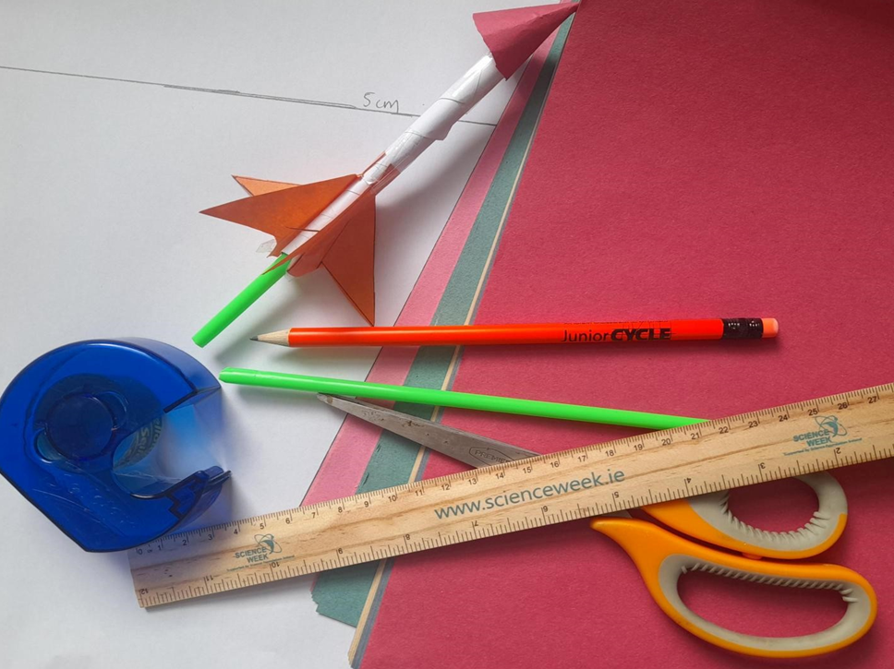
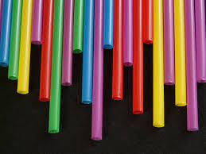

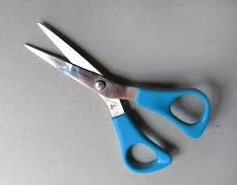
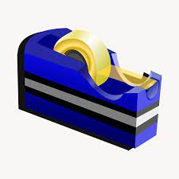

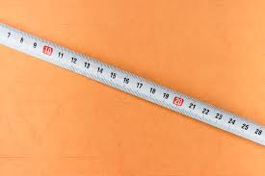
How to Make a Straw Rocket
Straws
Paper
Scissors
Sticky tape
Pencil
Measuring tape

Slide 4
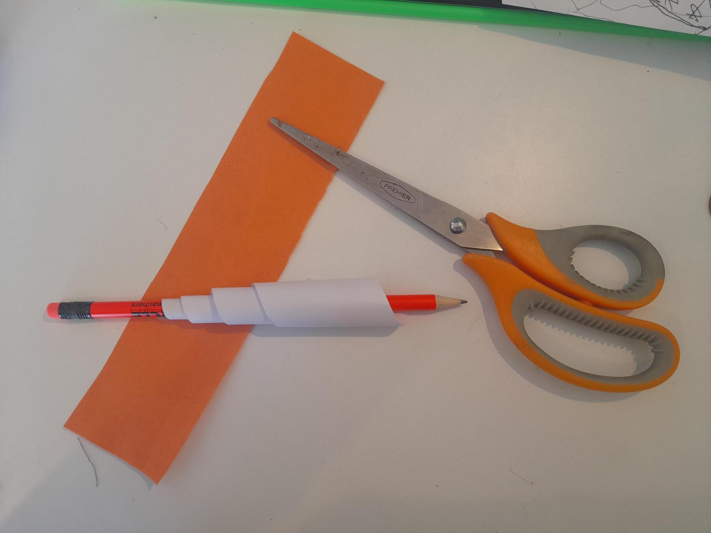
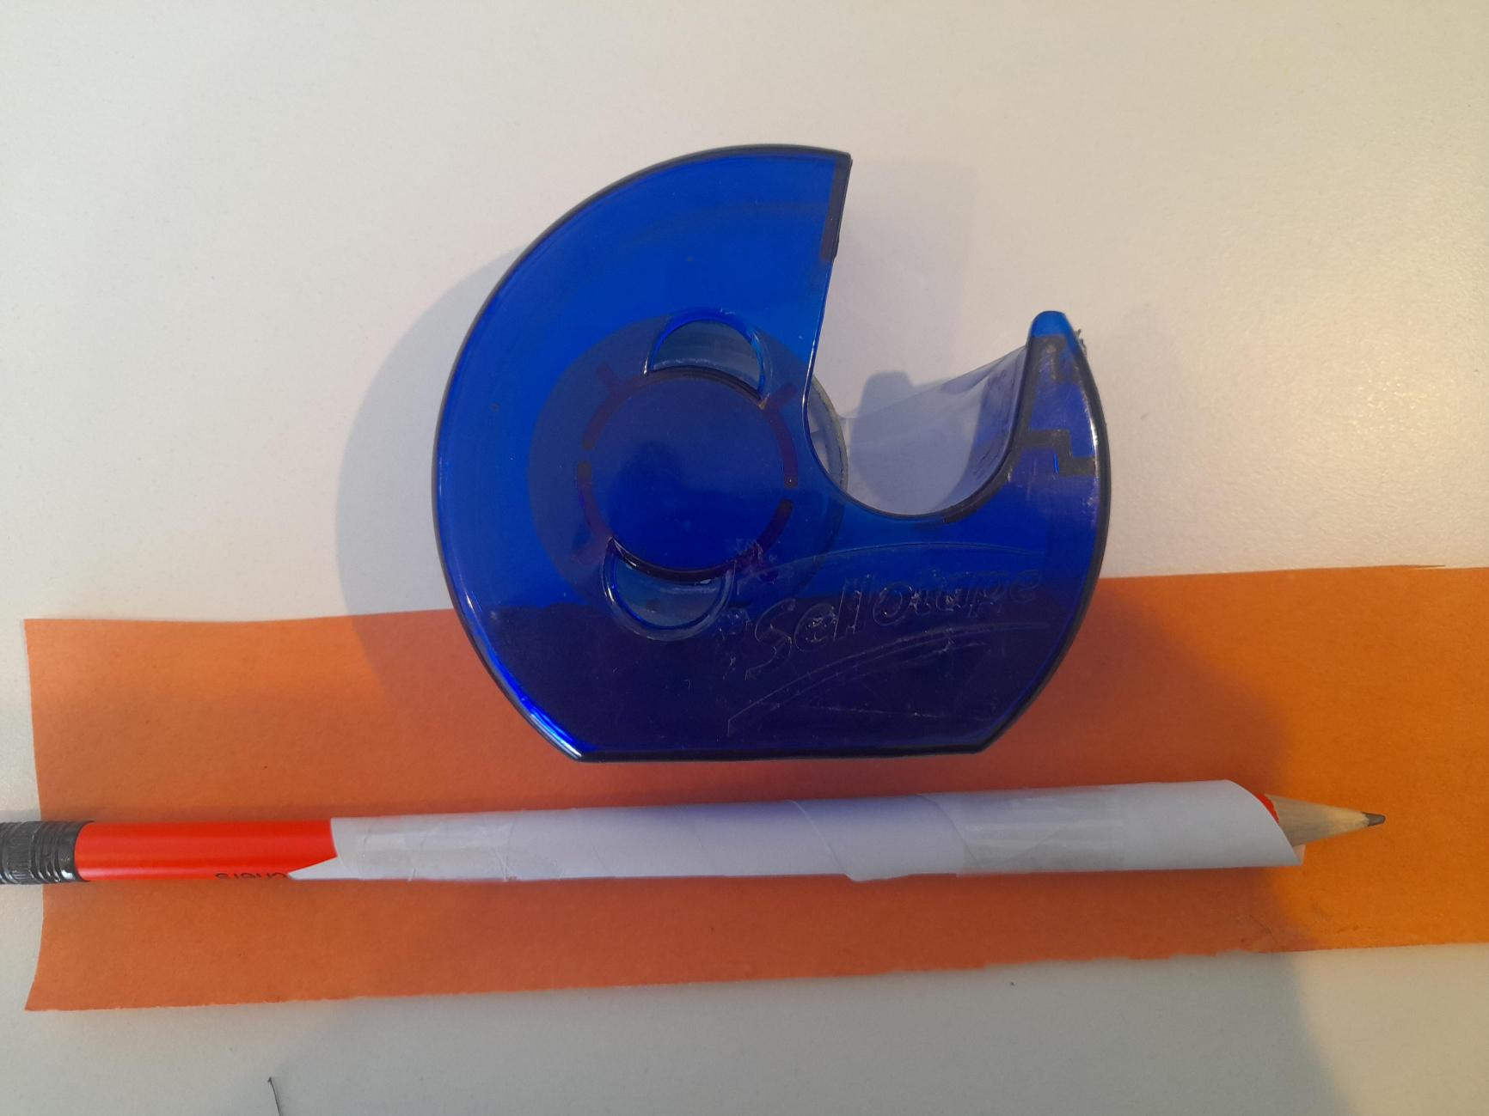
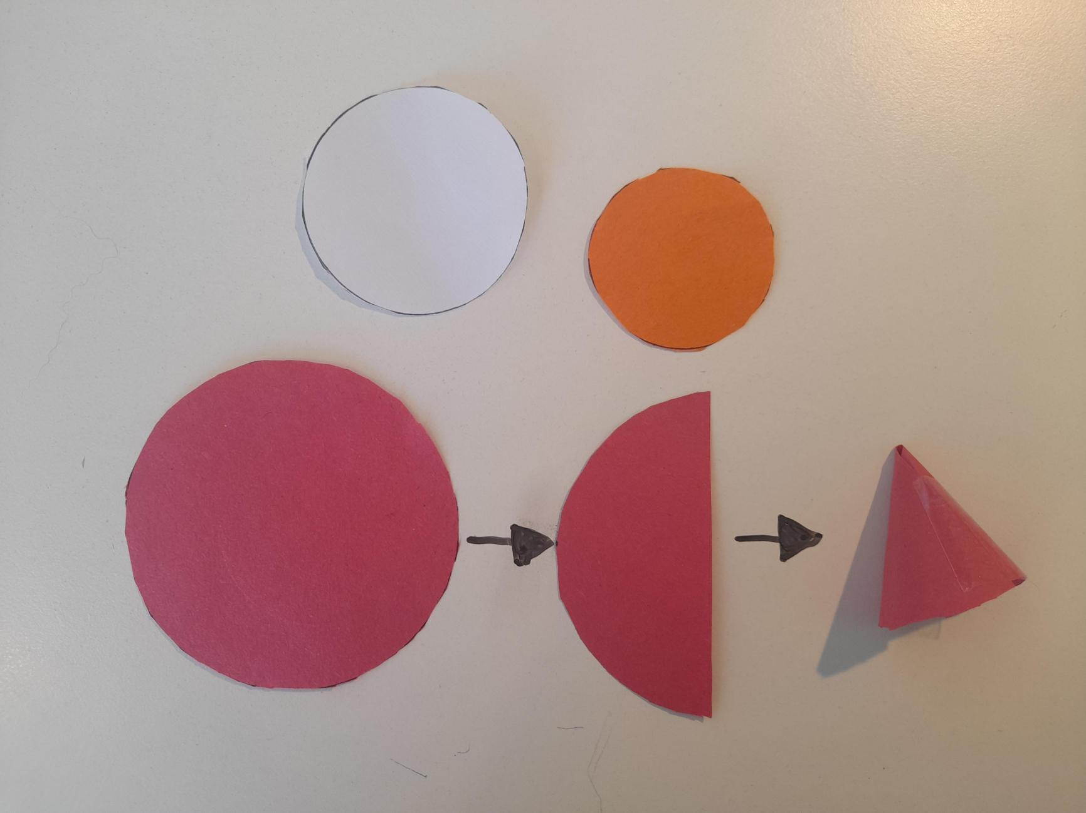
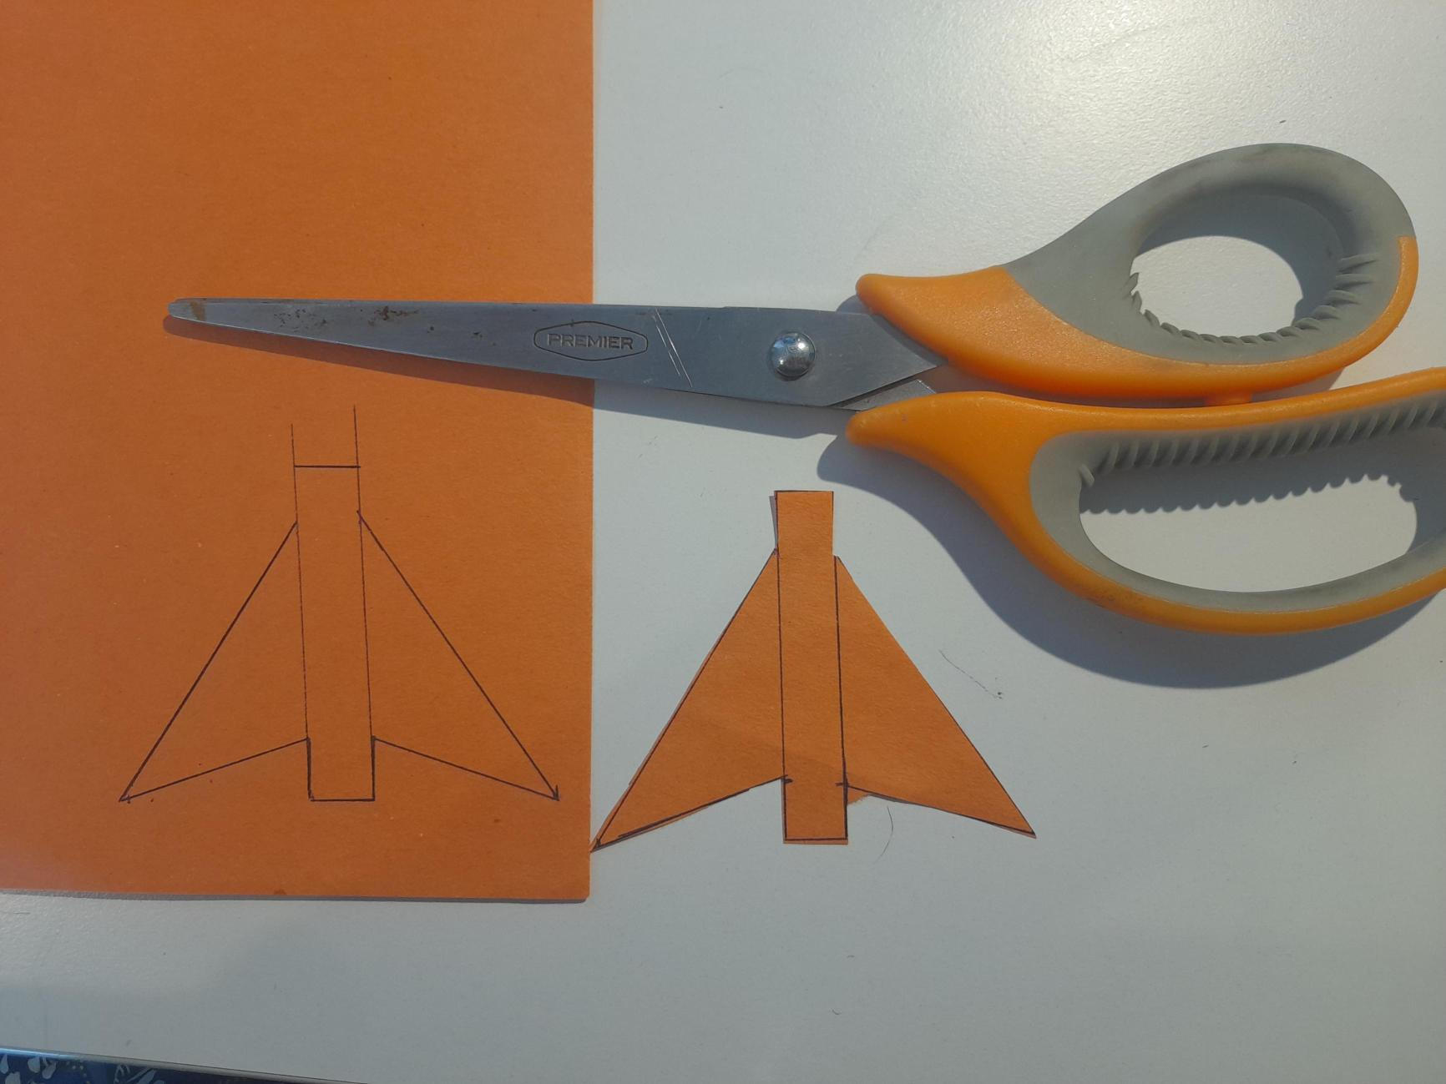
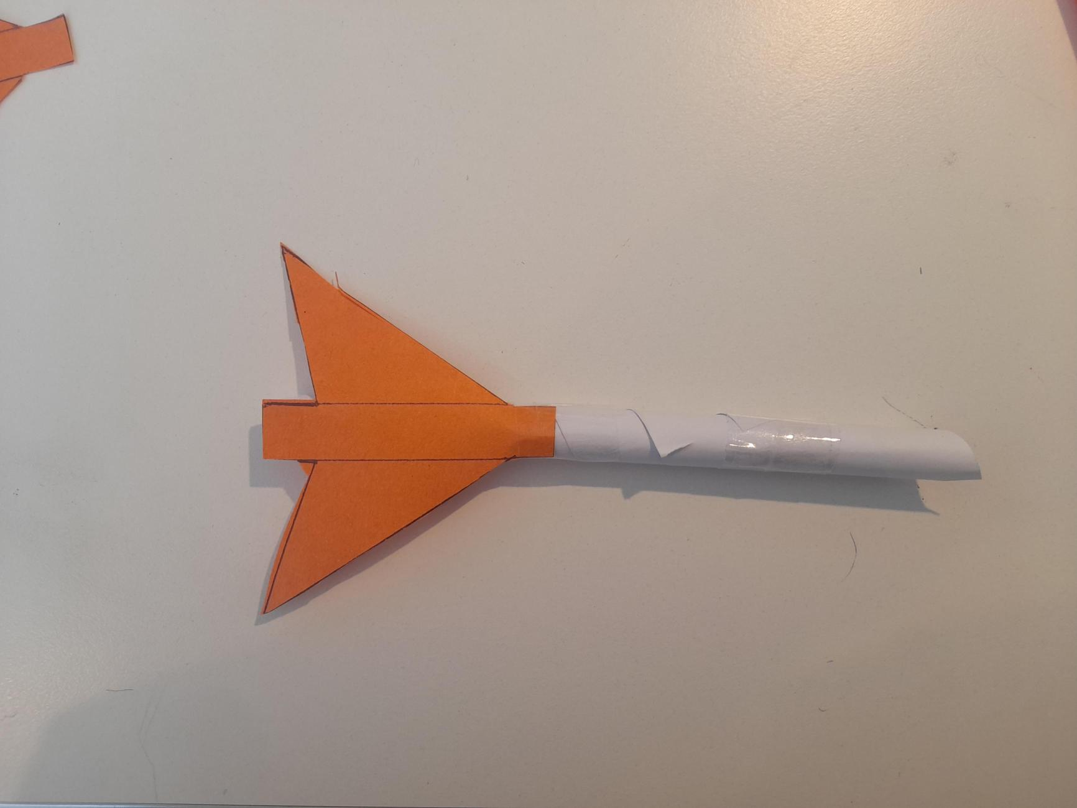
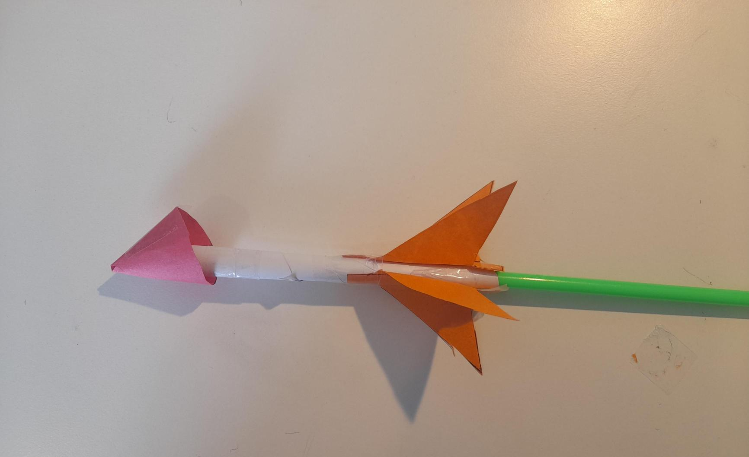
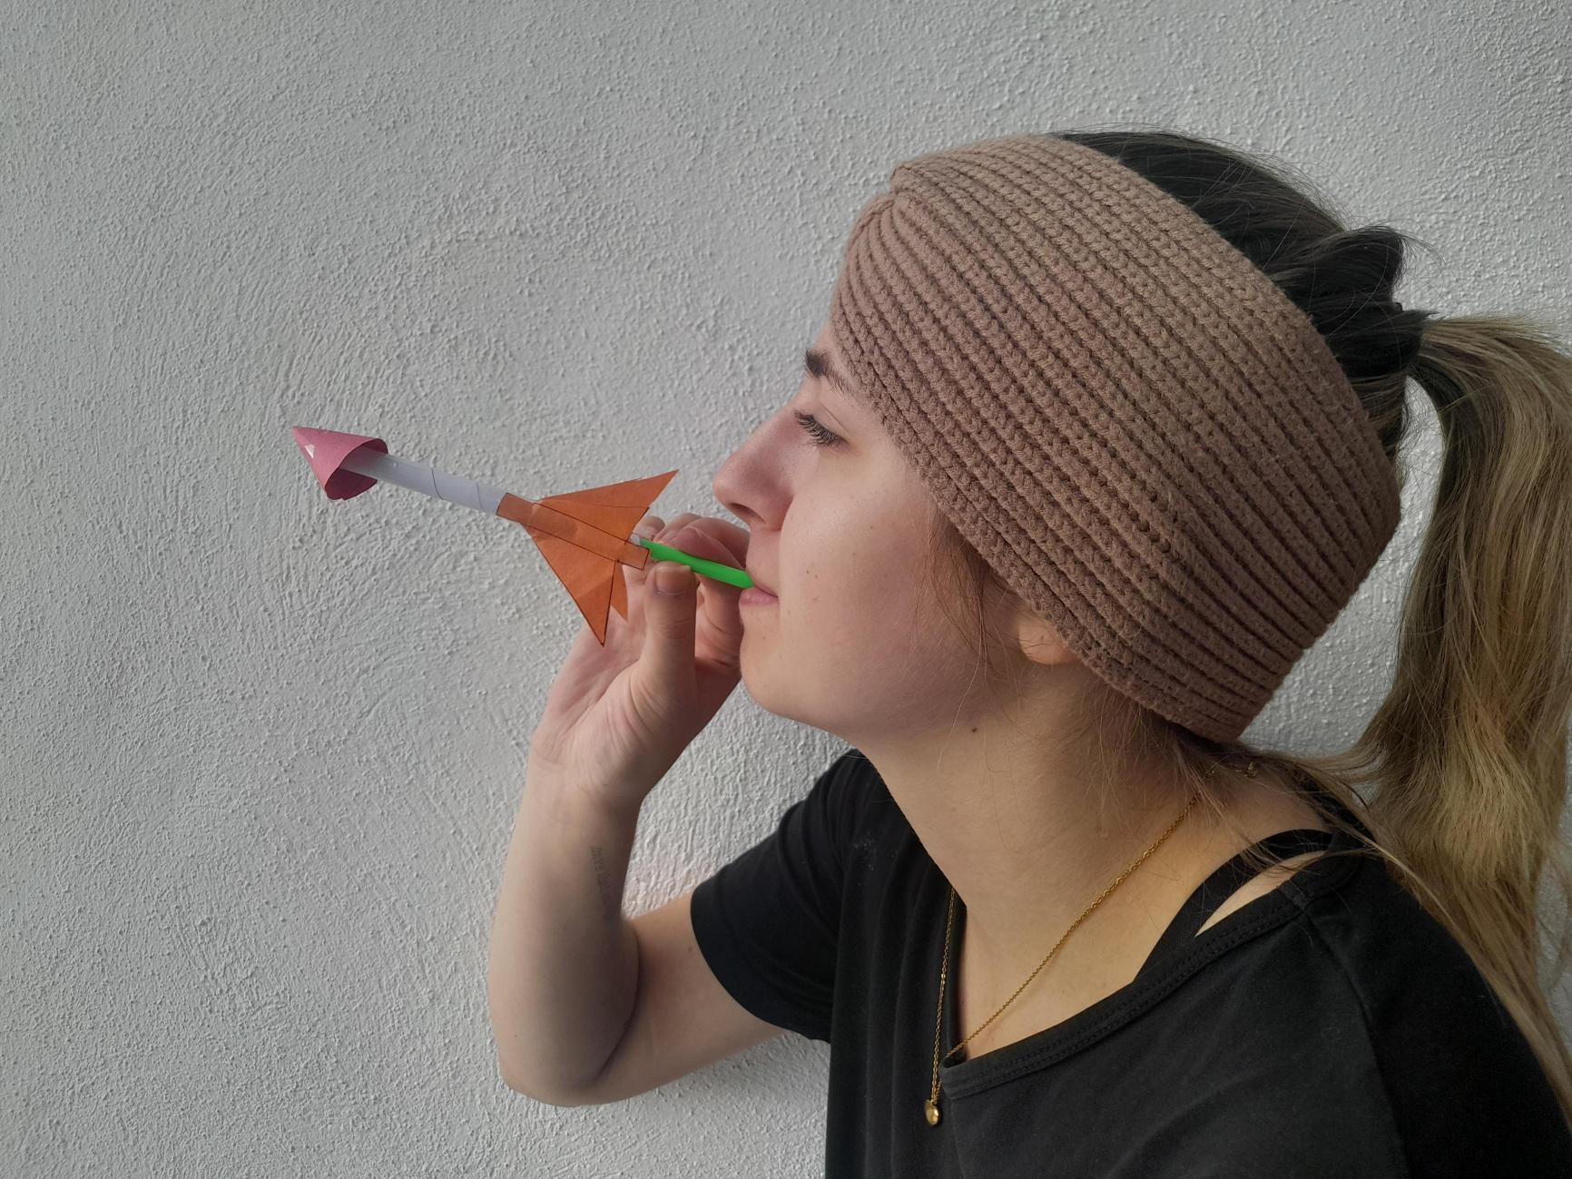
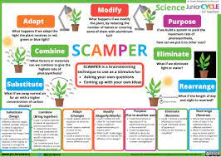
Before you start:
Safety first
Not CC
Not CC
Not CC
Please make sure that you are careful when using the scissors.
Only launch your rocket when the pathway is clear.
Rocket Body:
Cut a 5 cm wide strip from A4 paper. Make sure to decorate it.
Wrap it around the pencil and secure it with tape. Make sure to leave space for easy sliding.
Nose Cone:
Cut a small circle and attach it to one end of the rocket body forming a point at the front.
Measure the length of your nose cone.
Alternatively, twist the top of the body into a nose cone around the sharpened end of your pencil.
Fins:
Cut two triangular fins of equal size (as shown in the diagram above) and attach them, evenly spaced, around the bottom of your rocket. This is to keep it stable.
What you need
Equipment | Equipment
Pencil | Measuring tape
Scissors | Paper or card
Sticky tape | Student data log
A straw | Balloon
Not CC
Not CC
This resource has been adapted for Irish Science students from https://www.jpl.nasa.gov/edu/pdfs/strawrocket_worksheet.pdf.
Test:
Remove the pencil.
Slide the straw in and blow to test. Adjust design as needed.
Launch:
Hold the rocket by the straw, blow forcefully, and watch it soar! Estimate the distance you think it will travel!
Record the distance travelled on your student data log.
Extension:
Use SCAMPER to improve your rocket
How might a balloon or card help your design?

Slide 5
Student Data Log
Name: _____________________
Length of the nose cone (in cm) | Distance Travelled (in cm) |  |  |  |  |  |  |  | Average distance travelled
 | Trial 1 |  | Trial 2 |  | Trial 3 |  | Trial 4
 | Estimated distance |  | Estimated distance |  | Estimated distance |  | Estimated distance
 | Actual distance |  | Actual distance |  | Actual distance |  | Actual distance
 | Difference |  | Difference |  | Difference |  | Difference
 | Estimated distance |  | Estimated distance |  | Estimated distance |  | Estimated distance
 | Actual distance |  | Actual distance |  | Actual distance |  | Actual distance
 | Difference |  | Difference |  | Difference |  | Difference

