Slide 1

Step 1b
Radio Waves
Notes:
Page 1-5 support document

Slide 2

What is a wave?
Where have you heard the word ray before?
A ray is a very simple way to think about a wave.
A wave is one way that energy can be transferred from one place to another.
Waves can be described as oscillations.
© Ivica Drusany / Shutterstock.com, Shutterstock
Notes:
Possible answers: rays of sunshine, UV rays from the sun, in maths the geometric term “ray”, X-rays, Radiation…
© Ivica Drusany / Shutterstock.com, Shutterstock

Slide 3
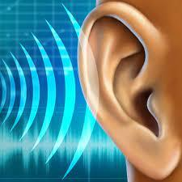
Sound waves
When you hear something, your ear is actually picking up sound waves that have travelled through the air.
The sound waves cause air particles to vibrate back and forth – your eardrum picks up this sound wave and turns it into an electrical signal that your brain can understand.
Source: http://www.earassociates.com/ear-education-how-we-hear-san-jose-ca.html
Notes:
http://www.earassociates.com/ear-education-how-we-hear-san-jose-ca.html

Slide 4
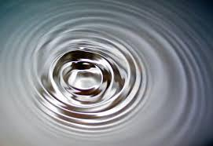
Water waves
In water, it is easy to “see” waves.
The ripples in water cause water particles to vibrate up and down.
What other types of waves can you think of?
https://commons.wikimedia.org/wiki/File:2006-01-14_Surface_waves.jpg
Notes:
https://commons.wikimedia.org/wiki/File:2006-01-14_Surface_waves.jpg
Other types of waves: Mexican wave, Slinky wave…radio waves, microwaves,..

Slide 5
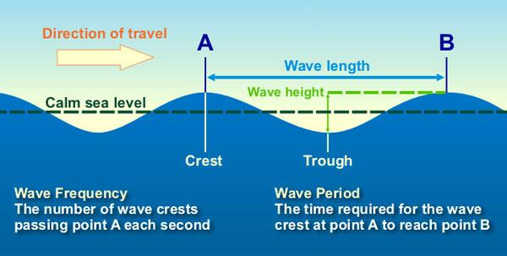
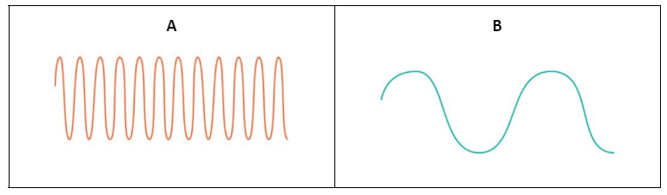
Frequency and Wavelength
The highest part of a wave is called the crest (also called the peak).
The frequency of a wave is the number of wave crests that pass a point every second.
The wavelength is the distance between two crests
Frequency is measured in Hertz.
1Hz equals 1 wave passing a fixed point in 1 second.
Wavelength is measured in metres.
https://commons.wikimedia.org/wiki/File:Water_wave_diagram.jpg
Which wave has the higher frequency?
Which wave has the longest wavelength?
Notes:
https://commons.wikimedia.org/wiki/File:Water_wave_diagram.jpg

Slide 6
Mechanical waves
We have looked at two different types of waves e.g. sound waves and water waves.
Water waves transfer their energy through water and sound waves transfer their energy through air.
You may have thought about other examples of waves… e.g the wave you make with a slinky and a Mexican wave!
There would be no slinky wave without the slinky and there would be no Mexican wave without people!
All these waves are are called mechanical waves because they need a medium to travel through.
But what about the other types of waves such as radio waves and x-rays?

Slide 7
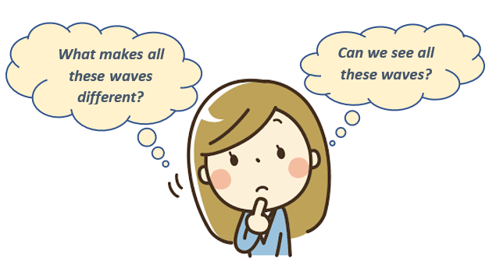
The Electromagnetic (EM) Spectrum
The Electromagnetic (EM) spectrum is the range of all the different types of waves that do not need anything to travel through (they don’t need water or air).
EM waves travel very fast, at the speed of light (in a vacuum)!
EM waves include radio waves, microwaves, visible light, ultraviolet (UV) radiation, X-rays, and gamma rays..
All these waves have different wavelengths and frequencies. We can only “see” a very small section of the EM spectrum - “visible light”

Slide 8
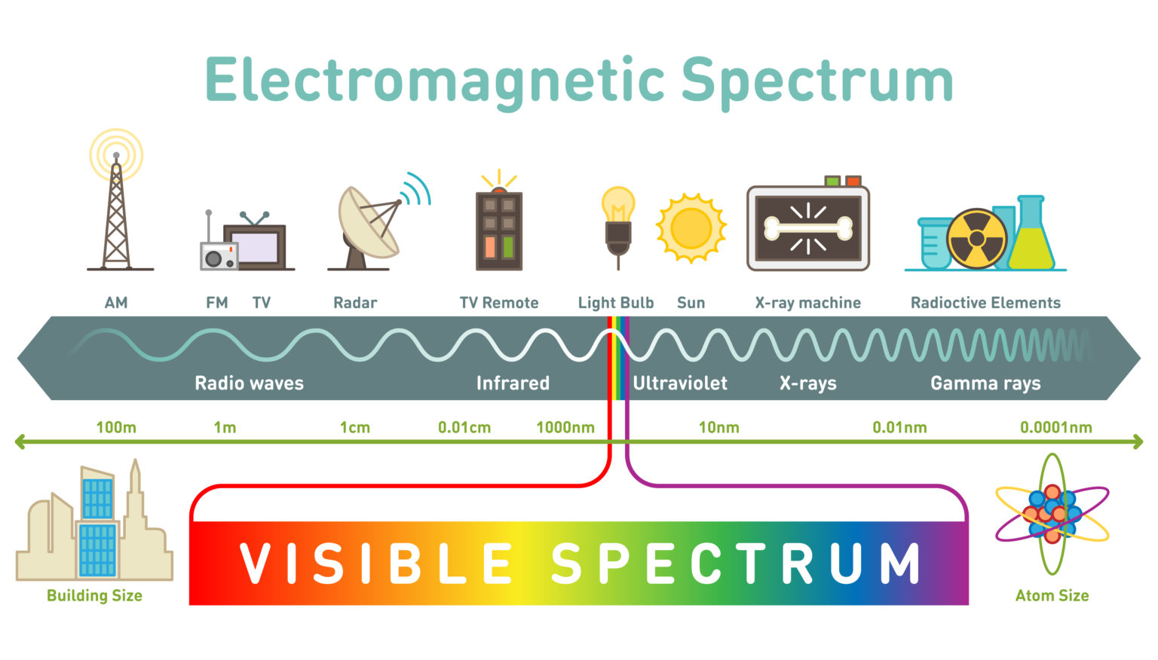
https://www.science-sparks.com/what-is-the-electromagnetic-spectrum/
Notes:
https://www.science-sparks.com/what-is-the-electromagnetic-spectrum/

Slide 9
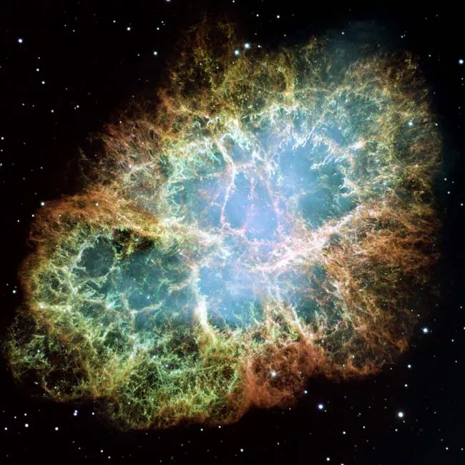

EM spectrum
Some radio waves have a wavelength that is a similar size to a building
Other rays like Gamma rays have a wavelength the size of an atom!
https://www.space.com/13838-nasa-gamma-ray-targets-blazars-fermi.html
Did you know:
Gamma-rays can’t pass through the earth’s atmosphere. The EIRSAT-1 satellite will be running an experiment on board to detect and record gamma-rays! Gamma-ray bursts are often created by events in the early universe. There's a lot about the early universe that we don't yet understand, and gamma-ray bursts are one of the best tools for investigating it.
Notes:
https://www.space.com/13838-nasa-gamma-ray-targets-blazars-fermi.html

Slide 10
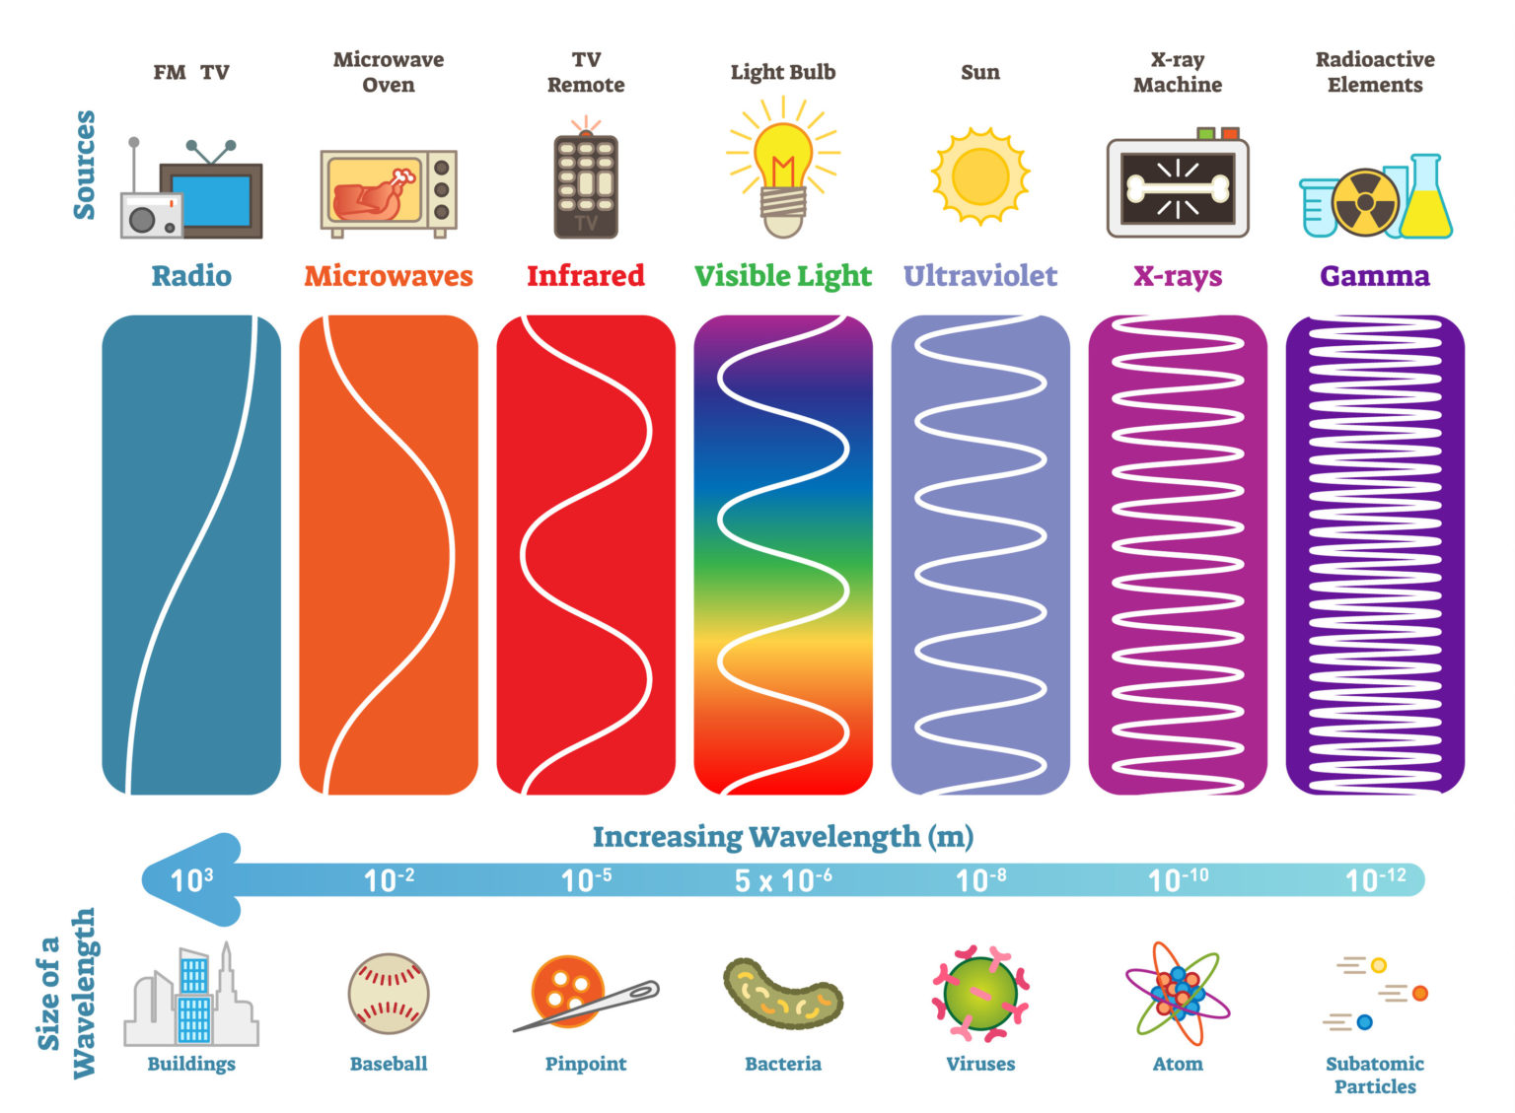
EM waves
The smaller the wavelength the more energy the wave has.
Radio waves can travel through your body but are harmless.
However, gamma rays have much more energy as they have the highest frequency in the EM spectrum.
They can cause damage to you but can also be used to treat cancers.

Slide 11

Radio waves
Did you know that radio waves are like the secret messengers of the electromagnetic spectrum?
They're invisible, but they can travel through walls and zip through the atmosphere to deliver information from one place to another, even to and from space!
With the help of devices like radio receivers, we can pick up these secret messages and convert them into sounds that our ears can understand or even dance to.
Radio waves can pass through many materials, including buildings and the human body. Radio waves transfer power over long distances.
If we zoom into the lower end of the EM spectrum we can see the radio waves up closer.

Slide 12


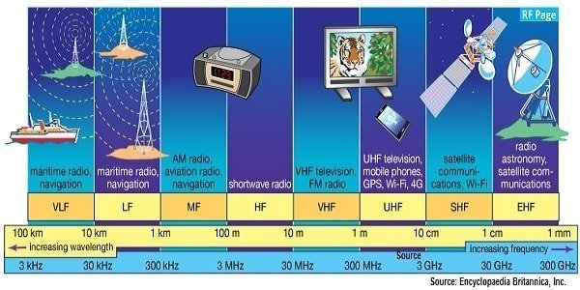

Slide 13
Radio waves
VLF: Very Low Frequency
LF: Low Frequency
MF: Medium Frequency
HF: High Frequency
VHF: Very High Frequency
UHF: Ultra High Frequency
SHF: Super High Frequency
EHF: Extremely High Frequency
Did you know:
EIRSAT-1 will communicate in the UHF and VHF parts of the EM spectrum

Slide 14

Could your Phone Hurt you?
Electromagnetic Pollution
https://www.youtube.com/watch?v=FfgT6zx4k3Q
Notes:
Kurzgesagt video: Could your Phone Hurt you? Electromagnetic Pollution
https://www.youtube.com/watch?v=FfgT6zx4k3Q

Slide 15

What’s next?
Do you want to learn more about Radio Communication?
Would you like to build a model satellite and receiver?
Continue to Step 2 “Let’s Communicate”

