Slide 1

Step 2
Let’s Communicate
Notes:
Page 1-5 support document

Slide 2
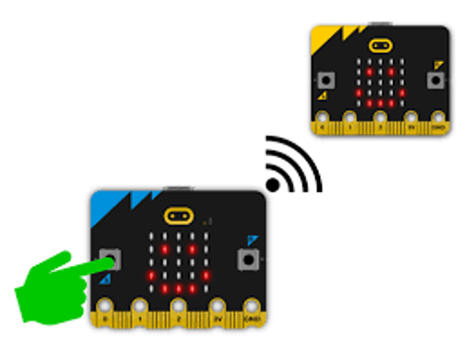
What is the micro:bit?
The micro:bit is a cool little computer board that you can use to learn how to code and make all kinds of fun projects!
With the micro:bit, you can make your own games, build robots, create digital art, and so much more. It has a bunch of sensors and input/output pins that you can use to interact with the world around you.
You are going to learn how to use the radio on the micro:bit, make a model satellite and ground station, and communicate!!
Notes:
© Ivica Drusany / Shutterstock.com, Shutterstock

Slide 3
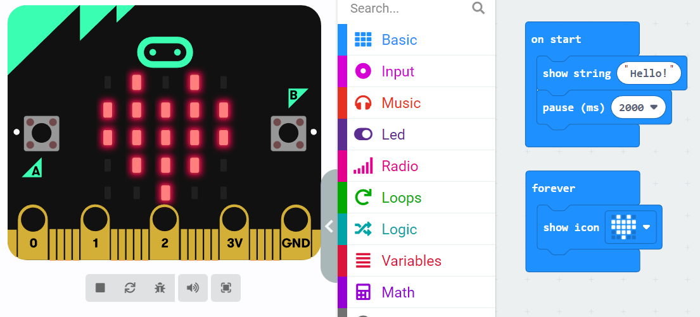
First steps with the micro:bit
To create your programme, click on the menu in the middle and drag the blocks to the right-hand side.
Let’s learn how to display a love heart and a message on the micro:bit using the simulator.
Open up the Micro:bit make code editor: https://makecode.microbit.org/ and click on “new project”. Give your project a name “myFirstProject”.
Change the message on the micro:bit to something else…
Show a different image on the micro:bit…
Drag the blocks in here, stick them together and create your programme!
Click on the “virtual” micro:bit to see if your programme works!
Notes:
For tons of tutorials to help you click here: https://makecode.microbit.org/tutorials

Slide 4
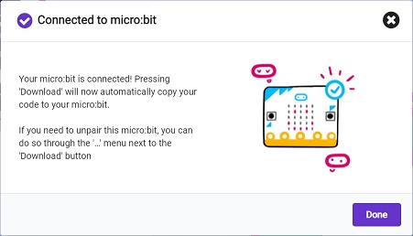
Transfer your code onto the micro:bit
When your micro:bit is connected, you’ll see the Connected to micro:bit message window.
Click on Done and you’re ready to go
Can you download your programme onto your micro:bit?
Notes:
Most of the time you will write and test your code in the simulator.
You are now going to download the programme onto your micro:bit.
(These instructions can be found here https://makecode.microbit.org/device/usb)

Slide 5
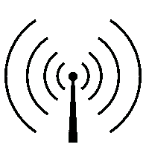
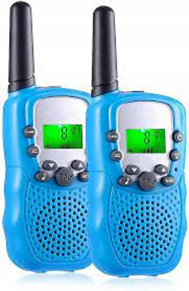
Walkie-talkies
Have you ever used walkie-talkies?
Walkie-talkies use radio waves to communicate.
When you use a walkie-talkie you have to make sure both walkie-talkies are on the same channel.
This means that the radio waves are at the same frequency - they are in the same part of the EM spectrum.
These walkie-talkies are set to the same channel no “8”
What does the number 8 on the walkie-talkies mean?
Notes:
https://commons.wikimedia.org/wiki/File:Water_wave_diagram.jpg

Slide 6
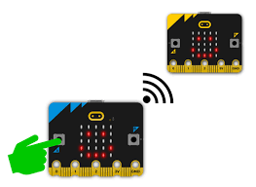
Coding the micro:bits to communicate via radio
We are going to learn how to code two micro:bits to allow us communicate
One will be a transmitter and one will be a receiver.
You will need two micro:bits.
Receiver
Transmitter

Slide 7
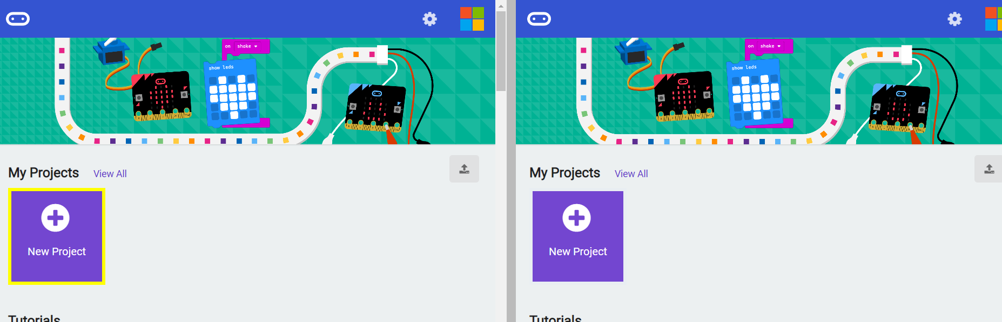
Micro:bit multi-editor
Open up the micro:bit multi-editor.
https://makecode.com/multi#
Create a new project called “transmitter” on the left and “receiver” on the right.

Slide 8
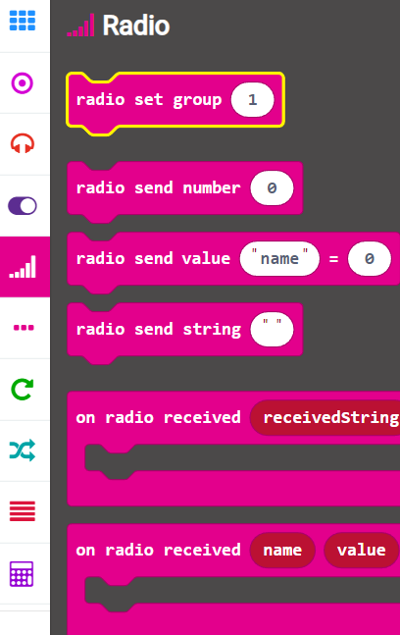
Using the radio blocks
You will need to click on the pink radio menu to access the radio blocks
Think back to the walkie-talkies… what did the number 8 mean?
We will have to set the same radio “channel” for the micro:bits also…
We will use the “radio set group” block to achieve this.

Slide 9
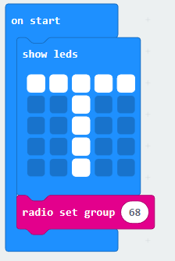
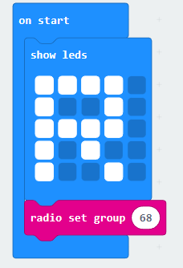
Setting the micro:bits to same channel
If we want the micro:bits to communicate then they need to be on the “same channel” just like with the walkie-talkies.
There are 256 channels on the micro:bits.
We are going to use the number 68.
Transmitter
Receiver

Slide 10

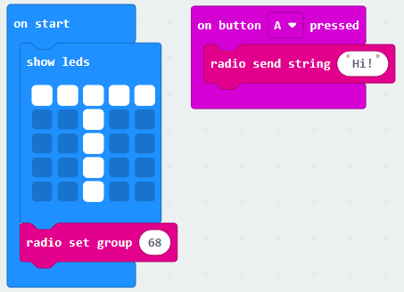
Sending a text message by radio
Let’s send a text message via radio signal
When I press button A I would like to send the message “Hi!”
“Hi!”
WHEN I PRESS BUTTON A
Transmitter code

Slide 11
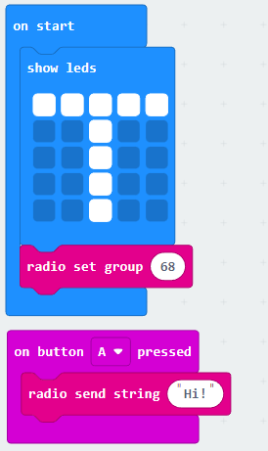
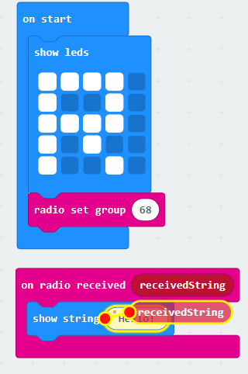
Make sure the micro:bits are the same radio group
TRANSMITTER
RECEIVER
Do you think everyone in the class should use the same radio group number?
Can you send a different message?
For the receiver code “click” on “receivedString” and drag into the blue block

Slide 12

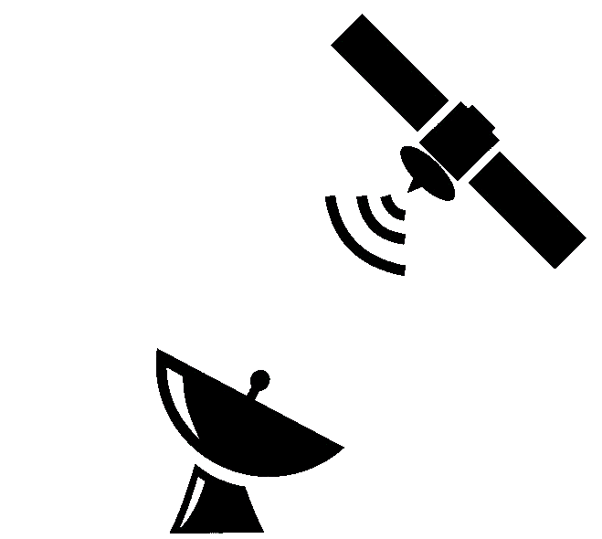
Telemetry
Ireland’s first satellite EIRSAT-1 is going to be carrying out experiments in space!
The data (or information) that is collected by EIRSAT-1 is going to be sent back to earth via radio signals. This data is going to be sent to ground stations. We call this process of recording and transmitting data telemetry.
We are going to make a model of a satellite and a ground station. The satellite is the transmitter and the ground station is the receiver. We will use two micro:bits.
Satellite is the “Transmitter”
Do you think we should keep pressing button A to send the data?
Ground station is the “Receiver”
Notes:
Obviously we don’t want to be pressing a button everytime we want to send telemetry.
Is there an astronaut up on the satellite sending back information to earth?
We want our transmitter micro:bit to automatically send data, e.g. we want it to record and send data - this is telemetry.

Slide 13
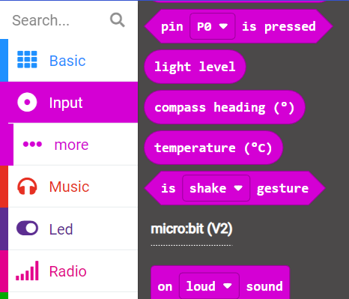
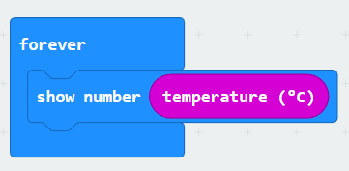
1. Turn transmitter micro:bit into a thermometer
First, we want to turn the transmitter micro:bit into a thermometer.
It is going to measure the temperature and have it showing on the display.
You will find “temperature” in the pink Input menu.
This code will forever show the temperature on the “transmitter” micro:bit
Notes:
Obviously we don’t want to be pressing a button everytime we want to send telemetry.
Is there an astronaut up on the satellite sending back information to earth?
We want our transmitter micro:bit to automatically send data, e.g. we want it to record and send data - this is telemetry.

Slide 14
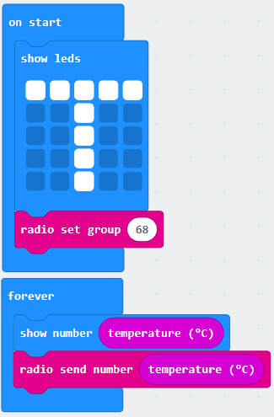
2. Sending the thermometer data via radio
We are now going to send this temperature data by radio signal.
Remember, we still have to set our radio group!
This code will
display the temperature forever on the transmitter micro:bit
keep sending (forever!) the “temperature” by radio signal.
Now… we want the receiver micro:bit to “receive” the temperature AND display it…
TRANSMITTER
Notes:
Obviously we don’t want to be pressing a button everytime we want to send telemetry.
Is there an astronaut up on the satellite sending back information to earth?
We want our transmitter micro:bit to automatically send data, e.g. we want it to record and send data - this is telemetry.

Slide 15
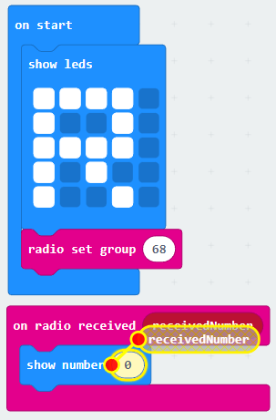
3. Receiving the temperature data and displaying it
We are now going to receive the temperature data by radio signal.
Remember, we still have to set our radio group!
The receiver data “doesn’t care” what type of data is being sent.
It just waits for numbers to be sent.
RECEIVER

Slide 16
Sending telemetry using micro:bits
TRANSMITTER
RECEIVER
For the receiver code “click” on “receivedNumber” and drag into the blue block

