Slide 1
Why is there junk in space?
The Kessler Effect

Slide 2
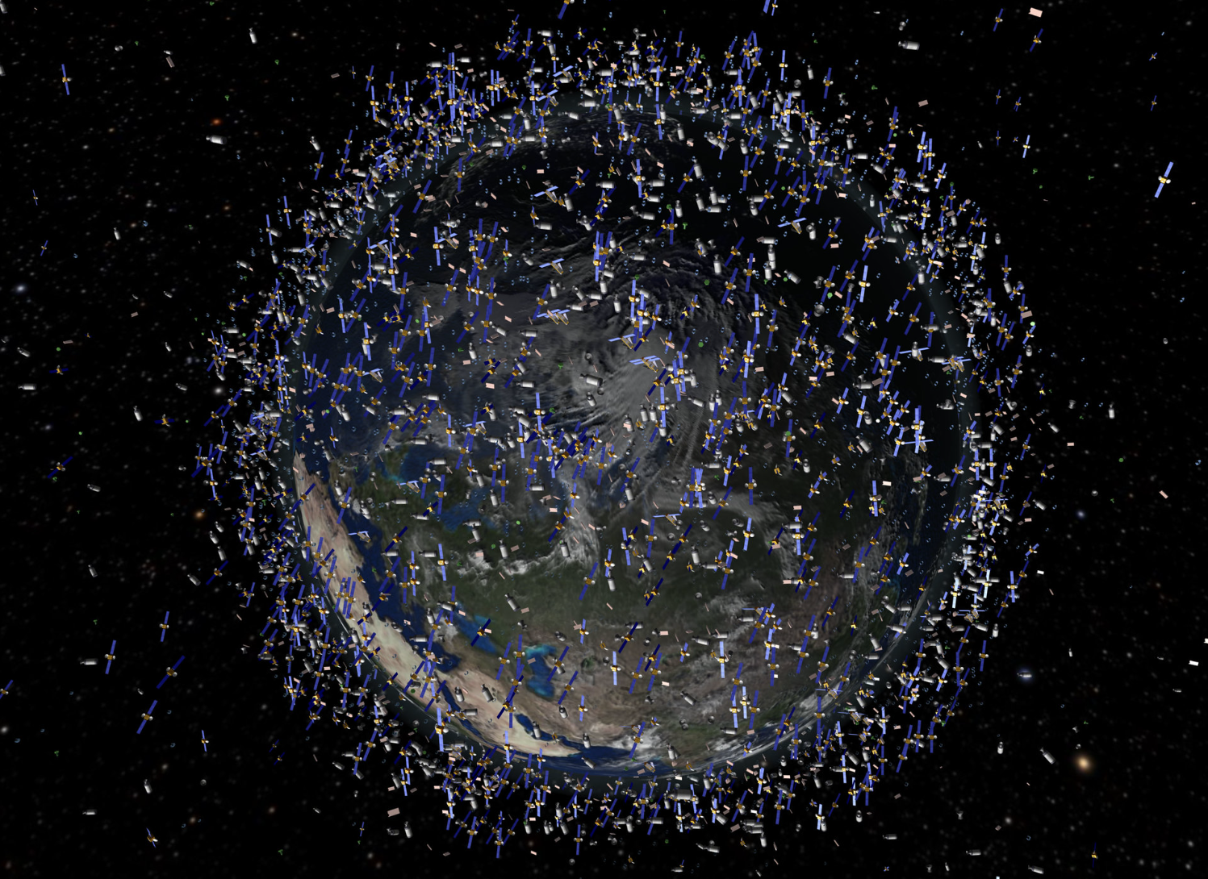
Why is there junk in space?

Slide 3
Introduction
A fully documented step-by-step tutorial designed to empower students (TY / leaving cert.) to build on their Python programming skills.
Heavily scaffolded tasks – based on Use-Modify-Create family of pedagogies. Students learn my using and modifying someone else’s code rather that creating their own.
Builds on basic programming constructs – sequential execution, variables, assignments, arithmetic operations, datatypes, iteration and selection. Provides a good opportunity to develop students understanding of data structures especially lists and dictionaries.
Aligned with Leaving Certificate Computer Science Learning Outcomes.
Provides opportunities to develop Computational Thinking Skills – algorithmic thinking, decomposition, evaluation, pattern recognition/generalisation and most importantly of all abstraction.
Notes:
A fully documented step-by-step tutorial designed to empower students (16-18 year olds/TY and leaving cert students) to build on their Python programming skills
Heavily scaffolded tasks – based on Use-Modify-Create family of pedagogies. Students learn my using and modifying someone else’s code rather that creating their own
Aligned with Leaving Certificate Computer Science Learning Outcomes
Particularly builds on basic programming constructs – sequential execution, variables, assignments, arithmetic operations, datatypes, iteration and selection
Provides a good opportunity to develop students understanding of data structures –lists and dictionaries.
Provides opportunities to develop Computational Thinking Skills – algorithmic thinking, abstraction, pattern recognition/generalisation and most importantly of all Abstraction
Context of space will be interesting for many students

Slide 4
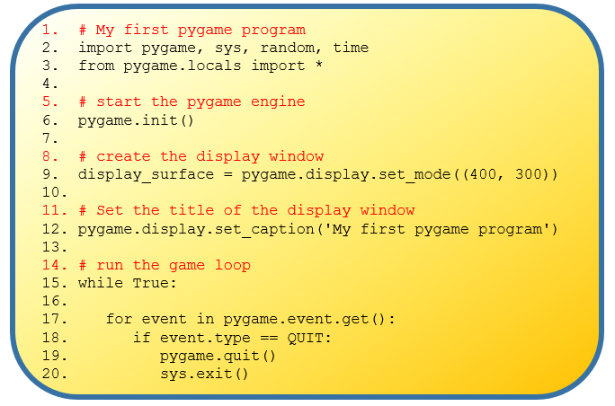
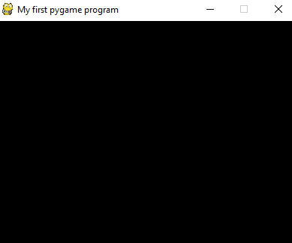
Program 1
Notes:
Pygame is a 3rd party/external Python library designed for writing video games
In this tutorial we use pygame to simulate the Kessler effect
This is our first pygame program - the ‘Hello World’ of pygame
The program initialises the pygame engine and creates a basic window - 400x300 pixels.
Every pygame program uses the basic game loop shown
When the program is run the window is displayed - CLICK

Slide 5
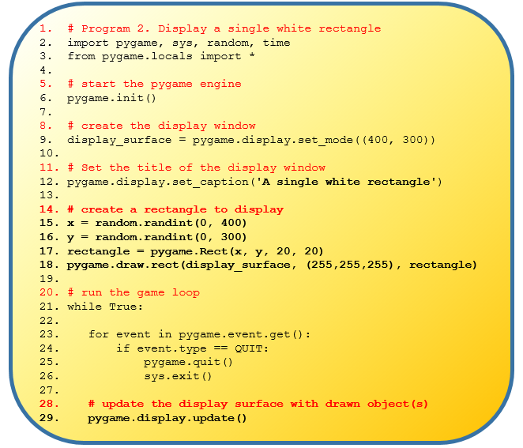
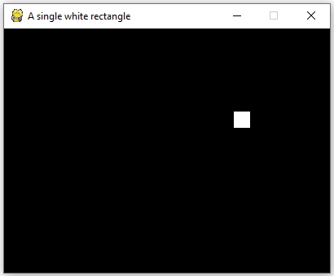
Program 2
Notes:
We extend our first program to draw a single white square
The additional/new lines of code are shown in bold
When the program is run the window is displayed - CLICK

Slide 6
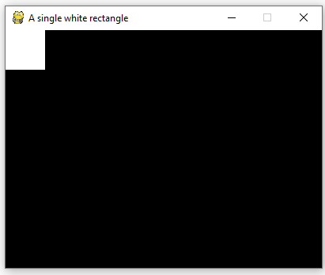
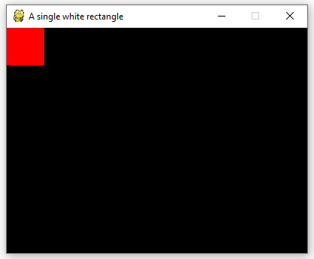
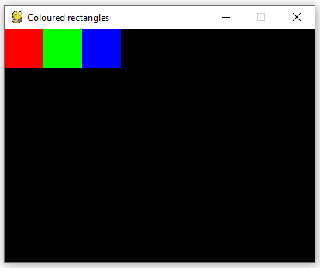
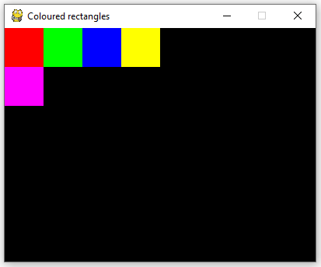
Program 2 - exercises
From this ….
… to this ….
… to this ….
… to this ….
Notes:
The tutorial includes some exercises …

Slide 7
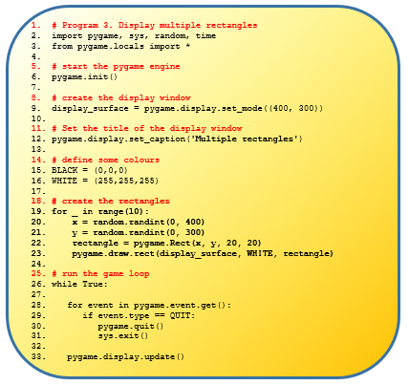
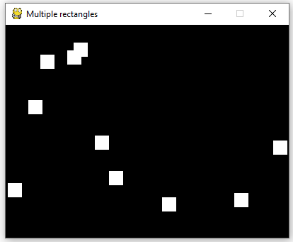
Program 3
Notes:
This program introduces the concept of loops to draw multiple squares (satellites)
When the program is run the window is displayed - CLICK

Slide 8
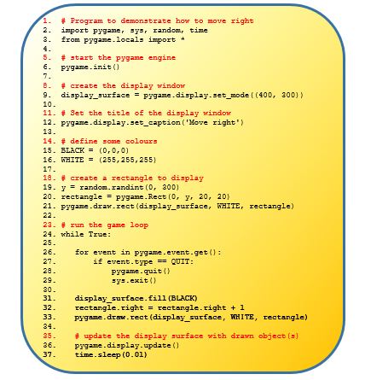
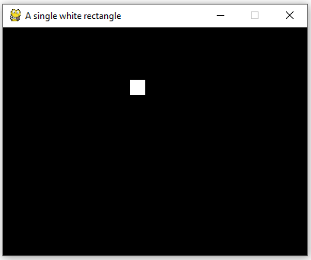
Program 4 – Animation I
Notes:
The tutorial now introduces animation / movement.
Animation is simulated by changing the object’s co-ordinates and refreshing the window (every hundredth of a second)
The ‘old’ object is replaced with the ‘new’ one!
Left … becomes left/right … horizontal
Up … becomes up/down … vertical
Example of Computational Thinking Skill of generalisation
Students must use pattern matching skills to learn how to change the object’s direction
Directions can be combined to simulate diagonal movement

Slide 9
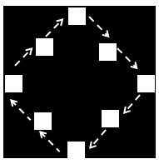
Program 5 – Animation II
Notes:
In the previous lesson we learned how by changing the position of a square we can create the illusion of animation.
One obvious drawback to the way our animation behaves is that the square disappears as soon as it reaches the edge of the window.
In this tutorial students learn how to keep the objects inside the window by simulating a bouncing effect
Requires logical thinking … what are all the possibilities
- object is moving downward left-right and hits the right edge
- object is moving downward left-right and hits the bottom edge
- if object is moving downward left-right it the case of hitting the top and left edge should not arise
What are the other possibilities?
What about anti-clockwise?

Slide 10
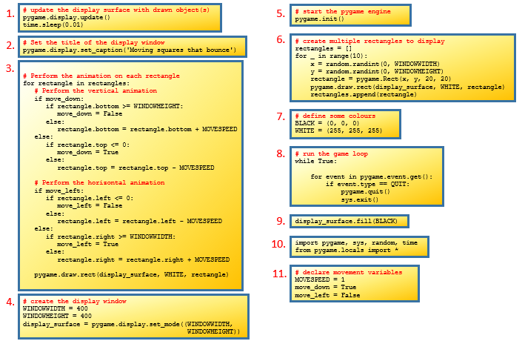
Program 5A – Parson’s Problem
Notes:
The graphic depicts 11 separate blocks of code in no particular order.
When the blocks are combined into the correct order the resulting program will display 10 squares – ALL MOVING IN THE SAME DIRECTION.
Each square will be animated in a manner similar to the animation achieved on the previous slide
TASK: Arrange the blocks to achieve the required task

Slide 11
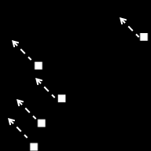
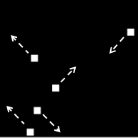
Program 6 – Animation III
Actual behaviour
Every square moves in the same direction
Desired behaviour
Squares moving independently
Notes:
The solution to the previous programming task yields a program that displays 10 animated squares.
However, there is one major drawback (which hopefully you identified in the evaluation) - the squares do not move independently.
This gives a ‘herd like’ behaviour in which every square follows the same movement pattern as depicted on the left hand side below.
The arrows indicate the direction of movement.
The desired behaviour – all squares moving independently in different directions – is depicted on the right hand side.

Slide 12
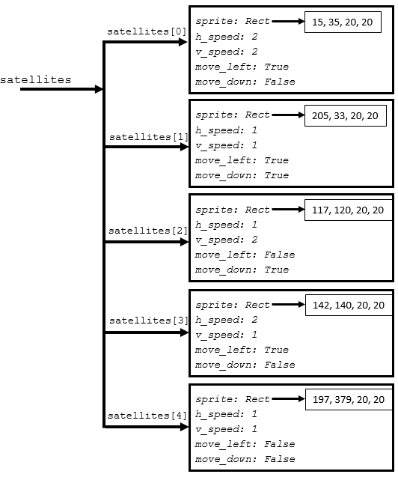
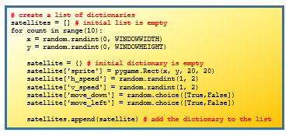
Program 6 – Animation III
Notes:
Data structures – lists and dictionaries
The use of dictionaries enables independent movement
Each satellite is represented as a dictionary and stored as a separate list element

Slide 13
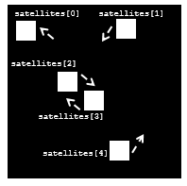
Program 6 – Animation III

Slide 14
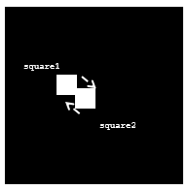

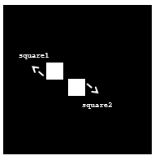

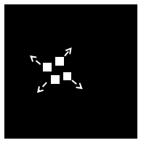
Program 7 – Collision Detection
Notes:
What should happen when two squares crash into one another?

Slide 15
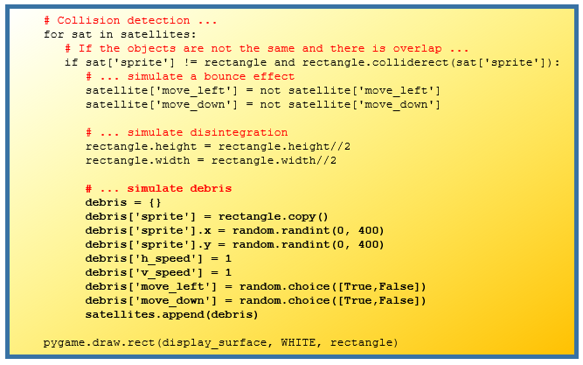
Program 7 – Collision Detection
Notes:
We want the satellite to break up – disintegrate
Q. From what you have learned so far how do you think this could be achieved?
The code would need to create new smaller satellites when it detects a collision.
CLICK. The key code block is shown on the right

Slide 16

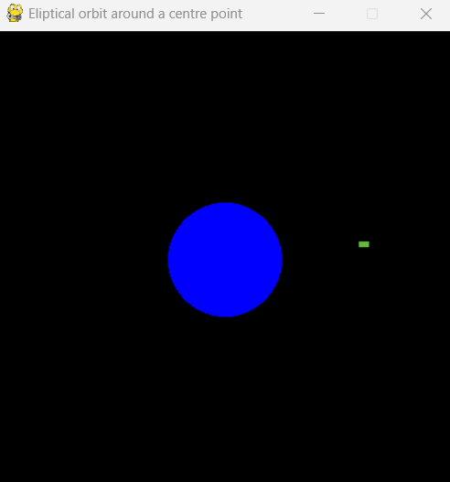
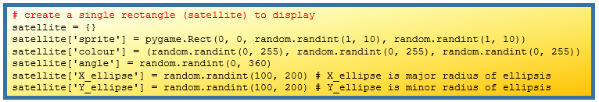
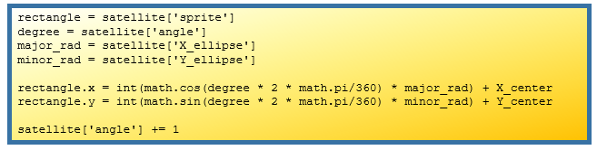
Program 8 – Circular Motion
STEP 1
STEP 2
STEP 3
STEP 4
Notes:
We’re now ready to apply our knowledge to simulate circular motion. We want to draw a satellite (rectangle object) moving around Earth (blue circle object)
We will piece the different elements of the solution like a jigsaw.
STEP 1. The first piece of the jigsaw is the code to display Earth.
STEP 2. The next step is to create the satellite object itself. We already know how to do this from earlier programs, but the code is shown here again just to remind you.
STEP 3. We now need the code to simulate the elliptical motion. This is accomplished using the formula for the circumference on a circle as illustrate in the code below. The code is placed inside the main program loop which refreshes the screen every hundredth of a second during which time the x and y position of the satellite are changed to give the illusion of movement.
STEP 4. Now that the details of the satellite have been changed it can be displayed at its new position using the following line of code.
STEP 5. Putting it all together – this is left as an exercise

Slide 17
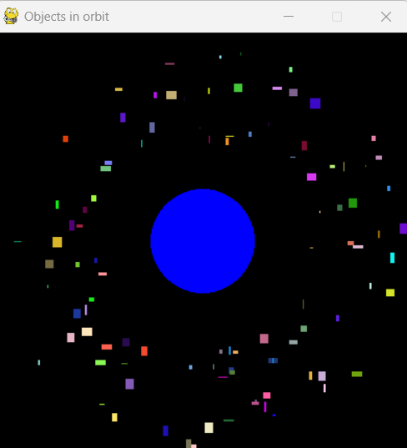
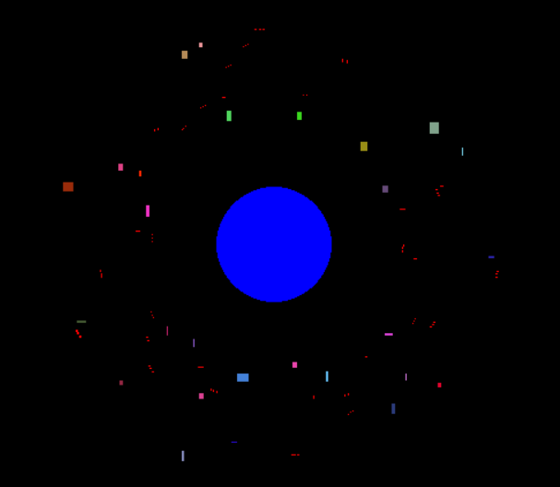
Program 9 – Final Exercise
Notes:
Now that we know how to simulate circular motion of 1 object ….
… CLICK
Write a program to create and display 100 satellite objects all orbiting about a central point and then …
… CLICK
Simulate the Kessler effect. As the satellites collide into each other they will break up into smaller satellites (shown below in RED).

Slide 18



