Slide 1

Conics in Space Travel

Slide 2

Educational Irish Research Satellite
(EIRSAT-1)
https://www.eirsat1.ie/
EIRSAT-1 is supported by the ESA Education Office under its ‘Fly Your Satellite!’ programme
https://www.esa.int/Education

Slide 3


Gravity turn and Elliptical Orbit
Elliptical orbit of the satellite
`
Gravity turn or parabolic portion of a rockets path entering space
`
Notes:
When launching a rocket into space after the initial vertical take-off a rocket must make a gravity turn to enter its orbit around the earth. This turn is in the shape of a Parabola.
Satellites that have a low to medium earth orbit have a Circular orbit while satellites which have a high earth orbit will have an Elliptical orbit.

Slide 4

Different types of Orbit
Depending on the function of the satellite there are different types of orbits
LEO – Low earth orbit
MEO- Medium earth orbit
GEO- Geostationary Orbit
GSO- Geosynchronous Orbit
HEO – High Elliptical Orbit
MEO
GSO
HEO
LEO
GSO
Notes:
LEO – Low earth orbit (Circular Orbit)
Altitude: 160-2000km,
Orbit period 90min
Uses: Voice and data services
MEO- Medium earth orbit (Circular Orbit)
Altitude: 2000 – 35,786 km
Orbit period: 2-14hours
Uses: Global positioning services
GEO- Geostationary Orbit (Circular Orbit)
Altitude: 35,786km
Orbit period: 24hours
Communications & Broadcasting services (TV)
GSO- Geosynchronous Orbit (Circular Orbit)
Altitude: 35,786km
Orbit period: 24hours
Weather forecast
HEO – High Elliptical Orbit (Elliptical Orbit)
Altitude: 1,000 – 40,000
Orbit period: 12 hours
Interesting Fact: When a satellite is in HEO the Earth will be positioned on the focal point of the Elliptical path that satellite follows.

Slide 5
Student Activity
Students Research each of the different types of orbits
Research to include:
Orbit shape
Altitude
Orbital period:
Typical function of satellites in each orbit
MEO
GSO
HEO
LEO
GSO

Slide 6
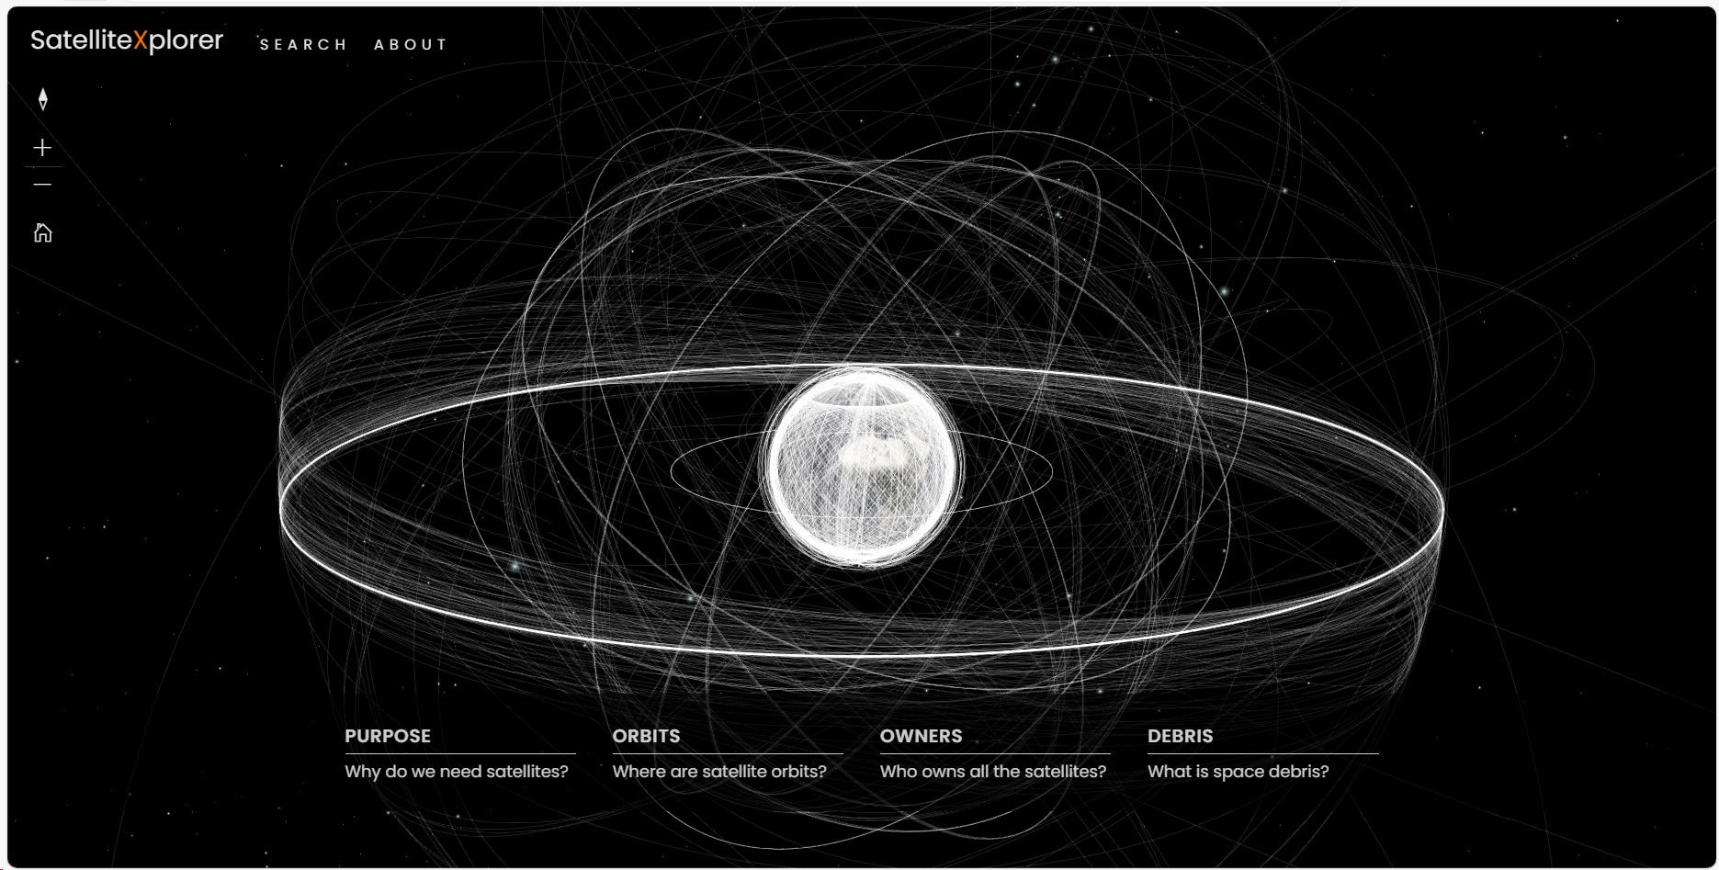
Space Explorer website
Space Explorer Tracks the all the satellites which orbit the earth at present.
Satellite Map | Explore Active Satellites Orbiting Earth (esri.com)

Slide 7
Student Activity
Student activity:
Using Space Explorer identify one satellite from each of the different types of orbits (LEO, MEO, GSO and HEO)
Then from the information provided create a scaled model of the earth and the 4 different satellites through a medium of your choice (board drawing, CAD or Physical model)
Information to include: You must include a profile of the satellites you have chosen. Include The name, purpose of the satellite, launch date, country it belongs to and the satellite inclination to the equator.

