Slide 1
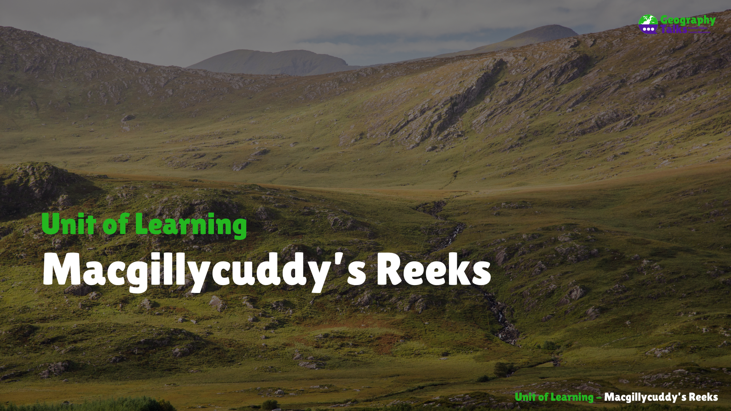

Slide 2

Learning Targets
Explain how fold mountains form.
Locate fold mountain ranges in Ireland and across the globe.
Categorise mountain ranges based on their orogeny.
Assess the suitability of sheep farming to mountains.
Outline the role of leaching on soil development on mountains.
Construct and label a diagram of a soil profile.
Identify the factors that influence soil creep.
Assess the impacts of soil creep.
Identify the rock type in the Macgillycuddy’s Reeks.
Explain the formation of sandstone.
Describe the process of freeze-thaw action.
Define the term recreational tourist.
Describe the environmental impacts of recreational tourism on mountains.
Assess the interationalship between tourism and transport in the Macgillycuddy’s Reeks.
Identify and locate spot heights on an O.S. Map.

Slide 3







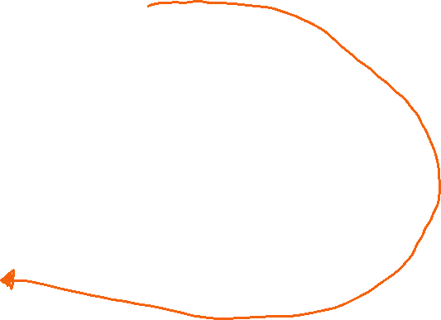


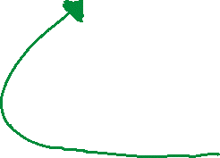









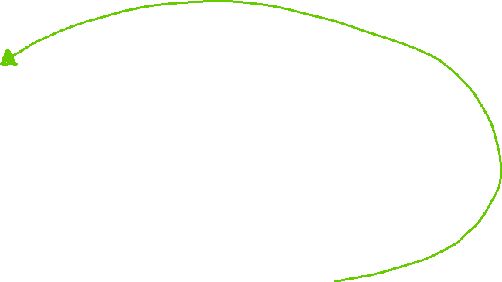



Mind Map of Topics in this Unit of Learning

Slide 4
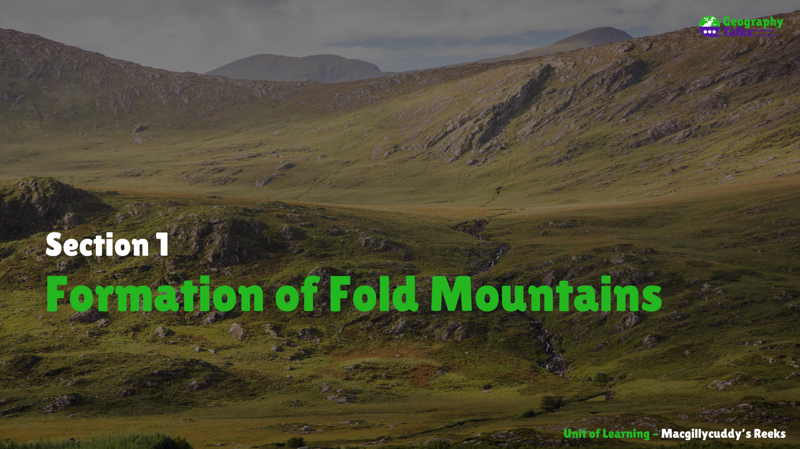

Slide 5
Learning Targets
Explain how fold mountains form.
Locate fold mountain ranges in Ireland and across the globe.
Categorise mountain ranges based on their orogeny.

Slide 6
Formation of Fold Mountains
The ridge-push process at opposite ends of two continental plates pushes them towards each other, aided by convection currents in the mantle.
The edges of both plates are folded upwards.
The rocks lying on top of these plates buckle into arch shapes, which are called mountains.
The top arch of a mountain is known as an anticline, and the valley, or downfold, between each mountain is known as a syncline.
As this process continues over millions of years, the mountains continue to grow.

Slide 7
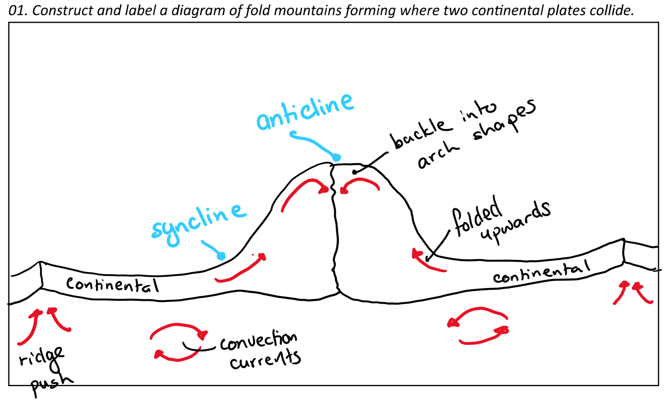
Diagram of a Fold Mountain at a Continental-Continental Plate Boundary

Slide 8
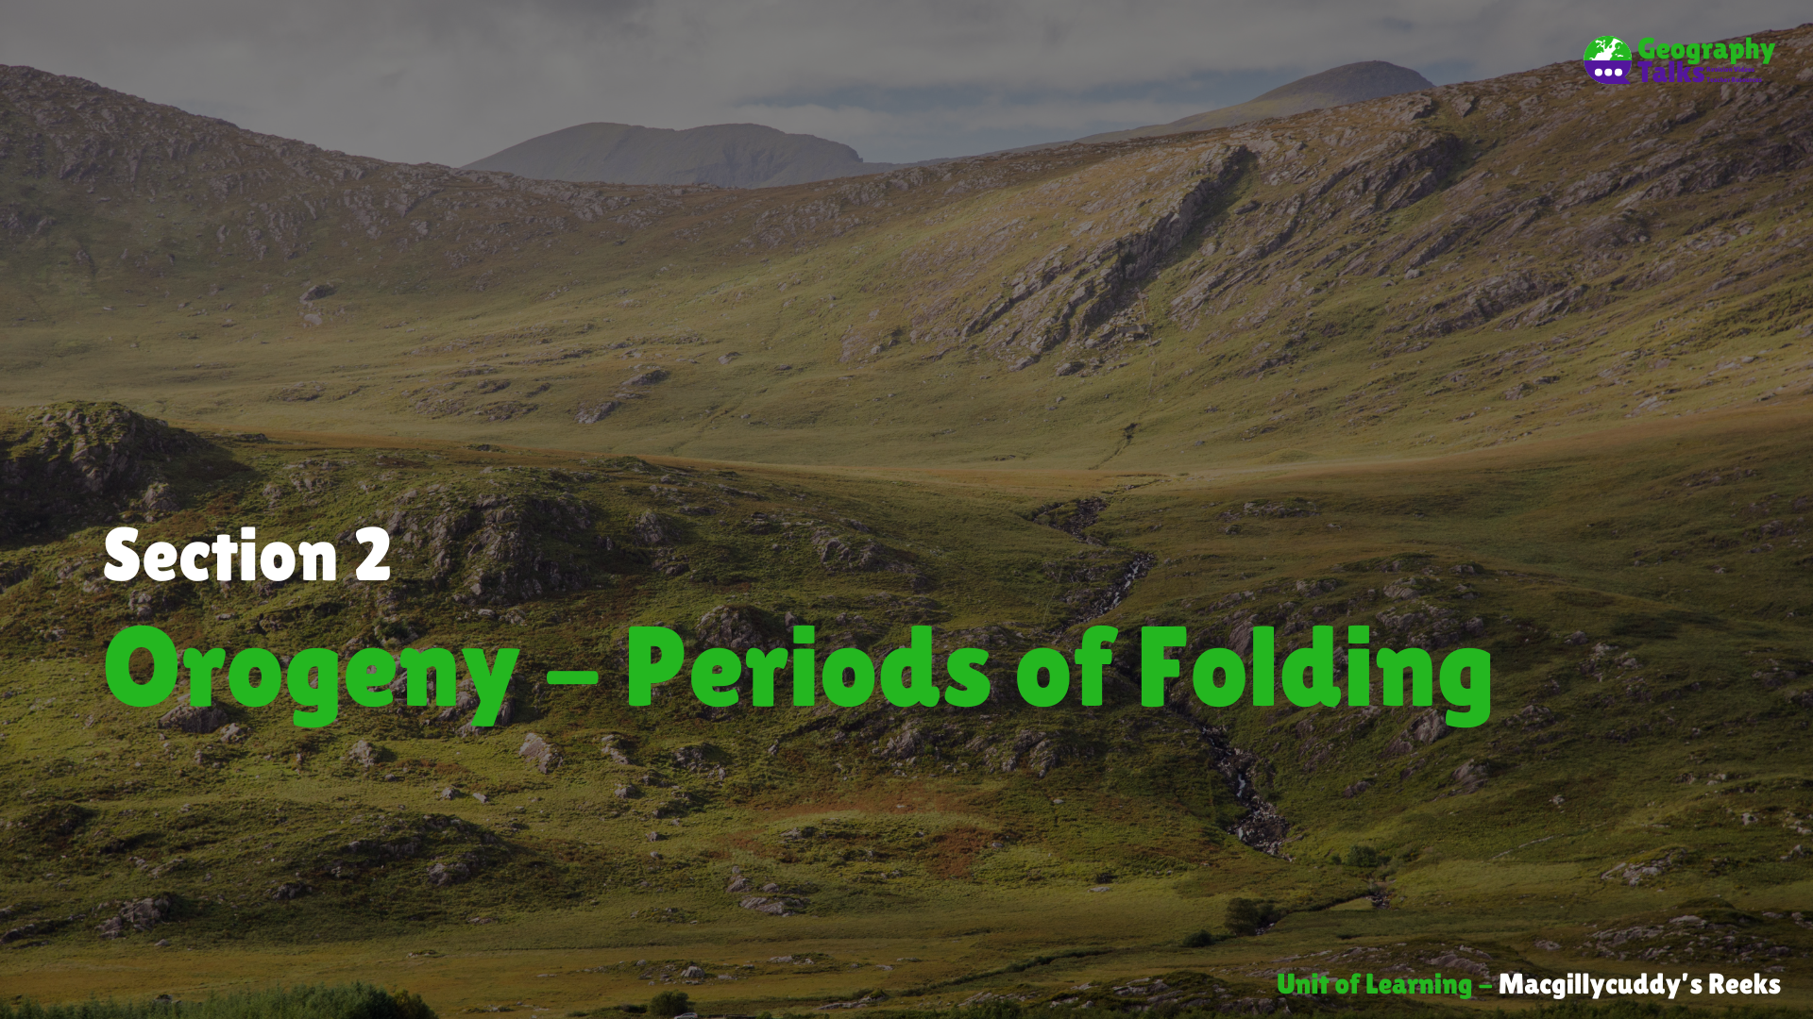

Slide 9
Learning Targets
Explain how fold mountains form.
Locate fold mountain ranges in Ireland and across the globe.
Categorise mountain ranges based on their orogeny.

Slide 10
Fold Mountain Orogeny
Orogeny = Periods in time when folding took place
Orogeny / Period | How long ago? | Example
Caledonian | 400 million yrs ago | Dublin - Wicklow Mts
Armorican | 250 million yrs ago | Macgillycuddy’s Reeks
Alpine | 35 million yrs ago | The Alps

Slide 11
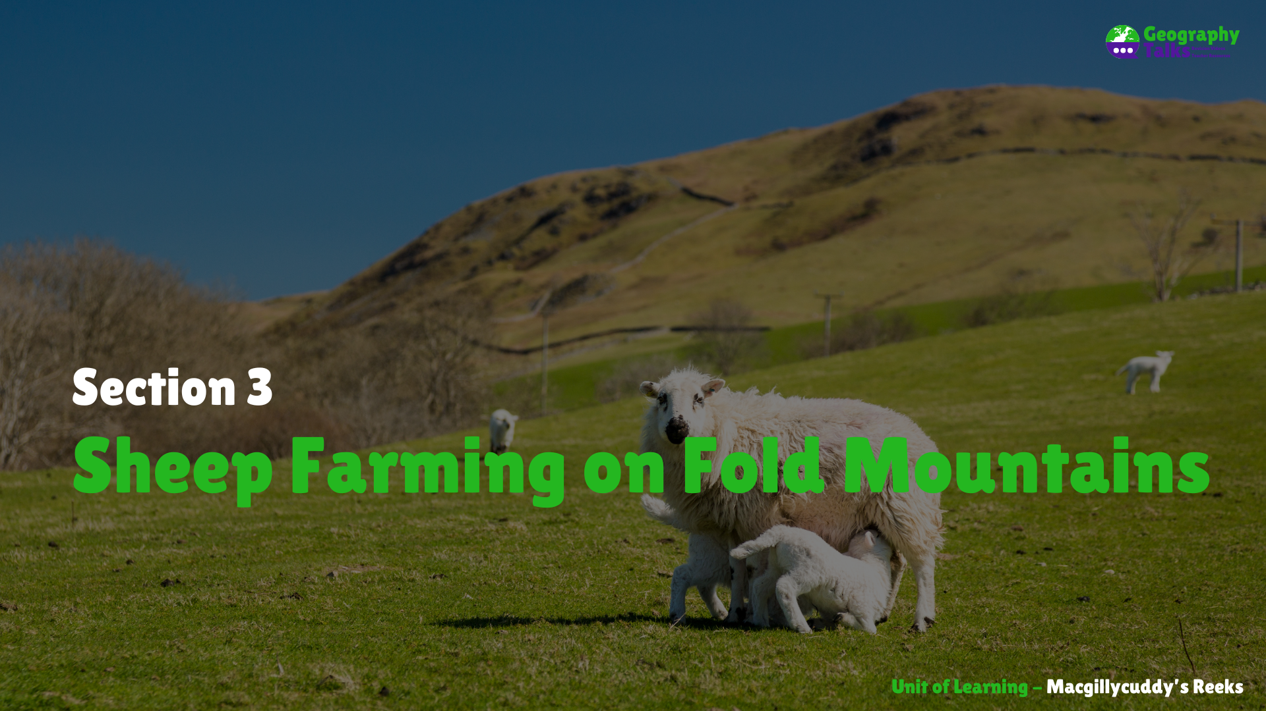

Slide 12
Learning Targets
Assess the suitability of sheep farming to mountains.
Outline the role of leaching on soil development on mountains.
Construct and label a diagram of a soil profile.

Slide 13
Key Words
Commercial farming | Farming to earn money
Primary Economic Activity | taking resources from the earth
slope | Steepness or angle of a mountain
adapted | Changing to better suit your surroundings
Altitude | Height above sea level
Podzol | Infertile type of soil
infertile | Lacks nutrients
coniferous | Trees that do not loose their leaves
Leaching | Nutrients washed away from A horizon
hardpan | Compact layer of soil between the A and B horizons

Slide 14










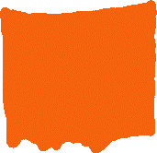







Diagram of a soil profile of Podzol Soil

Slide 15
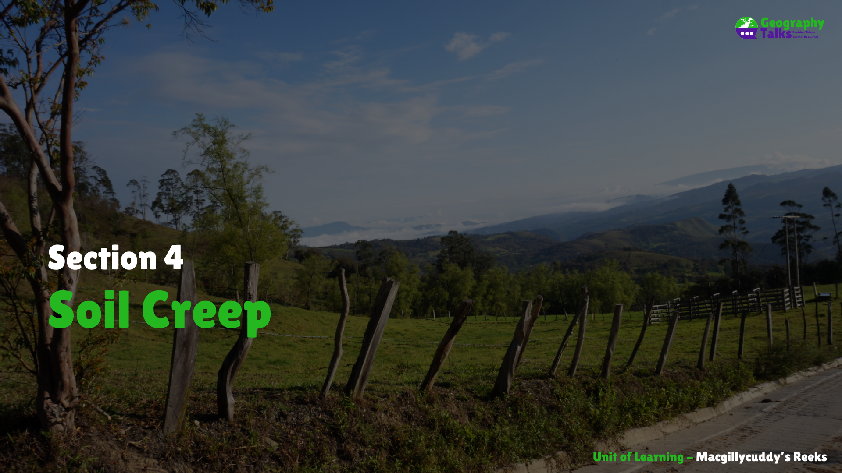

Slide 16
Learning Targets
Identify the factors that influence soil creep.
Assess the impacts of soil creep.

Slide 17





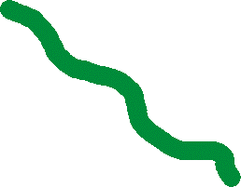

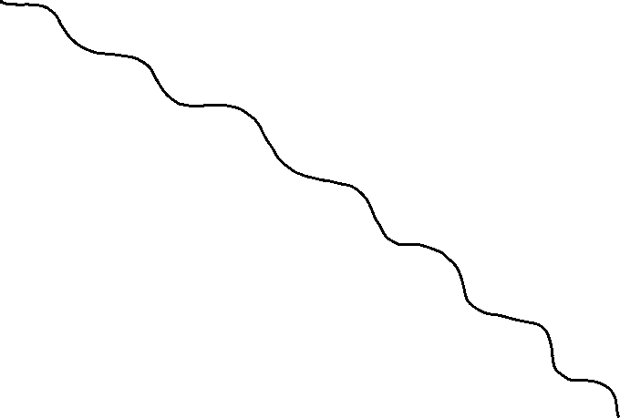










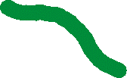




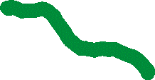
Diagram of a slope impacted by Soil Creep

Slide 18
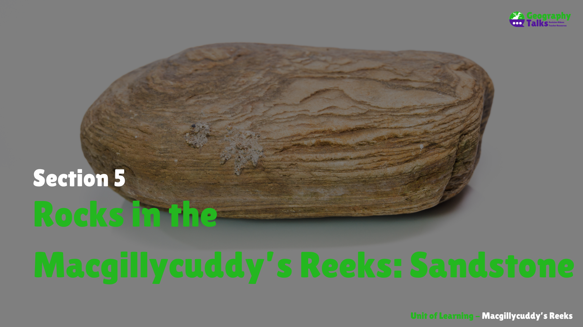

Slide 19
Learning Targets
Identify the rock type in the Macgillycuddy’s Reeks.
Explain the formation of sandstone.

Slide 20
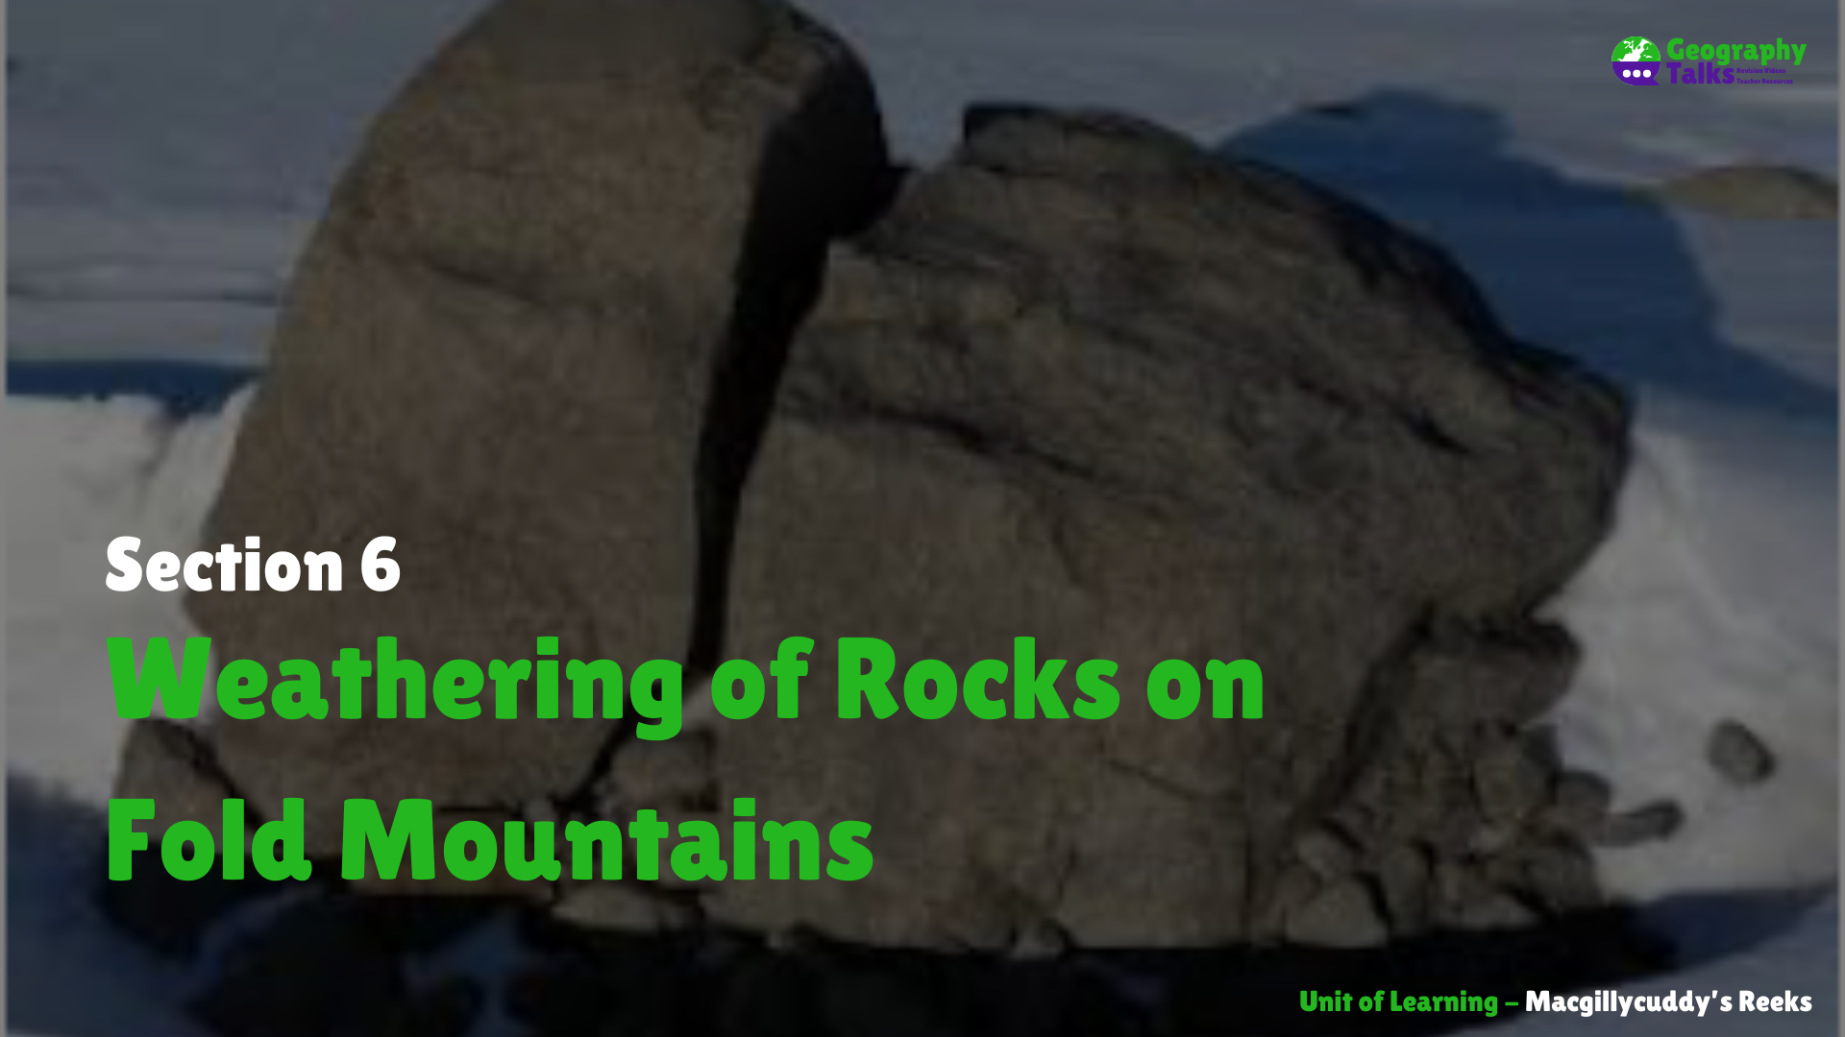

Slide 21
Learning Targets
Describe the process of freeze-thaw action.

Slide 22
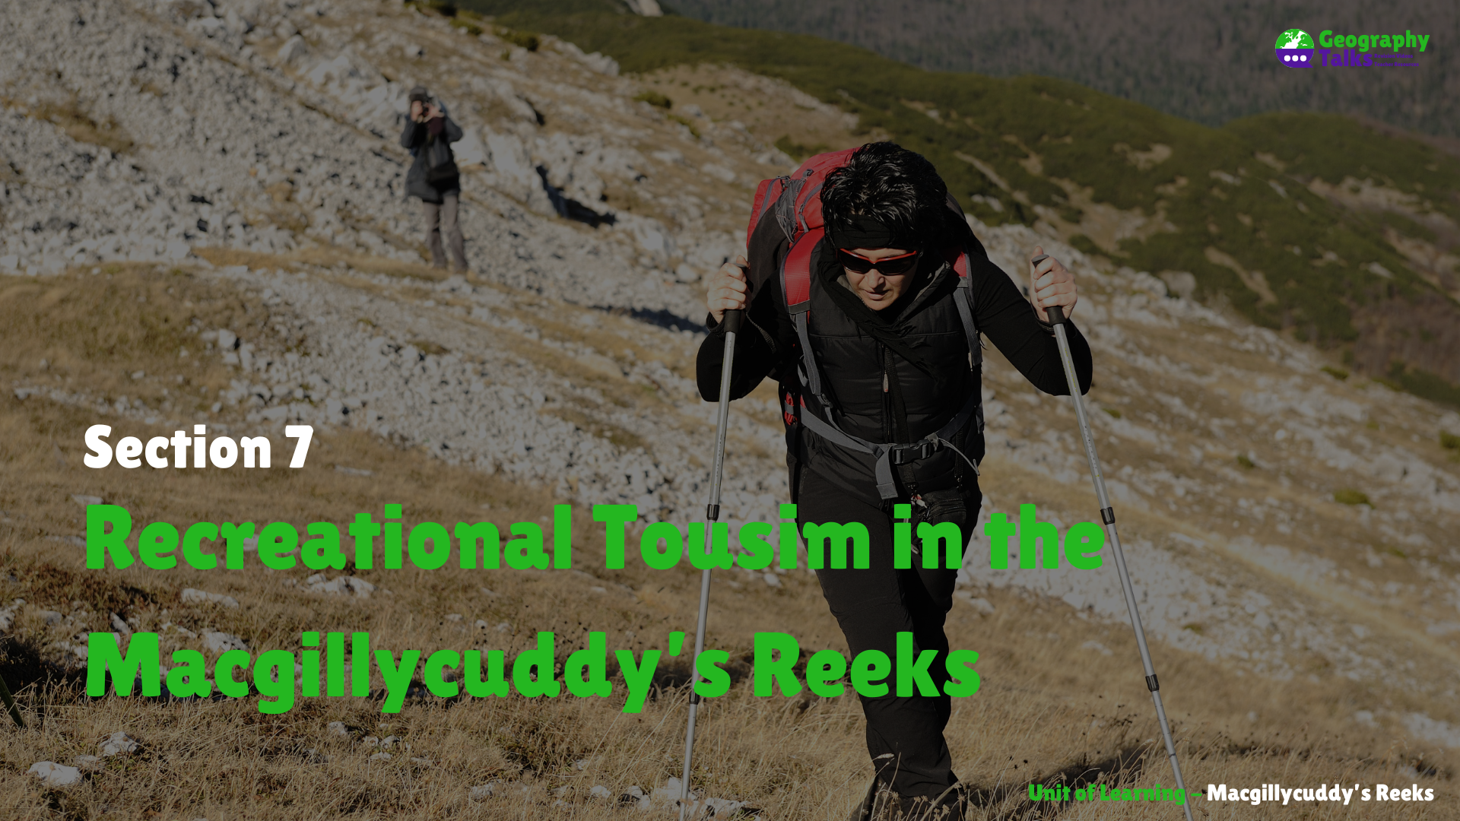

Slide 23
Learning Targets
Define the term recreational tourist.
Describe the environmental impacts of recreational tourism on mountains.
Assess the interconnection between tourism and transport in the Macgillycuddy’s Reeks.
Identify and locate spot heights on an O.S. Map.

Slide 24
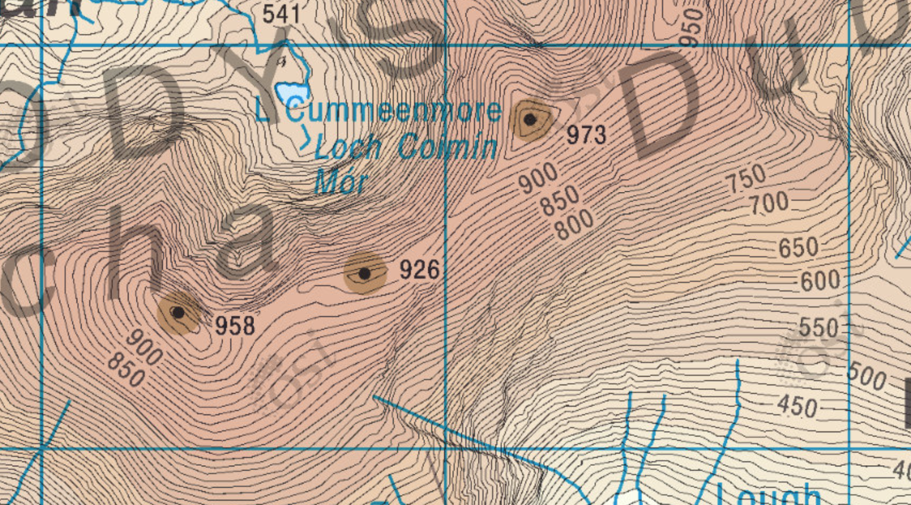
Spot Heights on O.S. Maps
Examples
988m – V 83 84
958m – V 82 83

