Slide 1
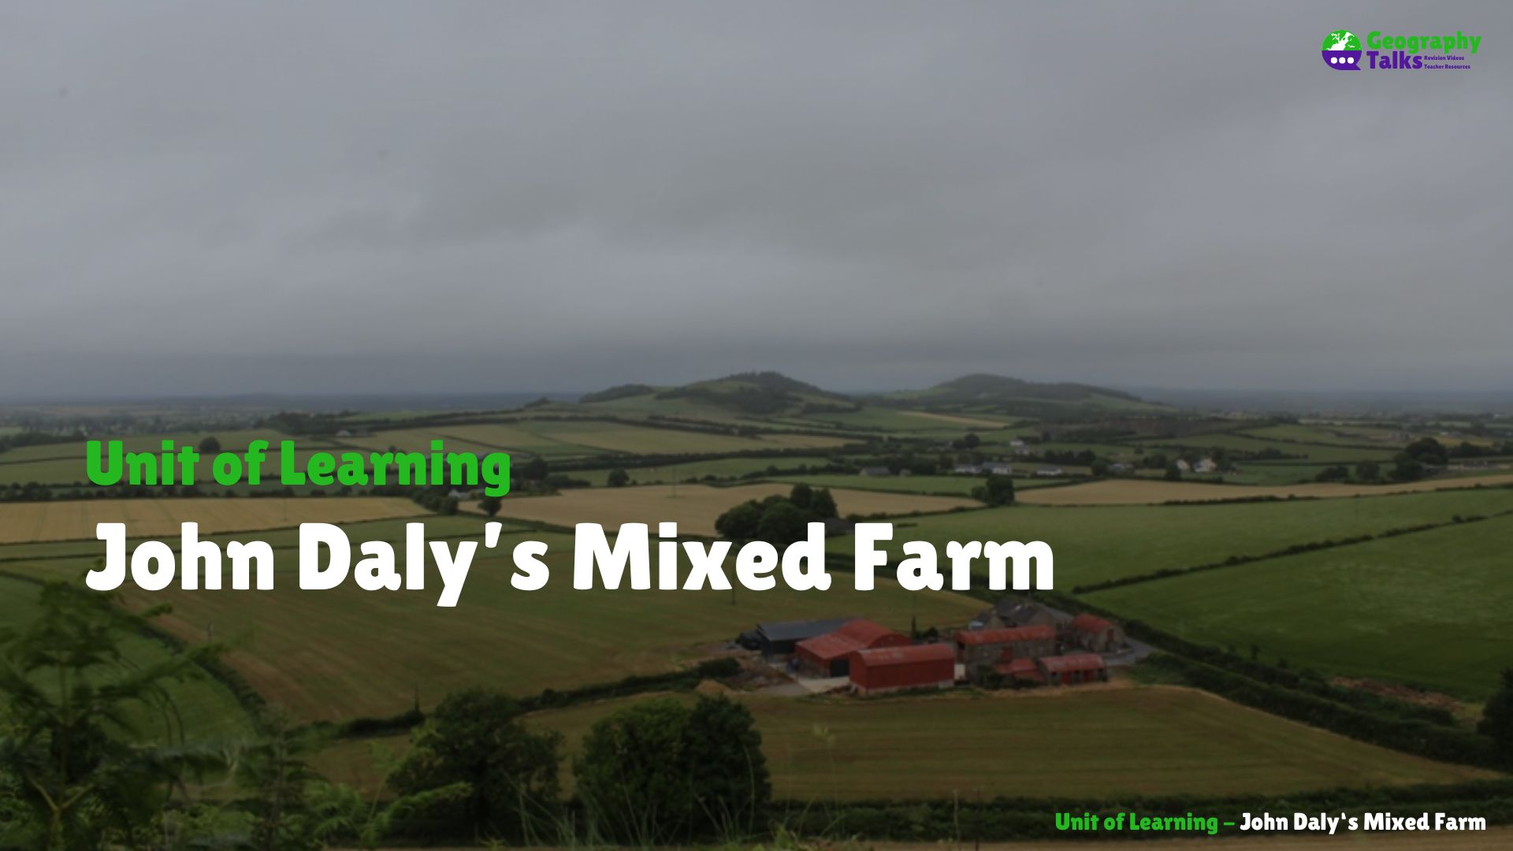

Slide 2

Learning Targets
Describe different types of farms.
Explain the physical factors that influence the location of farms.
Explain the human factors that influence the location of farms.
Use an O.S. Map to identify suitable locations for a farm.
List the inputs, processes, and outputs for a farm you have studied.
Describe the formation of Brown Earth soils.
Explain why Brown Earth soils are suitable for farming.
Locate Brown Earth soils in Ireland.
Define the term sustainable exploitation.
Identify farming practices that can damage soil.
Identify farming practices that can protect soil.
Define the term globalisation.
Describe how Irish farms benefit from globalisation.

Slide 3
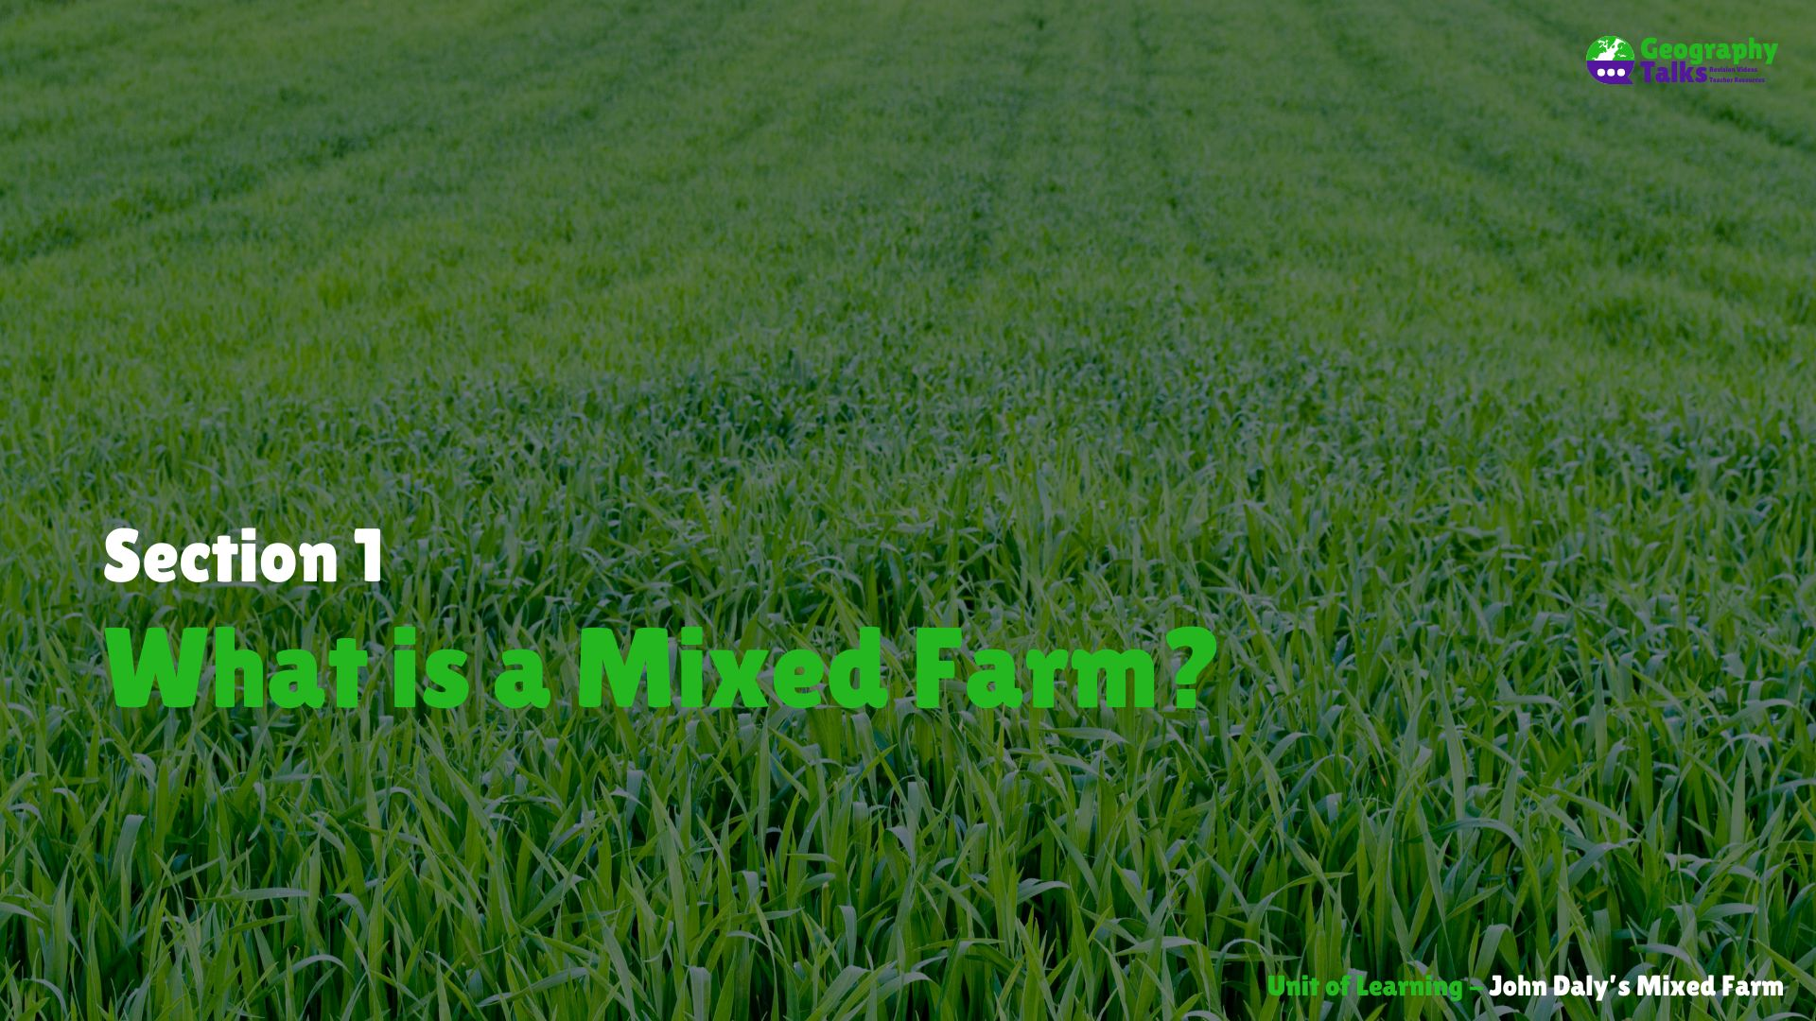

Slide 4
Learning Targets
Describe different types of farms.

Slide 5
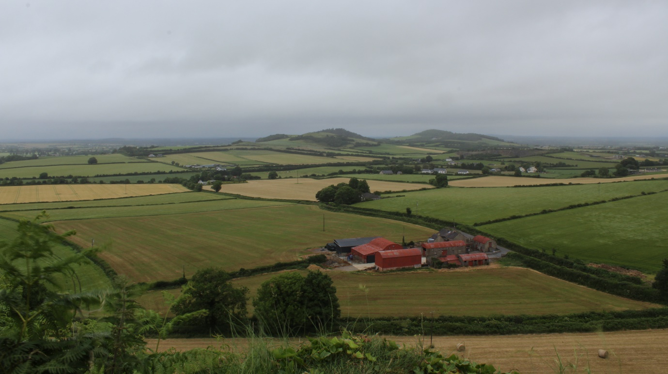

Slide 6
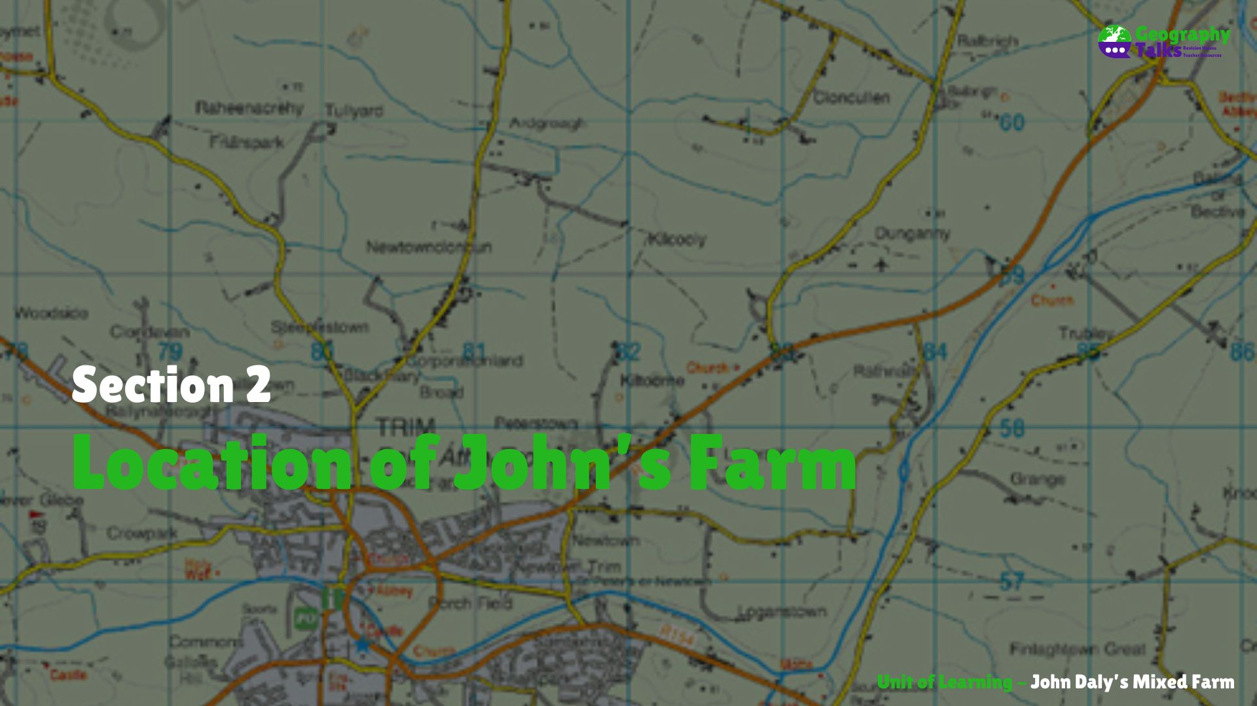

Slide 7
Learning Targets
Explain the physical factors that influence the location of farms.
Explain the human factors that influence the location of farms.
Use an O.S. Map to identify suitable locations for a farm.

Slide 8
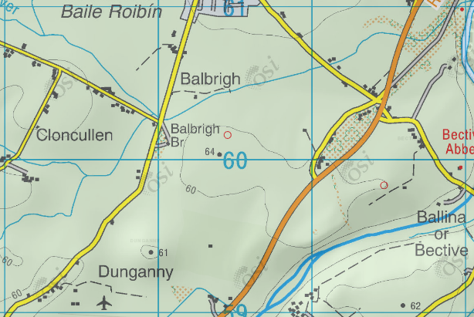
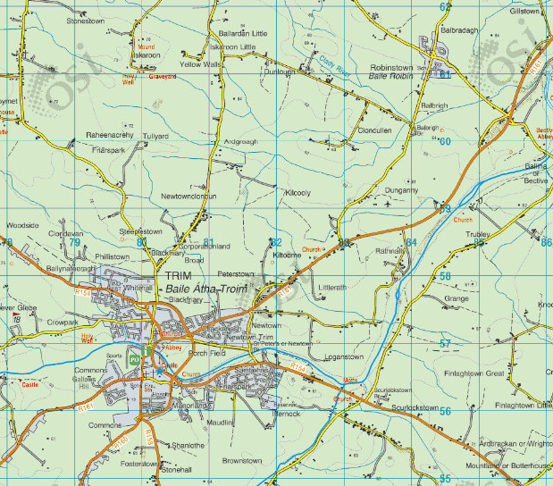

Slide 9
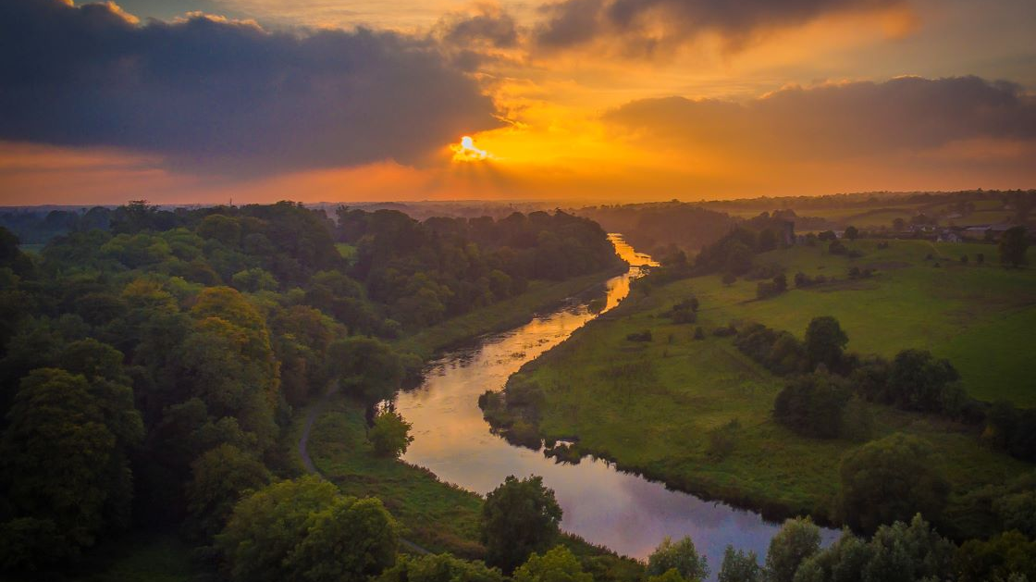
River Boyne

Slide 10
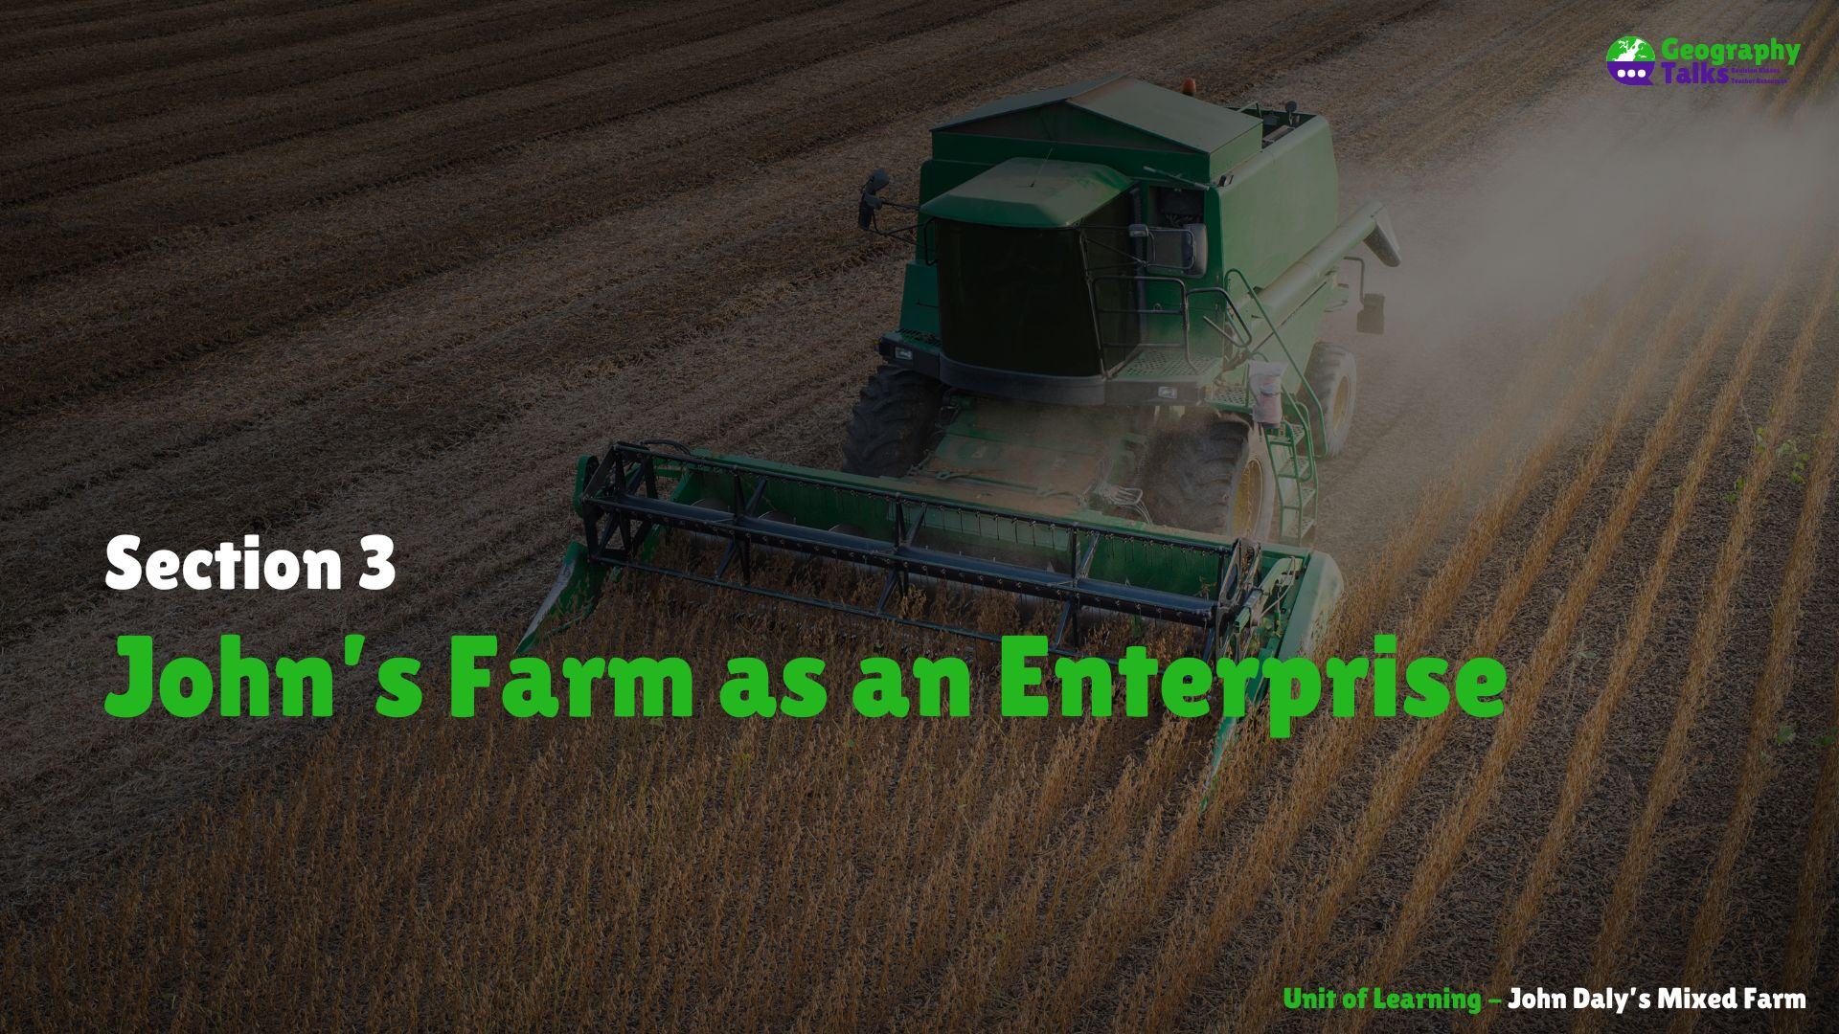

Slide 11
Learning Targets
List the inputs, processes, and outputs for a farm you have studied.

Slide 12
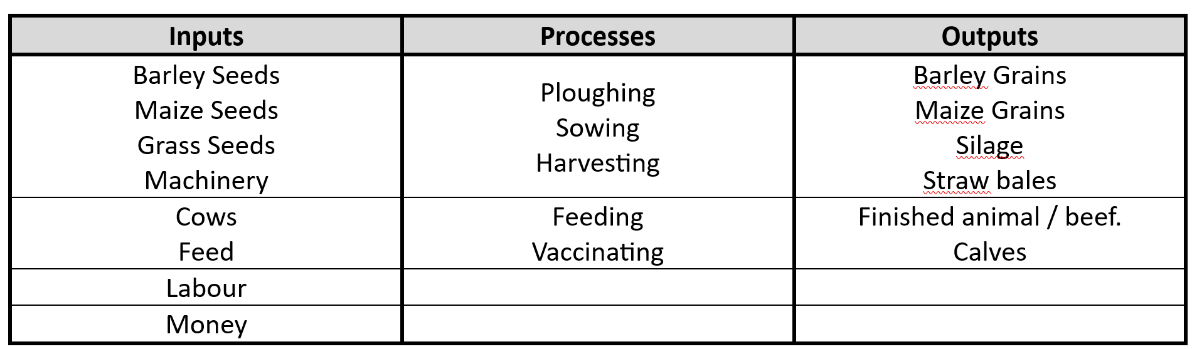

Slide 13
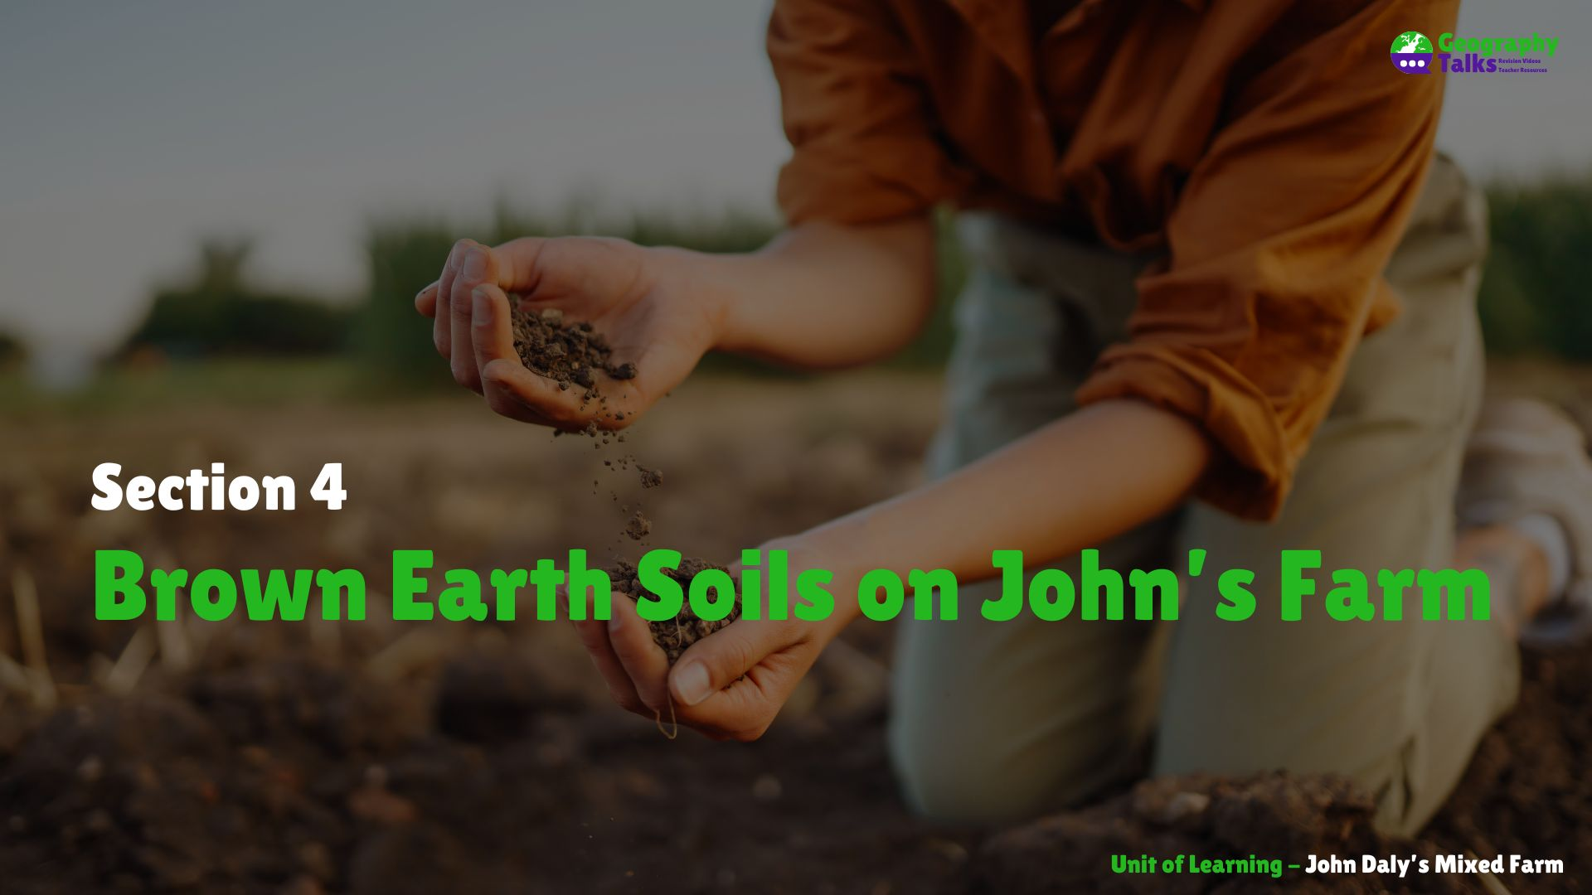

Slide 14
Learning Targets
Describe the formation of Brown Earth soils.
Explain why Brown Earth soils are suitable for farming.
Locate Brown Earth soils in Ireland.

Slide 15
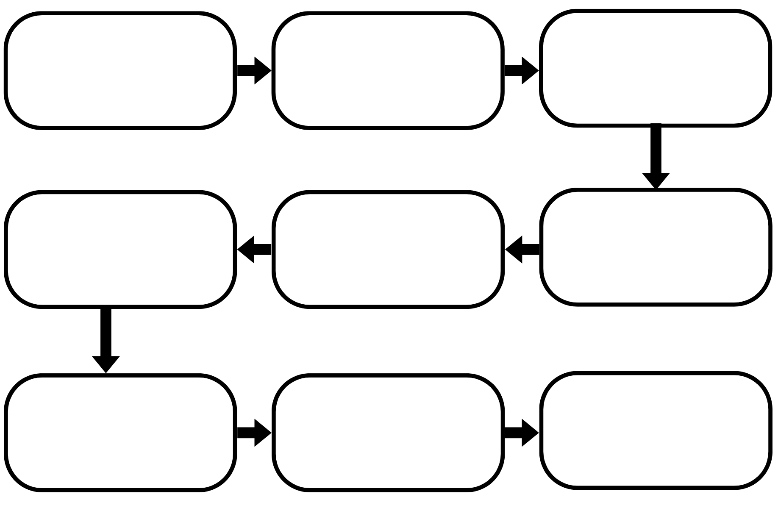
Flowchart for the formation of Brown Earth Soils

Slide 16
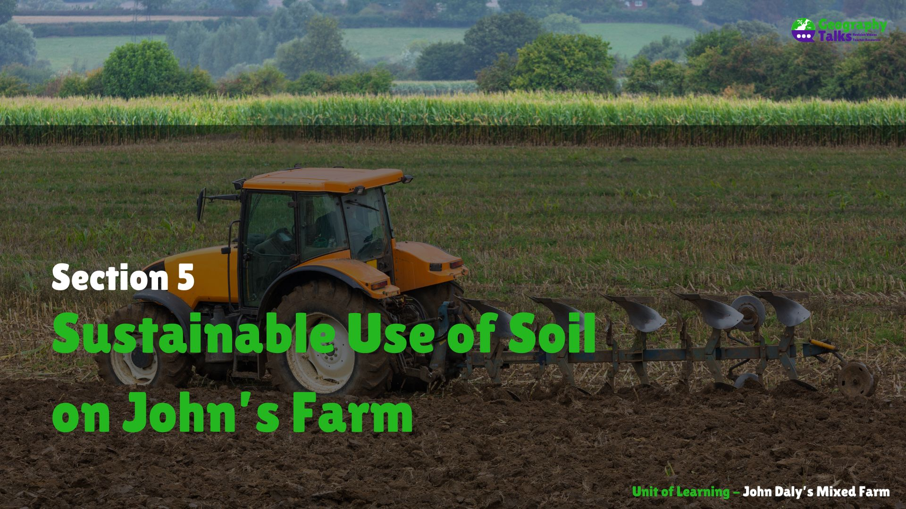

Slide 17
Learning Targets
Define the term sustainable exploitation.
Identify farming practices that can damage soil.
Identify farming practices that can protect soil.

Slide 18
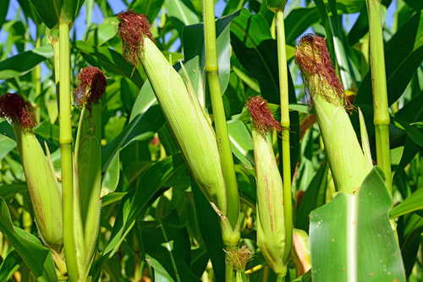
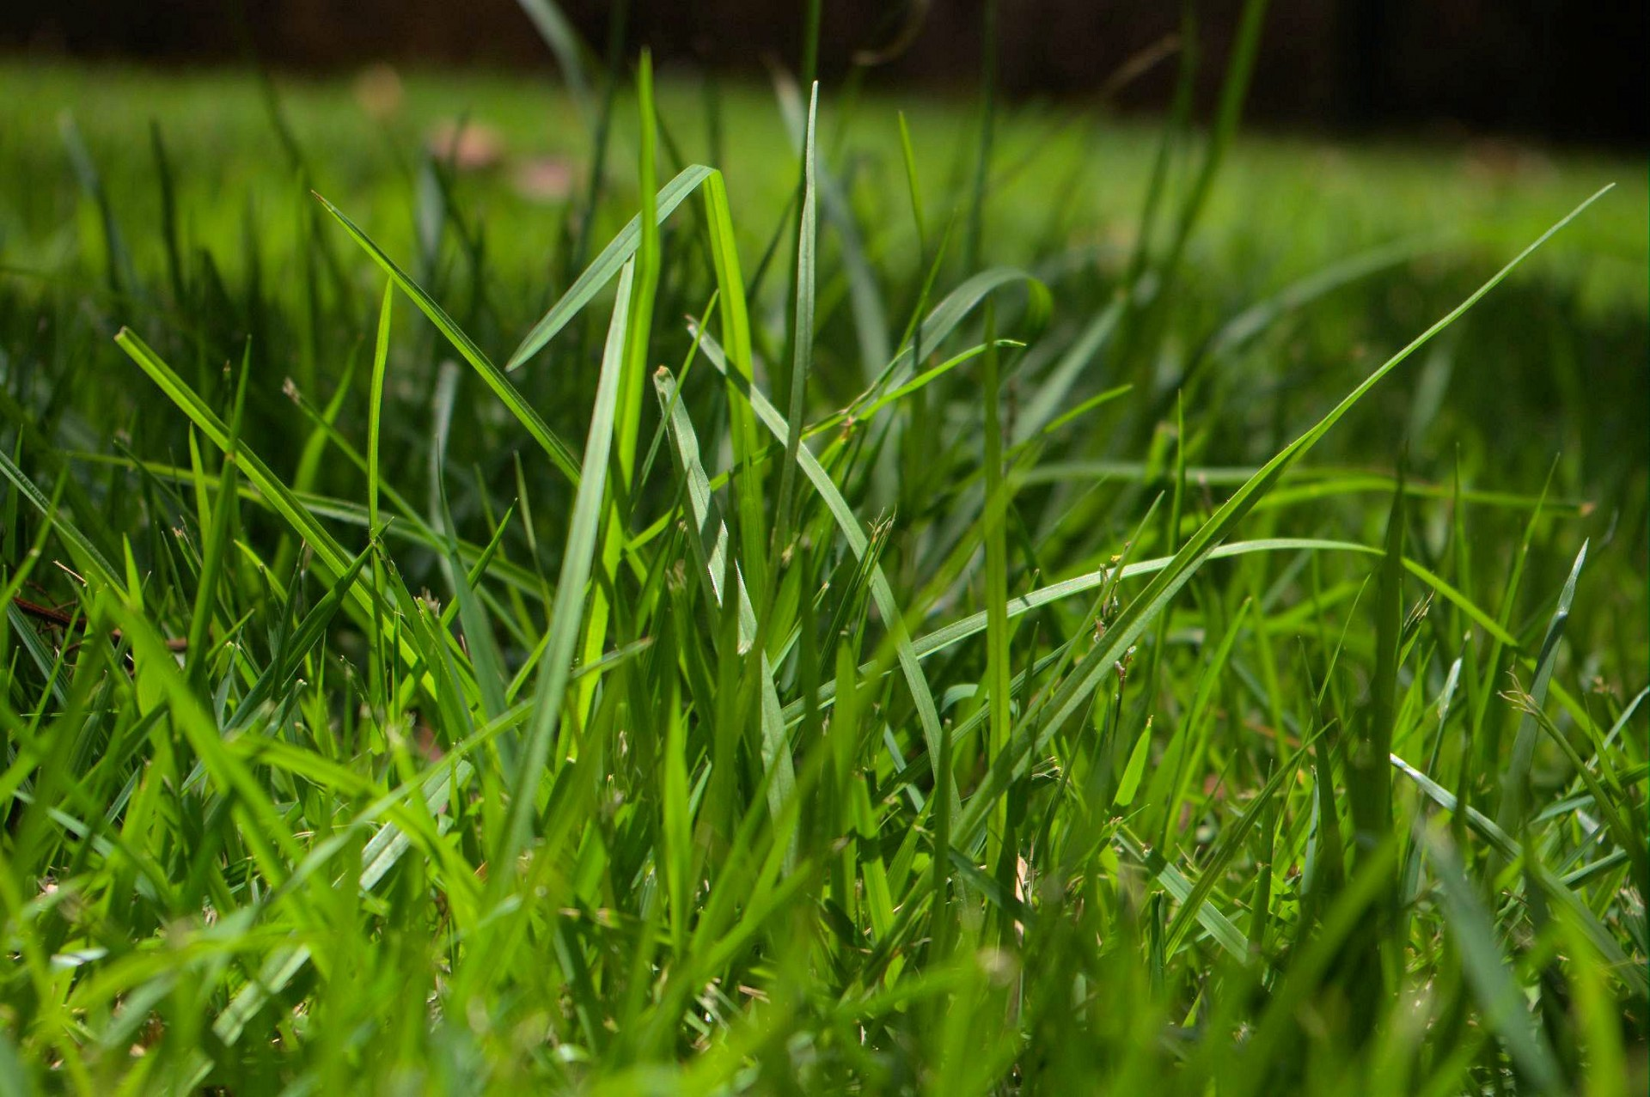
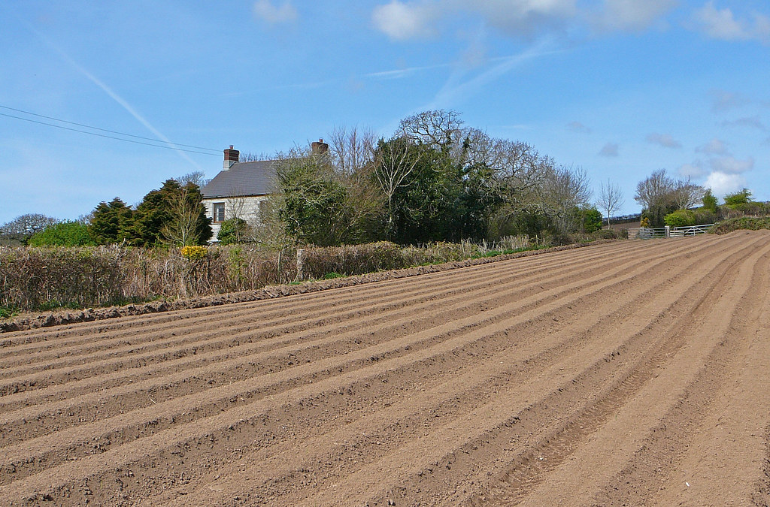
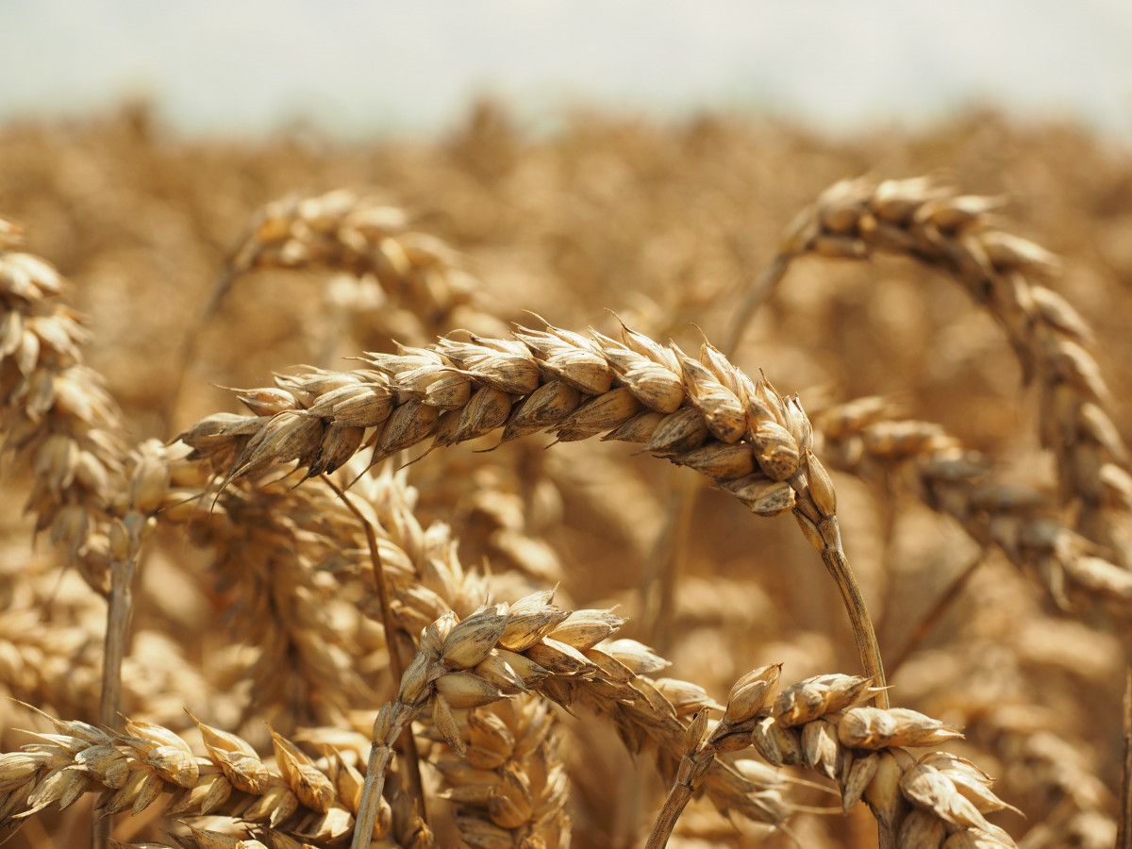
Crop Rotation

Slide 19


Slide 20
Learning Targets
Define the term globalisation.
Describe how Irish farms benefit from globalisation.

Slide 21
