Slide 1


Unit 1 E– Teamwork
Work co-operatively with others as part of a team
Appreciate the value of teamwork in generating ideas, assessing risks, solving problems and completing tasks

Slide 2

Teamwork (2022)
When a group of people work together/co-operatively with each other to achieve a common goal/aim/job

Slide 3
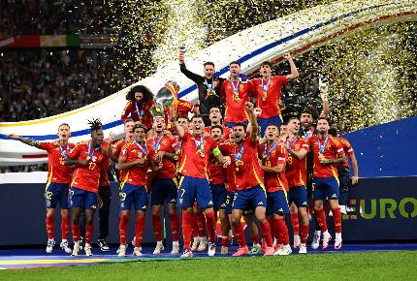
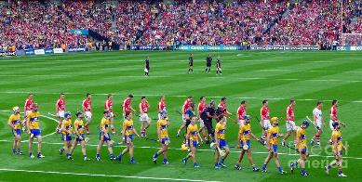
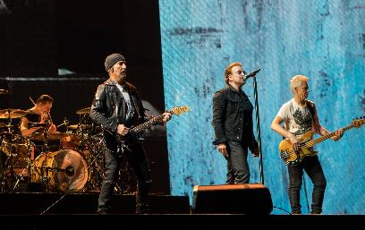

What makes these Teams Successful?

Slide 4
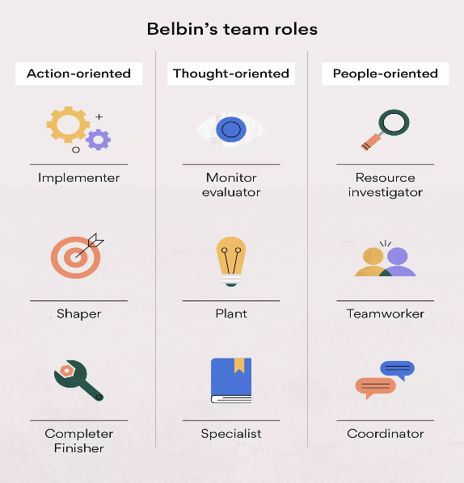
What's your usual Team Role

Slide 5

Teamwork
There can be 5 stages in the life of a team:
Forming – when the team comes together for the first time.
Storming – when members compete for roles within the team & disagreements break out.

Slide 6

3. Norming – when members settle into their roles / responsibilities. The team is in agreement on how they should behave & how the group should progress.
4. Performing – when the team performs together in order to achieve the objectives.
5. Mourning/Transforming – when the team breaks up or a member leaves and a new team is formed.

Slide 7
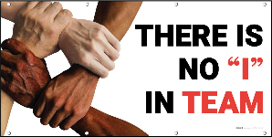
Describe two characteristics of an effective team member.(2022 & 2019)
1. A good listener
2. A good communicator
3. Willing to do their share/share ideas
4. Being good at encouraging others to participate/motivating others
5. Asking for help form others when needed/offering help to others
6. Good at keeping deadline/reaching targets
7. Committed to the team and its success
8. Tolerant of others' ideas and views/accepts criticism
9. Good leadership ability
10. Is flexible, decisive

Slide 8

How can a team of students ensure they successfully complete an activity?
1. Do good planning at the beginning.
2. Listen and contribute/do the work assigned to them.
3. Make decisions as and when required. Allow time for discussion
4. Adhere to a time plan/all areas can be covered in order/good time.
5. Assign appropriate people to the jobs/appoint a leader. Have clearly set out roles at the beginning and adhere to them. Break down the jobs into manageable parts.

Slide 9
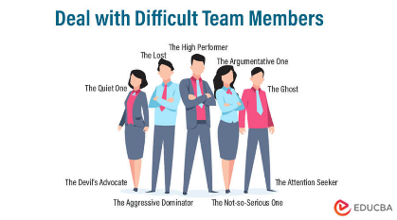
Describe three challenges of teamwork.(2019)
1. Team members not pulling their weight
2. Not turning up/turning up late
3. Team members may not be working well together/dominant personality/controlling/personality clash
4. Disagreement amongst team members – unequal distribution of roles
5. Poor leadership - It may be difficult to plan and co-ordinate the work of the team
6. There might be too much talking and not enough action
7. Lack of skills

Slide 10
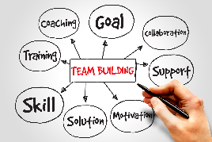
Overcome Challenges
1. There should be regular meetings to review progress of team members or to clearly define their duties.
2. Provide a team building exercise for members/bring in a mediator.
3. Members discuss decisions and agree to commit to final decisions or some decisions remain flexible so that agreement can be reached.
4. A strong team leader is needed who clearly defines roles within the team/regular meeting.
5. Training is needed. The importance of sticking to time schedules needs to be clearly established.

Slide 11

A dispute has arisen among the students in the class about responsibilities. Describe three steps that could be taken to resolve this dispute. (2022)
1. Ask the teacher to act as a mediator/is impartial/listens to everyone’s opinions/teacher will get written opinions from the class/speaks to each member individually/works to help resolve the dispute.
2. Ask each person separately what went wrong/can explain their side/get suggestions for a solution
3. Bring both sides together to find common ground/agree on a best solution/redefine responsibilities/identify points of agreement and disagreement.
4. Class discussion to gather ideas on how to address the conflict from within the class/ look to class members to give a solution to the conflict/develop a plan to help overcome the difficulty.

Slide 12
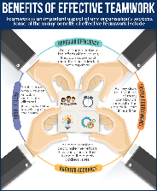
Outline three benefits of teamwork in this LCVP activity. (2021 & 2020)
1. Goals are achieved quicker/more work is done.
2. Decisions can be made or problems solved more quickly.
3. The responsibility is shared so no one person is under too much pressure/everyone takes ownership of the part of the task they are responsible for.
4. Members of a team will have a variety of strength/skills or ideas/experience, and skills are shared/more ideas.

